Slide 1
HOW FIRM A FOUNDATION
ROOTED. ASSURED. EQUIPPED.

Slide 2
FOUNDATIONAL CONCEPT
The Bible is inspired by God; in it He reveals Himself and His will to us.
The Bible was written, collected, organized, and transmitted by people.
The Bible claims to be the Word of God in written form. (2 Timothy 3; 2 Peter 1)
What evidence is there to support this claim? What about objections?

Slide 3
IS THE BIBLE INSPIRED BY GOD?
What is the evidence for Biblical inspiration?
What are the common objections to inspiration?
Where should we place our confidence?

Slide 4
EVIDENCE FOR INSPIRATION
Internal Consistency
Fulfilled Prophecy
Around 40 authors of the Biblical text
From different cultures (3 languages)
They wrote over a 1000 year span
→ Message is cohesive and consistent

Slide 5
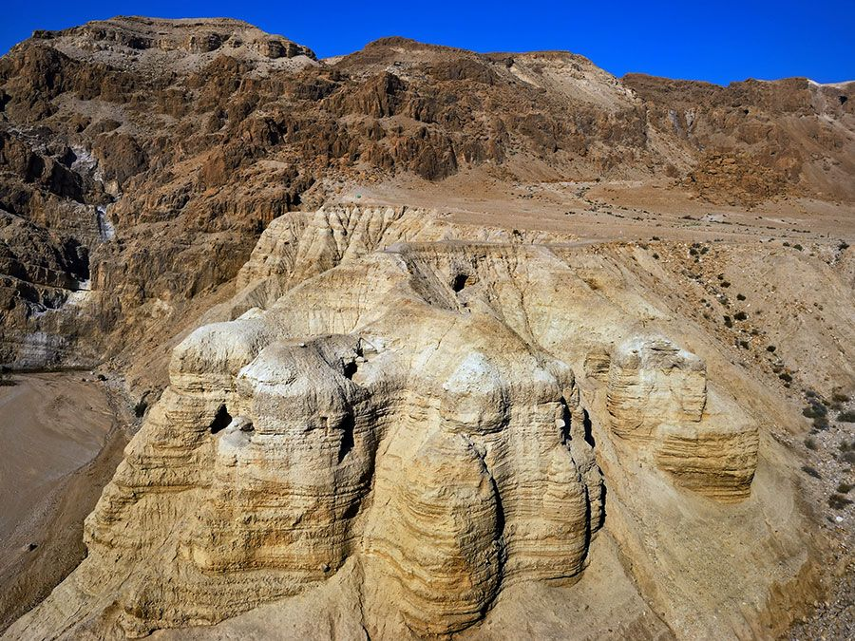
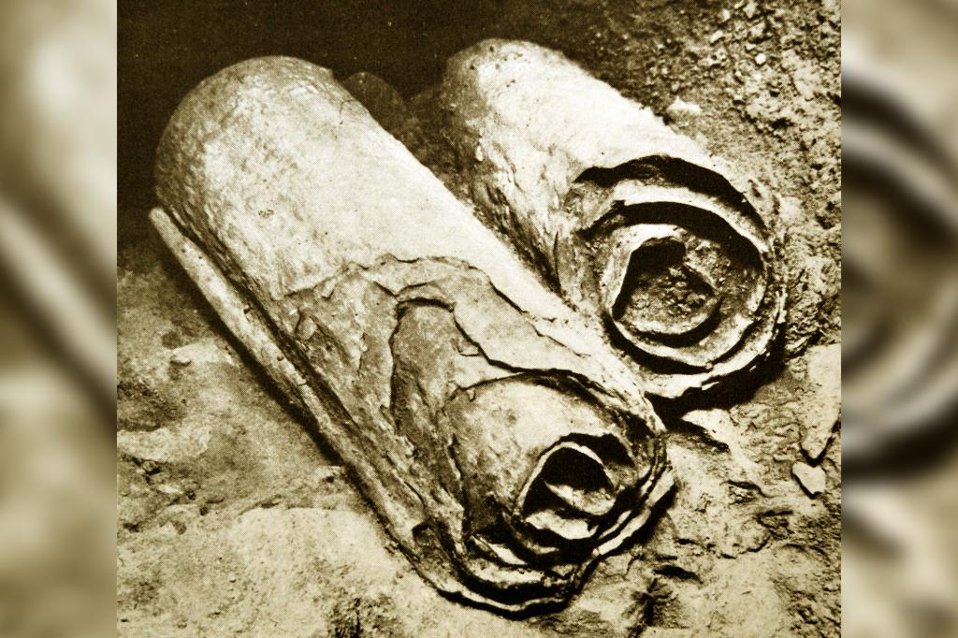
Dead Sea Scrolls (discovered 1946)
Contained all OT books (but Esther)
Texts from 3rd cen. BC to 1st cen. AD
Provides MSS of Messianic texts before Jesus’ life (Ps.22, Is.53, etc.)

Slide 6
EVIDENCE FOR INSPIRATION
Internal Consistency
Fulfilled Prophecy
Historical Accuracy
Archaeological Corroboration

Slide 7
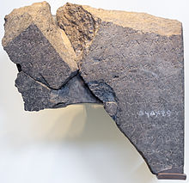
“House of David” named on Tel-Dan stele, discovered in 1993

Slide 8
EVIDENCE FOR INSPIRATION
Internal Consistency
Fulfilled Prophecy
Historical Accuracy
Archaeological Corroboration

Slide 9
IS THE BIBLE INSPIRED BY GOD?
What is the evidence for Biblical inspiration?
What are the common objections to inspiration?
Where should we place our confidence?

Slide 10
OBJECTIONS TO INSPIRATION
‘Absurdity’ of Supernatural
’Distasteful’ Elements
‘Contradictions’ in Accounts

Slide 11
DEALING WITH ‘CONTRADICTIONS’
Mark 5 – Jairus tells Jesus his daughter is sick (she dies)
Matthew 9 – Jairus tells Jesus his daughter has died
“just died” & “at the point of death” could overlap in meaning
Matt is shortening the story (we do this)
Gospels give us multiple, partial reports
Context, intent, storytelling often resolves
Unexplained doesn’t mean unexplainable
Skeptics can (will) always raise attacks

Slide 12
IS THE BIBLE INSPIRED BY GOD?
What is the evidence for Biblical inspiration?
What are the common objections to inspiration?
Where should we place our confidence?

Slide 13
OUR CONFIDENCE IN JESUS
The most important evidence for the truth of Scripture is the resurrection of Jesus.
Jesus, the Resurrected Son of God
Affirmed the authority of Scripture (Mt.5:17-9)
Recognized the entirety of the OT (Lk.24:44-6)
Spoke of Scripture as historical (Mt.24:37-9)
Used Scripture as moral authority (Mt.19.4-5)
Said the Spirit would speak God’s Word through His apostles (Jn.16:13-5)

Slide 14
HOW FIRM A FOUNDATION
ROOTED. ASSURED. EQUIPPED.

