Slide 1
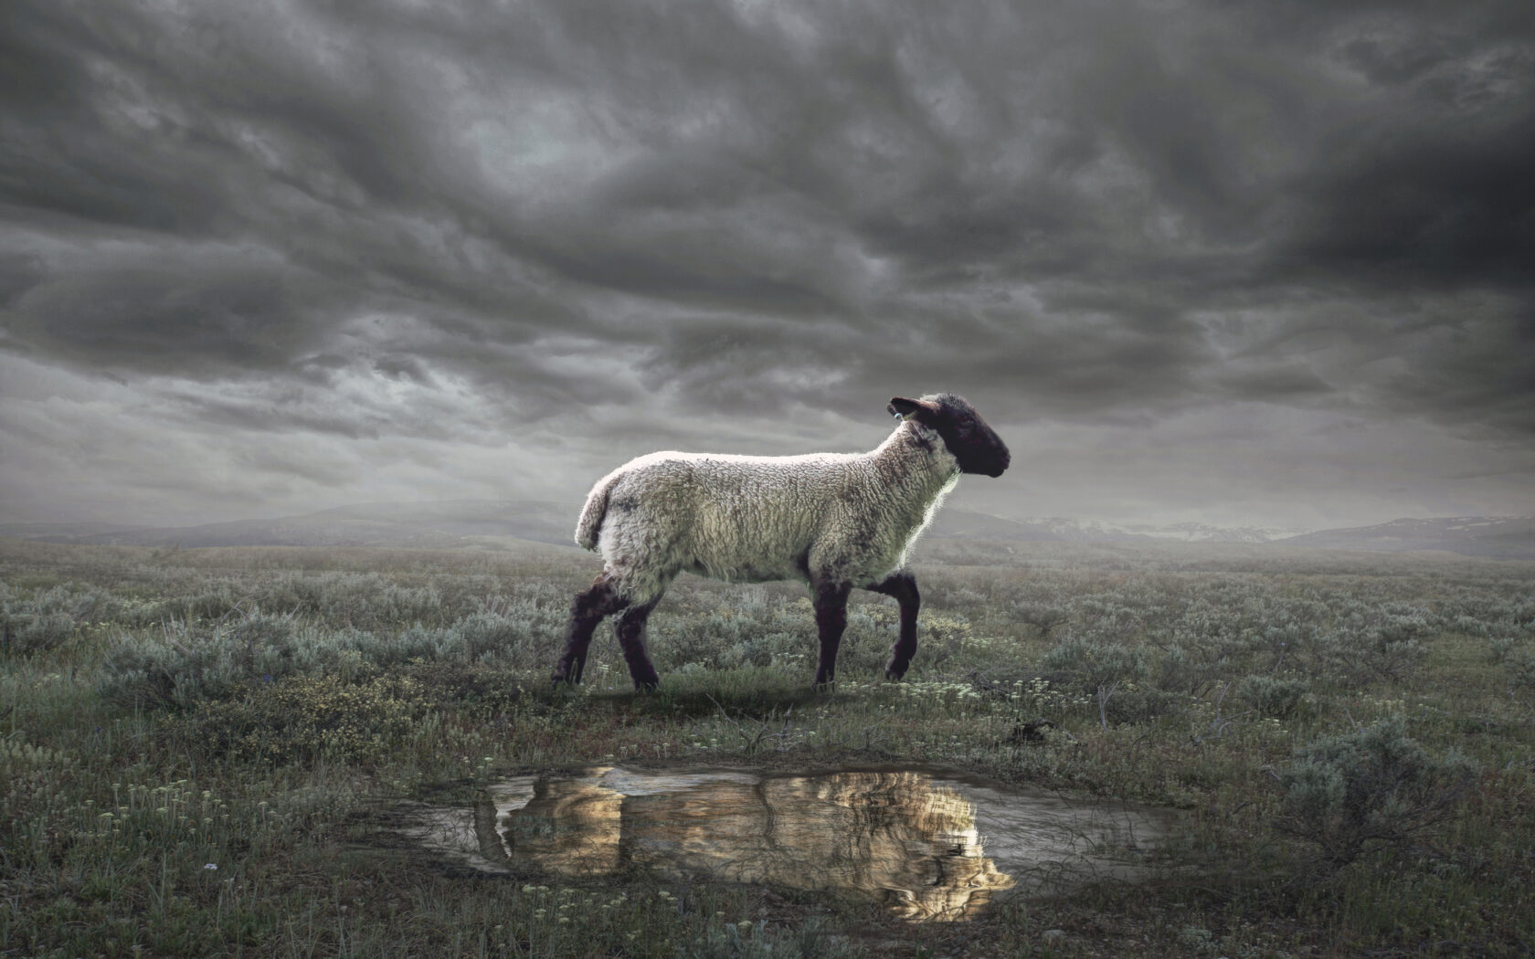
The Revelation
Wednesday Nights
Winter 2023-24

Slide 2
”Unholy Trinity” of Rev. 12-13
Dragon
(12:1-17)
devil/satan
Sea Beast
(13:1-10)
empire
Earth Beast (13:11-18)
imperial cult
The dragon has been defeated, is raging against God’s people
Dragon uses empire(s) to draw people’s worship, war against saints
Empire(s) has appeal of wealth/ belonging to give it life (& teeth)

Slide 3
Revelation 14
Read (listen to) the signs.
How does this chapter give confidence & comfort to the people of God (in light of the dragon & beasts of 12-13)?

Slide 4
Three “Signs” in Rev. 14
The Lamb & the 144,000 (1-5)
God’s king over the raging nations (Psalm 2)
His army marked with His name (13:16-18)
Sing a new song (5:9) that no one knows
They have resisted the world’s immortality
They imitate the Lamb’s conquering death
Redeemed as a promise of more to come
They choose truth over lies (see 13:14)

Slide 5
Three “Signs” in Rev. 14
The Lamb & the 144,000 (1-5)
Three Angelic Proclamations (6-13)
1st proclamation (6-7) – gospel for all: Sovereign God’s judgment has come
2nd proclamation (8) – Babylon is fallen
3rd proclamation (9-11) – all who belong to the beast will be tormented forever
Call for endurance (12-13) – trust King Jesus, obey Him, rest is promised

Slide 6
Three “Signs” in Rev. 14
The Lamb & the 144,000 (1-5)
Three Angelic Proclamations (6-13)
Two Harvests (14-20)
Two pictures of judgment? (see Isaiah 63:3)
One picture of salvation and one picture of judgment? (see Mark 4:29)
Two pictures of salvation? Saints saved by shedding of their blood (see 4:6 and 19:15)

Slide 7
Overview: Revelation 1-16
Introduction (1-3) – Glorified Christ revealed to John in exile; seven churches in crisis addressed
Heavenly Council (4-5) – God on throne, the scroll (plan to judge & to save), and the worthy Lamb
Seven seals (6-8) – God’s judgments on earth (6), God’s people sealed (7), 7th seal → trumpets (8)
Seven Trumpets (8-11) – God’s wrath on earth (8-9), God’s people bear witness (10-11), 7th trumpet brings the eternal kingdom of Christ (11)
Seven signs (12-15) – War in heaven (12) spills to earth (13), Lamb conquers, wicked judged (14)
Seven Bowls (15-16) – TBD

Slide 8
Revelation 15-16
Read (listen to) the drama.
What is revealed about God’s justice, holiness, & truth?

Slide 9
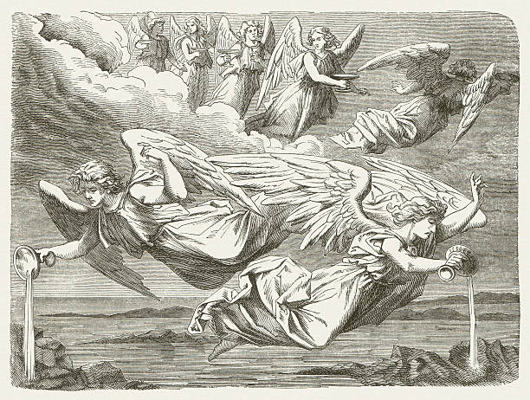
Seven Bowls (Revelation 15-16)

Slide 10
Making sense of Rev. 15-16
Patterns in Scripture – What reminds you of Exodus? Why is that significant?
In Context – What had the souls under the altar cried (6:10)? What is said here?
Key Points – What happens (in simple terms) at the “Battle of Armageddon”?
Original Readers – Why do the churches (ch.2-3) need the warning of 16:15?

Slide 11
Reflections on Revelation 16
How do we need to “wake up” (16:15) in response to Revelation 16?

Slide 12
Overview: Revelation 1-16
Introduction (1-3) – Glorified Christ revealed to John in exile; seven churches in crisis addressed
Heavenly Council (4-5) – God on throne, the scroll (plan to judge & to save), and the worthy Lamb
Seven seals (6-8) – God’s judgments on earth (6), God’s people sealed (7), 7th seal → trumpets (8)
Seven Trumpets (8-11) – God’s wrath on earth (8-9), God’s people bear witness (10-11), 7th trumpet brings the eternal kingdom of Christ (11)
Seven signs (12-15) – War in heaven (12) spills to earth (13), Lamb conquers, wicked judged (14)
Seven Bowls (15-16) – Total pouring out of wrath on the unrepentant, beast-worshipping Babylon

Slide 13
The Revelation
Next Week (2/14)
10. ch17-18: Babylon the Harlot

