Slide 1
The Book of Genesis
1
2

Slide 2
Date | Topic | Teacher
12/3/23 | Introduction / Creation | David Haley
12/10/23 | Creation / Fall of Man | David Haley
12/17/23 | Cain & Abel | Doug Greer
12/24/23 | Noah & The Flood | Doug Greer
12/31/23 | Babel and Abrahams Call | David Haley
1/7/24 | Abraham & Sarah | Doug Greer
1/14/24 | Abraham’s Test | David Haley
1/21/24 | Jacob & Esau | Doug Greer
1/28/24 | Jacob’s Dream & Wrestling w/ God | David Haley
2/4/24 | Joseph: Slave to Governor | Doug Greer
2/11/24 | Joseph: Reconciliation w/ Brothers | David Haley
2/18/24 | Jacob: Blessing & Genesis’ End | Doug Greer
2/25/24 | Conclusion / Review | David Haley
2

Slide 3
Jacob and Esau
Genesis 25:19 – 34 / Genesis 26:34-35
3

Slide 4
Ithcar – (me): I am being interviewed by the Isaac family to help with the flocks and herds as a hired servant. I would report directly to you (Jacob). I have extensive knowledge in animal husbandry with some experience in breading animals to accentuate certain traits (e.g. spotted, speckled and streaked characteristics). I’m somewhat hesitant to accept the position based on some things that I have heard.
Jacob – (Class): You are to show me around, answer any questions that I have and introduce me to your brother Esau. You are a little over 40 years old.
4

Slide 5
Jacob and Esau
Genesis 25:19 – 34 / Genesis 26:34-35
5

Slide 6
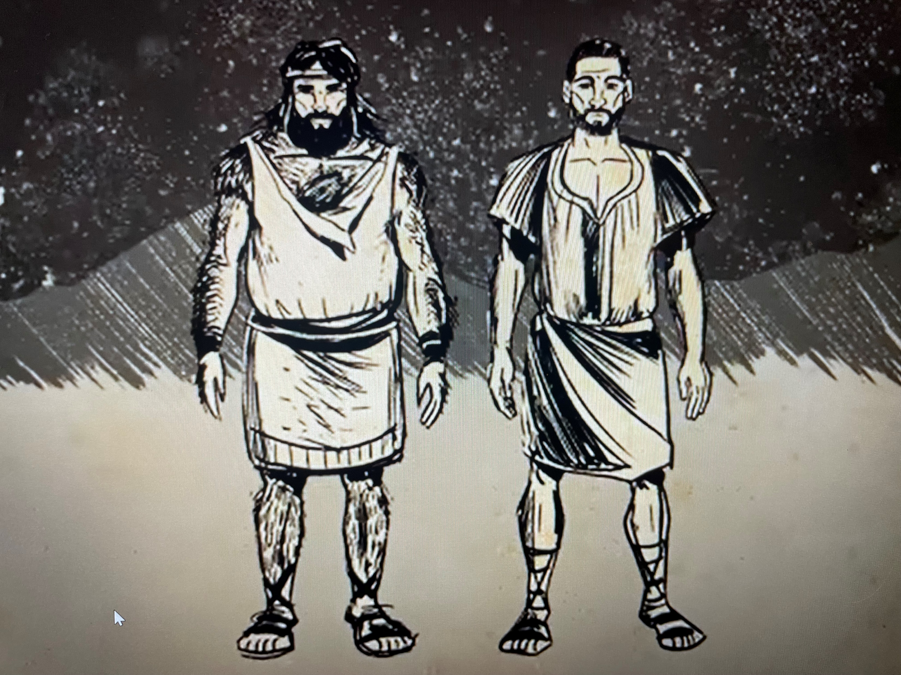
6

Slide 7
Jacob: Esau:
What we know about Jacob and Esau
7

Slide 8
Jacob: Loved by God/Loved by Rebekah – Romans 9:13 Name means: Supplanter/Deceiver Smooth skinned – Genesis 27:11 Dwelt in tents – caring for flocks/herds Mild/plain/quiet man –The Hebrew word tam means perfect or complete, undefiled, upright and possibly even mature. It is the exact word that God used to describe Job when God called him “a perfect and upright man…Job 1:8 Esau: Hated by the Lord/Loved by Isaac - Romans 9:13/Hebrews 12:16-17 Name means: Hairy Loved to hunt – Cunning hunter/a man’s man Wearied himself doing what he loved to do Man of the field – treasured his time in the wild
What we know about Jacob and Esau
7

Slide 9
Jacob and Esau
Genesis 25:21 – 34
Genesis 27:1 – 28:4
The Birth,
The Birthright; and
The Blessing.
8

Slide 10
Jacob and Esau – the Birth
Rowdy pregnancy – children struggle within her
Inquires of Lord – two nations are in your womb
The older shall serve the younger - 1 Chronicles 18:12-13
Romans 9:10-13 – what does this mean?
9

Slide 11
Jacob and Esau – the Birth
Plan of God chose:
Issac over Ishmael
Moses over his older brother Aaron to lead the Israelites
Joseph, the 11th of 12 brothers, to be second to Pharoh
Gideon, the weakest clan, the youngest in his family, to deliver Israel
A shepherd boy named David to be king over his older brothers and even over King Saul’s son Jonathan
Solomon over Adonijah
Joseph’s younger son Ephraim over his older brother Manasseh
Jacob over his older brother Esau
11

Slide 12
What is the Birthright?
12

Slide 13
The Birthright or Right of Birth
The birthright is emphasized in the Bible because it honored the rights or privileges of the family’s firstborn son. After the father died, or in the father’s absence, the firstborn son assumed the father’s authority and responsibilities in the family. In addition to assuming the leadership role in the family, the recipient of the birthright received a double portion of the inheritance.
13

Slide 14
Jacob and Esau – the Birthright
Esau is weary from the field (25:32 says he about to die)
3 minutes / 3 days / 30 days
What is this birthright to me?
Sold his birthright with an oath
What does this event tell us about Esau and Jacob?
14

Slide 15
What is our Spiritual Birthright?
John 1:12 (7-13) – … as many as received Him, to them he gave the right to become children of God
1 Peter 1:3-5 – God has begotten us again to a living hope through the resurrection of Jesus Christ from the dead, to an inheritance incorruptible and undefiled and that does not fade away, reserved for you in heaven
Romans 8:16-17 - …if children of God, then heirs of God and joint heirs with Christ
Titus 3:7 - …Having been justified by His grace we should become heirs according to the hope of eternal life
15

Slide 16
Hebrews 12:12-17
…lest there be any fornicator or profane person like Esau, who for one morsel of food sold his birthright. For you know that afterward, when he wanted to inherit the blessing, he was rejected, for he found no place for repentance, though he sought it diligently with tears.
16

Slide 17
How do we sell our Birthright?
17

Slide 18
How do we sell our Birthright?
Matthew 16:26 – For what profit is it to a man if he gains the whole world, and loses his own soul? Or what will a man give in exchange for his soul?
Esau was physically weak when he sold his birthright. What makes us spiritually weak?
How did Jesus respond to Satan when he was physically weak? What did he rely on?
17

Slide 19
Jacob and Esau – the Blessing
Was there any question about who would receive the blessing?
Why would Isaac bless Esau?
Why would Rebekah devise such a scheme to trick Isaac?
What could have happened if Isaac had blessed Esau?
18

Slide 20
What is our Spiritual Blessing?
Acts 3:25-26 It is you who are the sons of the prophets, and of the covenant which God made with your fathers, saying to Abraham, `And in your seed all the families of the earth shall be blessed. For you first, God raised up His Servant Jesus, and sent Him to bless you by turning every one from your wicked ways.
Acts 13:32-33,38 we preach to you the good news of the promise made to the fathers, that God has fulfilled this promise to our children in that He raised up Jesus...that through Him forgiveness of sins is proclaimed to you
Gal 3:8-9 And the Scripture, foreseeing that God would justify the Gentiles by faith, preached the gospel beforehand to Abraham, saying, "All the nations shall be blessed in you." So then those who are of faith are blessed with Abraham, the believer.
Gal 3:29 if you belong to Christ, then you are Abraham's offspring, heirs according to promise.
20

