Slide 1
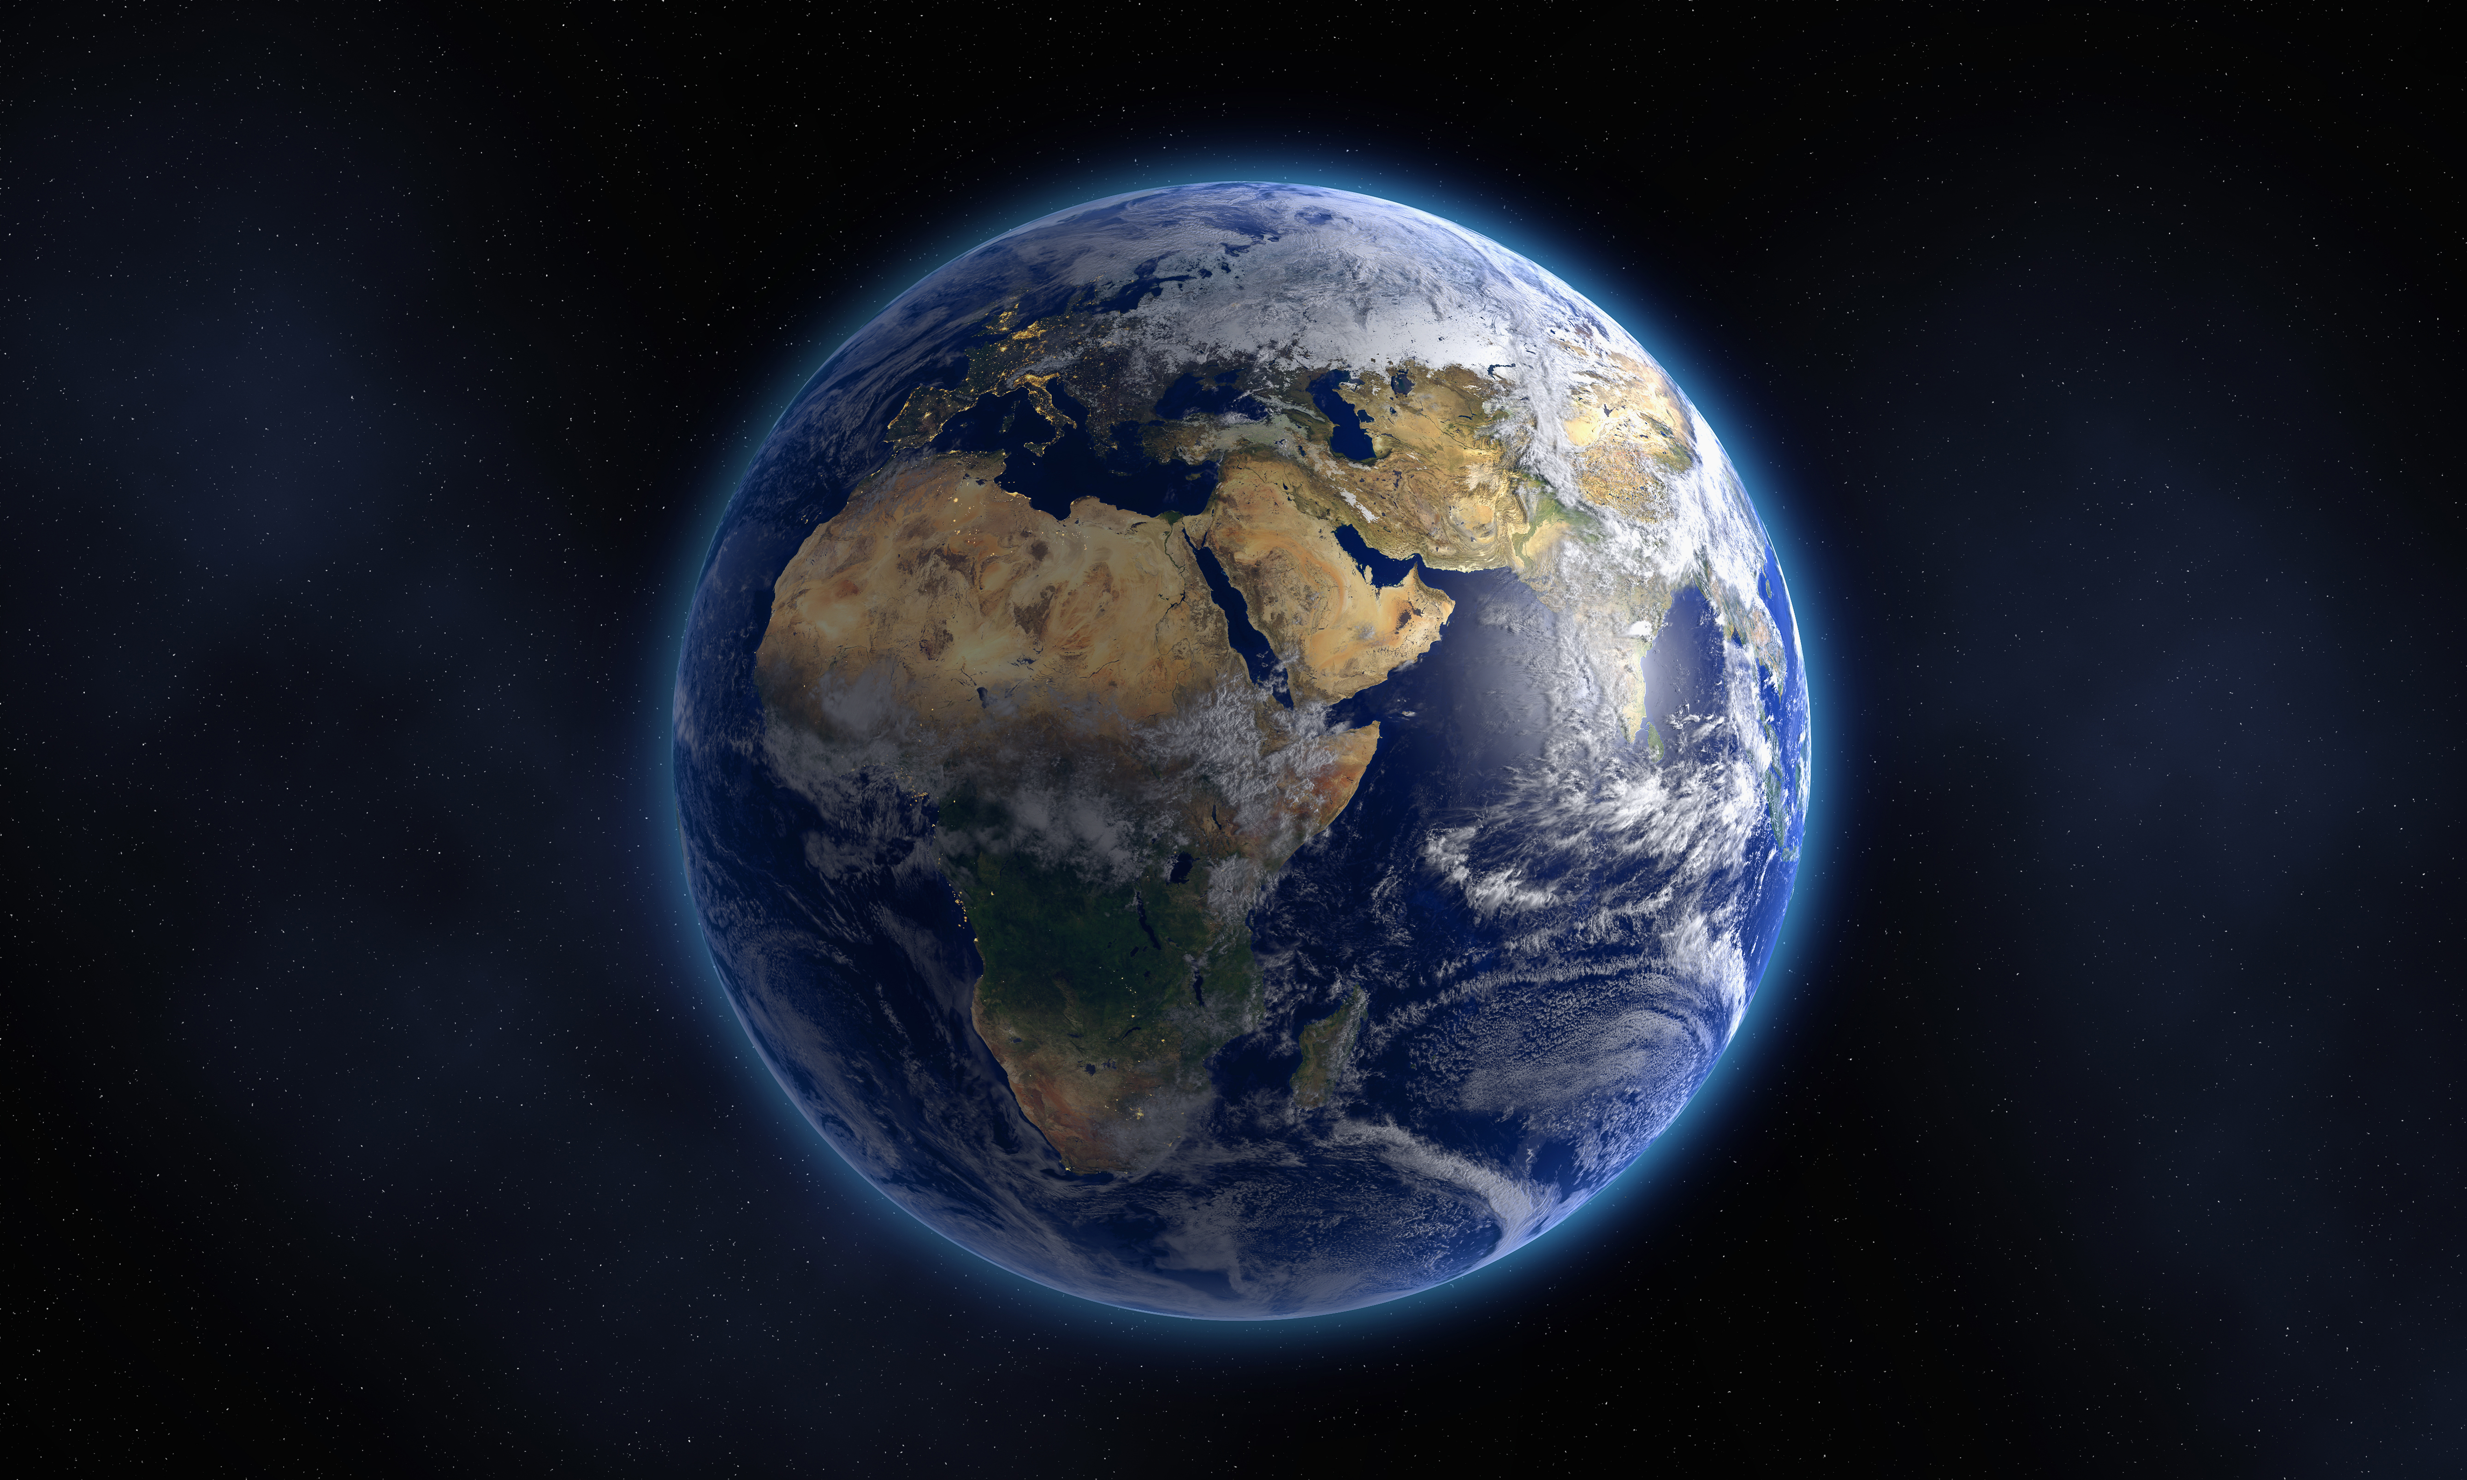
The Book of Genesis
A Study of the Pentateuch
1

Slide 2
Date | Topic | Teacher
12/3/23 | Introduction / Creation | David Haley
12/10/23 | Creation / Fall of Man | David Haley
12/17/23 | Cain & Abel | Doug Greer
12/24/23 | Noah & The Flood | Doug Greer
12/31/23 | Babel and Abrahams Call | David Haley
1/7/24 | Abraham & Sarah | Doug Greer
1/14/24 | Abraham’s Test | David Haley
1/21/24 | Jacob & Esau | Doug Greer
1/28/24 | Jacob’s Dream & Wrestling w/ God | David Haley
2/4/24 | Joseph: Slave to Governor | Doug Greer
2/11/24 | Joseph: Reconciliation w/ Brothers | David Haley
2/18/24 | Jacob: Blessing & Genesis’ End | Doug Greer
2/25/24 | Conclusion / Review | David Haley
2

Slide 3
Why a new name?
Abram – Abraham: …you will be a father of nations
Sarai – Sarah: …she will be a mother of nations
Jacob – Israel: …because you have wrestled with God and men, and you have won
Simon – Peter: You shall be called Peter (which is translated, A Stone)
Sinner - Christian
17

Slide 4
The Three Visitors/Sarah Laughs Genesis 18
Three visitors
Did Abraham know who they were?
Why the visit?
2 Chronicles 20:7 – Abraham referred to as God’s friend forever
Isaiah 41:8 - …the descendants of Abraham, My friend
James 2:23 – … Abraham believed God, and it was accounted to him for righteousness. And he was called the friend of God.
Stoic to Sense of Urgency Genesis 18:6 – Tells Sarah to make ready three measures of fine meal, knead it and make cakes
Sarah laughs within herself – Gen 18:13-15
What was the difference between Abraham’s laugh and Sarah’s laugh?
Is anything too hard for the Lord? Genesis 18:14
18A

Slide 5
Lessons from Abraham’s petition to the Lord - Genesis 18:22-33
Respectful/Humble
Persistent, but not demanding (Bold)
He listened
Made specific requests (not generic)
Requests were not self-centered
Trusted God would do the right thing
Tried to change God’s mind or at least tried to find out what was on God’s mind
Exodus 32:9-14
The impact of a few righteous can be life changing for the whole
Wait for the Lord to act – Abraham returned to his place
18B

Slide 6
Sodom and Gomorrah – Genesis 19
How evil was Sodom? – Gen 19:4-5
Sodomy: from the Latin phrase “peccatum Sodomiticum” - Sin of Sodom
Lot urges the angels to come into his house
Was Lot a good father?
Where Lot’s daughters good daughters? – Gen 19:31 – 38
Man-made schemes are sometimes based on false assumptions
Moabites – people of Jordan
Ammonites - people of Jordan and Iraq
19

Slide 7
Sodom and Gomorrah – Genesis 19
Evil men struck blind – Gen 19:11
Genesis 19:9 – Lot’s life threatened
Angels urge Lot and family to head to the mountains
What did his sons in law think when he told them to get out of this place?
Lot petitions to save Zoar – Gen 19:21
20

Slide 8
Lots of Lessons from Lot Genesis 13/14/19
God’s judgment is real – Genesis 19:29
God rescues the righteous/makes examples of the evil – 2 Peter 2:6-7
God hears the fervent intercession of a righteous person – James 5:16
Abraham petitions for the cities and saves Lot
Lot petitions to save Zoar
Individually accountable – wife turned to salt
21

Slide 9
Lots of Lessons from Lot – Lot’s wife
“The most miserable person in the world is the half-committed Christian, who is just enough in the world to be miserable in God and just enough into God that they are miserable in the world.”
Charles Spurgeon
(1834-1892)
“No one can serve two masters...”
Jesus
(Matthew 6:24)
22

Slide 10
Sarah who? – Genesis 20
Near the border of Egypt…again
Tells Abimelech that Sarah is his sister…again
God visits King Abimelech in a dream
You are a dead man
Why didn’t the king touch Sarah – Gen 20:6
Lord closed the wombs of the king’s house
“The fear of God was not in this place” – Gen 20:11
23

Slide 11
Lessons from Genesis 13 - 20
God will accomplish His will His way
God will do what he has promised
God’s timing is not our timing – 2 Pet 3:8/Jer 42:7/Is 40:31/Gen19:15
We can’t conceal anything from the Lord – Sarah laughed within
Baptism is necessary (as was circumcision)
God is involved in the affairs of men – Genesis 20:6
Don’t assume the fear of God is not in some place – Gen 20: 11
24

Slide 12
Lessons from Genesis 13 - 20
Nations/Cities are judged in this life and sometimes people
Intercession for others does work – 1 Timothy 2:1
Abraham for Sodom
Lot for Zoar
Abraham for King Abimelech
The presence of the righteous will preserve a city
Be humble, respectful and bold in our appeals to God
Not everyone will head God’s warnings – Gen 19:14
Salvation involves mercy
25

