Slide 1
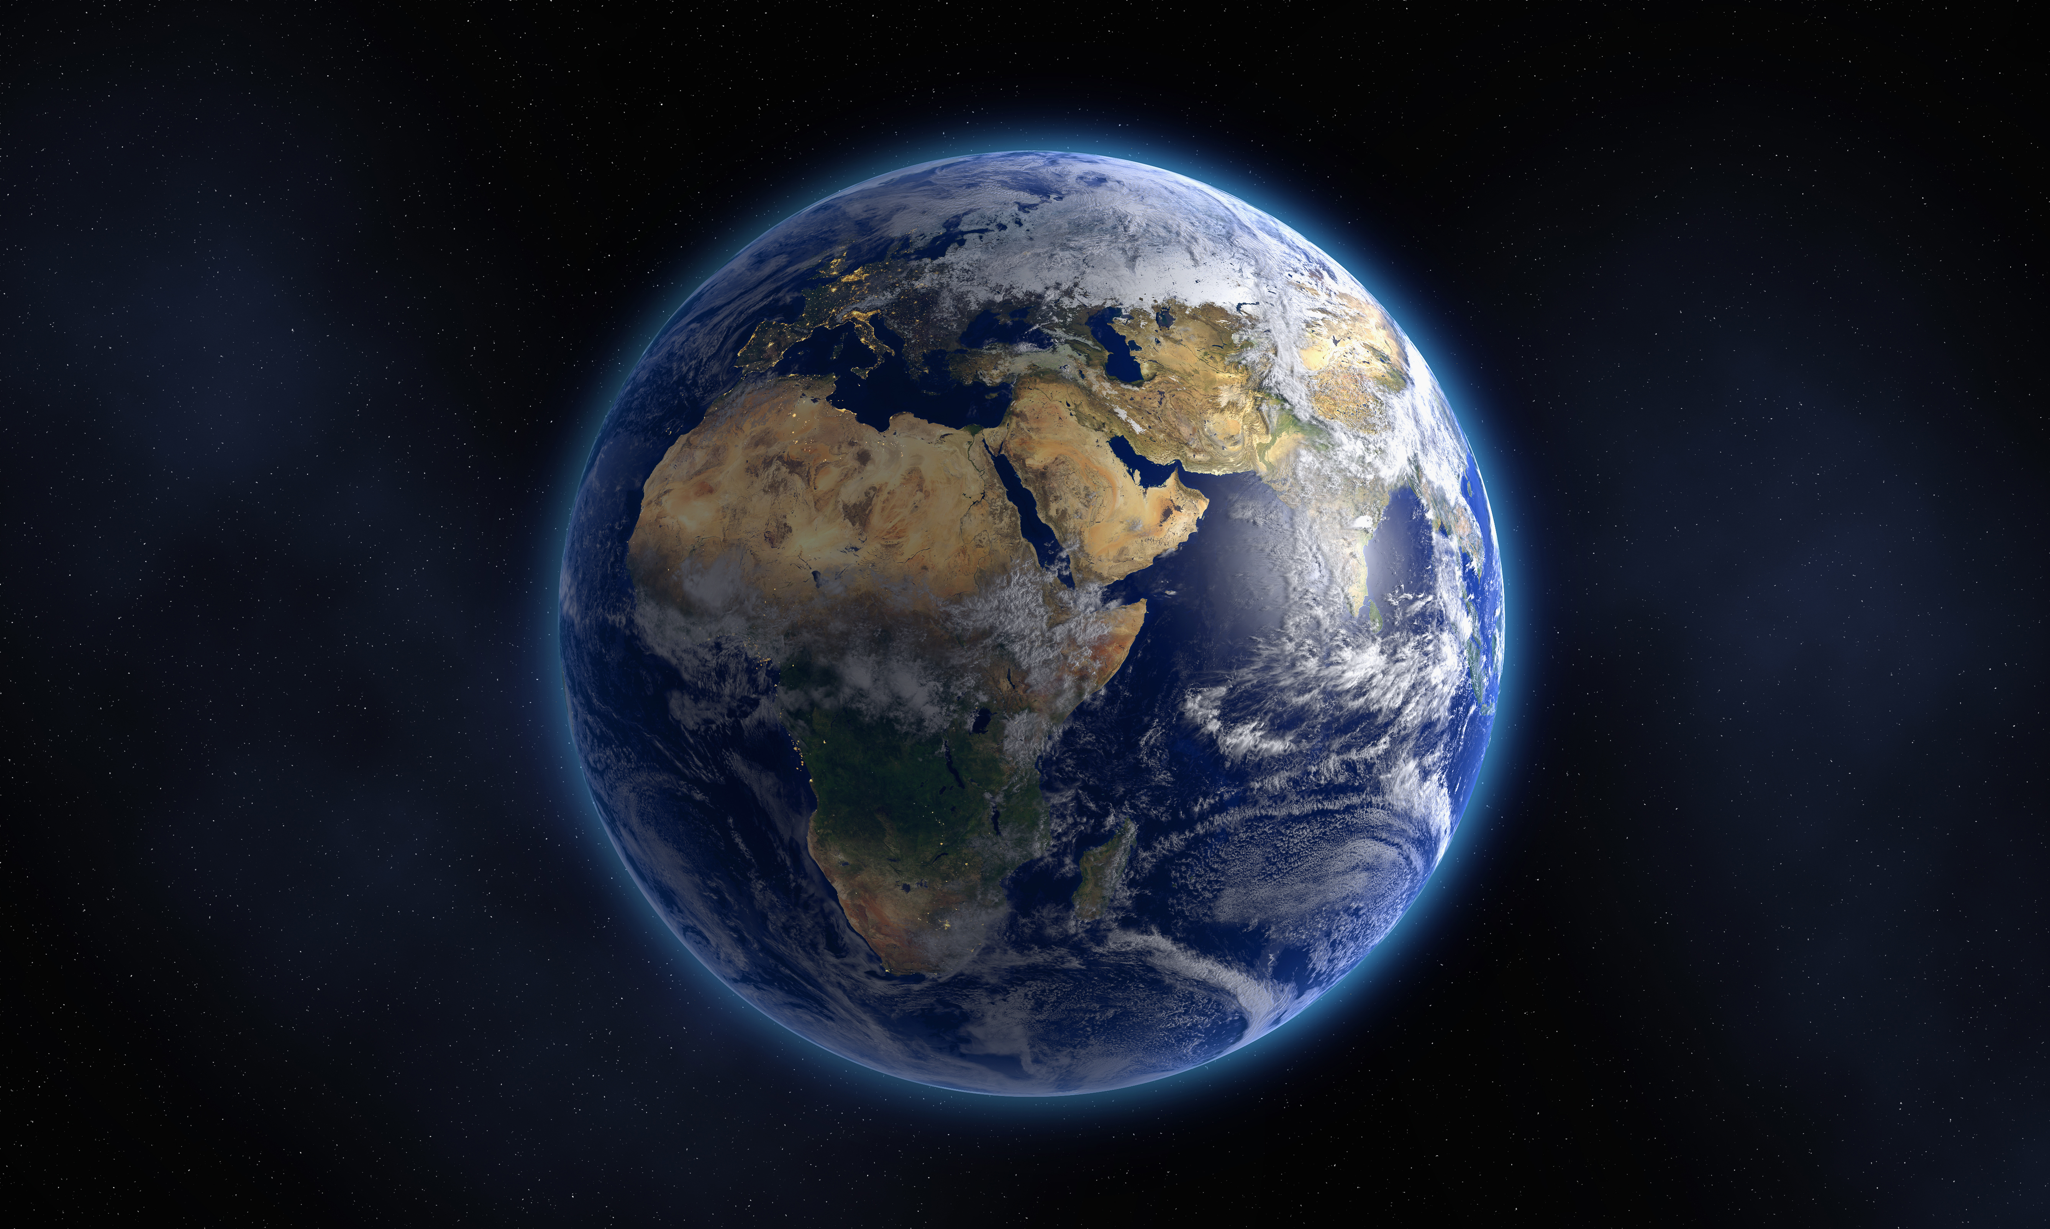
The Book of Genesis
A Study of the Pentateuch
1

Slide 2
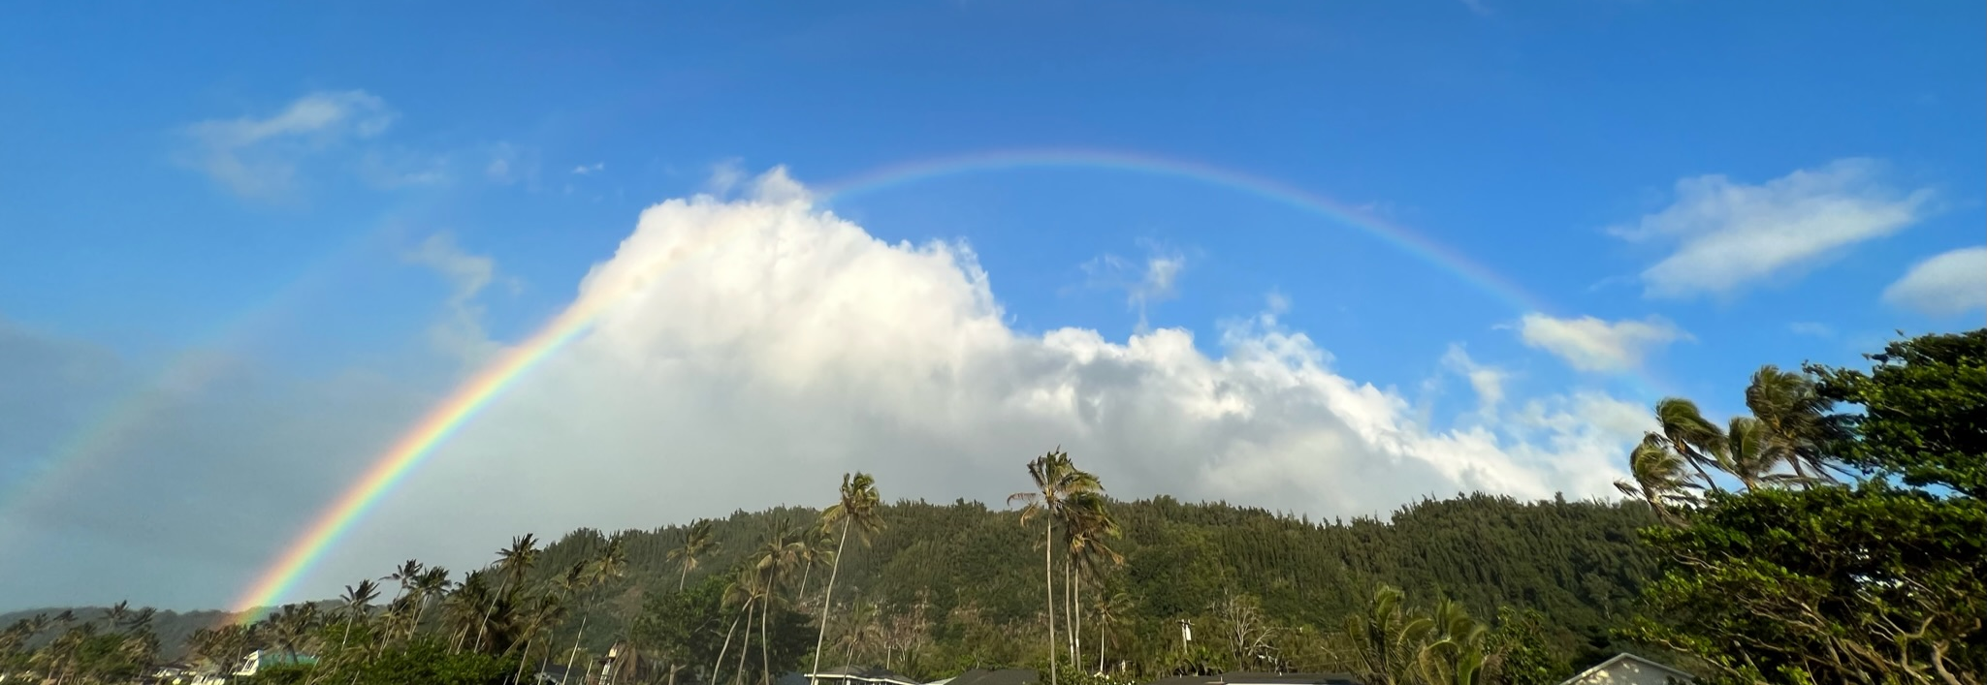
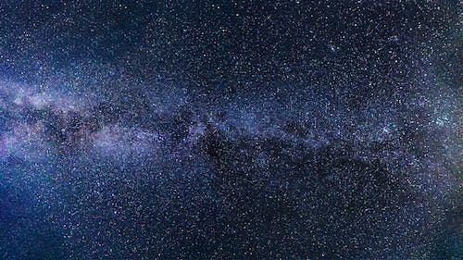
2

Slide 3
Date | Topic | Teacher
12/3/23 | Introduction / Creation | David Haley
12/10/23 | Creation / Fall of Man | David Haley
12/17/23 | Cain & Abel | Doug Greer
12/24/23 | Noah & The Flood | Doug Greer
12/31/23 | Babel and Abrahams Call | David Haley
1/7/24 | Abraham & Sarah | Doug Greer
1/14/24 | Abraham’s Test | David Haley
1/21/24 | Jacob & Esau | Doug Greer
1/28/24 | Jacob’s Dream & Wrestling w/ God | David Haley
2/4/24 | Joseph: Slave to Governor | Doug Greer
2/11/24 | Joseph: Reconciliation w/ Brothers | David Haley
2/18/24 | Jacob: Blessing & Genesis’ End | Doug Greer
2/25/24 | Conclusion / Review | David Haley
2

Slide 4
Abraham and Sarah - Genesis 12-20 Chapter 12 – The call (Sarai my sister) Chapter 13 – The split (Abram/Lot) Chapter 14 – The kidnapping Chapter 15 – The Covenant Chapter 16 – The confusion (Ishmael/Isaac) Chapter 17 – The laughter and name change Chapter 18 – The visitors, more laughing, 50/45/40/30/20/10 Chapter 19 – Lots of lessons from Lot Chapter 20 – Rush to judgment (Sarah my sister…again)
3

Slide 5
God and Abraham Why did God call (choose) Abraham?
4

Slide 6
The Call and Sister Sarai – Genesis 12
What was the call and how did Abraham answer it?
Why did Abraham have to call Sarah his sister?
5

Slide 7
Lots of Lessons from Lot The Split (Abram/Lot) – Genesis 13 and 14
What did Abram’s approach to the issue reflect about Abram?
What did Lot response to the issue reflect about Lot?
Decisions have consequences
People are watching – Genesis 13:7
Beware of the progression of sin
Parted from Abraham
Chose ALL the best lands
Moved in the area of sinful cities
Sat in Sodom’s city gate – leader/politics/commerce
Moved into the city
Had to flee the city
6

Slide 8
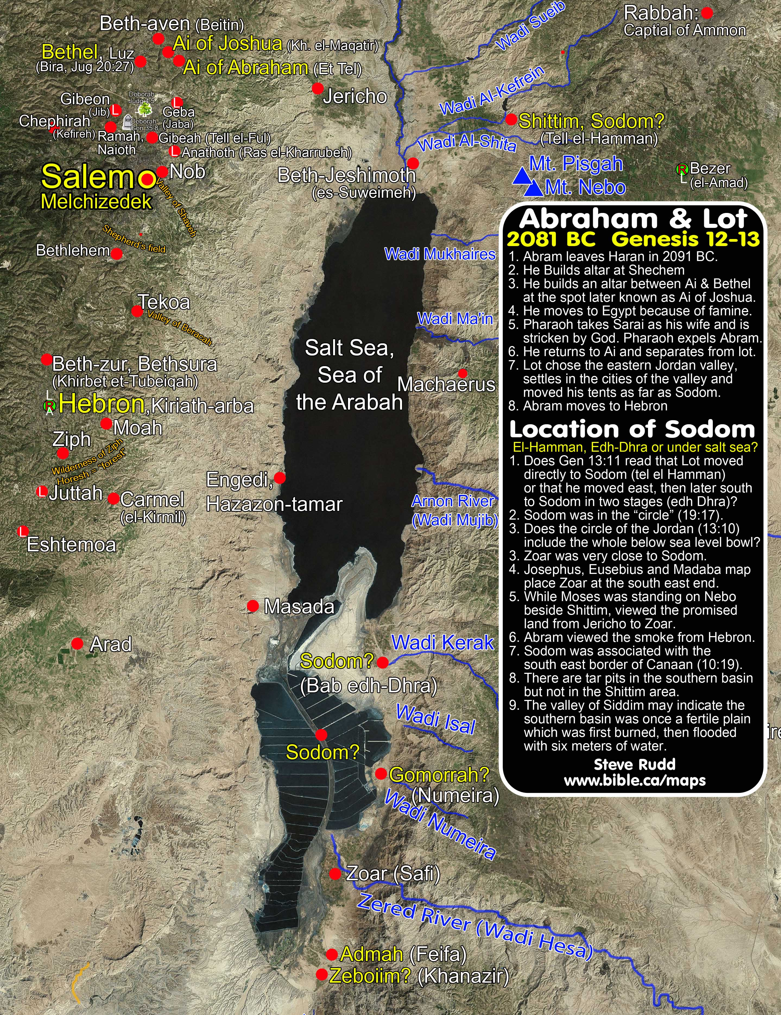
Lot goes East
Lot lifted his eyes and saw ALL the plain of Jordan, that it was well watered EVERYWHERE, like the GARDEN of the Lord…then Lot chose ALL the plain of Jordan for HIMSELF
7

Slide 9
Abram saves Lot three times
It pays to have a Righteous Uncle
When they split over resource disputes – Genesis 13
When Lot was captured by the kings – Genesis 14
318 versus ~ 135,000
When God destroyed Sodom and Gomorrah – Genesis 18/Genesis 19:29
8

Slide 10
Abram, Melchizedek and the other Kings
Blessed be Abram of the most high God – Genesis 14:19
confirmation of Abram’s relationship with God
Abram gave Melchizedek a tithe of all – Genesis 14:20
Confirmation of Melchizedek’s role/status
Abram was careful not to beholden himself to the king of Sodom – Genesis 14:23 – God was the reason
9

Slide 11
The Covenant - Genesis 15
God’s plan is to destroy the wicked and establish the righteous all the way to the end of time on his schedule.
In a vision God appears to Abraham: I am your shield, your exceedingly great reward – Genesis 15:1.
What will you give me seeing I go childless?
Abraham believed in the Lord and He accounted it to him for righteousness – Genesis 15:6.
Abraham asks how shall I know that I will inherit these things?
Cut down the middle: heifer, goat and ram
Only God passed between them – God confirms with a covenant
Smoking furnace/oven and burning lamp/torch
10

Slide 12
The Covenant - Genesis 15
God told Abraham, that he would not see the complete fulfillment of the promise – Genesis 15:15
God doesn’t get upset when Abraham asks for confirmation – who else in the Bible asked for confirmation?
Do we have confirmation of the promise that God has made to us?
If you are in Christ, you are Abraham’s seed and heirs according to the promise – Galatians 3:29
11

Slide 13
Abram, Sarai, Hagar, and oh…God too Genesis 16
Helping God’s plan along?
Sarai’s doubt
Sarai’s plan - An ill-conceived conception
Abraham’s compliance
Hardship follows – strained relationships
What did both Abram and Sarai fail to do?
Who did Sarai blame? Genesis 16:5
12

Slide 14
Abram, Sarai, Hagar, and oh…God too
What resulted from this ill-conceived conception?
Strained relationship between Sarai and Hagar
Strained relationship between Abraham and Sarai
Strained relationship between Abraham and Hagar
Ishmael sent away with Hagar
Continuous fighting – no peace
Sometimes, the least guilty receive the most damage
Galatians 4:21-31 – God’s over arching plan
13

Slide 15
Abraham and Ishmael
Genesis 15:4 - …the heir born in your house (Eliezer of Damascus) shall not be your heir, but one who will come from your own body shall be your heir.
Genesis 17:18-20 – Abraham said to God, “Oh, that Ishmael might live before you!” Then God said: “No, Sarah your wife shall bear you a son, and you shall call his name Isaac; I will establish My covenant with him for an everlasting covenant, and with his descendants after him. And as for Ismael, I have heard you. Behold, I have blessed him, and will make him fruitful, and will multiply him exceedingly. He shall begat twelve princes, and I will make him a great nation.
14

Slide 16
Ishmael/Ishmaelites
Named by God
Name means “God will hear”
Part of the Midianites/Some but not all Arabs
Genesis 37:28 – bought Joseph from his brothers
Wore gold earrings – Judges 8:24
Will be fruitful and God will multiply him exceedingly
Will begat 12 princes/Will be a great nation
He will be a wild man
He will be against every man
Every man against him
15

Slide 17
The Covenant Confirmed/Abraham Laughs Genesis 17
God appears to Abraham at the age of 99
Confirms the covenant again
Circumcision – Was it absolutely necessary?
Gen 17:14
What is circumcision compared to in the New Testament?
Promises a child – Abraham laughs
Changes names: Abram/Abraham and Sarai/Sarah
16

Slide 18
Why a new name?
Abram – Abraham
Sarai – Sarah
Jacob – Israel
Simon – Peter
Saul – Paul
Sinner - Christian
17

Slide 19
The Three Visitors/Sarah Laughs Genesis 18
Three visitors
Did Abraham know who they were?
Genesis 18:6 – Tells Sarah to make ready three measures of fine meal, knead it and make cakes
Sarah laughs within herself – Gen 18:13-15
What was the difference between Abraham’s laugh and Sarah’s laugh?
Is anything too hard for the Lord? Genesis 18:14
What was the other reason for the visit?
18

Slide 20
Sodom and Gomorrah – Genesis 19
How evil was Sodom? – Gen 19:4-
Sodomy: from the Latin phrase “peccatum Sodomiticum” - Sin of Sodom
Lot urges the angels to come into his house
Was Lot a good father?
Where Lot’s daughters good daughters? – Gen 19:31 – 38
Man-made schemes are sometimes based on false assumptions
Moabites – people of Jordan
Ammonites - people of Jordan and Iraq
19

Slide 21
Sodom and Gomorrah – Genesis 19
Evil men struck blind – Gen 19:11
Genesis 19:9 – Lot’s life threatened
Angels urge Lot and family to head to the mountains
What did his sons in law think when he told them to get out of this place?
Lot petitions to save Zoar – Gen 19:21
20

Slide 22
Lots of Lessons from Lot Genesis 13/14/19
God’s judgment is real – Genesis 19:29
God rescues the righteous/makes examples of the evil – 2 Peter 2:6-7
God hears the fervent intercession of a righteous person – James 5:16
Abraham petitions for the cities and saves Lot
Lot petitions to save Zoar
Individually accountable – wife turned to salt
21

Slide 23
Lots of Lessons from Lot – Lot’s wife
“The most miserable person in the world is the half-committed Christian, who is just enough in the world to be miserable in God and just enough into God that they are miserable in the world.”
Charles Spurgeon
(1834-1892)
“No one can serve two masters...”
Jesus
(Matthew 6:24)
22

Slide 24
Sarah who? – Genesis 20
Near the border of Egypt…again
Tells Abimelech that Sarah is his sister…again
God visits King Abimelech in a dream
You are a dead man
Why didn’t the king touch Sarah – Gen 20:6
Lord closed the wombs of the king’s house
“The fear of God was not in this place” – Gen 20:11
23

Slide 25
Lessons from Genesis 13 - 20
You can trust God with your unknown future
Trust and obey even if we don’t understand the reasoning
God will accomplish His will His way
God will do what he has promised
Don’t avoid entertaining strangers – Hebrews 13:2
God’s timing is not our timing – 2 Pet 3:8/Jer 42:7/Is 40:31/Gen19:15
God’s words point to Jesus – Gal 4:28-31
We can’t conceal anything from the Lord – Sarah laughed within
Baptism is necessary for salvation
24

Slide 26
Lessons from Genesis 13 - 20
Intercession for others does work – 1 Timothy 2:1
Abraham for Sodom (i.e. Lot)
Lot for Zoar
Abraham for King Abimelech
The presence of the righteous will preserve a city
Be bold in our appeals to God - Hebrews 4:16
Not everyone will head the warnings – Gen 19:14
Rember Lot’s wife – Luke 17:32
Earthly ties are not easy to leave behind
Salvation involves mercy
Only evil deeds have to be covered up – Lot’s daughters
25

Slide 27
Lessons from Genesis 13 - 20
Don’t assume the fear of God is not in some place – Gen 20: 11
God sees and knows the affairs of men – Gen 20:6
Galatians 4:21-31
26

