Slide 1
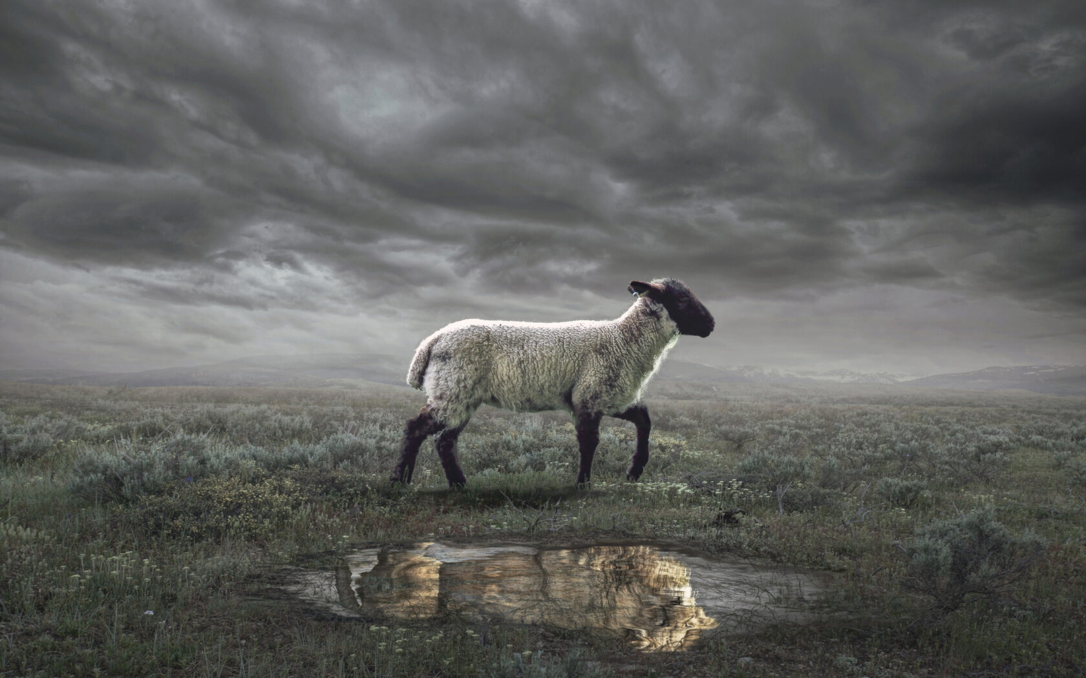
The Revelation
Wednesday Nights
Winter 2023-24

Slide 2
Revelation by the Chapter
Glorified Christ among the lampstands (1)
Seven churches charged to conquer (2-3)
God, the throne, the Lamb, and the scroll (4-5)
Six seals opened (6)
Interlude: God’s people sealed (7)
7th seal opened (8)
Six Trumpets (8-9)
Interlude: John’s call, church’s witness (10-11)
7th trumpet sounds (11)
God’s plan to judge wicked, rescue the righteous
Not chronological (within or between cycles)

Slide 3
Revelation by the Chapter
Glorified Christ among the lampstands (1)
Seven churches charged to conquer (2-3)
God, the throne, the Lamb, and the scroll (4-5)
Six seals opened (6)
Interlude: God’s people sealed (7)
7th seal opened (8)
Six Trumpets (8-9)
Interlude: John’s call, church’s witness (10-11)
7th trumpet sounds (11)
Show the role of God’s people in God’s plan
Descriptions are concurrent with the judgments

Slide 4
Revelation by the Chapter
Glorified Christ among the lampstands (1)
Seven churches charged to conquer (2-3)
God, the throne, the Lamb, and the scroll (4-5)
Six seals opened (6)
Interlude: God’s people sealed (7)
7th seal opened (8)
Six Trumpets (8-9)
Interlude: John’s call, church’s witness (10-11)
7th trumpet sounds (11)
Sense of finality, God’s plan now completed

Slide 5
Revelation 10-11
Read (listen) to these chapters.
What part do God’s people (first John, then the church) play in God’s plan?

Slide 6
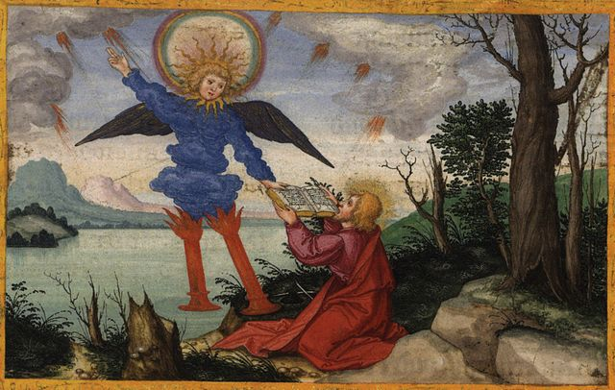
Thunders & a Scroll (Rev. 10)

Slide 7
Thunders & a Scroll (Rev. 10)
Mighty Angel (1-2) : representative of God, has authority over land and sea (see 13:1, 11)
“little scroll” (2) : God’s plan (like in 5:1)
7 thunders (3-4) : sealed up, not written
More judgments that are not carried out?
Action of God not revealed to man?
Angel’s oath (5-7) : see Daniel 12:4-9
In Daniel, it would be time, times, ½ a time
In Rev. 10, there will be no more delay
God’s mystery fulfilled in the 7th trumpet

Slide 8
Thunders & a Scroll (Rev. 10)
Eat the scroll (8-11) : like Ezekiel 2-3
Follows the chain of revelation from 1:1-3
God (5:1) → Lamb (5:7) → Angel (10:1) → John (10:10) → Readers
Sweet to taste, but bitter to swallow…
a message for peoples, nations, kings…

Slide 9
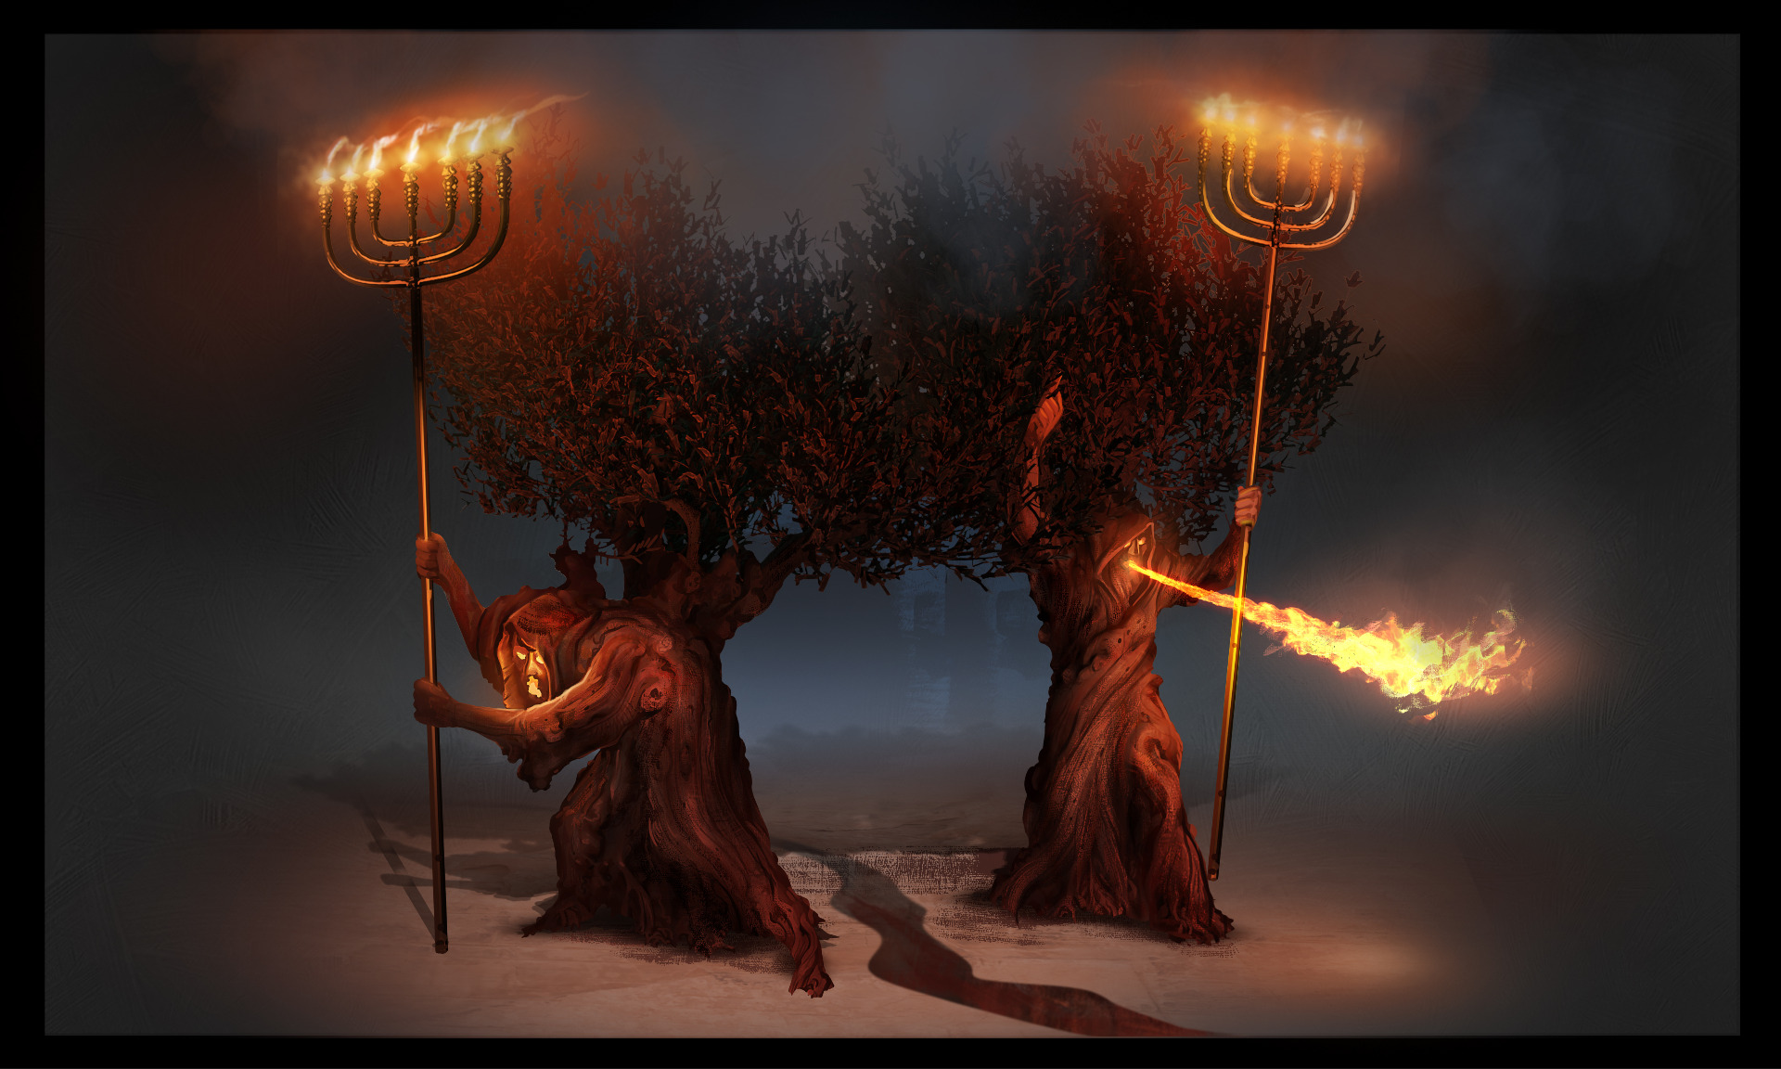
Two Witnesses (Rev. 11:1-14)

Slide 10
Two Witnesses (Rev. 11:1-14)
Measure the temple (1-2) : like sealing in ch.7, this marks off God’s people (Zech. 2:1-5)
God’s people as the temple (Ezekiel 40-48)
Protected, but not spared (trampling)
Two Witnesses (3-14) : granted authority
Called witnesses, prophets, olive trees, and lampstands → people of God (3-4)
They have the spirit of Moses & Elijah (5-6)
They are killed by the beast (see ch.13), their death is celebrated by the world (7-10)
They are raised & taken to heaven (11-12)
The result? The people glorify God (13)

Slide 11
Seventh Trumpet (Rev 11:15-19)
Eternal kingdom (15) : of God & His Christ
Everything fulfilled, completed (see 10:7)
Heaven and Earth reunited under the authority of God and the Son of Man
Worship around throne (16-18) : see ch.4
God is and was; “is to come” is no more (?)
He’s dealt with raging nations, destroyed the destroyers, and rewarded His servants
Temple opens (19) : separation removed
cycle concludes with God’s power (4:5; 8:5)

Slide 12
Reflections on Revelation 11
How can we (the church) live out the call of John (ch.10) and the vision of the witnesses (ch.11)?

Slide 13
The Revelation
Next Week (1/31)
8. chs. 12-13: Dragon & Beasts

