Slide 1
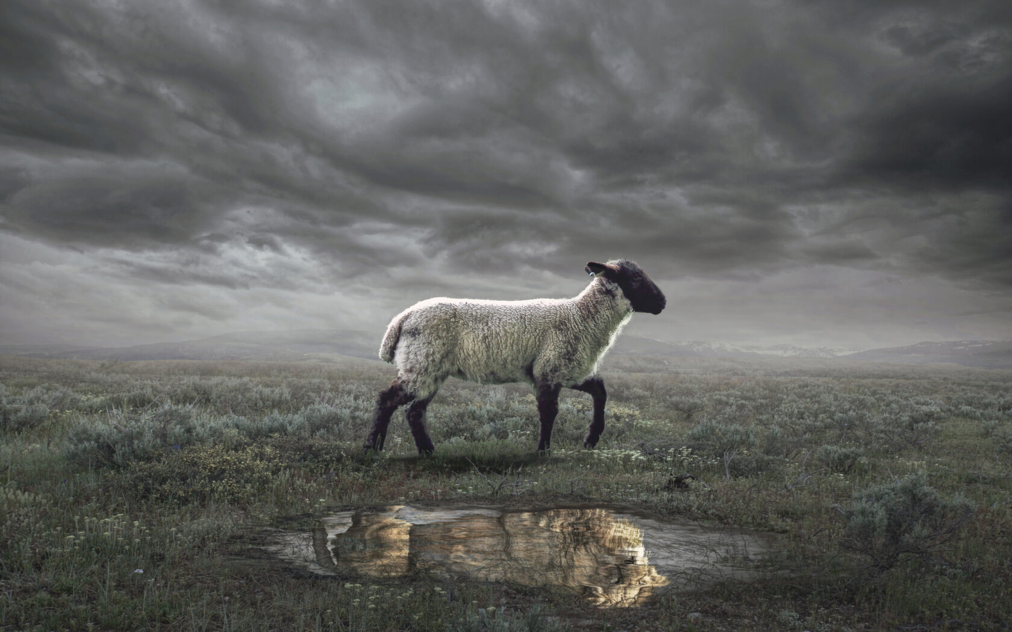
The Revelation
Wednesday Nights
Winter 2023-24

Slide 2
Review Quiz
Place these sections in order:
Letters to the churches
Seven seal judgments
Seven trumpet judgments
Christ appears to John
Vision of God & the Lamb
Christ appears (1)
Letters (2-3)
Throne & Lamb (4-5)
7 Seals (6-7)
7 Trumpets (8-9)

Slide 3
Revelation 8-9
Read (listen) to these chapters.
See the action in your mind’s eye. Get the overall sense, and feel what is happening.

Slide 4
Making sense of Revelation 8-9
Put it in context – “when the Lamb opened the 7th seal…” (8:1)
the unfolding of God’s plan
serial judgments + rescue of God’s people
Identify key points – from this text
God responding to prayers (8:3-4)
heaven’s power unleashed on earth (8:5)
partial judgments (8:6-12; 9:5,18)
nightmares become reality (9:1-10)
purpose: mankind’s repentance (9:20-21)

Slide 5
Making sense of Revelation 8-9
See Biblical patterns – from OT and NT
fire, thunder, lightning of Sinai (8:5)
trumpets for warning, gathering, battle
plagues against Egypt (Exodus 7-12)
judgment as cosmic unraveling (Isaiah 13)
locusts / armies for judgment (Joel 1-2)
Consider the audience – 1st century Asia
persecuted, looking for God to act
tempted to compromise with sin
this comforts & rebukes in shocking images

Slide 6
Trumpet Judgments (Rev. 8-9)
First Four (8:7-12) : foundations of life (vegetation, seas, water, heavenly lights)
‘Three Woes’ (8:13) : ominous escalation
Fifth Trumpet (9:1-12) : demon locusts!?
“a star fallen” – see Luke 10:18 (?)
“bottomless pit” – or abyss, see Rev. 11:7
locusts – see Joel 1:4-12; 2:1-11; 3:23-25
”Destroyer” – Satan? or death personified?
→ God is unleashing hell on earth

Slide 7
Trumpet Judgments (Rev. 8-9)
Sixth Trumpet (9:13-19) : angelic army
invasion a fear of any nation
2 Kings 6:17 – horses & chariots of fire
The result? (9:20-21) : Men didn’t repent
dual-purpose of judgment and repentance
sins: idolatry, violence, sexual sin, greed
→ God gives them over to self-destruction

Slide 8
Reflections on Trumpets
Who is causing all these catastrophes on the earth?
What/who is God using to carry out these catastrophes?
What is His purpose?
How does all of this inform the way we see catastrophes in our day?

Slide 9
Luke 13:1-5
There were some present at that very time who told him about the Galileans whose blood Pilate had mingled with their sacrifices. And he answered them, “Do you think that these Galileans were worse sinners than all the other Galileans, because they suffered in this way? No, I tell you; but unless you repent, you will all likewise perish. Or those eighteen on whom the tower in Siloam fell and killed them: do you think that they were worse offenders than all the others who lived in Jerusalem? No, I tell you; but unless you repent, you will all likewise perish.”

Slide 10
Thunders & a Scroll (Rev. 10)
Mighty Angel (1-2) – representative of God, authority over land and sea
“little scroll” (2) – God’s plan (like in 5:1)
7 thunders (3-4) – sealed up, not written
More judgments that are not carried out?
Action of God not revealed to man?
Angel’s oath (5-7) – see Daniel 12:4-9
In Daniel, it would be time, times, ½ a time
In Rev. 10, there will be no more delay
God’s mystery fulfilled in the 7th trumpet

Slide 11
Thunders & a Scroll (Rev. 10)
Eat the scroll (8-11) – like Ezekiel 2-3
Follows the chain of revelation from 1:1-3
God (5:1) → Lamb (5:7) → Angel (10:1) → John (10:10) → Readers
Sweet to taste, but bitter to swallow…
a message for peoples, nations, kings…

Slide 12
The Revelation
Next Week (1/24)
7. chapter 11: Two Witnesses

