Slide 1
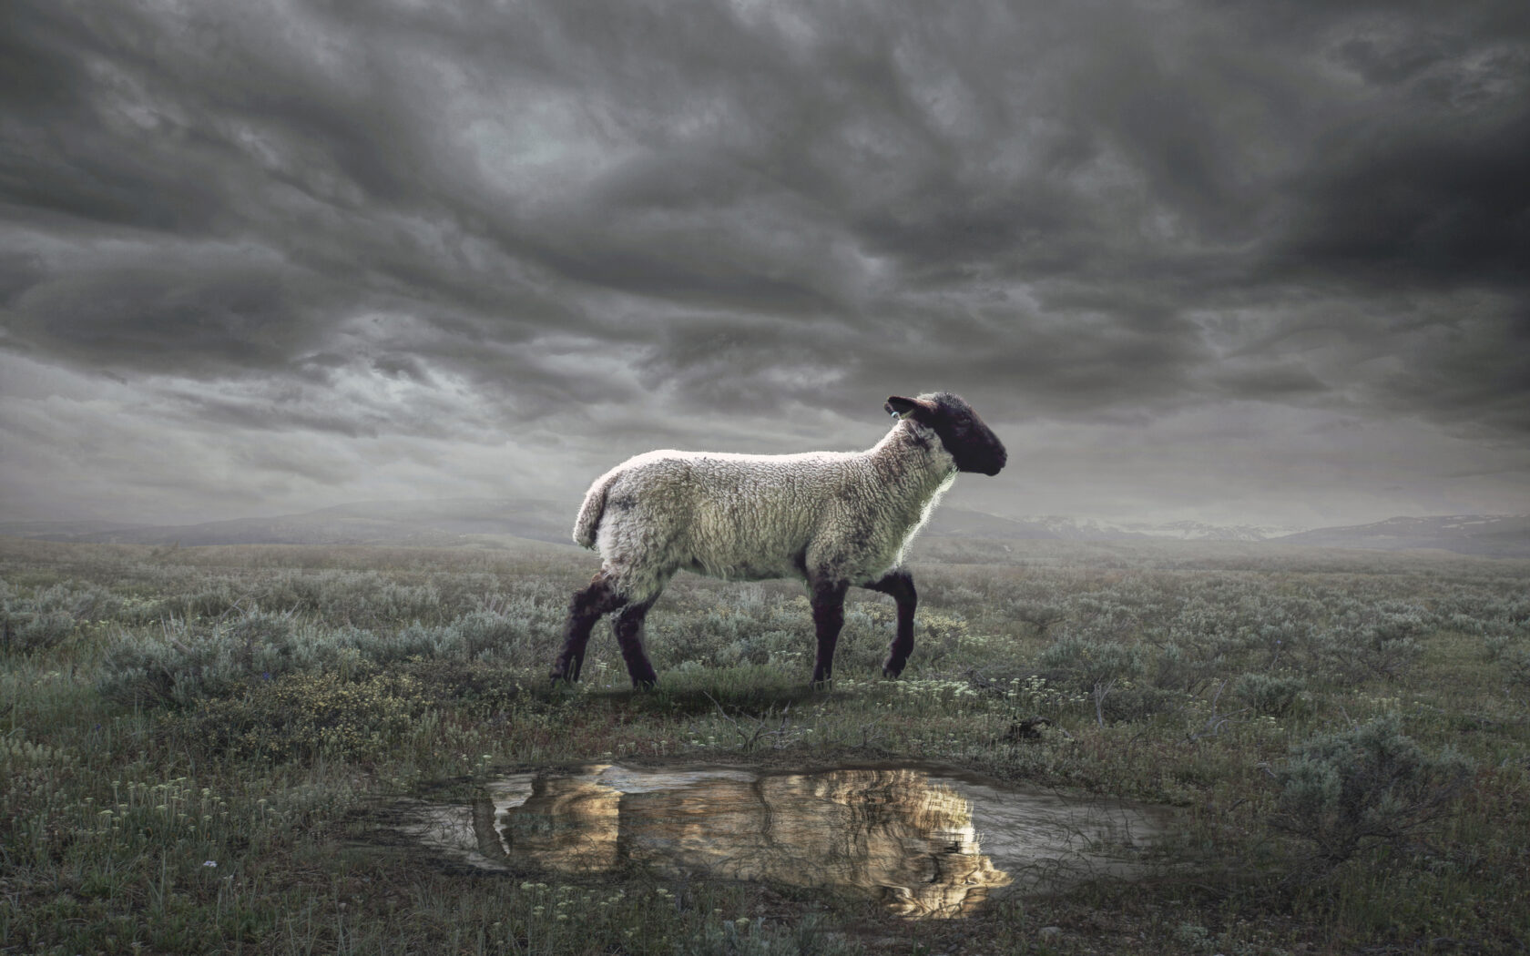
The Revelation
Wednesday Nights
Winter 2023-24

Slide 2
Review Quiz
What is the genre of the Book of Revelation?
_________
_________
_________

Slide 3
What are we reading?
¹ The Revelation of Jesus Christ, which God gave Him to show to His bond-servants, the things which must soon take place; and He sent and communicated it by His angel to His bond-servant John, ² who testified to the word of God and to the testimony of Jesus Christ, even to all that he saw. ³ Blessed is he who reads and those who hear the words of the prophecy, and heed the things which are written in it; for the time is near.
⁴ John to the seven churches that are in Asia:

Slide 4
Review Quiz
What were the external pressures facing the Christians in Asia?
___________
___________
What were the spiritual dangers?
___________
___________

Slide 5
Christians in Roman Asia
External Pressures
Persecution (1:9; 2:9; 2:13; 3:9)
Prosperity (3:2; 3:17)
Spiritual Dangers:
Compromise (2:6,14-15; 2:20)
Apathy (2:4; 3:1; 3:16)

Slide 6
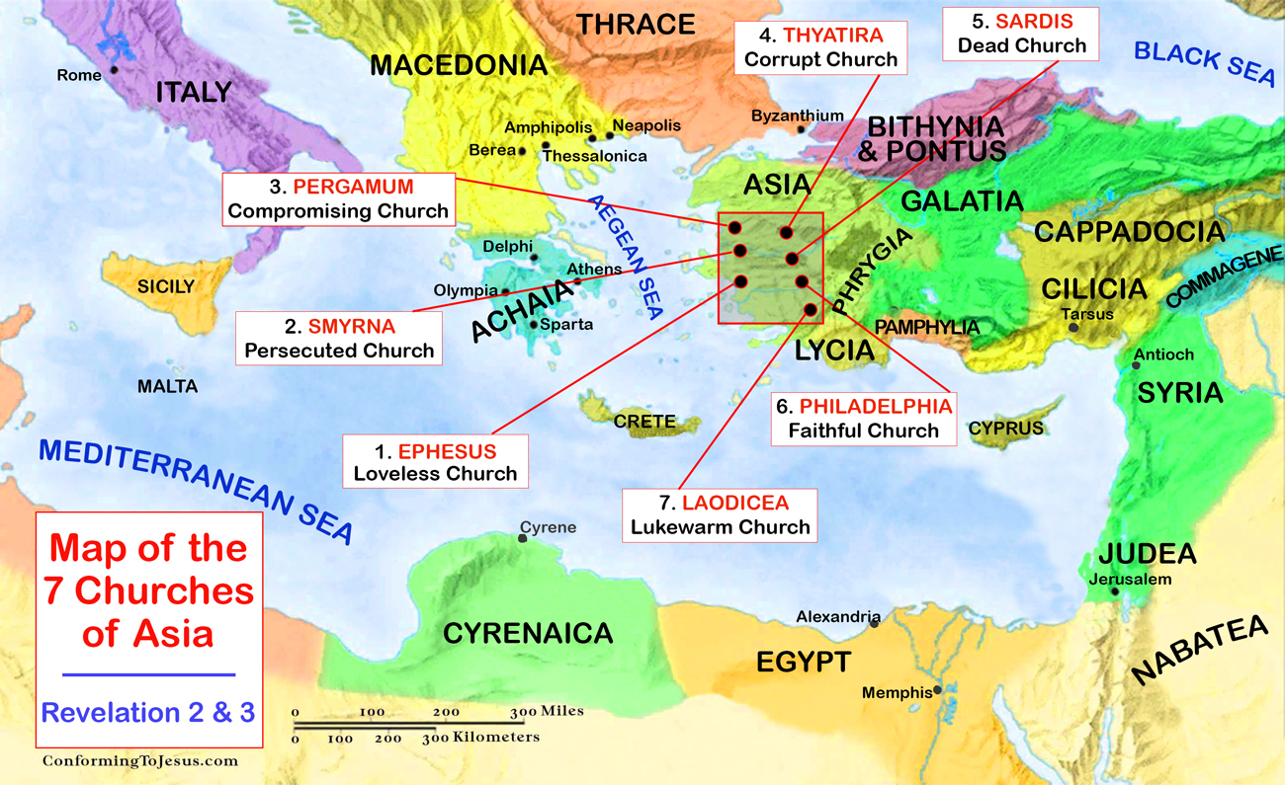

Slide 7
Structure of Revelation
Letters to the Churches (1-3)
The Throne of God & the Lamb (4-5)
Seven Seals (6-8)
Seven Trumpets (8-11)
Seven Signs (12-14)
Seven Bowls (15-16)
Fall of Babylon (17-19)
Final Battle (19-20)
New Heavens & New Earth (21-22)

Slide 8
Revelation 4-5
Hear & see (imagine) what John is describing.
What is the drama (story) playing out in these two chapters?

Slide 9
Revelation 4:1-11
John is shown a transcendent reality:
“a door in heaven” – God’s space
“what must take place” – God’s time
Focal point: God on the throne
Like the visions of the prophets
A direct contradiction to Caesar
God’s heavenly subjects recognize His holiness and lay their authority at His feet—because He gave it to them.

Slide 10
Revelation 5:1-14
The sealed scroll points us back to Daniel 12:4, 8-9 – God’s plan for history
defeating beasts + rescuing saints
no one worthy – all have rebelled
Jesus is worthy. Plan fulfilled in Him.
Lion: conquers + establishes kingdom
Lamb: conquers through sacrifice
The Lamb is worshipped by the living creatures and elders, like God in ch.4

Slide 11
Revelation 5:1-14
“sang a new song” – the progress of God’s work toward it’s culmination
ransomed a people for God
made them a kingdom and priests
they shall reign on the earth
Hears millions of angels worshipping
worthy to receive [seven things]
All creation now joins in praise of the one who sits on the throne and the Lamb

Slide 12
A theater of praise
Revelation 4 shows the heavenly creatures in God’s presence constantly praising Him, offering Him everything.
Revelation 5 tells the story of God’s redemption through the Lamb.
By 5:13, all creatures in heaven, on (and under) the earth, and in the sea join the praise of God & the Lamb.
Have we joined the song?

Slide 13
Revelation 4-5
What does this vision mean for the Christians in Roman Asia?
What does it mean for us?
Worship?
Conquering?

Slide 14
The Revelation
Next Week (1/10)
5. Revelation 6-7: Seven Seals

