Slide 1


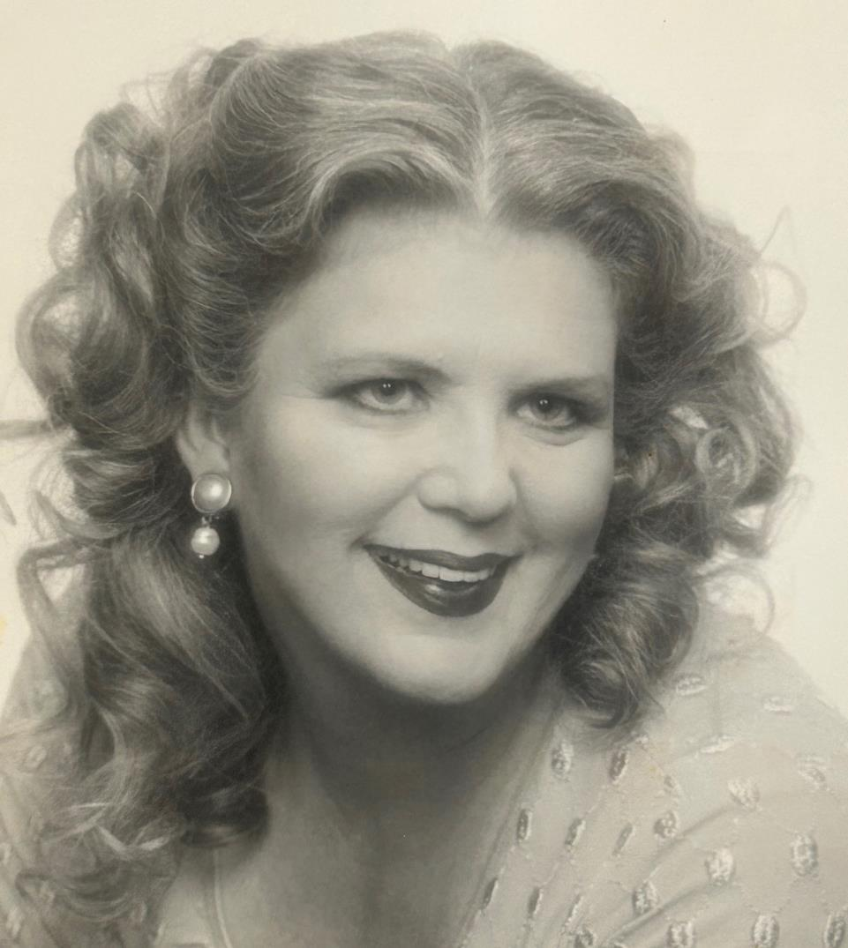
IN LOVING MEMORY OF
Priscilla
HILL
September 11, 1952 - November 16, 2023

Slide 2



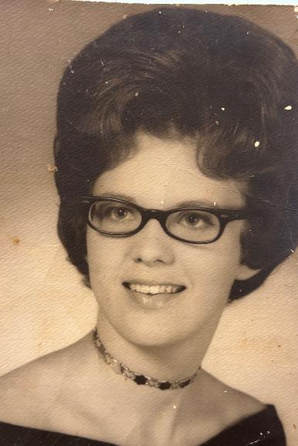
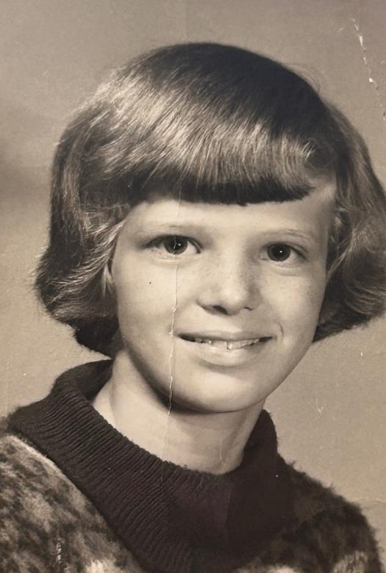

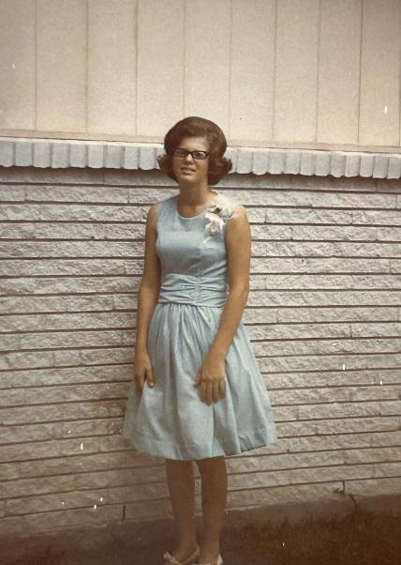
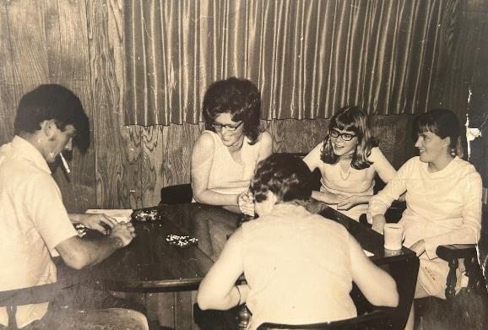
Early
DAYS

Slide 3

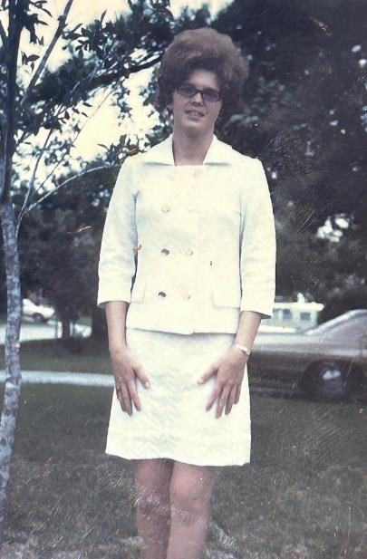

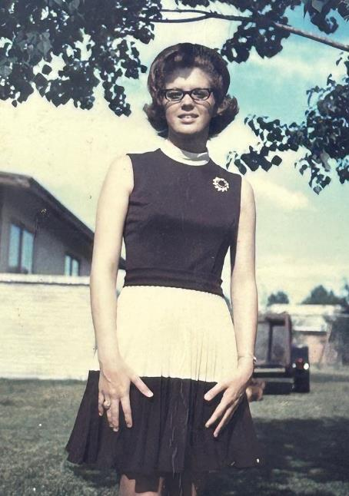
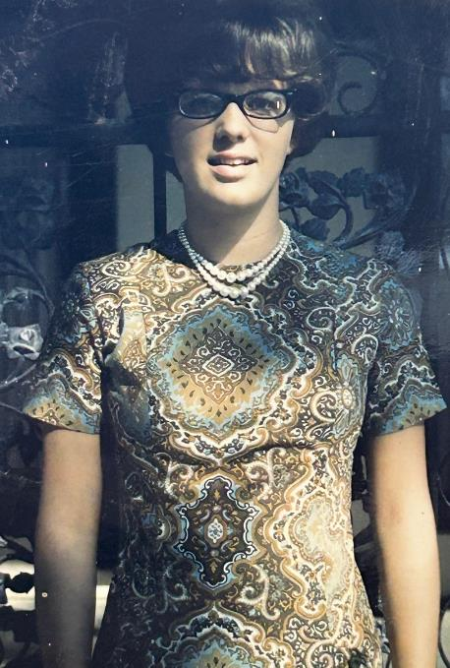
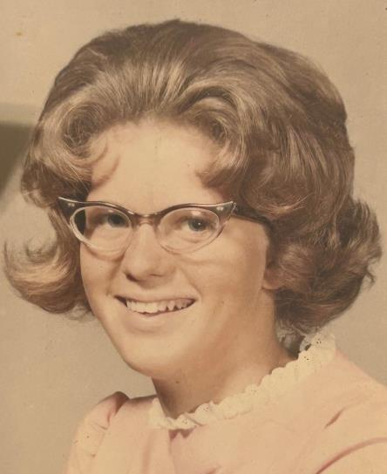

Early
DAYS

Slide 4


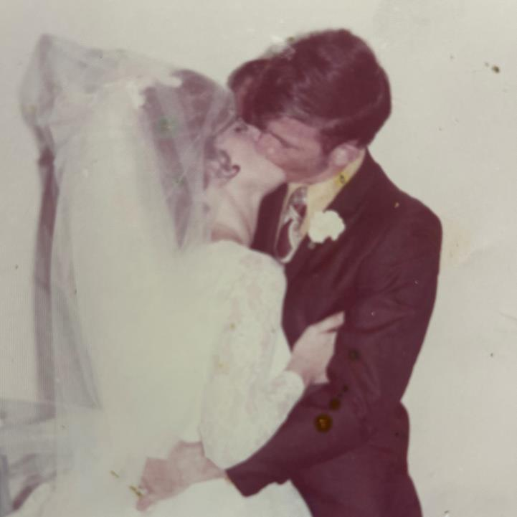
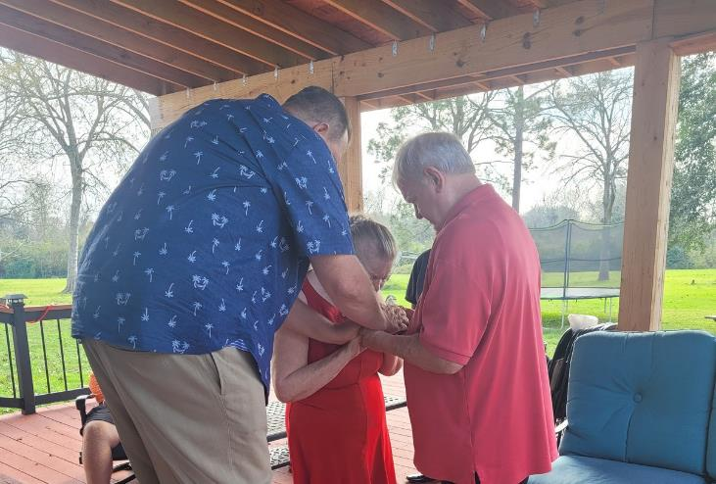
Happy
MARRIAGE
52 YEARS

Slide 5

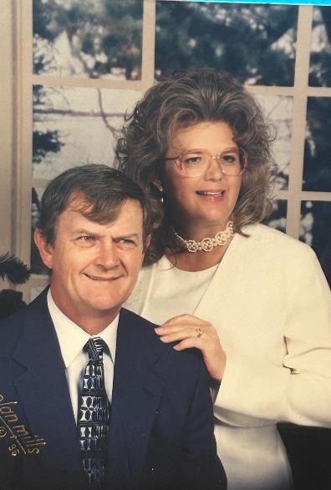
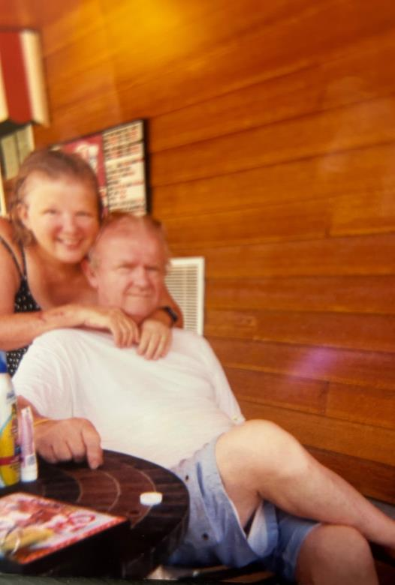
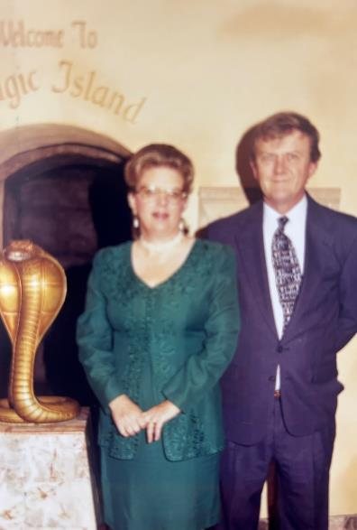
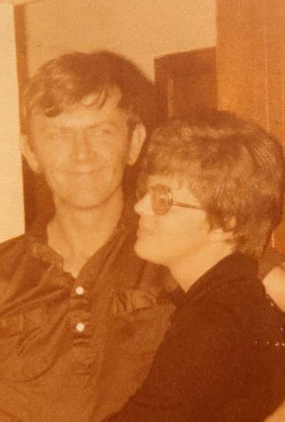
Loving
WIFE

Slide 6

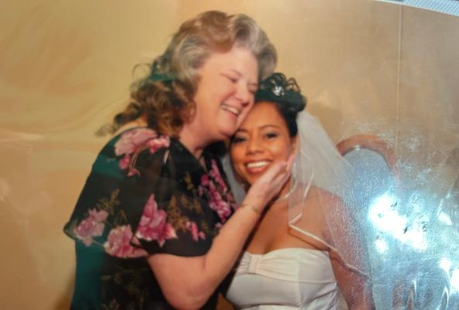
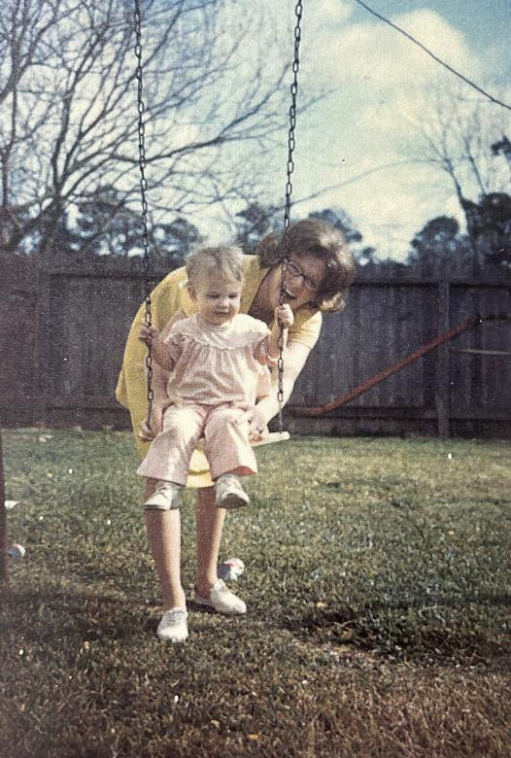
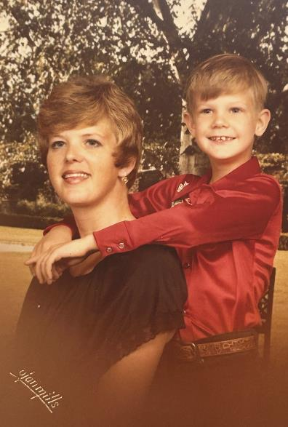

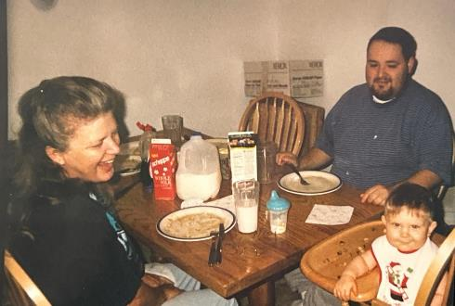
Caring
MOTHER

Slide 7


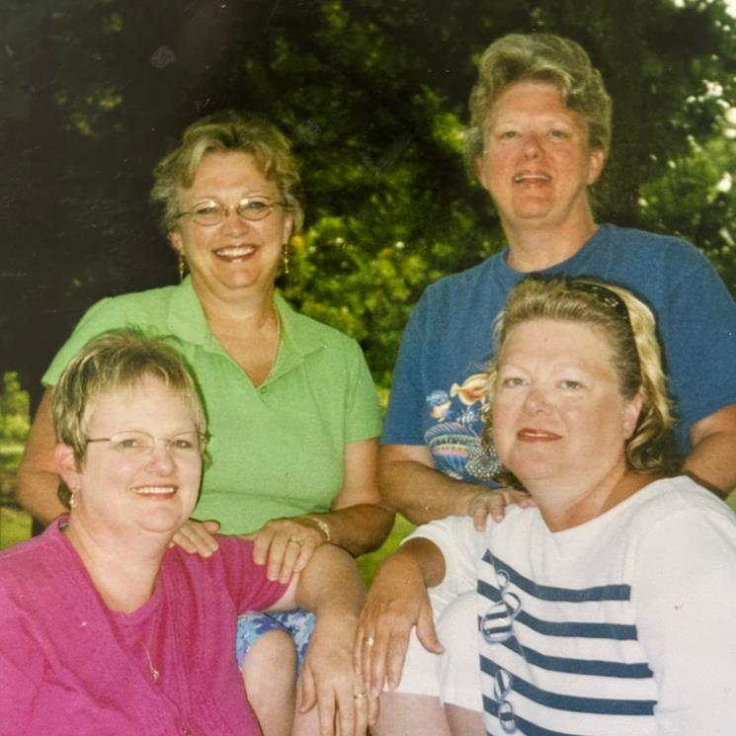
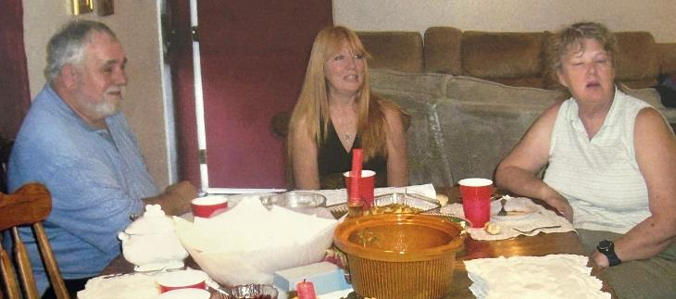

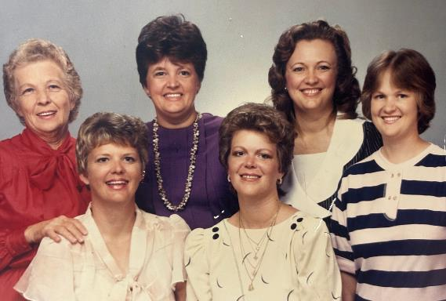
Best
SISTER

Slide 8

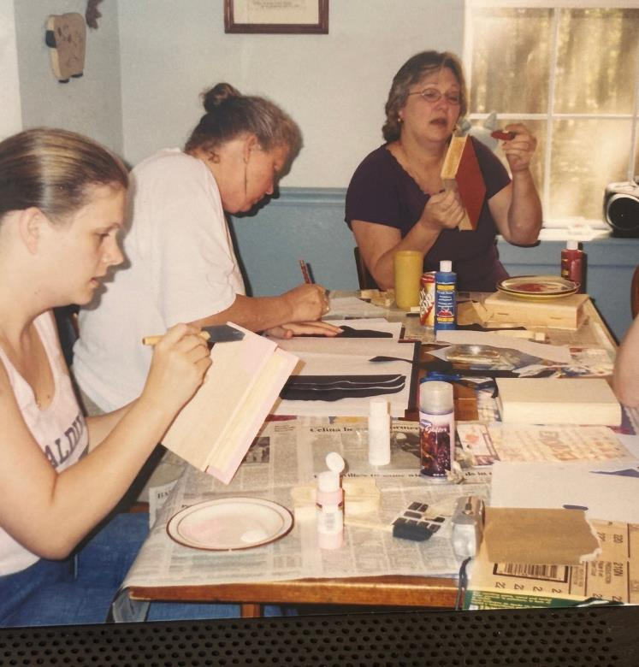

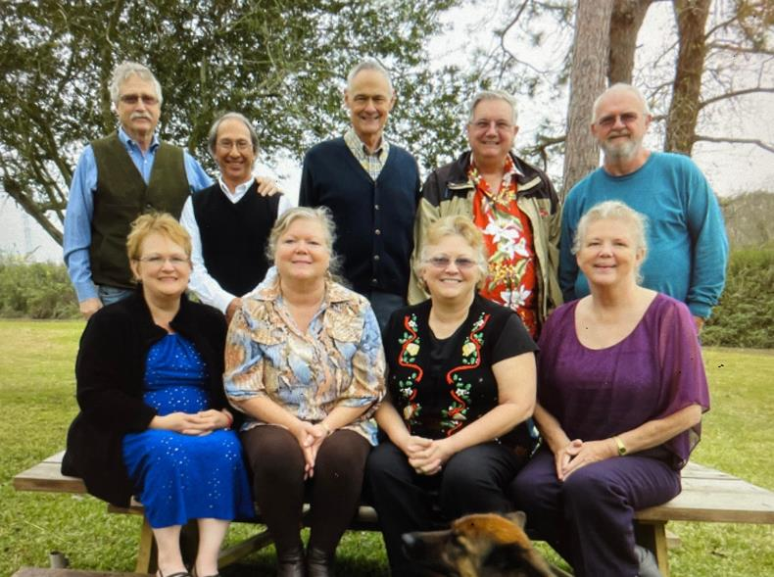
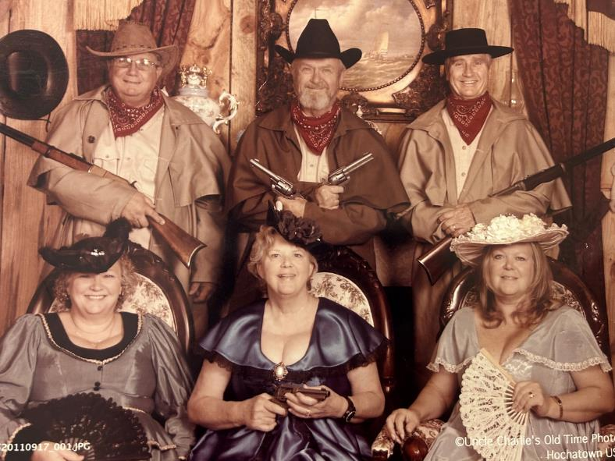
Best
SISTER

Slide 9

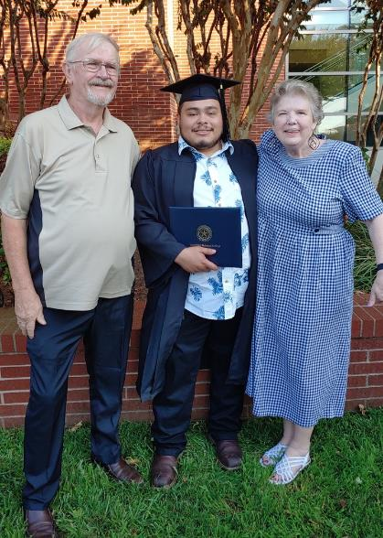
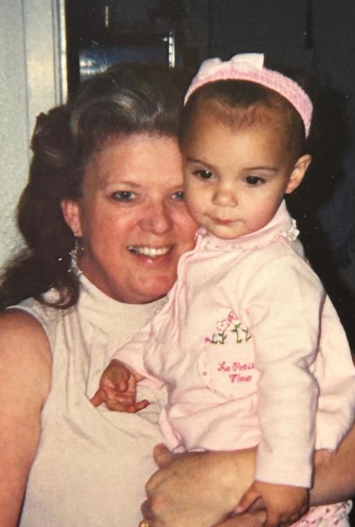

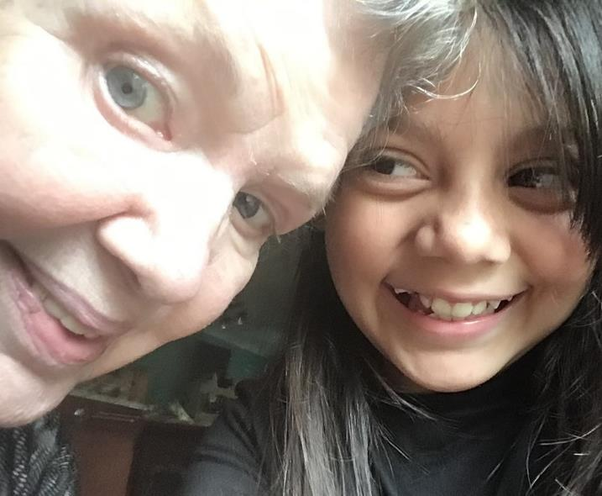
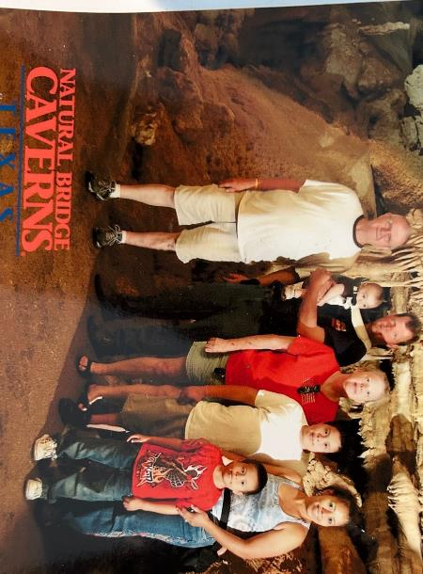
Happy
GRANDMA

Slide 10

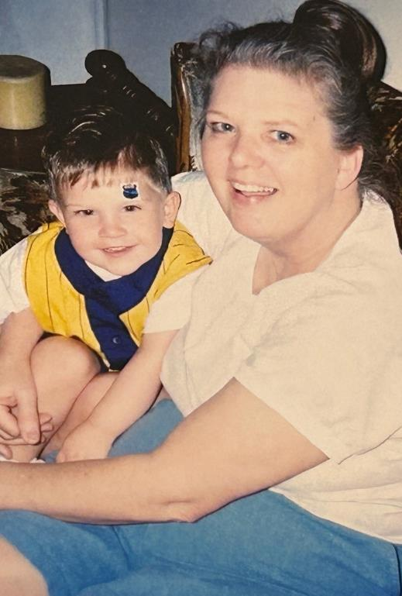
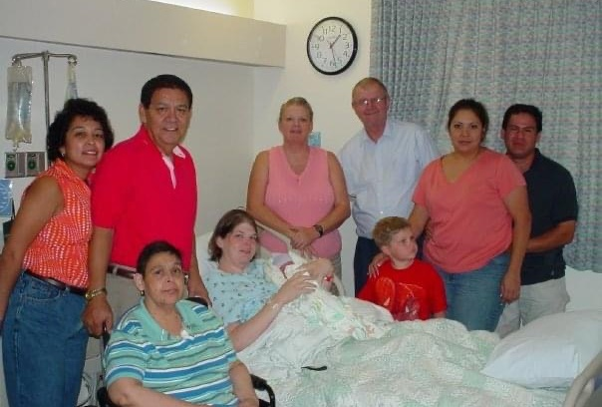
Happy
GRANDMA

Slide 11

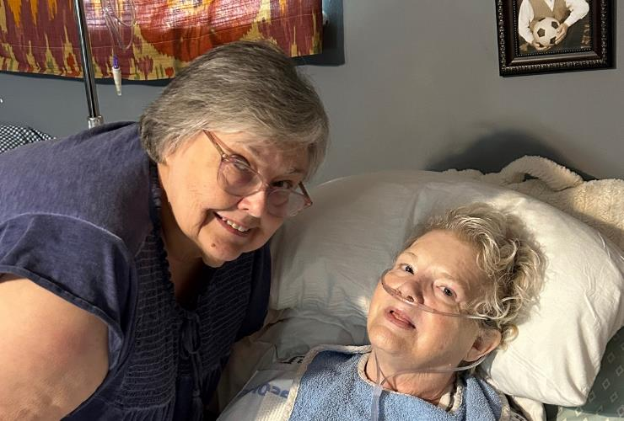

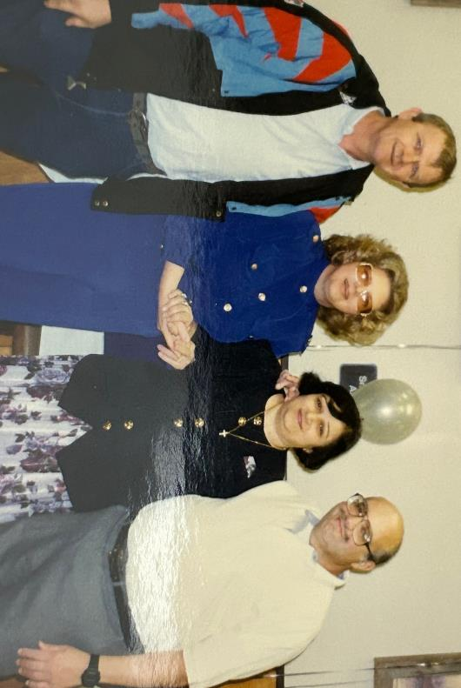
Good
FRIEND

Slide 12


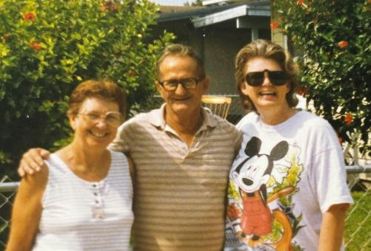
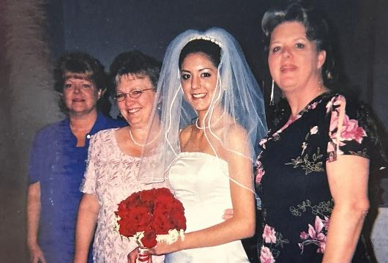
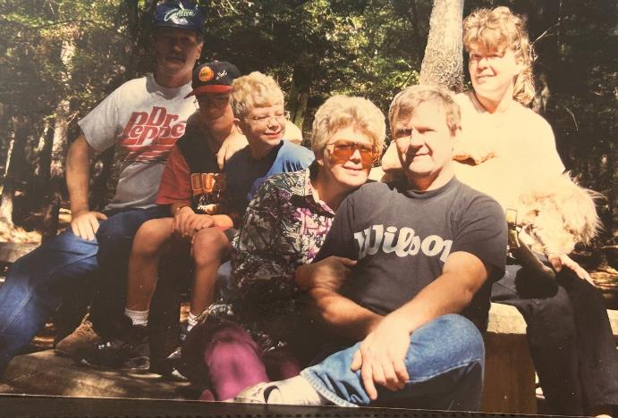
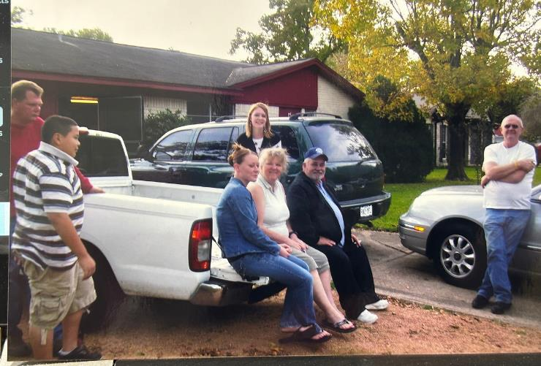
Big
FAMILY

Slide 13



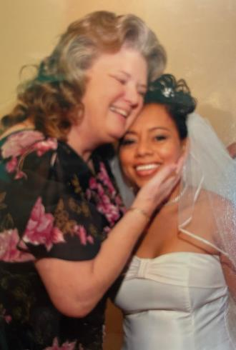
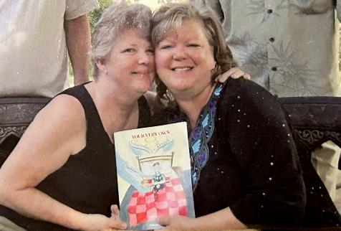


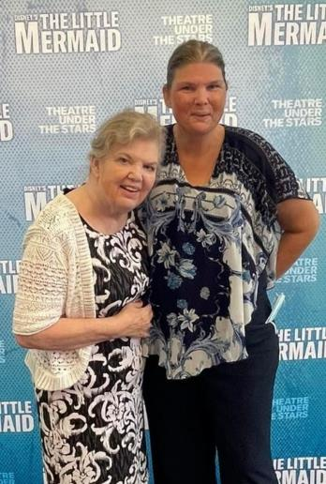
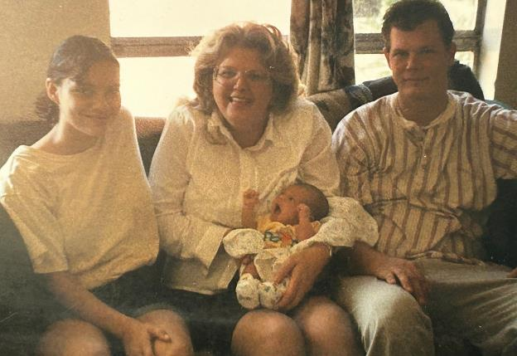
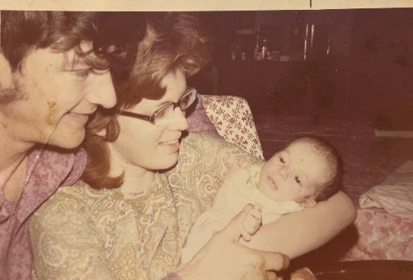
Unforgettable
MOMENTS

Slide 14

Favorite
BIBLE VERSES
AND IF IT SEEMS EVIL TO YOU TO SERVE THE LORD, CHOOSE FOR YOURSELVES THIS DAY WHOM YOU WILL SERVE, WHETHER THE GODS WHICH YOUR FATHERS SERVED THAT WERE ON THE OTHER SIDE OF THE RIVER, OR THE GODS OF THE AMORITES, IN WHOSE LAND YOU DWELL. BUT AS FOR ME AND MY HOUSE WE WILL SERVE THE LORD.
“LET NOT YOUR HEART BE TROUBLED; YOU BELIEVE IN GOD, BELIEVE ALSO IN ME. IN MY FATHER’S HOUSE ARE MANY mansions; if it were not so, I would have told you. I go to prepare a place for you. And if I go and prepare a place for you, I will come again and receive you to Myself; that where I am, there you may be also. And where I go you know, and the way you know.”
Joshua 24:15
John 14: 1-4

Slide 15


We're gonna miss you
PRISCILLA-PRISSY-CELLA-MOM-GRANDMA
September 11, 1952 - November 16, 2023

