Slide 1
In Loving Memory
Priscilla Hill

Slide 2
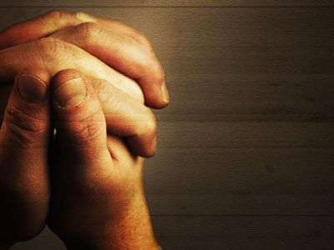
“In the day of my trouble, I call upon You, for You answer me.”
Psalm 86:7
Introduction & Prayer Daniel Broadwell

Slide 3
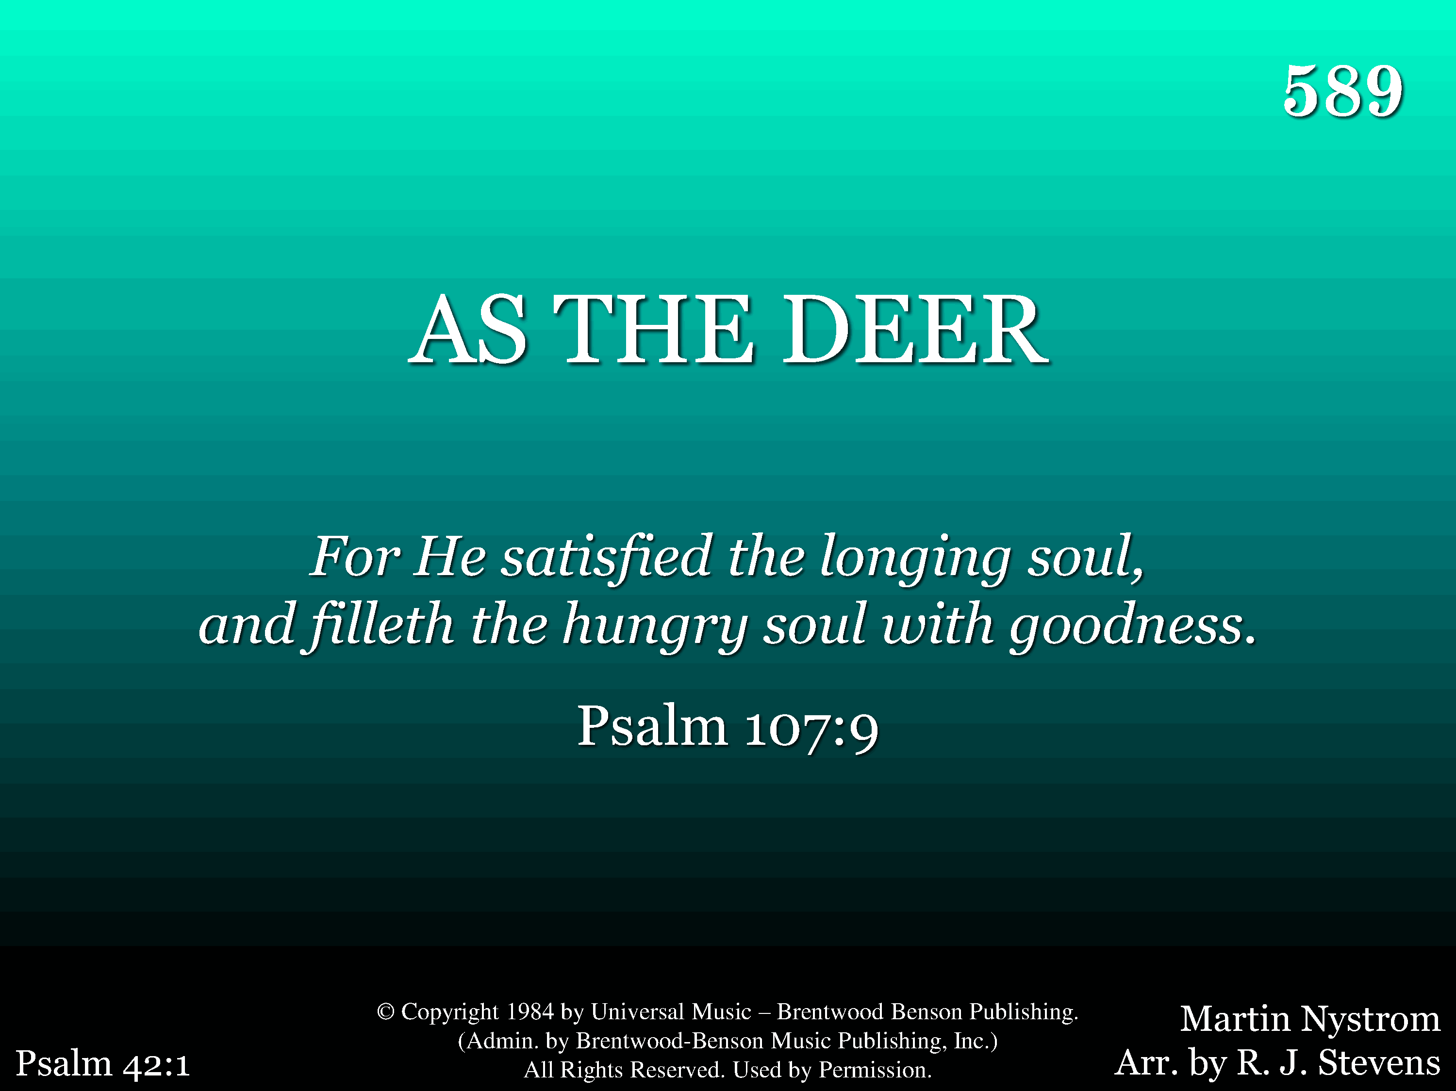
589 - As The Deer - Title

Slide 4
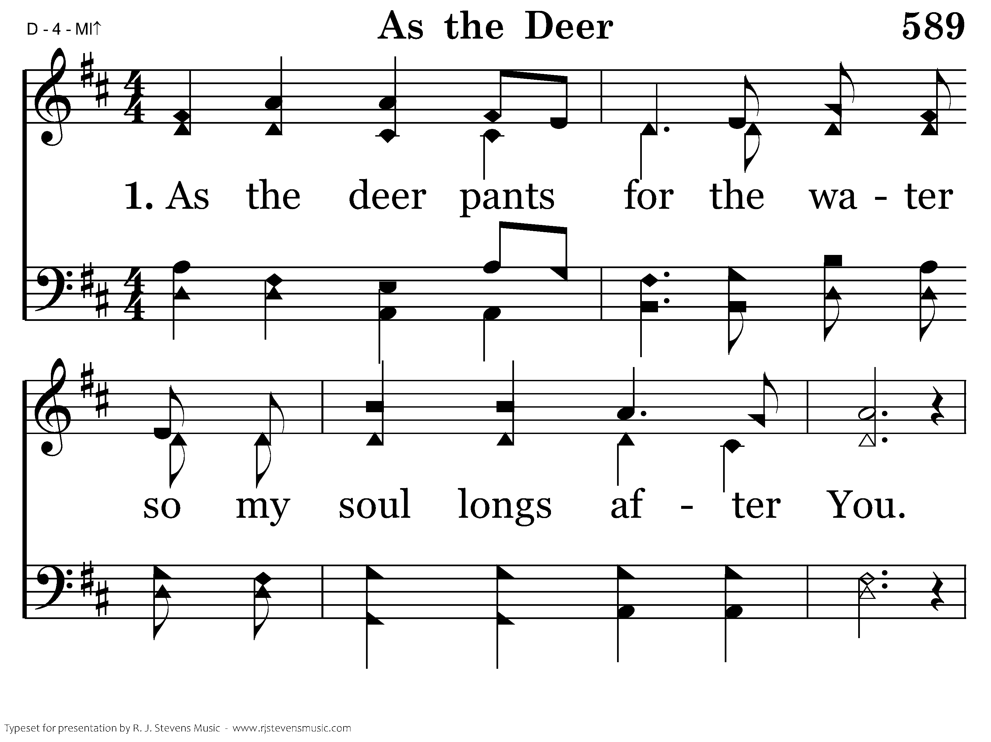
589 - As The Deer - 1.1

Slide 5
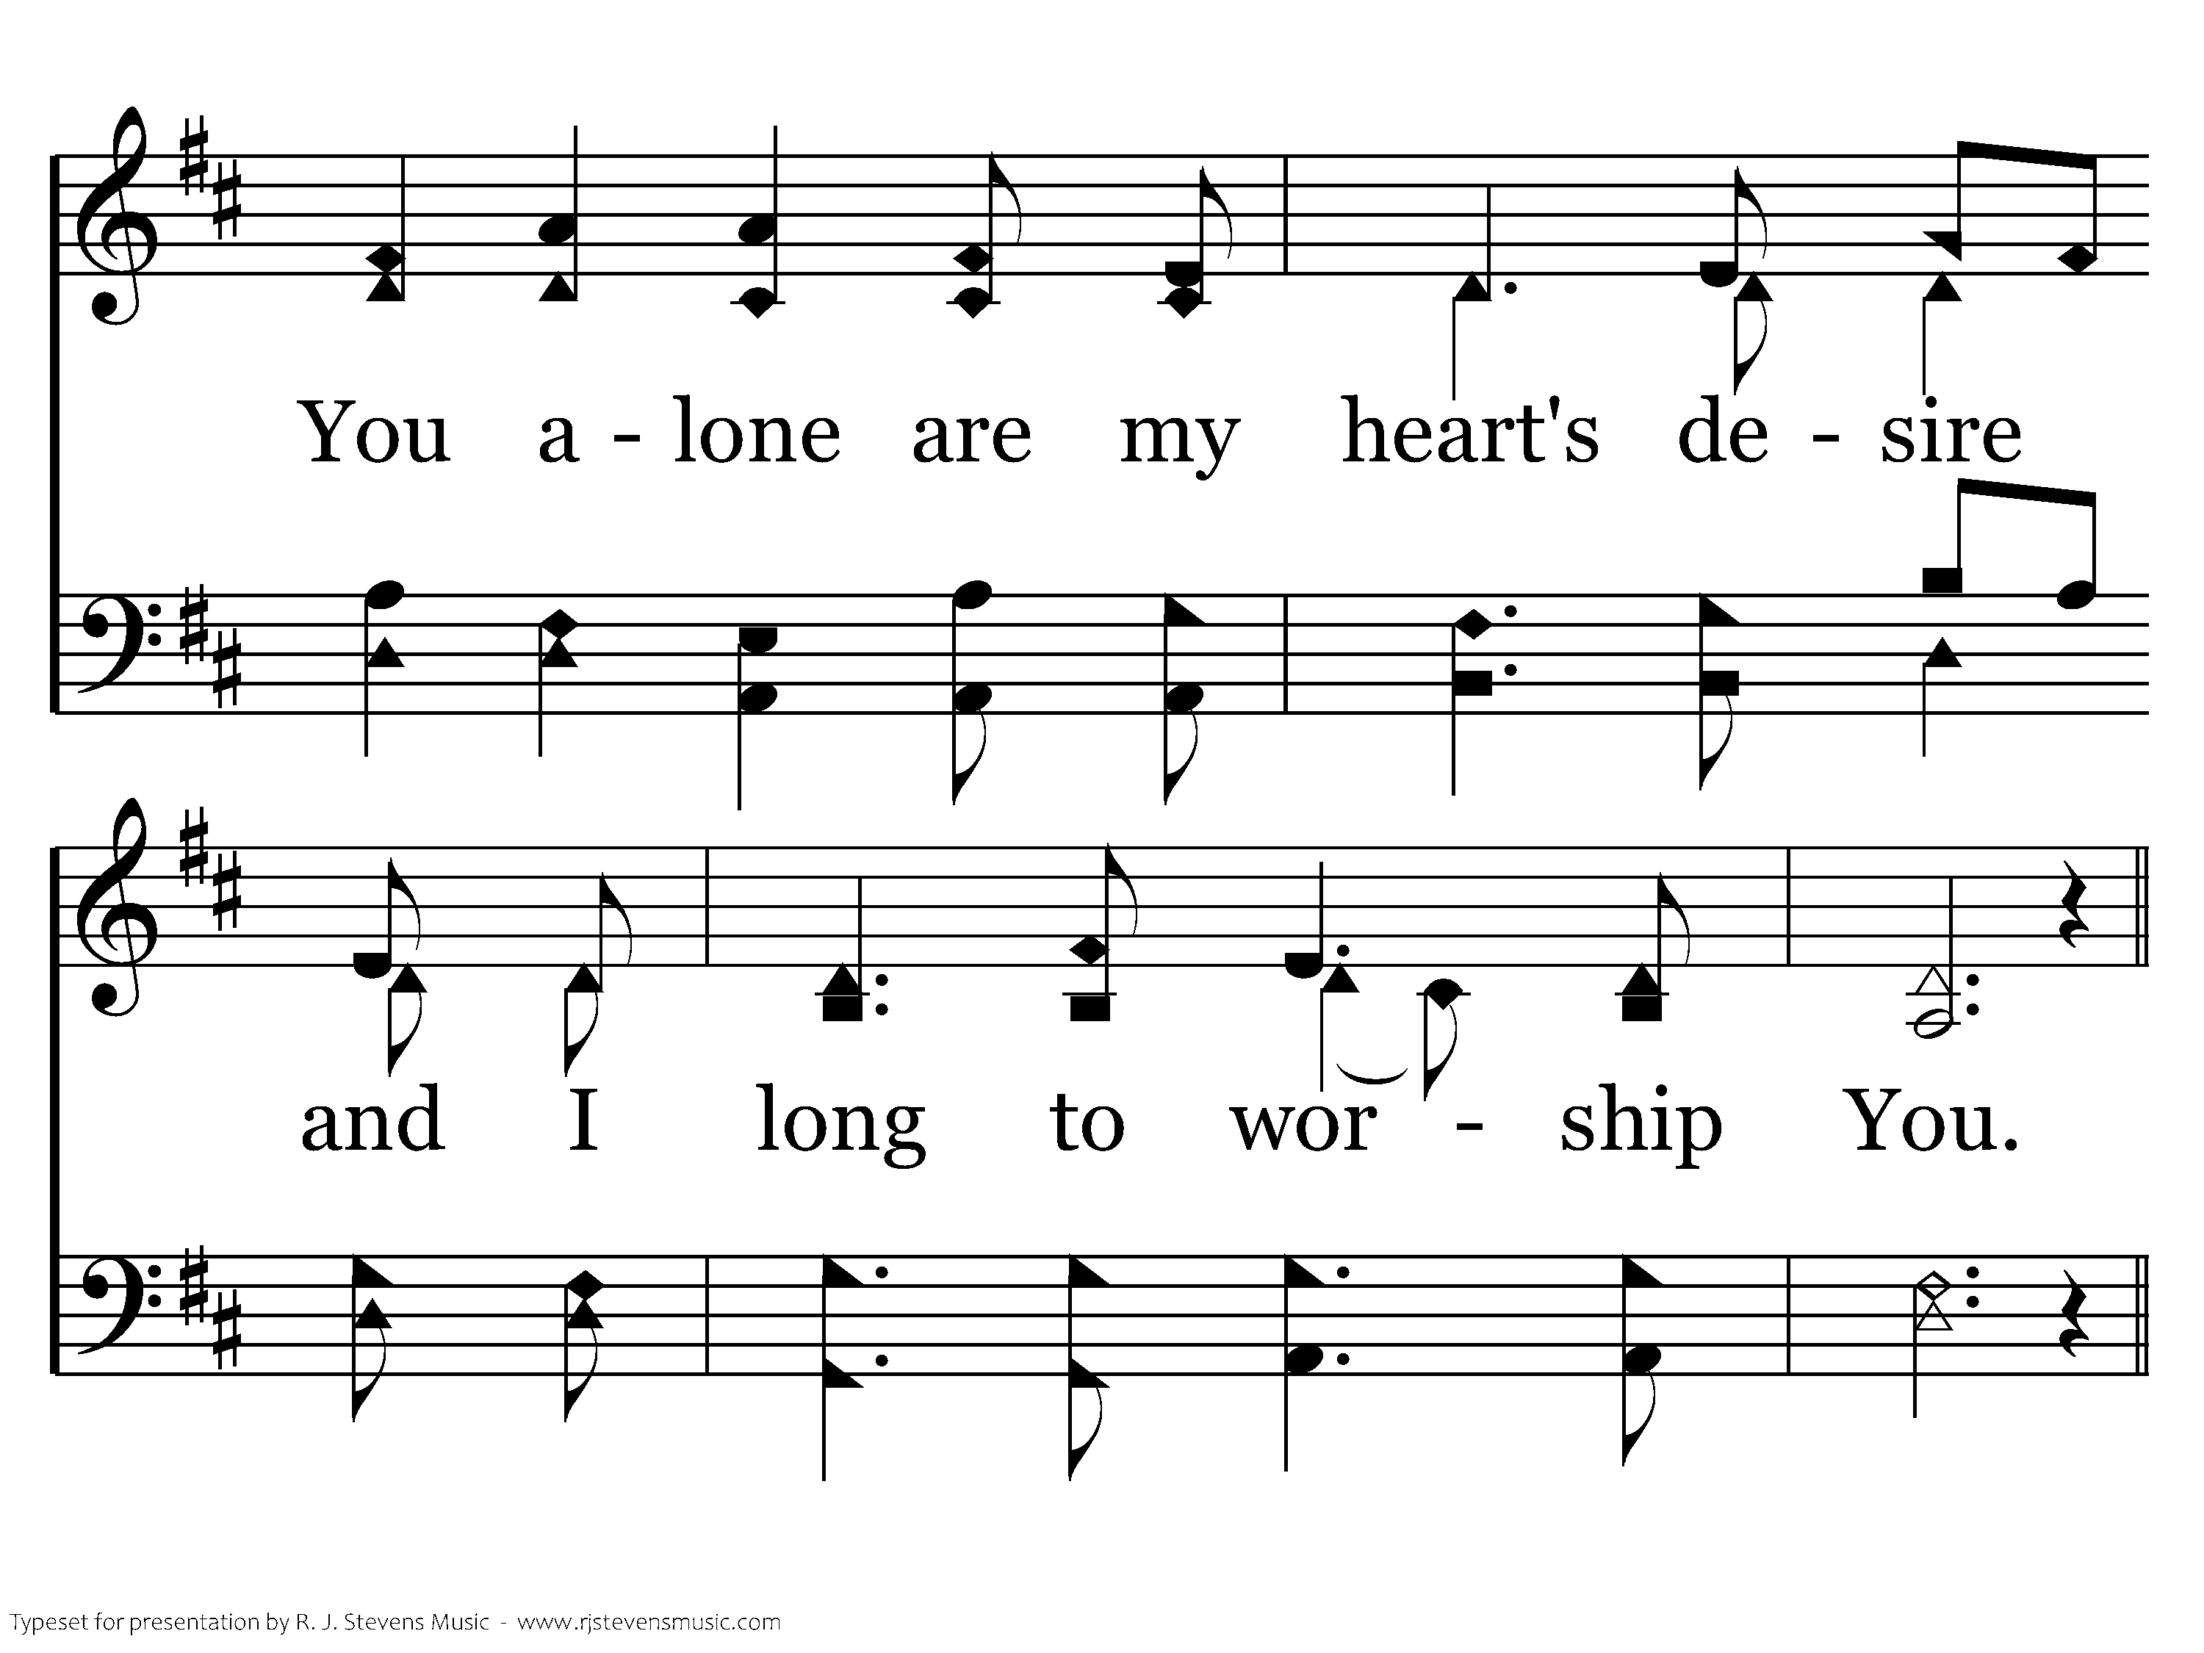
589 - As The Deer - 1.2

Slide 6
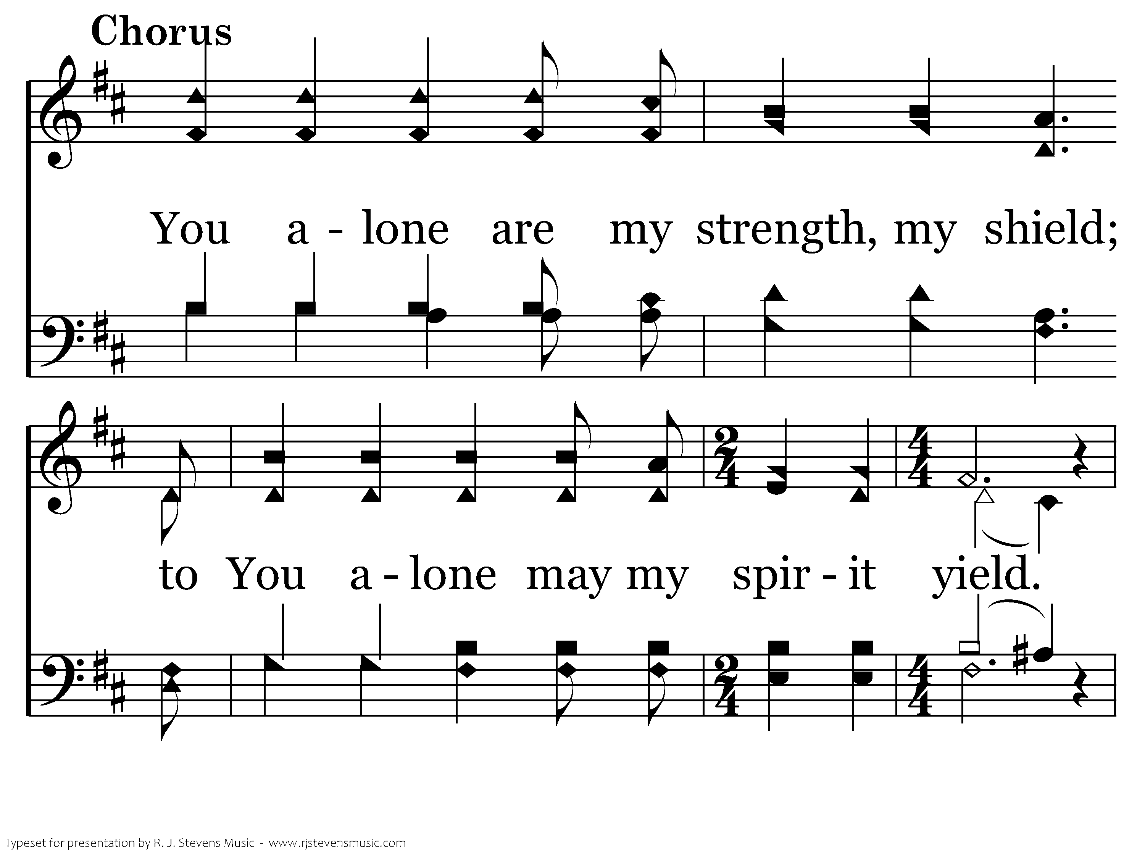
589 - As The Deer - C.1

Slide 7
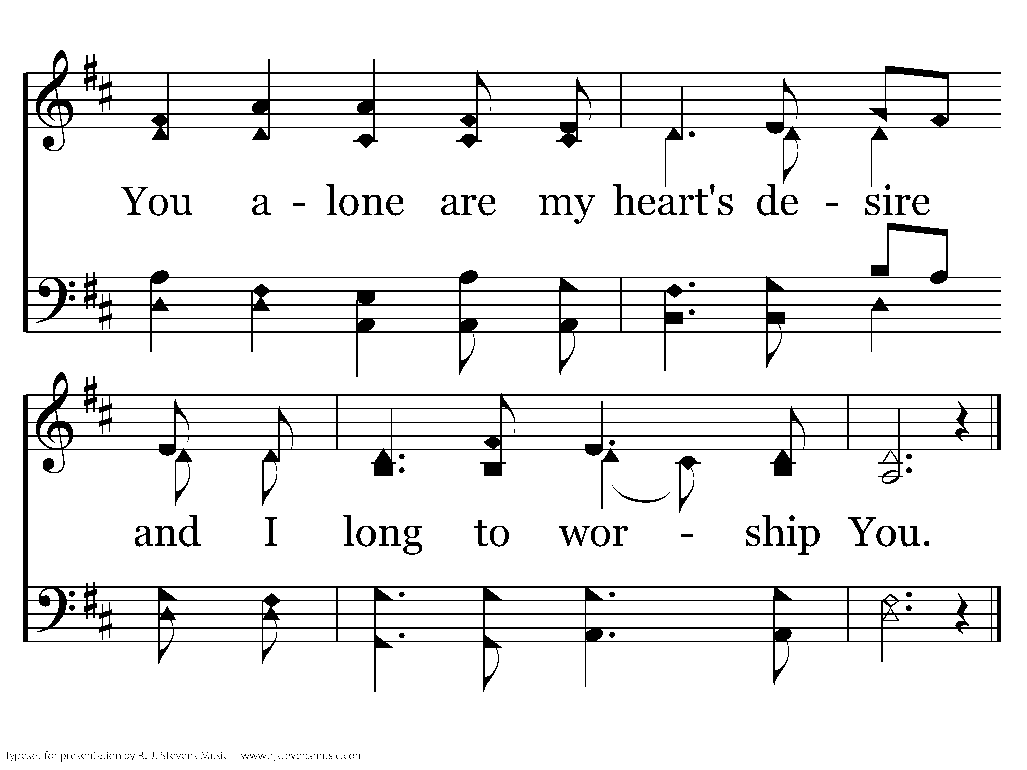
589 - As The Deer - C.2
End of Verse 1

Slide 8
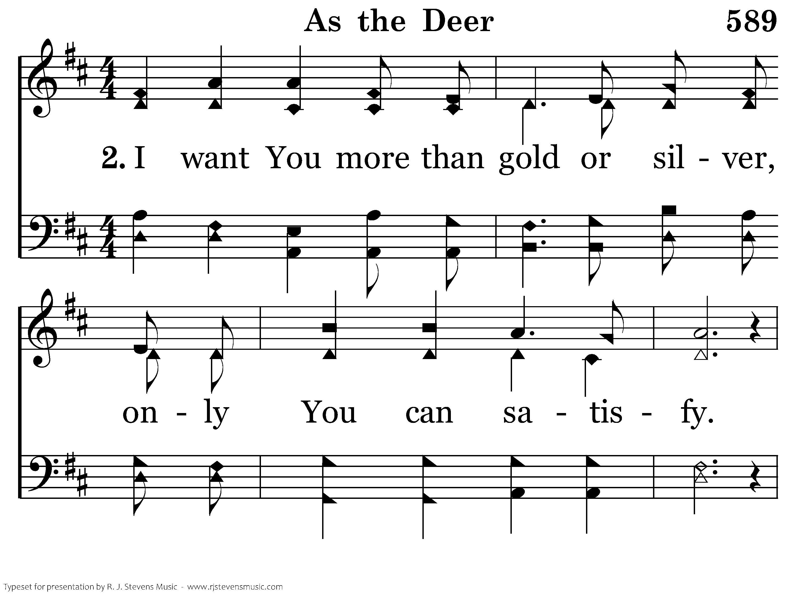
589 - As The Deer - 2.1

Slide 9
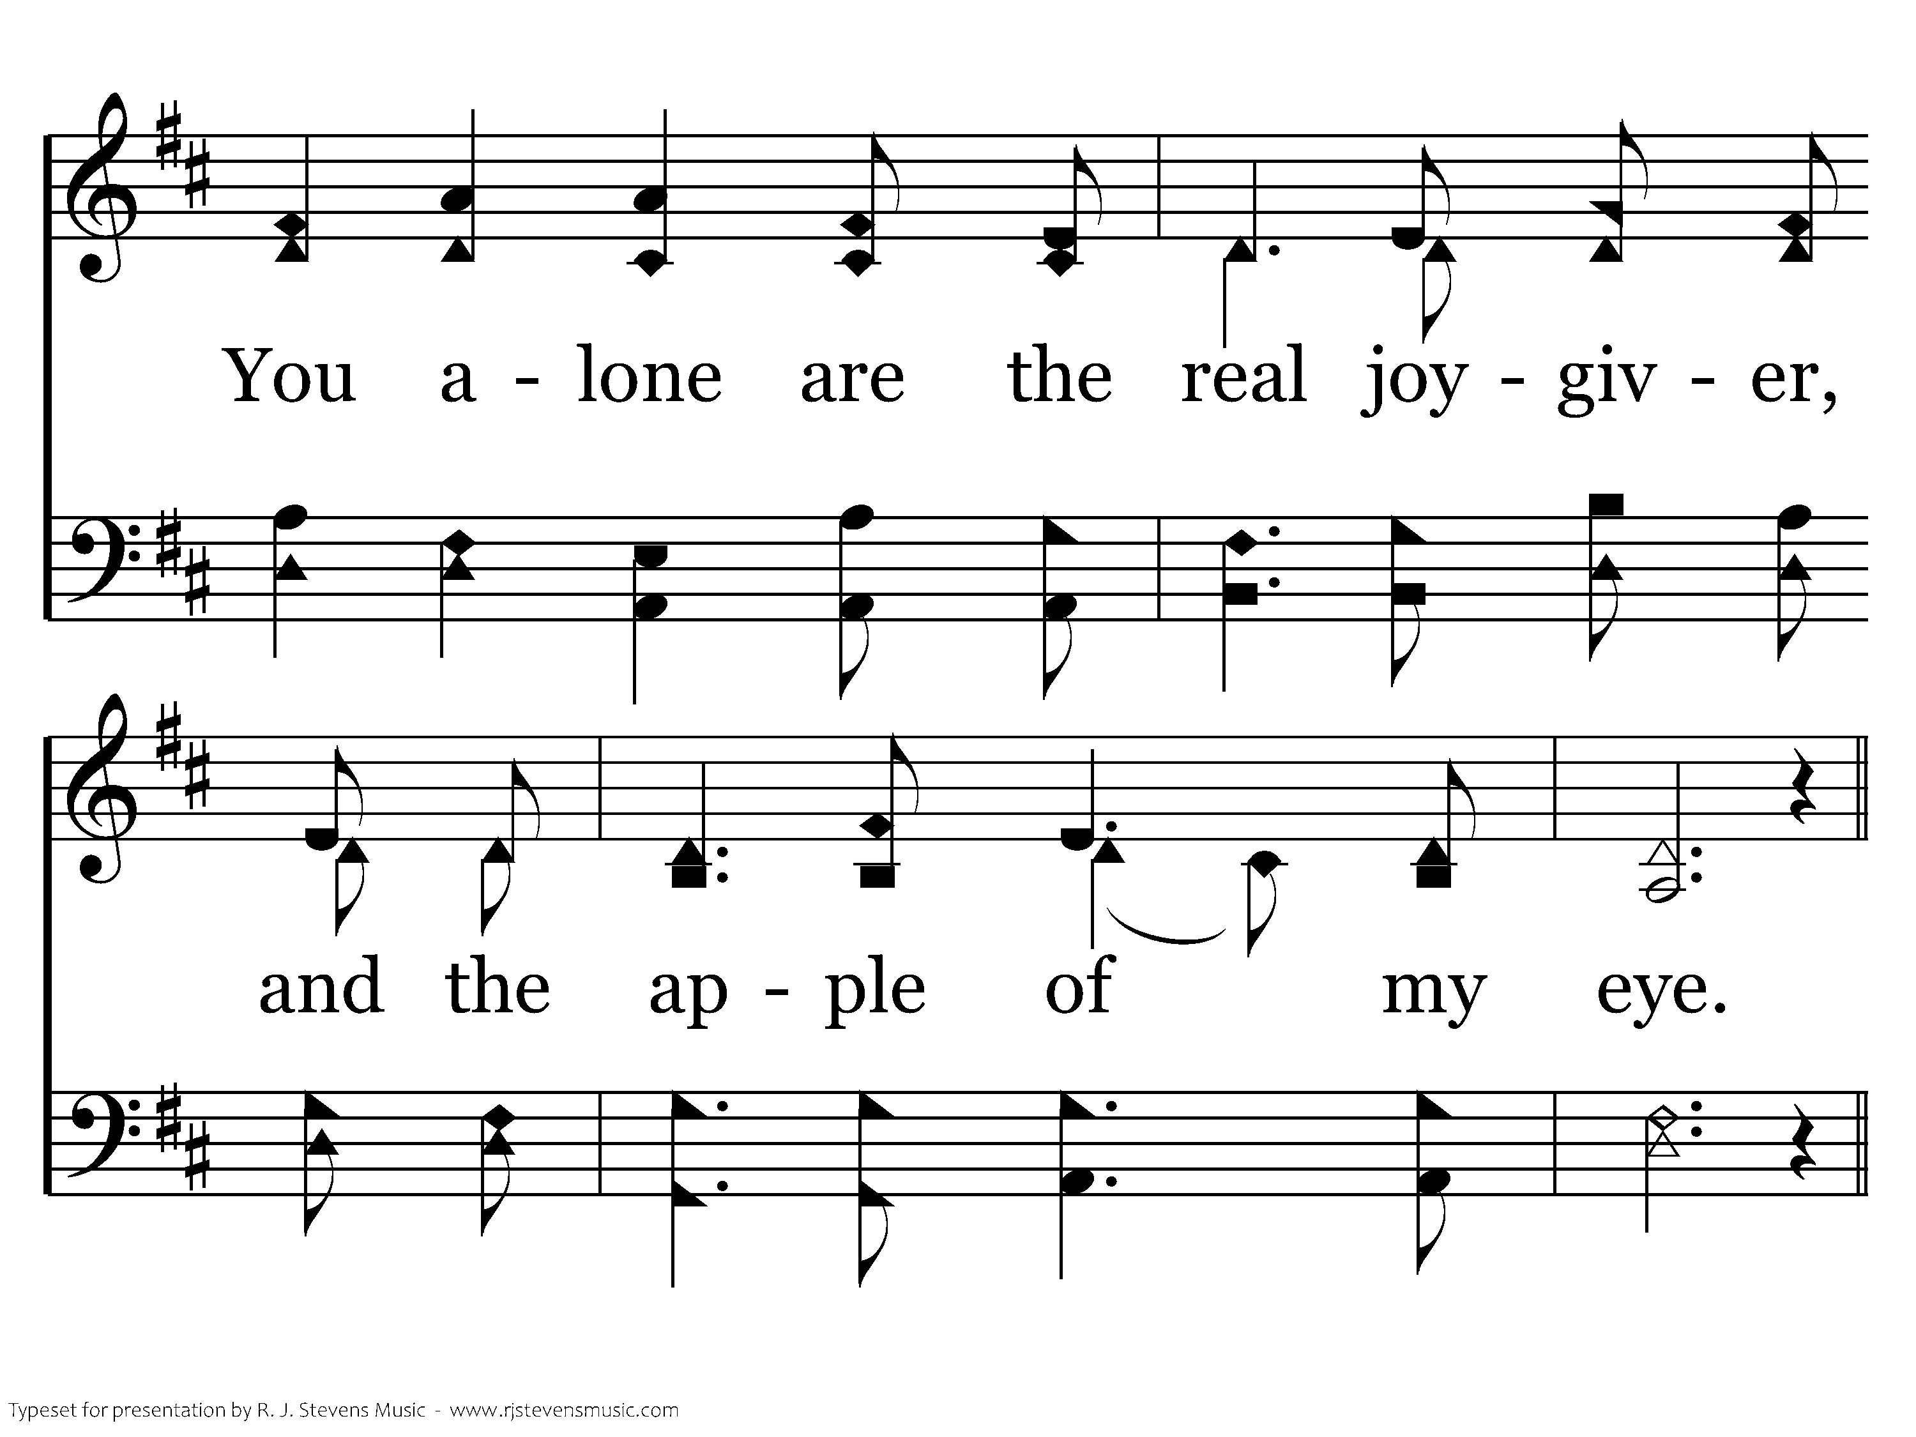
589 - As The Deer - 2.2

Slide 10
589 - As The Deer - C.1

Slide 11
589 - As The Deer - C.2
End of Song

Slide 12
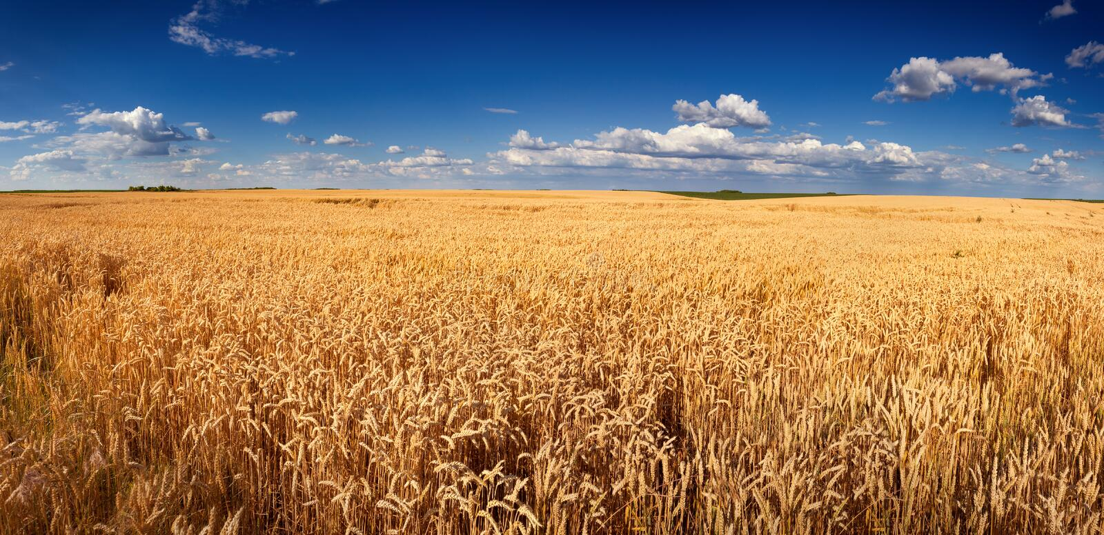
Reading of the Obituary
Caleb

Slide 13
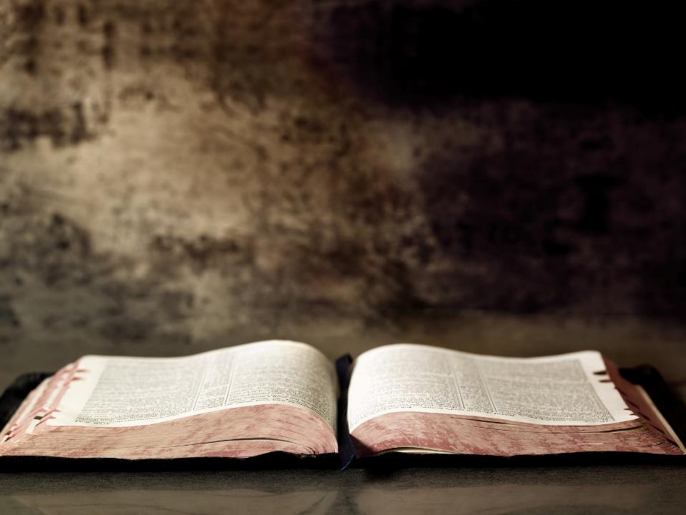
Eulogy
Jimmy

Slide 14
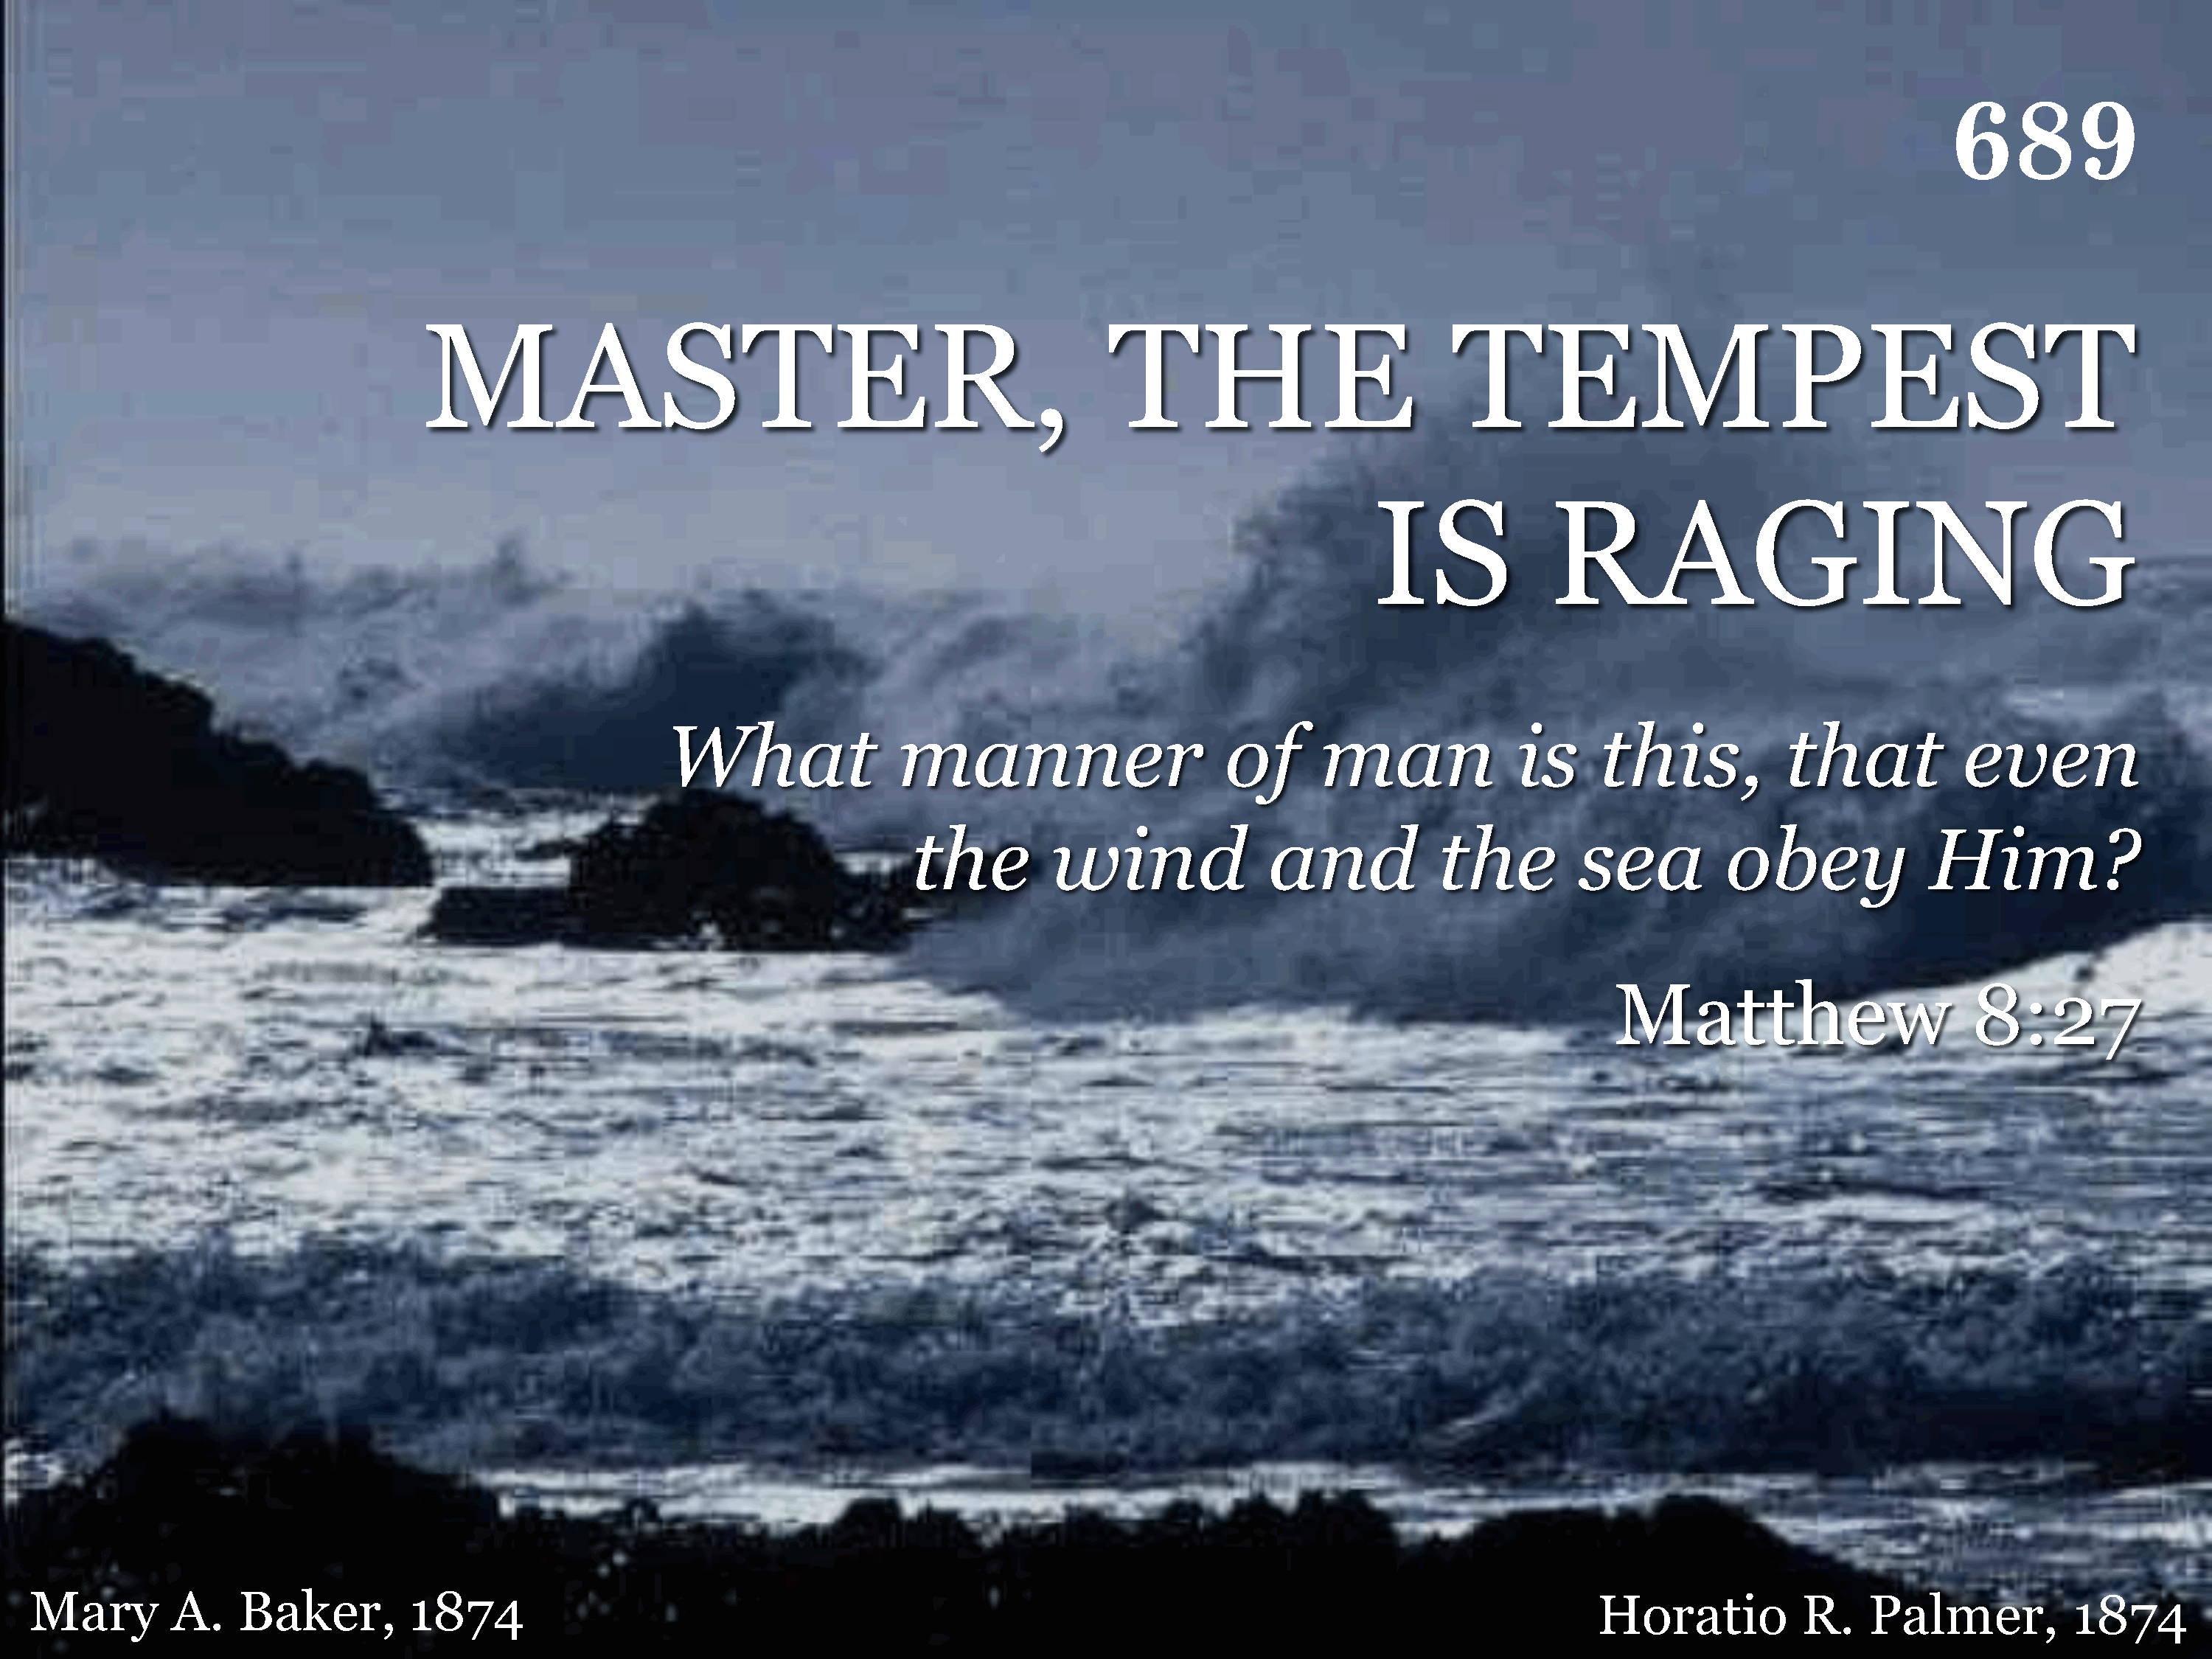
689 - Master, The Tempest Is Raging - Title

Slide 15
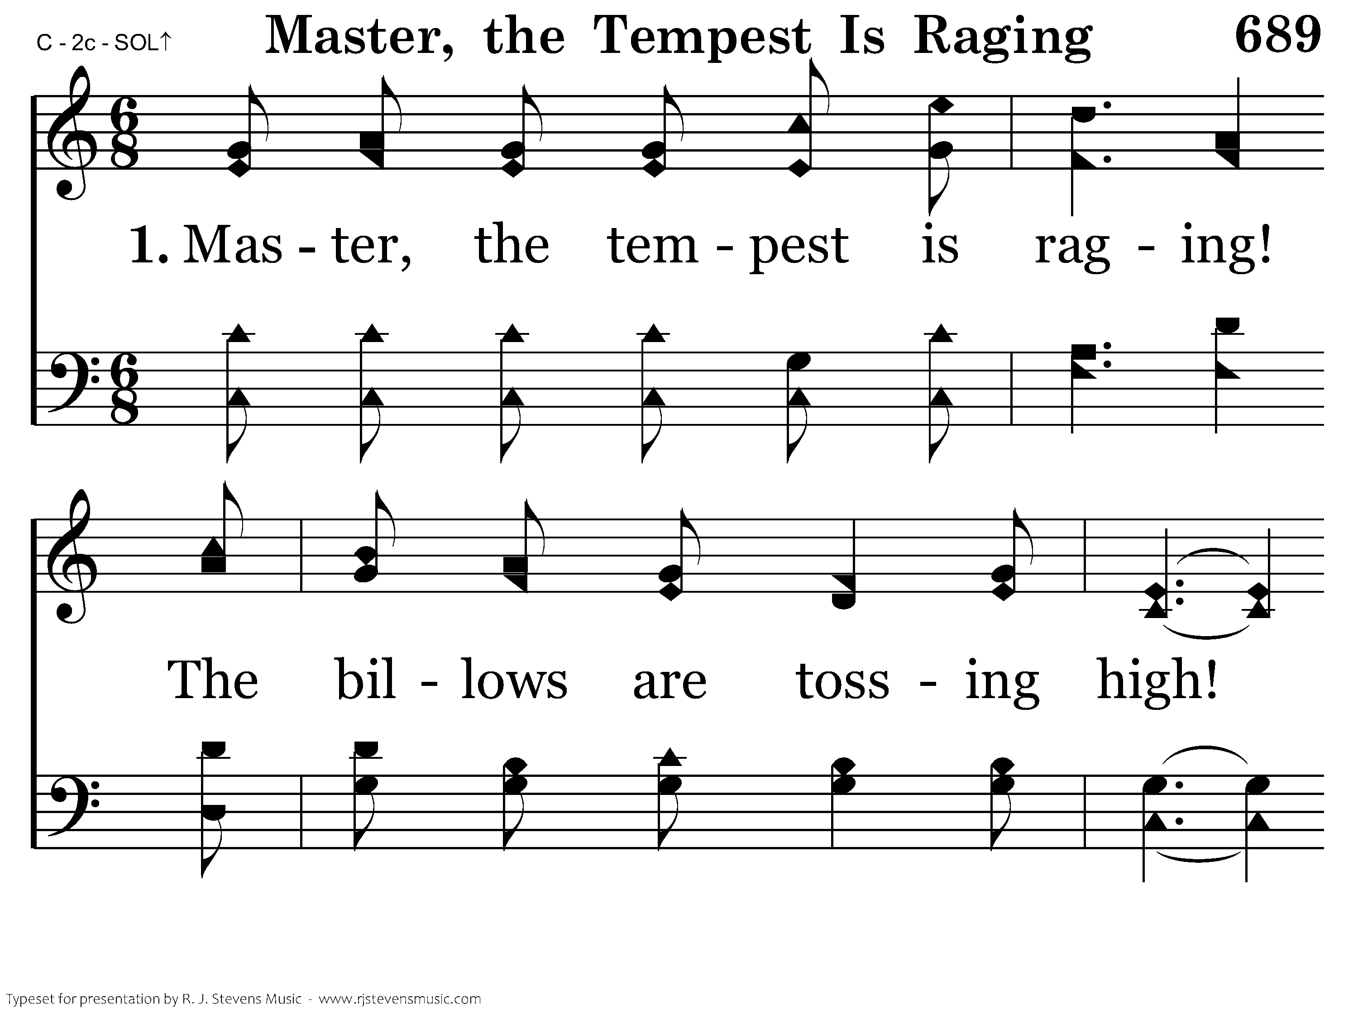
689 - Master, The Tempest Is Raging - 1.1

Slide 16
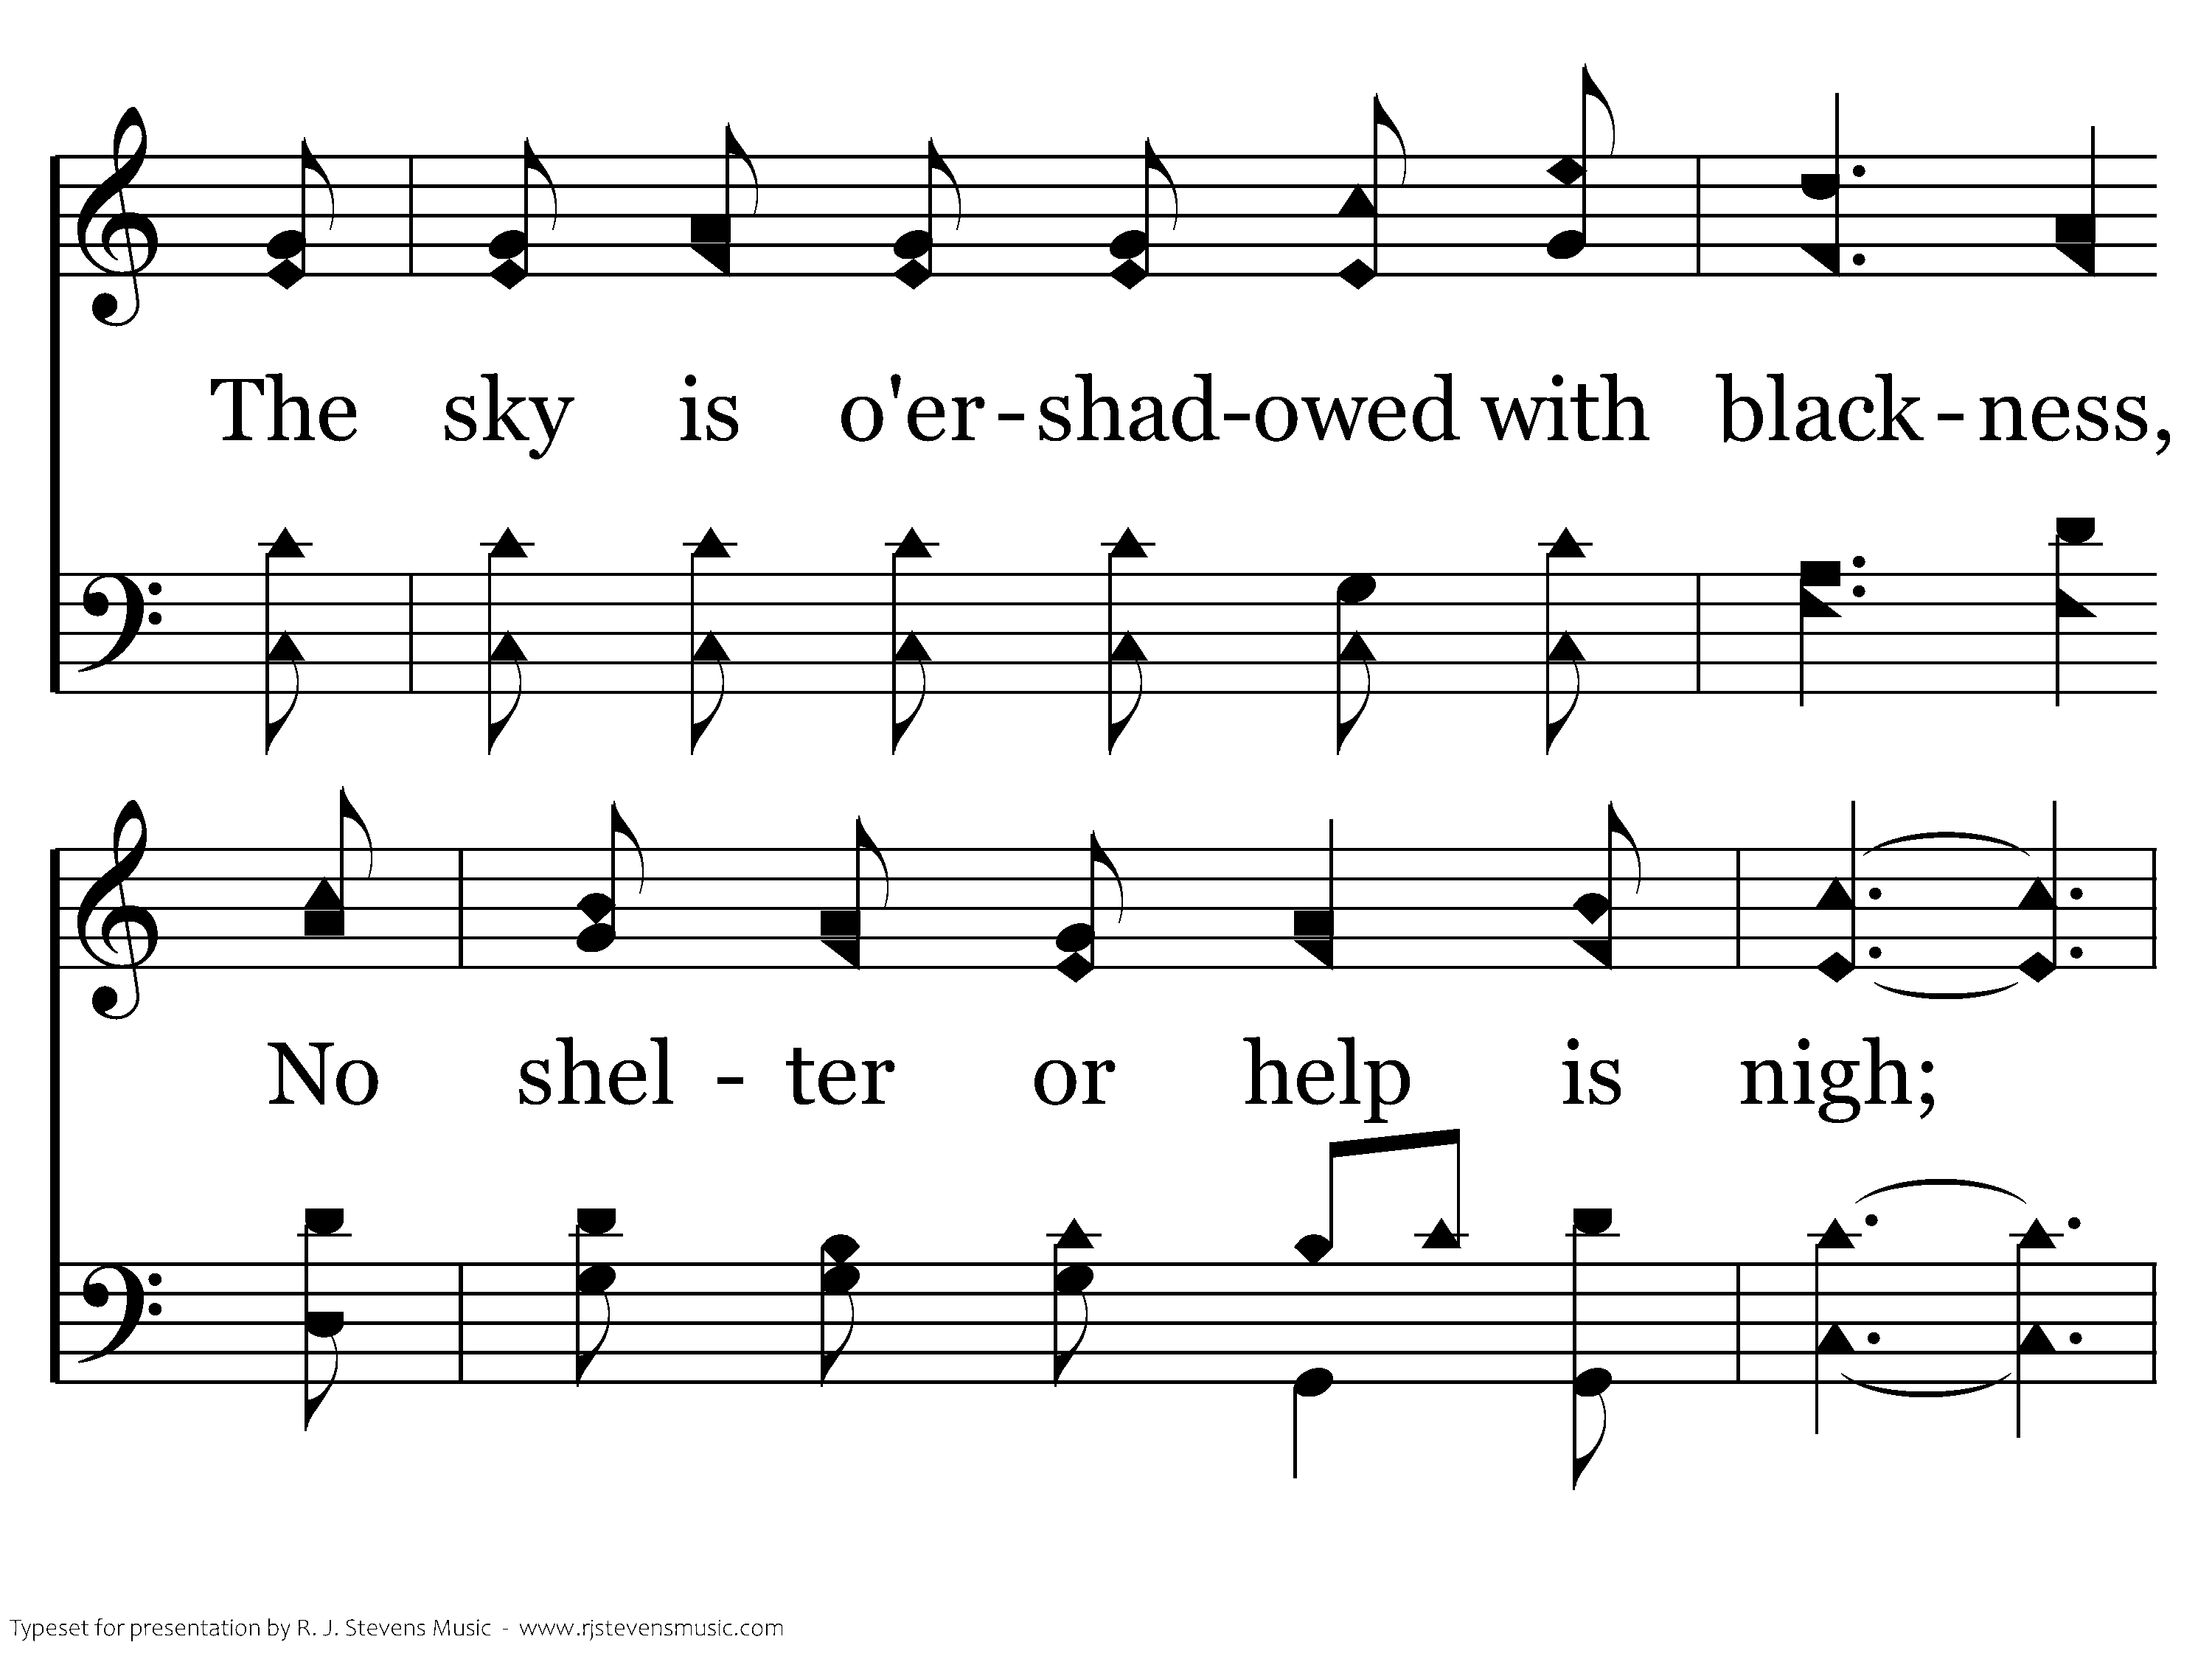
689 - Master, The Tempest Is Raging - 1.2

Slide 17
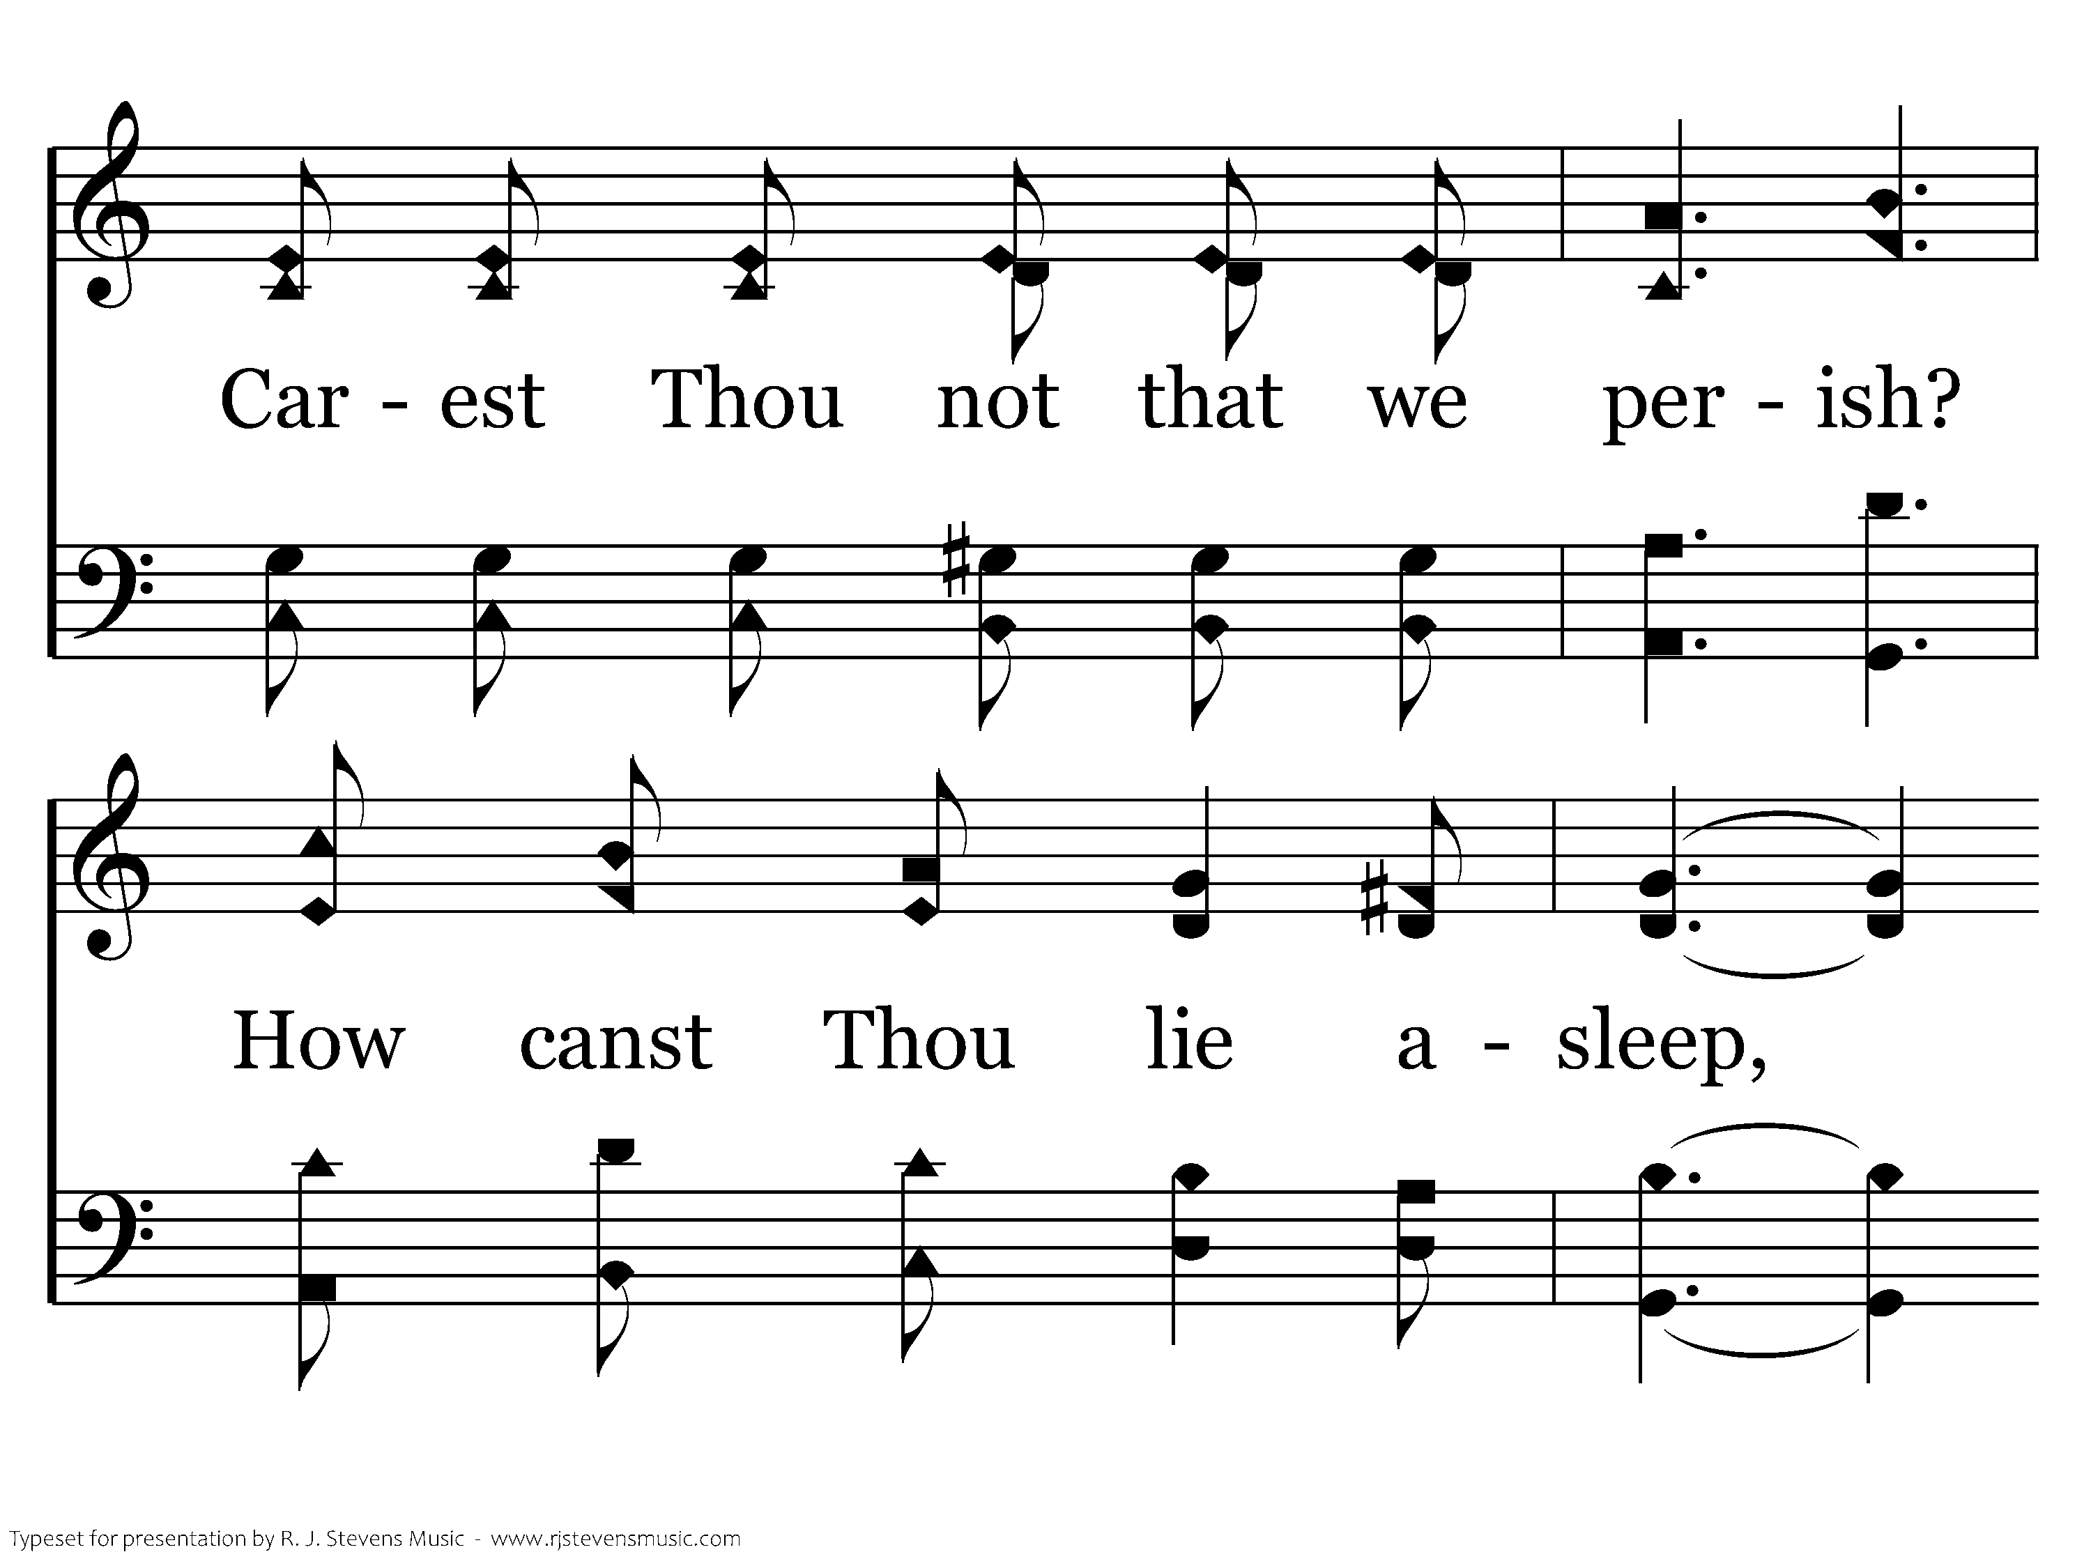
689 - Master, The Tempest Is Raging - 1.3

Slide 18
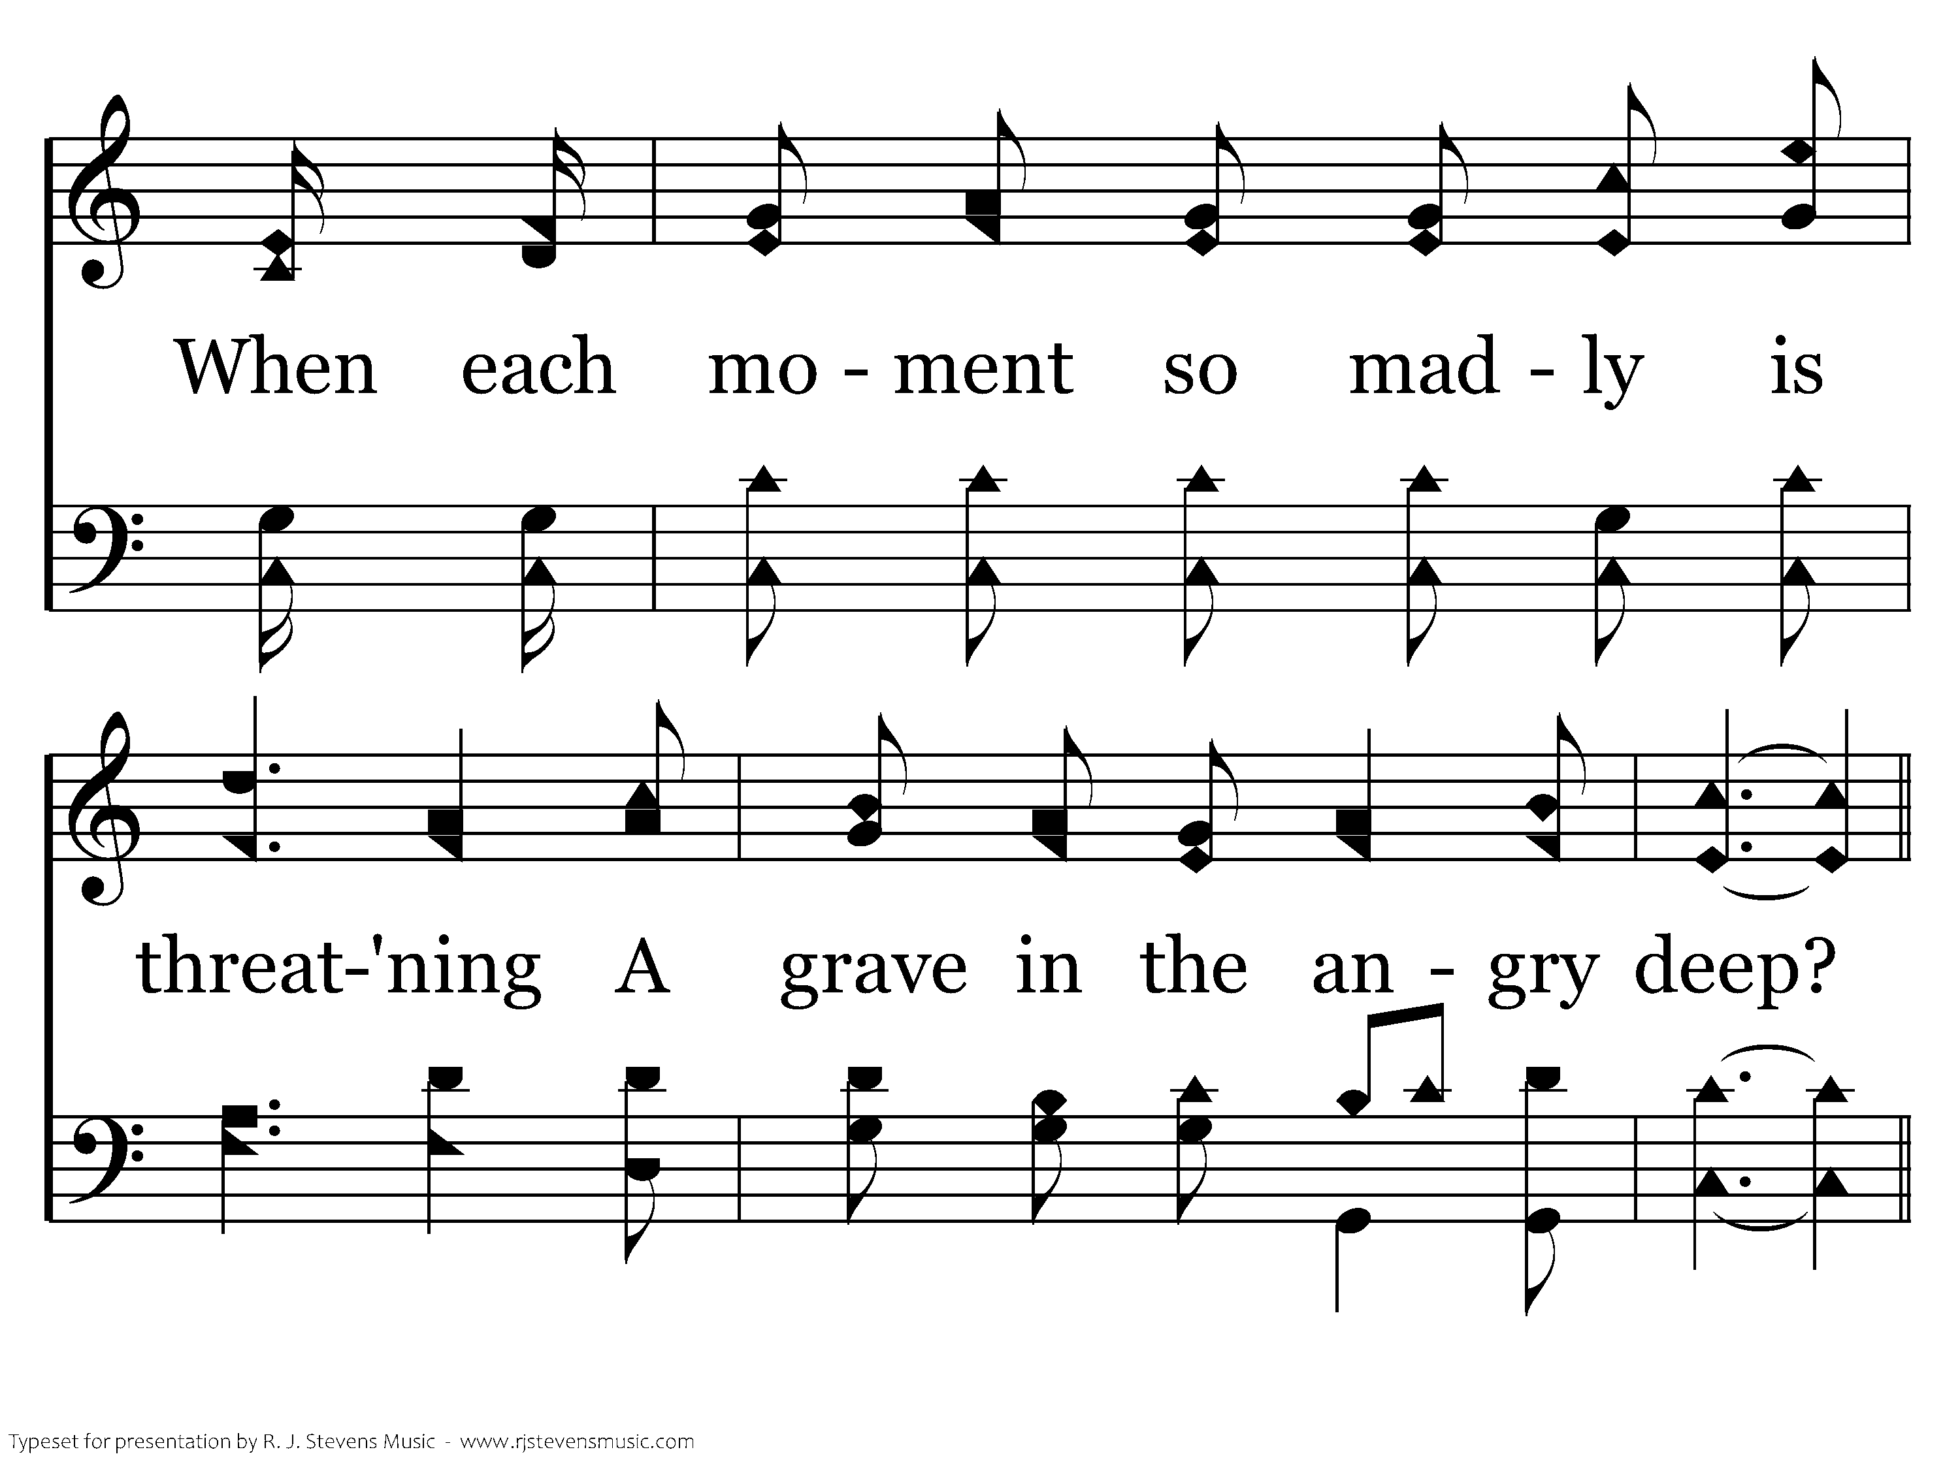
689 - Master, The Tempest Is Raging - 1.4

Slide 19
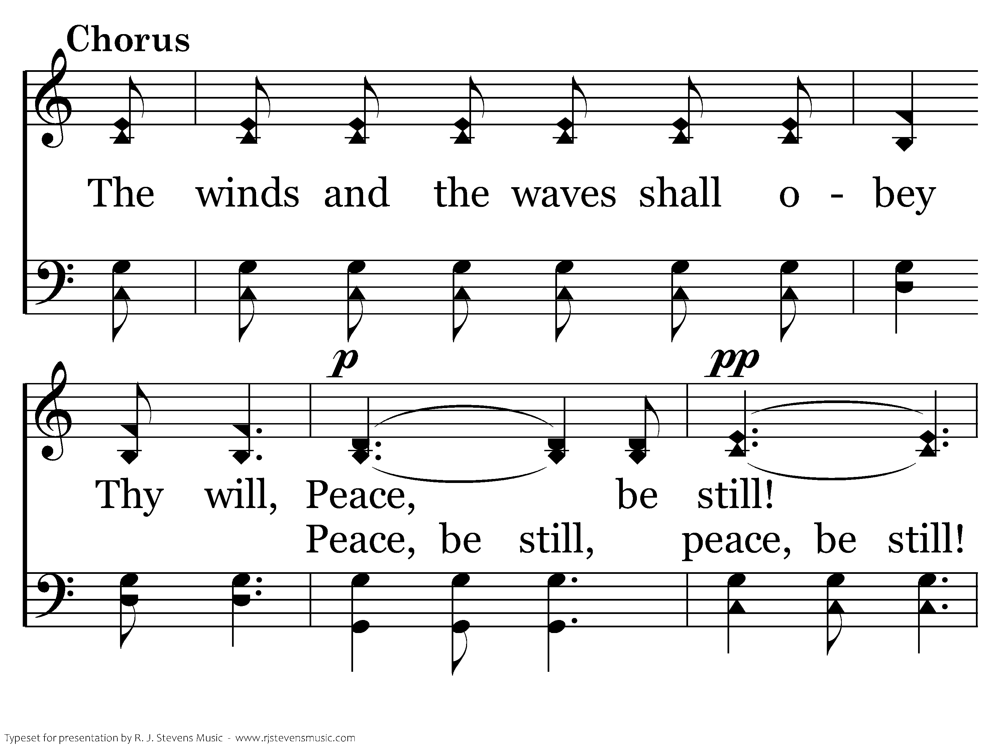
689 - Master, The Tempest Is Raging - C.1

Slide 20
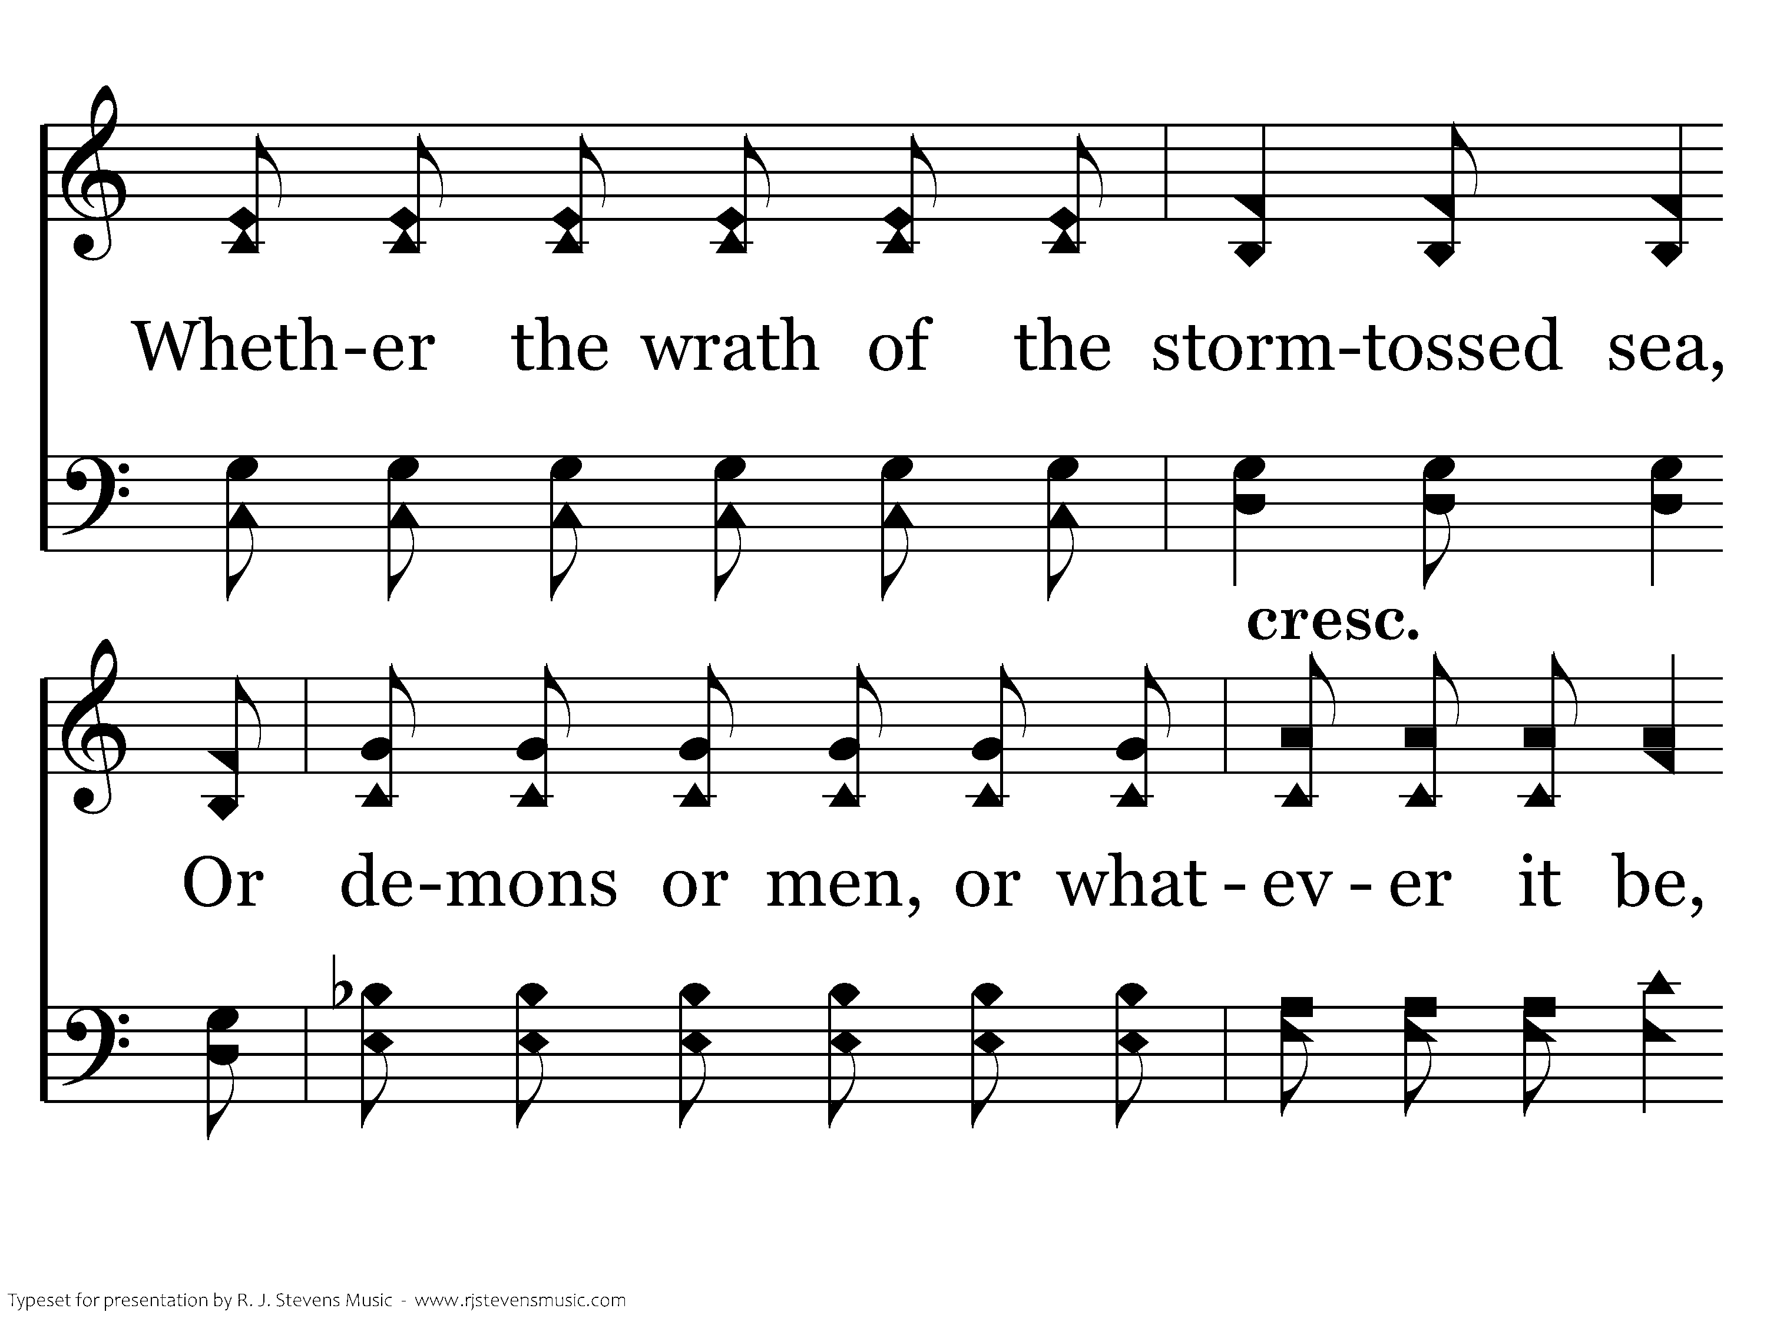
689 - Master, The Tempest Is Raging - C.2

Slide 21
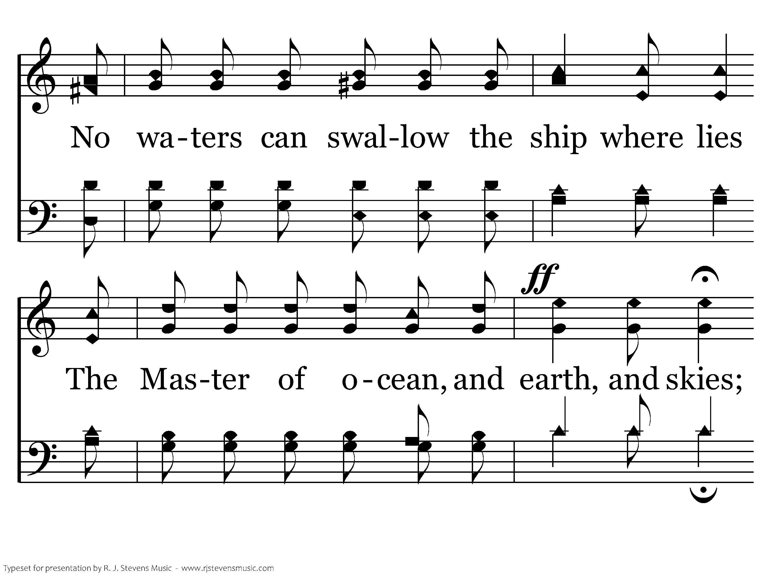
689 - Master, The Tempest Is Raging - C.3

Slide 22
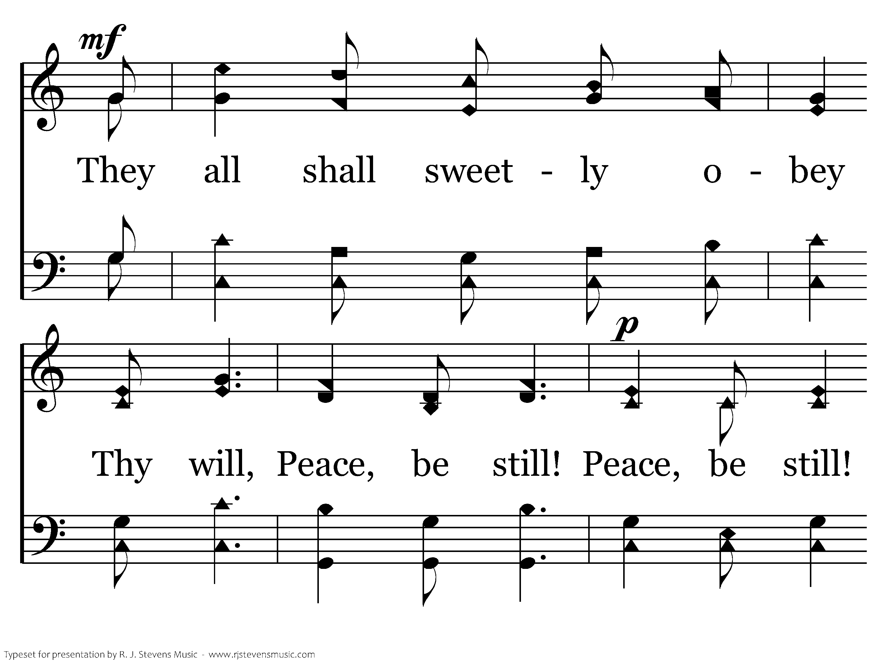
689 - Master, The Tempest Is Raging - C.4

Slide 23
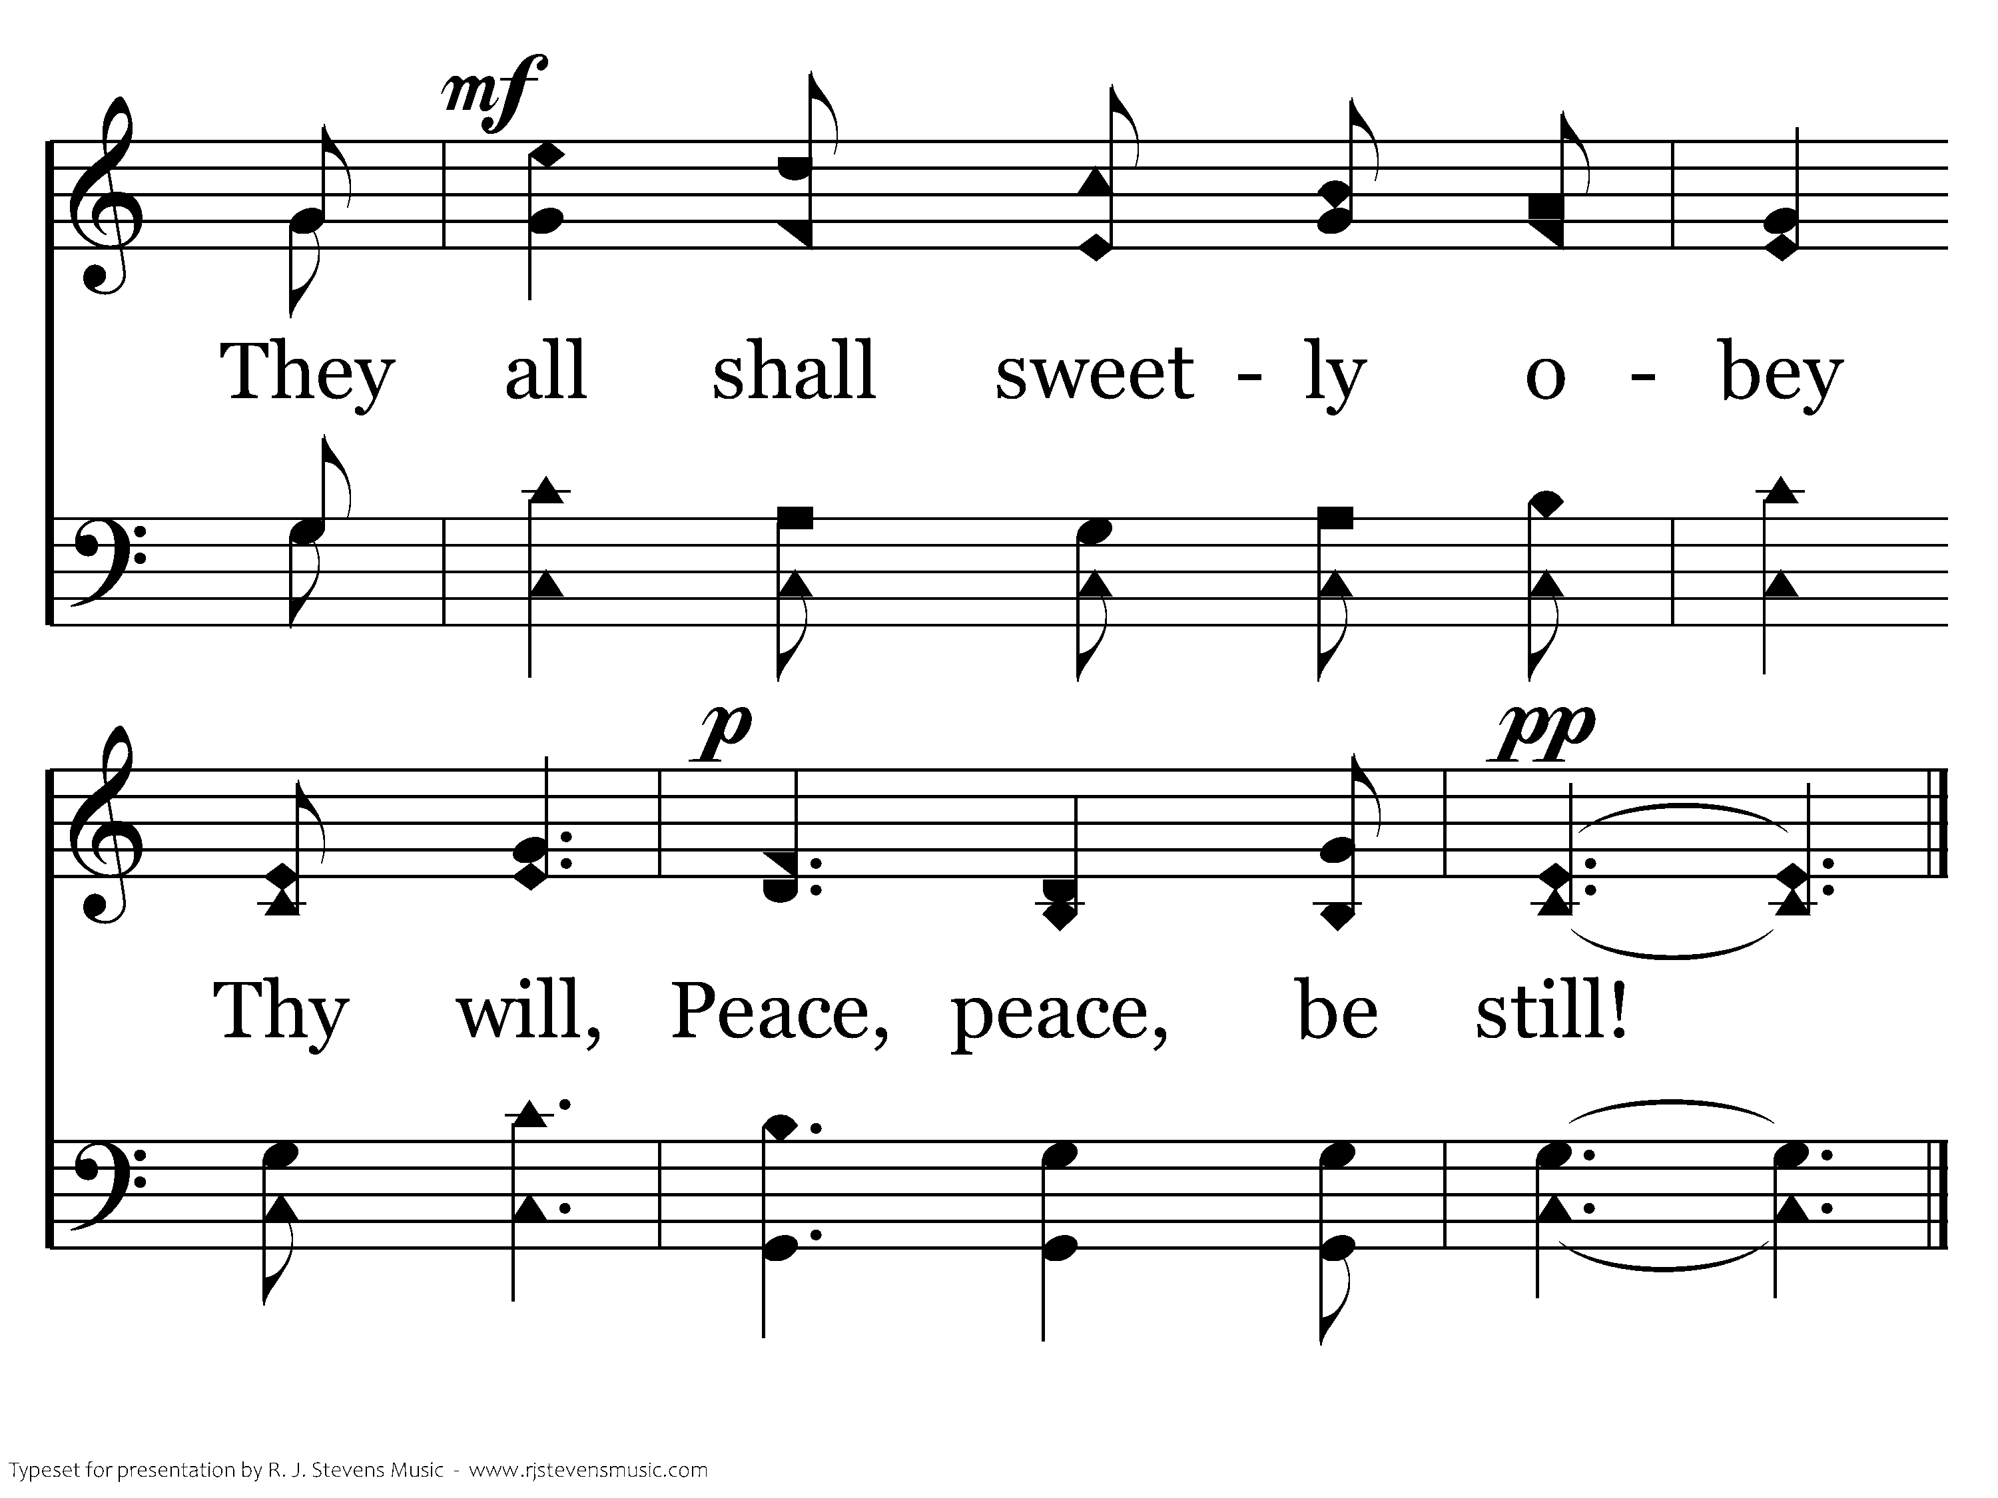
689 - Master, The Tempest Is Raging - C.5
End of Verse 1

Slide 24
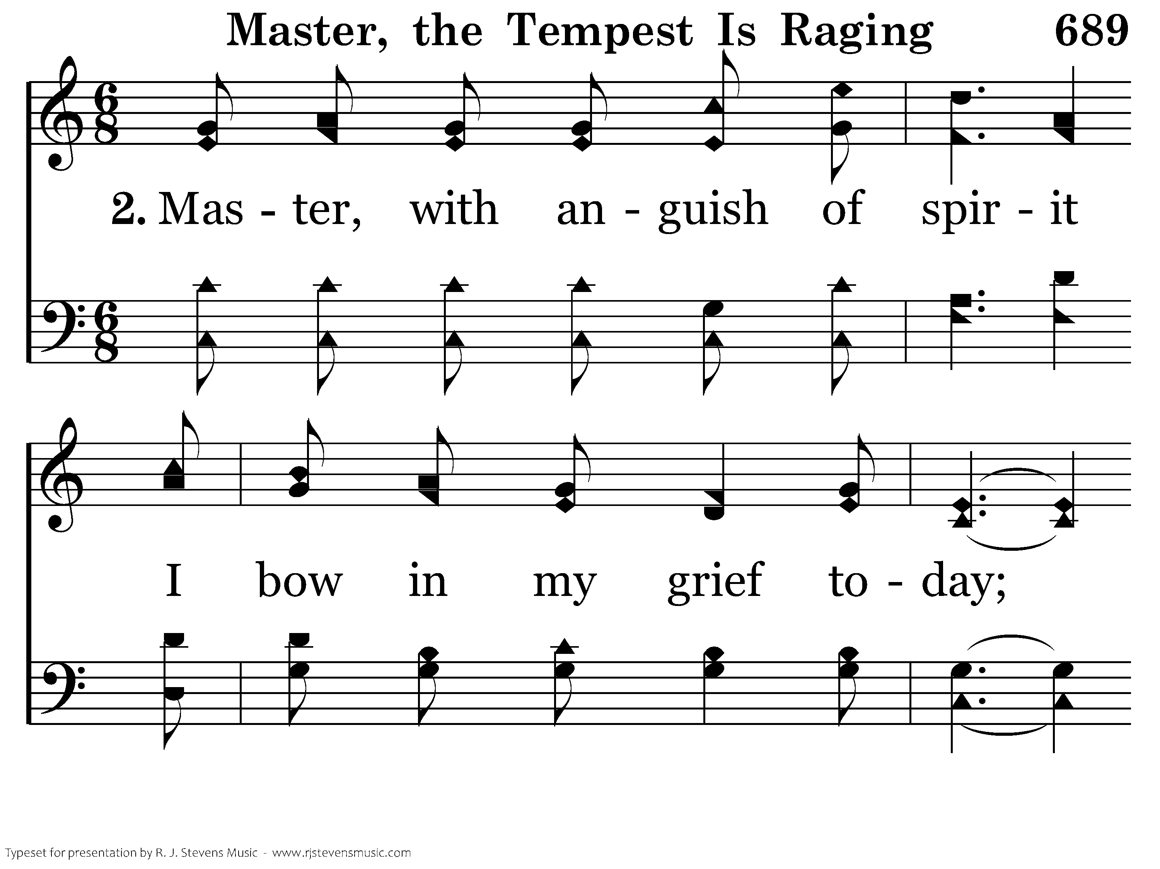
689 - Master, The Tempest Is Raging - 2.1

Slide 25
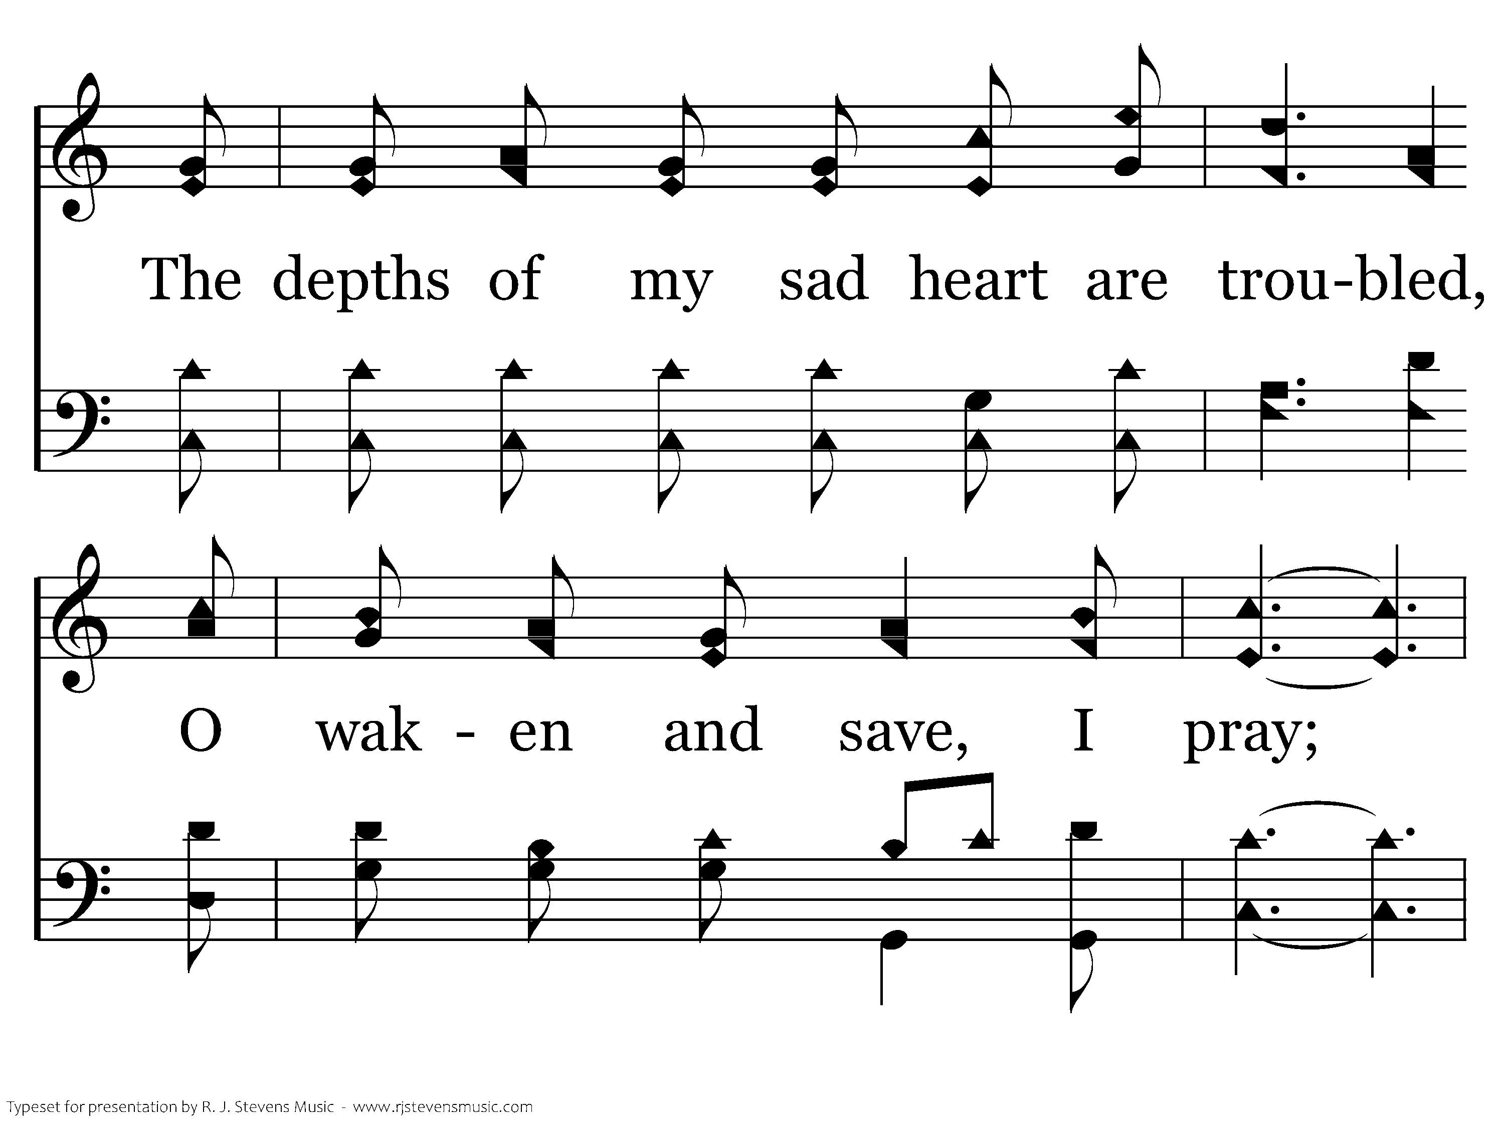
689 - Master, The Tempest Is Raging - 2.2

Slide 26
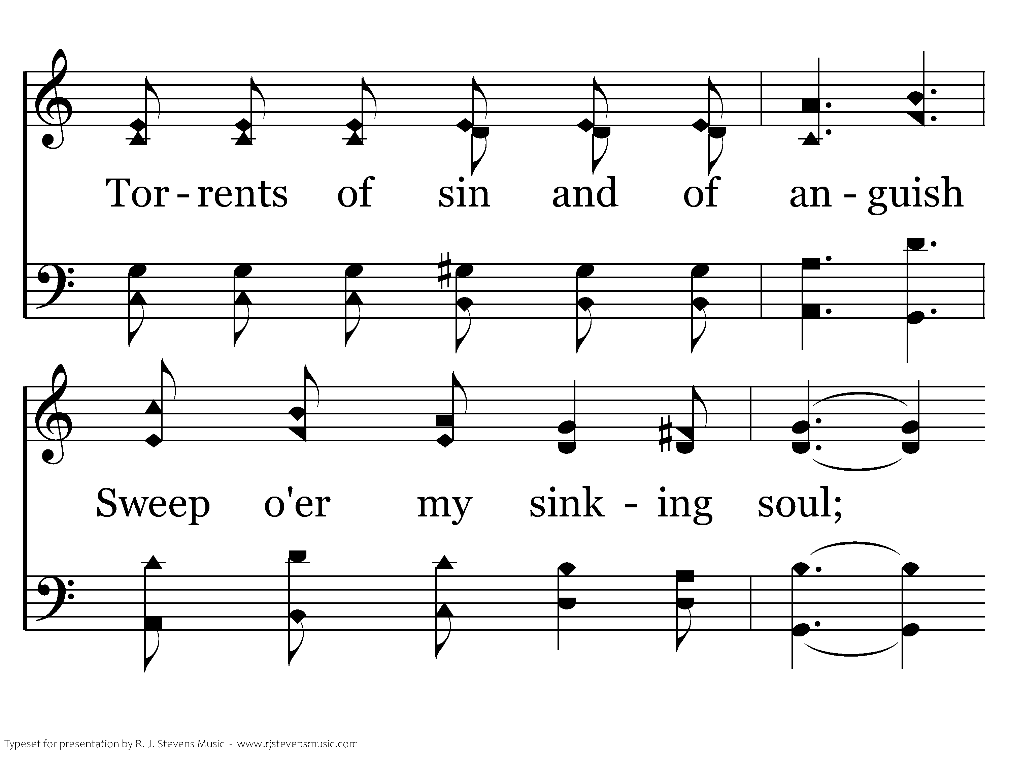
689 - Master, The Tempest Is Raging - 2.3

Slide 27
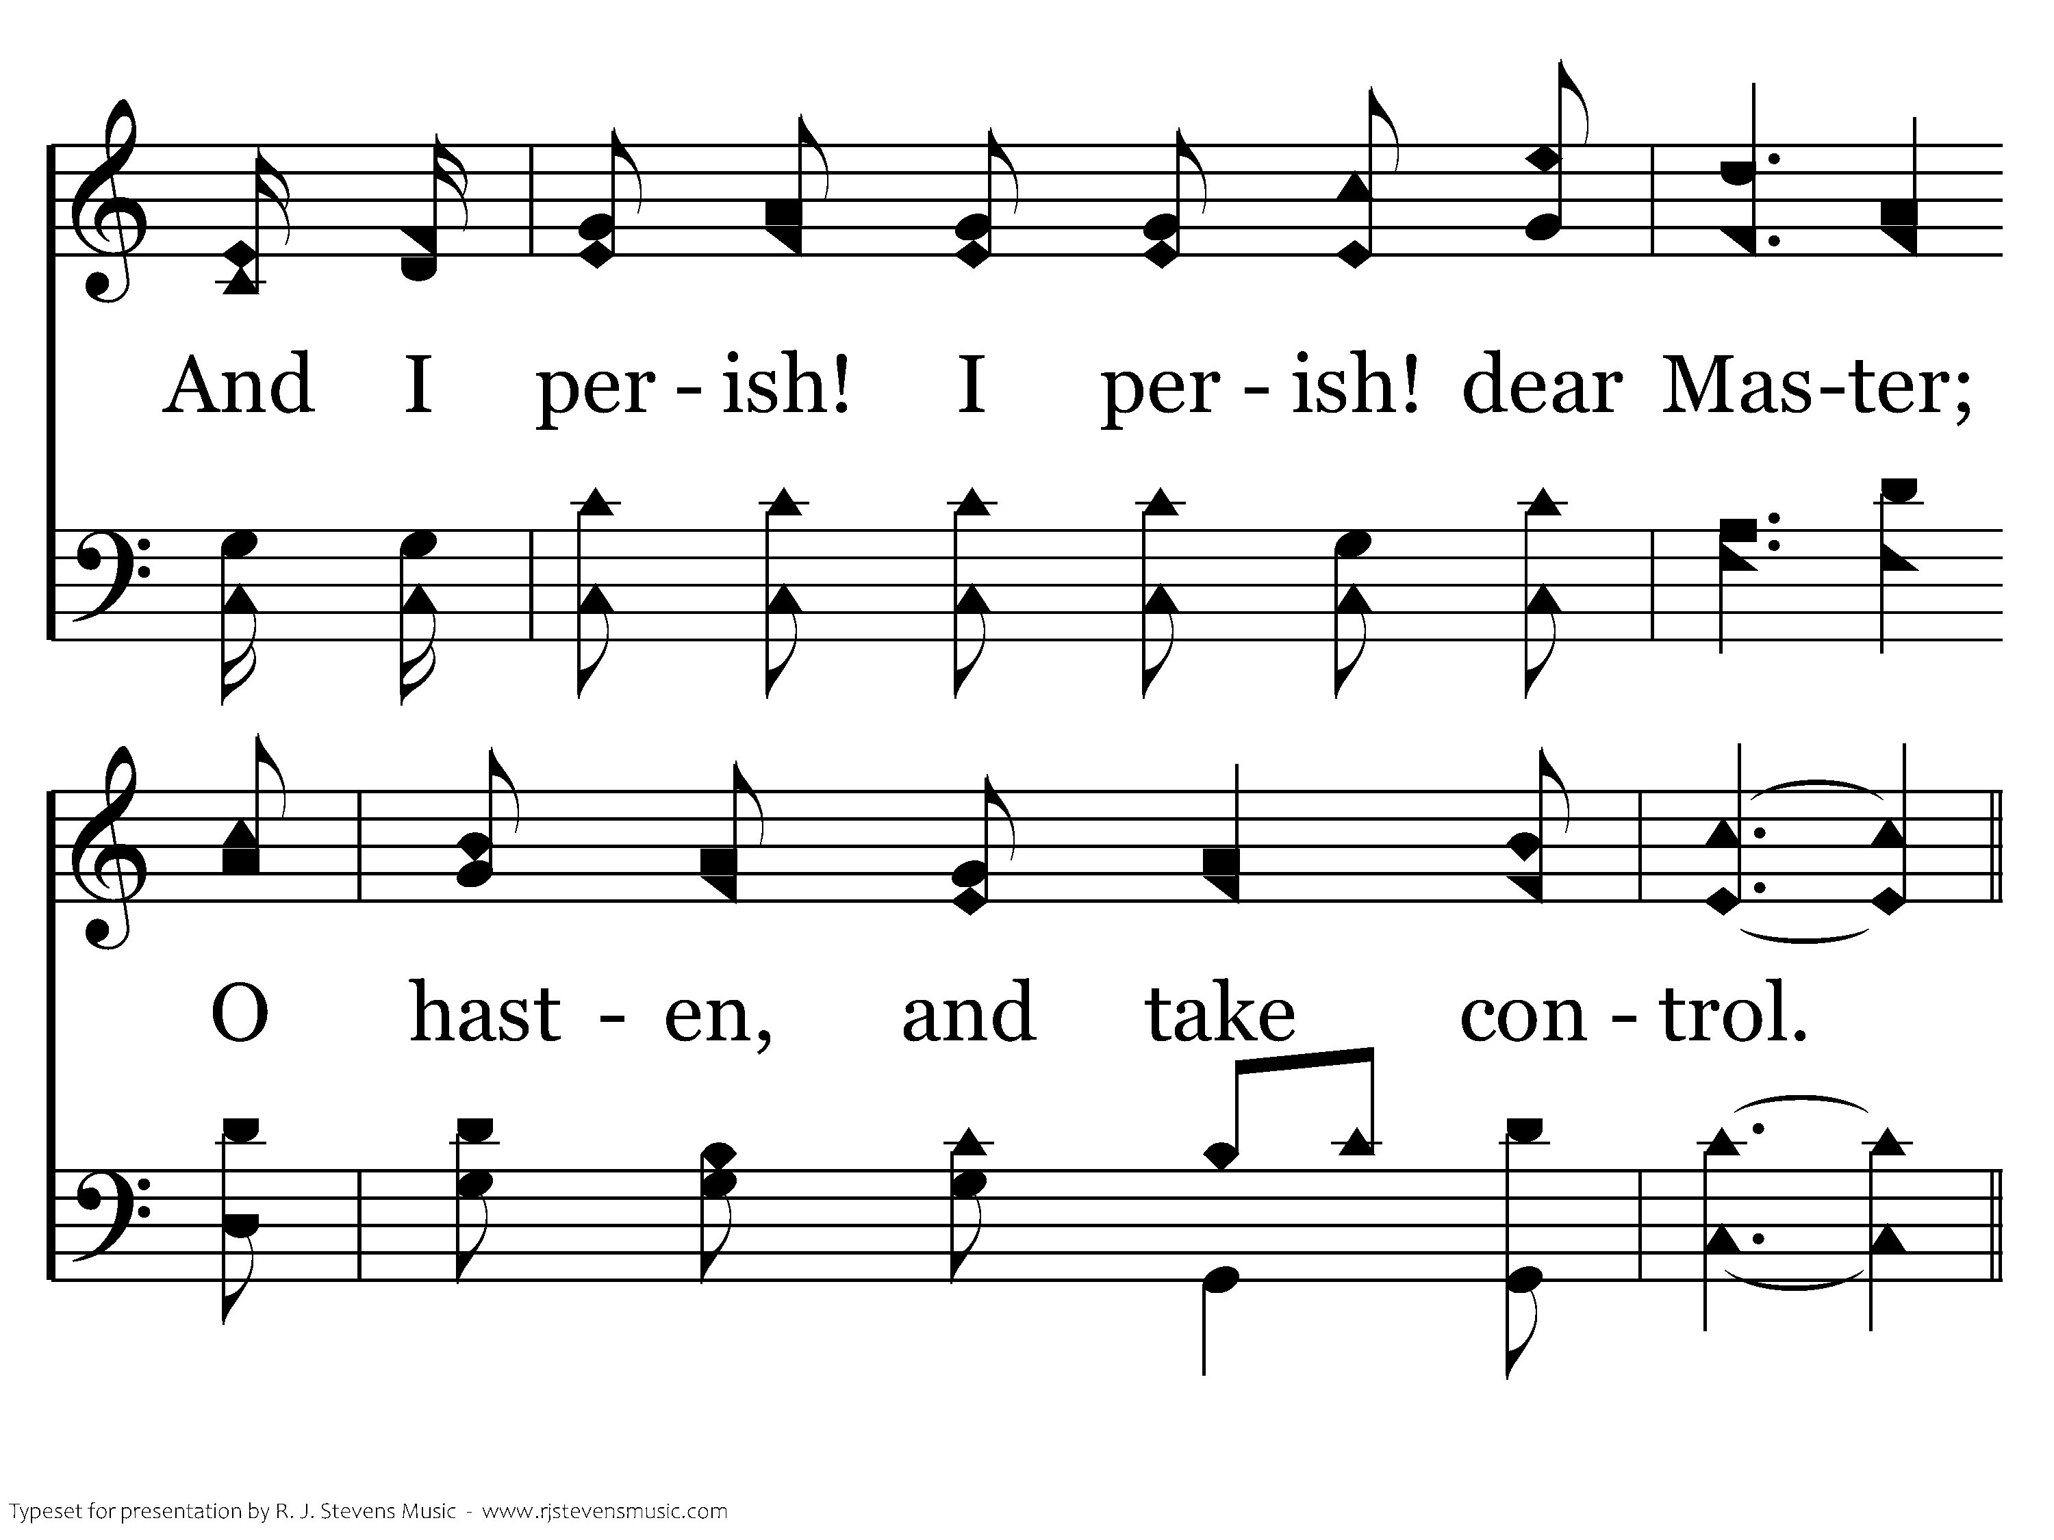
689 - Master, The Tempest Is Raging - 2.4

Slide 28
689 - Master, The Tempest Is Raging - C.1

Slide 29
689 - Master, The Tempest Is Raging - C.2

Slide 30
689 - Master, The Tempest Is Raging - C.3

Slide 31
689 - Master, The Tempest Is Raging - C.4

Slide 32
689 - Master, The Tempest Is Raging - C.5
End of Verse 2

Slide 33
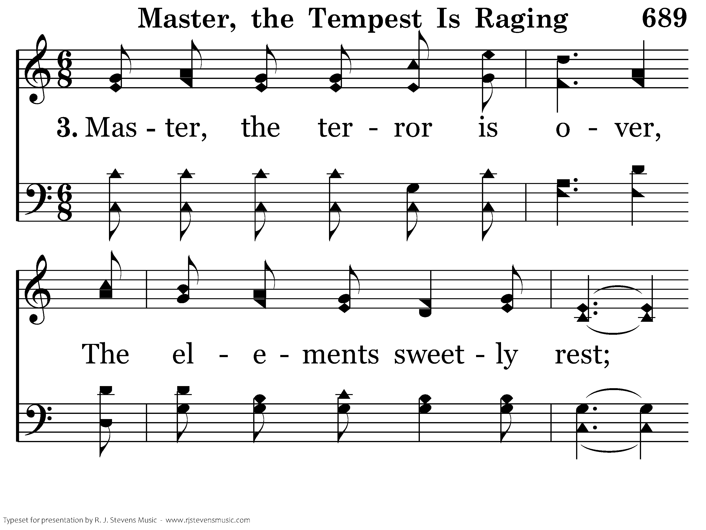
689 - Master, The Tempest Is Raging - 3.1

Slide 34
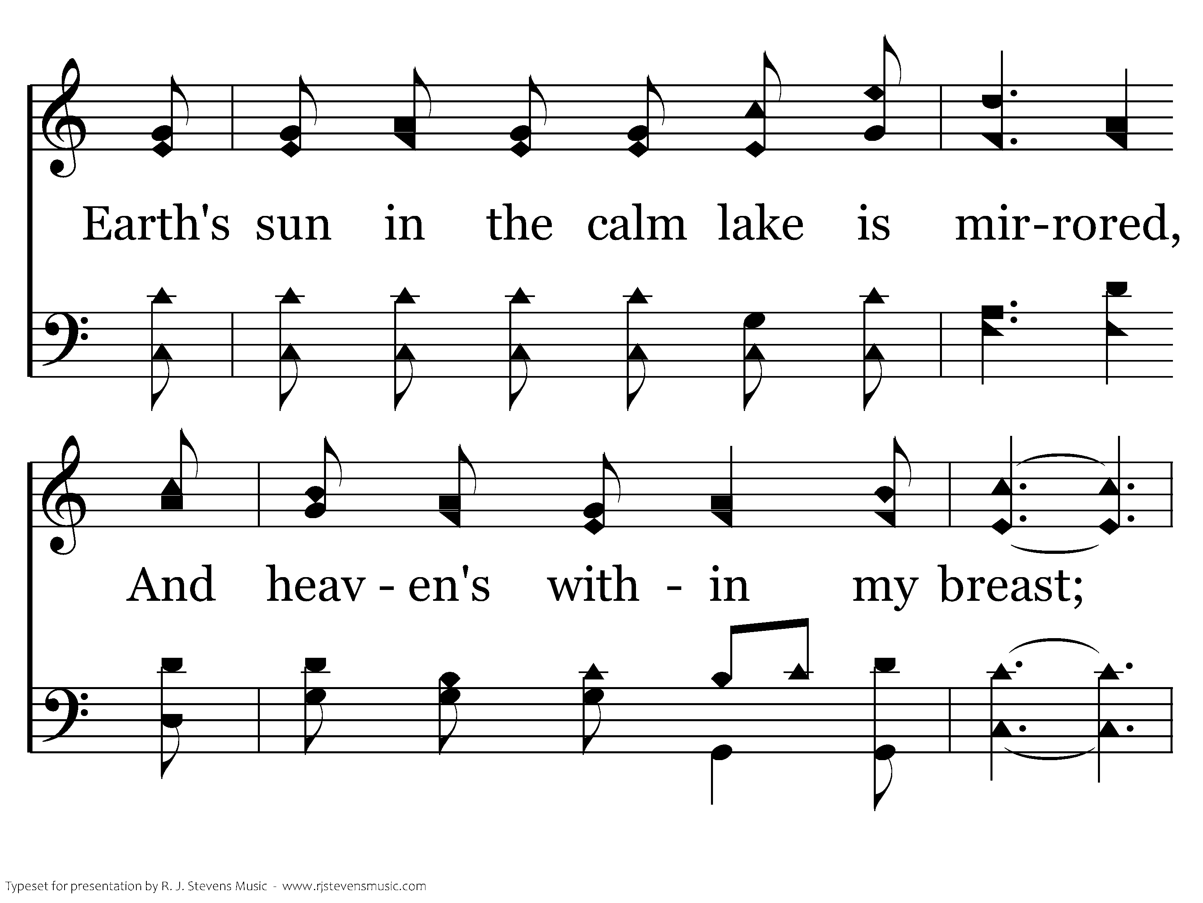
689 - Master, The Tempest Is Raging - 3.2

Slide 35
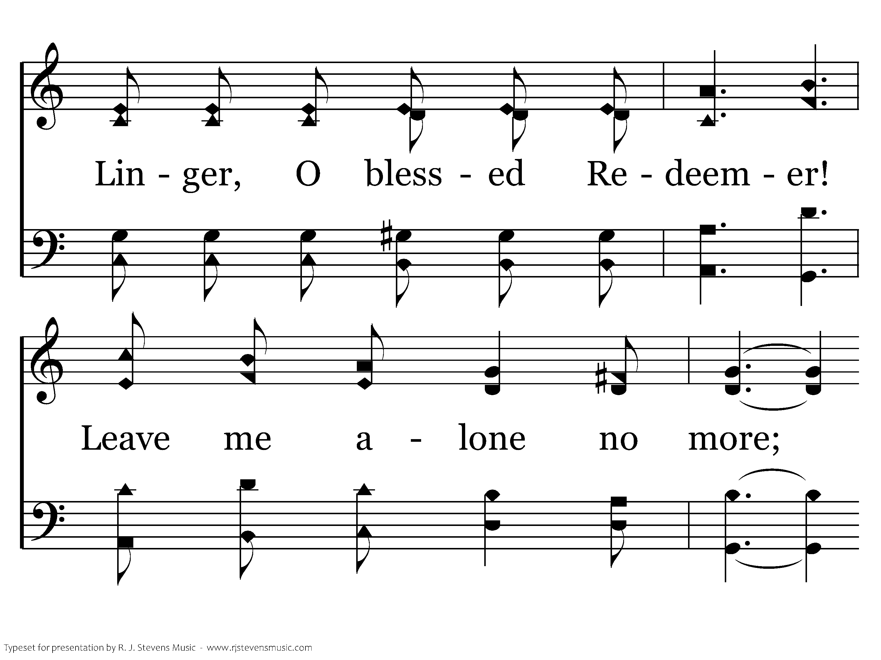
689 - Master, The Tempest Is Raging - 3.3

Slide 36
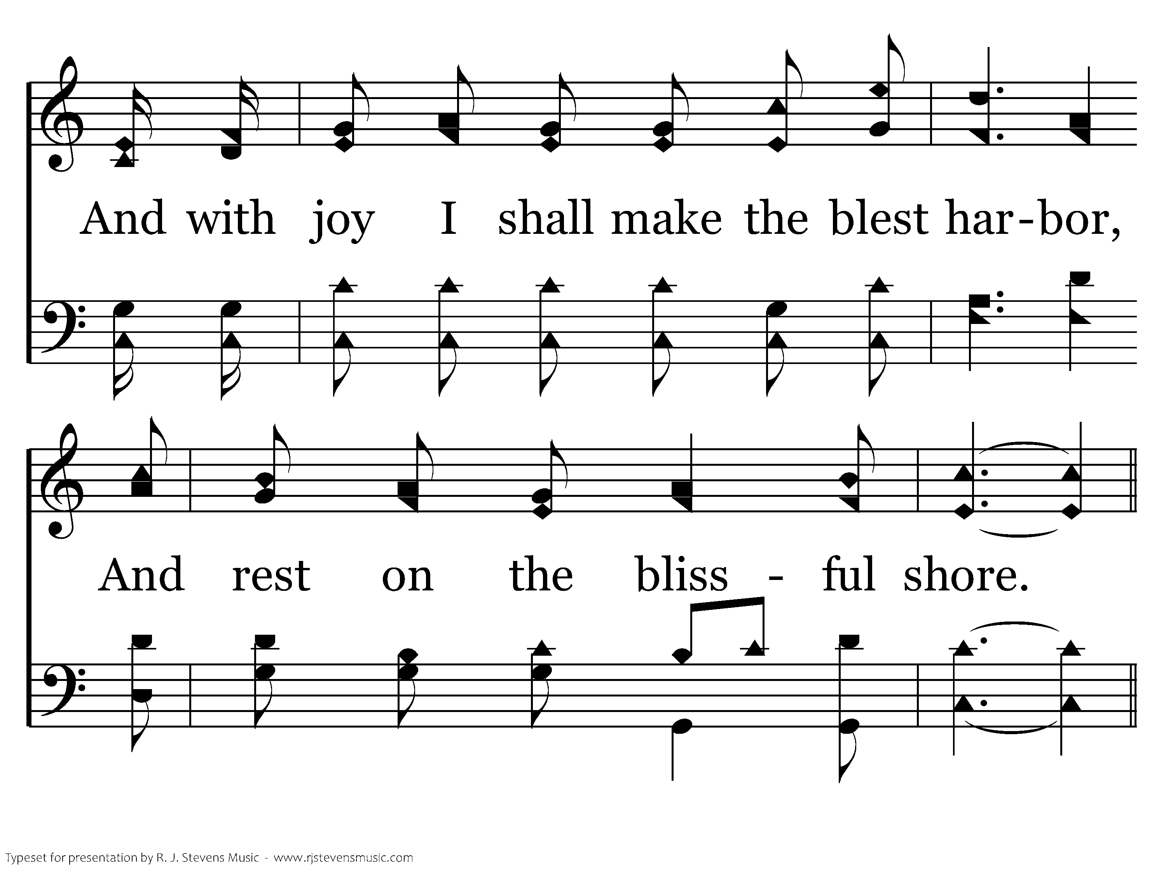
689 - Master, The Tempest Is Raging - 3.4

Slide 37
689 - Master, The Tempest Is Raging - C.1

Slide 38
689 - Master, The Tempest Is Raging - C.2

Slide 39
689 - Master, The Tempest Is Raging - C.3

Slide 40
689 - Master, The Tempest Is Raging - C.4

Slide 41
689 - Master, The Tempest Is Raging - C.5
End of Song

Slide 42
Invitation to Share stories about Prissy

Slide 43

Final Thoughts on Mom
Bridgett

Slide 44
Thank you for coming
Invitation to lunch at Jimmy’s
626 CR 948A
Alvin TX

