Slide 1
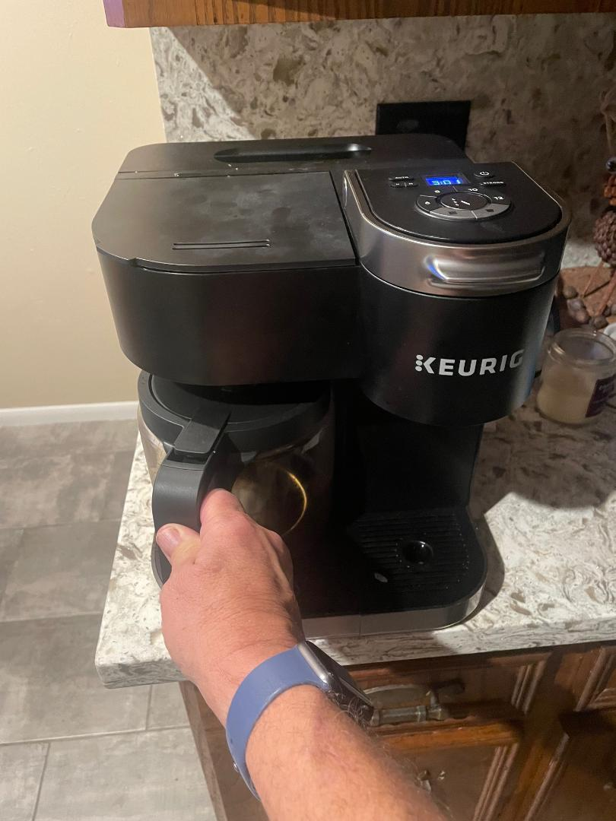

Slide 2
Better Things A Study of hebrews
Firm Until the End
Hebrews, Chapter 3
Wednesday, Dec 20,2023
Heb 3:13 “exhort one another daily, while it is called ‘Today’”

Slide 3
Outline of Hebrews
The Better Messenger: The Son
Heb 1:1 – 2:18
The Better Apostle
Heb 3:1 – 4:13
The Better Priest
Heb 4:14 – 7:28
The Better Covenant
Heb 8:1 – 9:28
The Better Sacrifice
Heb 10:1 – 10:31
The Better Way: Faith
Heb 10:32 – 12:29
Conclusion: The Practice of Faith
Heb 13:1 – 13:25

Slide 4
Hebrews 3:1-19 (1 of 2)
“consider the Apostle and High Priest of our confession, Christ Jesus”
Jesus was faithful like Moses
But Jesus was counted worthy of more glory than Moses
Moses was a servant in the house, but Jesus is the Son over His own house
We will be in Jesus’ house if we hold firm to the end
"Today, if you will hear His voice, do not harden your hearts as in the rebellion”
Your fathers tested and tried Me, even though they saw My works for 40 years
I was angry with that generation
They always go astray, and they have not known My ways
They shall not enter My rest

Slide 5
Part 1
Verses one through six.
Moses was one of the most significant figures in the mind of a Jew, perhaps second to Abraham. Any appeal to turn back to Judaism would be an appeal to follow Moses. Hence the need to demonstrate that Christ is far above Moses.
Here the Hebrew Christians are addressed as partakers of the heavenly calling. Their call to salvation was from heaven and pertained to going to heaven. The older religion was an earthly calling with an earthly inheritance. Christianity is a spiritual religion and involving a heavenly calling with a heavenly and spiritual inheritance as it’s ultimate object.

Slide 6
Vv 1-2
Christ is the faithful, apostle and high priest in his house. The reader is urged to consider Jesus the apostle and high priest. An apostle is one sent forth. Thus, Jesus is called an apostle, and that he was sent by God (Gal 4:4). He is our high priest as seen in the previous chapter. The apostle and high priest are not necessarily separate offices. He was sent (thus an apostle) as a high priest.
Paul here means to say that the Lord Jesus, under the new dispensation, filled the place of Moses, and of the high priest, under the old, and the office of apostle and high priest, instead of now being separate, as it was between Moses and Aaron, under the old dispensation was now blended in the Messiah.
The reader is told that Jesus is an apostle and high priest of their confession they had held to in publicly acknowledged who he was. The Full Meaning of this confession had obviously been missed by some of the readers, but this is not at all surprising, for it carried with the results which were a revolutionary nature for the Jewish mind.
Moses was never called an apostle, but he was one that he was sent by God.
Ex 3:10,13,15,4:28,5:22,7:16 Acts7:35.
He was faithful as God servant (NumGod’12:7). The comparison is obvious. Both Moses and Jesus are said to be faithful in God's house.

Slide 7
Vv 3-4
Christ is the builder of his house. Christ is worthy of more glory than Moses just as a builder has more glory and honor than the house. God is the builder of all things. This gives us evidence of the deity of Christ.He is the builder, but God is said to be the builder. Thus Jesus Christ is God! Moses was in God’s, but Christ is the builder of God’s house thus he is superior.
Vv 5-6
Christ is the son over his house. Moses was a faithful servant in God‘s house. His service and work served as a testimony, pointing to better things. Moses was involved in the preparation, but Christ was the fulfillment. Christ, the exalted position of the son over his own house. The people of God are that house of God, but conditioned upon holding fast and remaining firm to the end.

Slide 8
Hebrews 3:1-19 (2 of 2)
“Beware, brethren, lest there be in any of you an evil heart of unbelief in departing from the living God”
Exhort one another daily (Today)
Lest any of you be hardened by the deceitfulness of sin
We have become partakers of Christ, IF we hold steadfast to the end
Israel heard, but rebelled
God was angry with them for 40 years because they sinned
Those that did not obey did not enter His rest
They did not enter because of their unbelief

Slide 9
VV 7-19 Don’t Harden Your Heart
Here the Author begins with a warning against hardening the heart and rebelling like Israel old did under Moses.
The writer quote, psalms 95:7-11
And attributes that to the holy Spirit. This Psalm pleads for obedience today lest the heart becomes Harden. To refuse or delay obedience has a hardening effect on the heart.

Slide 10
Psalm 95
1 Oh come, let us sing to the Lord; let us make a joyful noise to the rock of our salvation! 2 Let us come into his presence with thanksgiving, let us make a joyful noise to him with songs of praise! 3 For the Lord is a great God, and a great King above all gods. In his hand are depths of the earth; the heights of the mountains are his also. 5 The sea is his, for he made it, and his hands formed the dry land. 6 Oh come, let us worship and bow down; let us kneel before the Lord, our Maker! 7 For he is our God, and we are the people of his pasture, and the sheep of his hand. 8 Do not harden your hearts, as at Menbah, as on the day at Massah in the wilderness.9 When your fathers put me to the test and put me to the proof, though they had seen my work. 10 For forty years I loathed that generation and said, “They are a people who go astray in their heart and they have not known my ways.” 11 Therefore I swore in my wrath, “They shall not enter my rest.”

Slide 11
1. Identify and briefly describe the 2 parts of Psalms?
2. For what reasons does God “loath that generation?
3. What is God’s rest?

Slide 12
1. Identify and briefly describe the 2 parts of Psalms?
Praise and worship God
2. For what reasons does God “loath that generation?
Harden their hearts and went astray
3. What is God”s rest?
Promise land

Slide 13
Part 2
They harden their heart VV 7–9 this psalm points to Israel’s rebellion in the wilderness when they murmur against Moses and the Lord, because they had no water (ex 17:1-7) There in the wilderness they put God to the test by constantly complaining and rebelling although they witnessed God‘s work for 40 years.(num 14:22)
Vv10-11Because they harden their hearts, and did not obey. God‘s anger was stirred. They were always going astray God said they have not known
my ways. Thus he swore that they would not enter into their rest in the land of Canaan(num 14:21-24)
Since the first case cited appeared at the beginning of the wilderness, wandering, and the second appeared at the end. This suggest that they’re hardening of their hearts was a process that persisted over the entire 40 years of their wanderings.
Here the application is made from the psalm. If the Hebrews did not take heed, they would depart and like Israel to the point of unbelief the warning is that they could happen to any of you. Thus there are four things they are told to do.

Slide 14
Beware. Vv 12-15
In the view of ever present danger, each Christian should take he take care constantly checking his spiritual condition.
Exhort one another.
Each reader of this letter to the Hebrews is to be an encourager of his brethren, the fact they were to do this daily while it is called today may point to some urgency to the looming crisis Example the destruction of Jerusalem in A.D. 70.
If we failed to exhort one another, the danger is ever increasing that some of us will be hardened by the deceitfulness of sin. If the members of the congregation of disciples would all watch over one another not a censors, but as members of the body of Christ., how many errors might be corrected in their beginnings. But as it is, how very different are the results. How many delinquent Christians are allowed to become harden in sin before the elders of the church call on them and admonish them!
Hold the beginning of our confidence. V14
To be partakers with Christ, and not to depart, one must hold firm and steadfast to the confidence that he had when he obeyed the gospel. This connects with what confessed at the time
Hear his voice v15
Since the end has not been reached, the reader is admonished to hear the voice of God who speaks to his son. He again quotes from Psalm 95:7-8 to make this point.

Slide 15
Those Israel who rebelled vv16-19
The point here is to emphasize how great the danger of failing is by showing how many fell in the wilderness before reaching the promised land. That number was all that came out of Egypt! While there were exceptions, Joshua and Caleb, the author is focusing on the bigger picture. It wasn’t a select view that fell, but the whole group of these that came out of Egypt. They were not allowed to enter their rest. That number since a strong warning to us.
The reason of their fall was their sin, their disobedience and their disbelief.
The parallel is clear the Israelites came out of Egypt, and before reaching the promise land. The same could happen to the Hebrews and us. We could easily fall before reaching the land of our wrist heaven.

Slide 16
Israel | Bondage of Egypt | Water Of Red Sea | Wilderness Wandering (many fell before they made it) | Promise Land
Today | Bondage Of Sin | Water of Baptism | Now (we too could fail before…) | Heaven-our Promise Land

Slide 17
Discussion Questions
How could verse 4 be used as an argument for the existence of God?
How could this chapter be used to show the possibility of apostasy? (See also1 Cor. 10:1-13).
Be prepared to discuss the “deceitfulness of sin”,
Be able to cite some cases from the history of Israel in the wilderness to illustrate their hardness of heart. (See the book of Numbers).
Discuss the repeated use of the term “today”.

Slide 18
For Wednesday
Read Hebrews 4
– The Better Sabbath Rest

