Slide 1
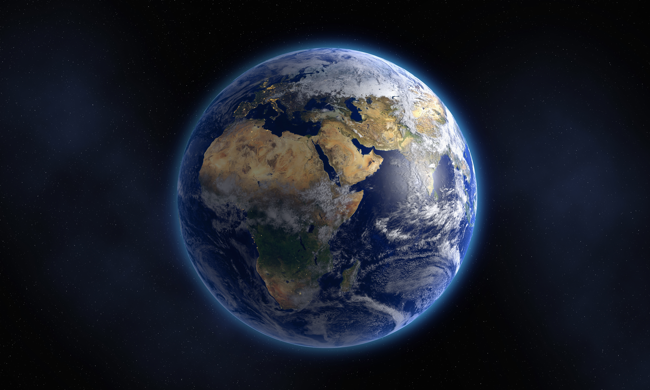
The book of genesis
A Study of the Pentateuch

Slide 2
The Pentateuch Genesis Exodus Leviticus Numbers Deuteronomy
Greek
Pente (Five) + Teuchos (Vessel, Container, Book or Volume)
Hebrew
Torah: Law, Instruction, or Teaching
Significance of Study
Historical Significance
Old Testament
New Testament
Today

Slide 3
HISTORICAL SIGNIFICANCE: OLD TESTAMENT
Pentateuch/Torah Designation | Passage
The Law | Josh. 8:34; Ezra 10:3; Neh. 8:2, 7, 14; 10:34, 36; 12:44; 13:3; II Chron. 14:4; 31:21; 33:8
The book of the Law | Josh. 1:8; 8:34; 24:26; II Chron. 34:14; Neh. 8:3; II Kings 22:8
The book of the Law of Moses | Josh. 8:31; 23:6; II Kings 14:6; Neh. 8:1
The book of Moses | Ezra 6:18; Neh. 13:1; II Chron. 35:12
The Law of the Lord | II Chron. 12:1; 31:3; Ezra 7:10; I Chron. 16:40, II Chron. 35:26

Slide 4
HISTORICAL SIGNIFICANCE: OLD TESTAMENT
Pentateuch/Torah Designation | Passage
The Law of God | Neh. 10:28, 29, Ezra 7:6
The book of the Law of God | Josh. 24:26; Neh. 8:18
The book of the Law of the Lord | II Chron. 17:9; 34:14; Neh. 8:18
The Law of Moses the servant of God | Dan. 9:11; Mal. 4:4
The Law of Moses the man of God | II Chron. 30:16; Ezra 3:2

Slide 5
Why did the ancients study the Pentateuch?
After Moses death Israelites cross Jordan into Promised Land
Joshua 8:34-35 “Then afterward he read all the words of the law, the blessing and the curse, according to all that is written in the book of the law. There was not a word of all that Moses had commanded which Joshua did not read before all the assembly.”
King Josiah Repairs the Temple and Discovers the Law
II Kings 22:8-11 “Then Hilkiah the high priest said to Shaphan the scribe, “I have found the book of the law in the house of the Lord” … “And Shaphan read it in the presence of the king. When the king heard the words of the book of the law, he tore his clothes.”
Restoration of Jewish Community after Babylonian Exile
Neh. 8:3 “He read from it (book of the law of Moses vs. 1) before the square…from early morning until midday, in the presence of men and women, those who could understand; and all the people were attentive to the book of the law.”

Slide 6
HISTORICAL SIGNIFICANCE: NEW TESTAMENT
Pentateuch/Torah Designation | Passage
The Law | Matt. 12:5; Luke 16:16; John 7:19; 8:5; Heb. 7:5
The book of the Law | Gal. 3:10
The book of Moses | Mark 12:26
The Law of the Lord | Luke 2:23, 24
The Law of Moses | Luke 2:22; John 7:23; Luke 24:44; Acts 13:39; 15:5; 28:23’ Heb. 10:28; I Cor. 9:9
The Law given by Moses | John 1:17; 7:19
Your or Our (Jews) Law | John 8:17; 10:34; 18:31; 19:7; Acts 25:28

Slide 7
How did Jesus + apostles view the Pentateuch?
Words of Jesus
John 5:46-47 “For if you believed Moses, you would believe Me, for he wrote about Me. But if you do not believe his writings, how will you believe My words?”
Luke 24:27; 44 “Then beginning with Moses and with all the prophets, He explained to them the things concerning Himself in all the Scriptures.”…”Now He said to them, “These are My words which I spoke to you while I was still with you, that all things which are written about Me in the Law of Moses and the Prophets, and the Psalms must be fulfilled.”

Slide 8
How did Jesus + apostles view the Pentateuch?
New Testament Writings
Gal. 3:24 “Therefore the Law has become our guardian (tutor) to lead us to Christ, so that we may be justified by faith.”
Heb. 11:3 “By faith we understand that the worlds were prepared by the word of God, so that what is seen was not made out of things which are visible…”
2 Pet. 3:5; 2 Cor. 4:6; Heb. 6:7; Acts 17:24; I Cor. 11:7; Matt. 19:4

Slide 9
Genesis class outline
Date | Topic | Teacher
12/3/23 | Introduction / Creation | David Haley
12/10/23 | Creation / Fall of Man | David Haley
12/17/23 | Cain & Abel | Doug Greer
12/24/23 | Noah & The Flood | Doug Greer
12/31/23 | Babel and Abrahams Call | David Haley
1/7/24 | Abraham & Sarah | Doug Greer
1/14/24 | Abraham’s Test | David Haley
1/21/24 | Jacob & Esau | Doug Greer
1/28/24 | Jacob’s Dream & Wrestling w/ God | David Haley
2/4/24 | Joseph: Slave to Governor | Doug Greer
2/11/24 | Joseph: Reconciliation w/ Brothers | David Haley
2/18/24 | Jacob: Blessing & Genesis’ End | Doug Greer
2/25/24 | Conclusion / Review | David Haley

Slide 10
Genesis: Major class themes
God is omnipotent, omnipresent, and omniscient.
God created the world and all its hosts – it was very good.
Mankind is the image bearer of God, blessed and imbued with divine purpose.
Man’s sin in the garden and every sin thereafter separates him from God (death) and creates disorder which is in opposition to the blessed and holy purpose of God’s creation.
The promise to Abraham reorients mankind back to the original garden blessing, relationship, and purpose which is fulfilled in Christ Jesus.
Abraham, landless and childless; Isaac, bound and deceived; Jacob, blessed but grief stricken; and Joseph, betrayed and imprisoned, must learn that the Great Promise, the lodestar of their lives, must be fulfilled divinely and miraculously or not at all.

Slide 11
Genesis 1:1 – 2:3
The Creation
1 In the beginning God created the heavens and the earth. ² The earth was formless and void, and darkness was over the surface of the deep, and the Spirit of God was moving over the surface of the waters. ³ Then God said, “Let there be light”; and there was light. ⁴ God saw that the light was good; and God separated the light from the darkness. ⁵ God called the light day, and the darkness He called night. And there was evening and there was morning, one day.
⁶ Then God said, “Let there be an expanse in the midst of the waters, and let it separate the waters from the waters.” ⁷ God made the expanse, and separated the waters which were below the expanse from the waters which were above the expanse; and it was so. ⁸ God called the expanse heaven. And there was evening and there was morning, a second day.

Slide 12
Genesis 1:1 – 2:3
⁹ Then God said, “Let the waters below the heavens be gathered into one place, and let the dry land appear”; and it was so. ¹⁰ God called the dry land earth, and the gathering of the waters He called seas; and God saw that it was good. ¹¹ Then God said, “Let the earth sprout vegetation, plants yielding seed, and fruit trees on the earth bearing fruit after their kind with seed in them”; and it was so. ¹² The earth brought forth vegetation, plants yielding seed after their kind, and trees bearing fruit with seed in them, after their kind; and God saw that it was good. ¹³ There was evening and there was morning, a third day.

Slide 13
Genesis 1:1 – 2:3
14 Then God said, “Let there be lights in the expanse of the heavens to separate the day from the night and let them be for signs and for seasons and for days and years; 15 and let them be for lights in the expanse of the heavens to give light on the earth”; and it was so. 16 God made the two great lights, the greater light to govern the day, and the lesser light to govern the night; He made the stars also. 17 God placed them in the expanse of the heavens to give light on the earth, 18 and to govern the day and the night, and to separate the light from the darkness; and God saw that it was good. 19 There was evening and there was morning, a fourth day.

Slide 14
Genesis 1:1 – 2:3
20 Then God said, “Let the waters teem with swarms of living creatures, and let birds fly above the earth in the open expanse of the heavens.” 21 God created the great sea monsters and every living creature that moves, with which the waters swarmed after their kind, and every winged bird after its kind; and God saw that it was good. 22 God blessed them, saying, “Be fruitful and multiply, and fill the waters in the seas, and let birds multiply on the earth.” 23 There was evening and there was morning, a fifth day.
24 Then God said, “Let the earth bring forth living creatures after their kind: cattle and creeping things and beasts of the earth after their kind”; and it was so. 25 God made the beasts of the earth after their kind, and the cattle after their kind, and everything that creeps on the ground after its kind; and God saw that it was good.

Slide 15
Genesis 1:1 – 2:3
26 Then God said, “Let Us make man in Our image, according to Our likeness; and let them rule over the fish of the sea and over the birds of the sky and over the cattle and over all the earth, and over every creeping thing that creeps on the earth.” 27 God created man in His own image, in the image of God He created him; male and female He created them. 28 God blessed them; and God said to them, “Be fruitful and multiply, and fill the earth, and subdue it; and rule over the fish of the sea and over the birds of the sky and over every living thing that moves on the earth.” 29 Then God said, “Behold, I have given you every plant yielding seed that is on the surface of all the earth, and every tree which has fruit yielding seed; it shall be food for you;

Slide 16
Genesis 1:1 – 2:3
30 and to every beast of the earth and to every bird of the sky and to every thing that moves on the earth which has life, I have given every green plant for food”; and it was so. 31 God saw all that He had made, and behold, it was very good. And there was evening and there was morning, the sixth day.
The Creation of Man and Woman
2 Thus the heavens and the earth were completed, and all their hosts. ² By the seventh day God completed His work which He had done, and He rested on the seventh day from all His work which He had done. ³ Then God blessed the seventh day and sanctified it, because in it He rested from all His work which God had created and made.

Slide 17
Genesis 1 reading What questions do you see answered in genesis 1? What stands out in text to you?

Slide 18
“…And yet He did not leave himself without witness…for since the creation of the world his invisible attributes are clearly seen, being understood by the things that are made… the heavens declare the glory of god; and the firmament shows his handiwork.” acts 14:17; rom. 1:20; psalm 19:1

Slide 19
Gen. 1: Parallel structure
Disordered + Uninhabited + Dark
A. Light
B. Sea and Sky
C. Dry Land
A. Luminaries
B. Fish and Birds
C. Land Animals and Humans
Ordered + Inhabited + Light
D. Sabbath
Climax of the creation narrative
Stands in position of emphasis

Slide 20
THE LAND (erets) Gen. 1:1 Formless - Wild/Disordered (Tohu) and Void - Waste/Uninhabited/empty (Vohu)
SKIES | Day 1 – 1:3-5 “and God said…” Light and dark / day and night evening and morning: Day 1 | Day 4 – 1:14-19 “and God said…” Lights separate and rule day and night evening and morning: Day 4 | HOST OF THE SKIES
 | Day 2 – 1:6-8 “and God said…” The dome/firmament/expanse separates… …the waters above …the waters below evening and morning: Day 2 | Day 5 – 1:20-23 “and God said…” Creatures in the waters …birds by the waters above …fish in the waters below evening and morning: Day 5
LAND | Day 3 – 1:9-10 “and God said…” The waters below gather The dry land emerges | Day 6 – 1:24-28 “and God said…” Land creatures emerge from the dry land Humans appointed to rule | HOST OF THE LAND
 | Bonus Day 3 – 1:11-13 Plants and seed emerges from the group Evening and morning: Day 3 | Bonus Day 6 – 1:29-31 And provided with trees, plants and seed Evening and morning: Day 6
Gen. 2:1 – AND SO THEY WERE COMPLETED THE SKIES AND THE LAND AND ALL OF THEIR HOSTS

Slide 21
Mankind’s purpose
Look at Genesis 1:26-31
Question: Discuss what is gleaned from this passage regarding mankind’s purpose?

Slide 22
Genesis 26a – “Then God said, “Let Us make man in Our image, according to Our likeness…”
Begs the reader answer…
“Who is this God whom I bear the image and likeness of?”
In the context of the Creation + Eden story who is God revealed to be?
Spiritual and Eternal Being, Free Willed, Capable of Love and Relationships, Self Aware, Moral Being, has Dominion, Holy, Just
Notes:
- Hebrew word for image (tselem) is also used for the construction of royal images. That is, while the king could not be physically present throughout his entire realm, he would set up images of himself throughout the kingdom to remind the people of his authority.

Slide 23
Genesis 26a – “Then God said, “Let Us make man in Our image, according to Our likeness…”
Begs the reader answer…
“What does this say about my purpose and relationship with Him?”
Divine calling to be God’s representations (image/tselem) in His creation
Romans 8:29 – those called to Christ are “…conformed to the IMAGE of His Son, so that He would be the firstborn among many brethren…”
Matthew 5:16 – “Let your light shine before men…”
Leviticus 26:1 – “You shall not make for yourselves idols, nor shall you set up for yourselves an image…”
Deuteronomy 27:15 – “Cursed is the man who makes an idol or a molten image, an abomination to the Lord…”
A “likeness” is only a facsimile – exists by derivation
Clearly distinguishes God from humanity
Mankind (Females and Males) share equally in God’s image + likeness
Notes:
- Hebrew word for image (tselem) is also used for the construction of royal images. That is, while the king could not be physically present throughout his entire realm, he would set up images of himself throughout the kingdom to remind the people of his authority.

Slide 24
Mankind’s blessing + purpose
The image of God statements are immediately followed by sections that unpack the meaning and significance of the divine image:
Vs. 26b – “…in order that they may rule…”
Given dominion
Vs. 28-29 – “God blessed them…”
All needs are provided for by God
Not only a gift but a purpose
“…Be fruitful and multiply, and fill the earth, and subdue it; and rule over the fish of the sea and over the birds of the sky and over every living thing that moves on the earth…”

Slide 25
7th day blessed and sanctified
Gen. 2:2-3 – “By the seventh day God completed His work which He had done, and He rested on the seventh day from all His work which He had done. Then God blessed the seventh day and sanctified it, because it He rested from all His work which God had created and made.”
Rested: Literally CEASED
Rest of achievement, not in activity
God nurtures what he creates
Recall: John 5 - Jesus healed the lame man on Sabbath
Jews leveraged this against Jesus – His response vs 17 “…My Father is working until now, and I Myself am working.”
To desist of creative work resonates God’s creation was perfect and complete
Note Gen. 2:1-3: Formula of “evening and morning” noticeably absent
Implies infinite and eternal perspective

Slide 26
Creation as a macro-temple
In Genesis 1, creation is depicted as the cosmic prototype of which all later temples are symbolic miniatures.
In each later biblical temple, the seventh day is when God’s presence fills the sacred space.
Creation: Genesis 1
Tabernacle Instructions: Exodus 25-31
Completion of the Tabernacle: Exodus 39-40
Jerusalem Temple Completion: I Kings 6-8

Slide 27
Creation’s Completion – Gen. 1:31 – 2:3
Seven days open with divine command: “And God said…” Day 1 – 1:5 Day 2 – 1:8 Day 3 – 1:13 Day 4 – 1:19 Day 5 – 1:23 Day 6 – 1:31 Day 7 – Gen 2:1-3 SABBATH
Seventh day culminates in Sabbath (Gen. 2:1-3)
Gen. 1:31 “And God saw all that he had done, and behold, very good. And there was evening and morning, the sixth day.” Gen. 2:3 “Then God blessed the seventh day…”
Gen. 2:1 “And the skies and the land were completed (כל׳׳ה)
Gen. 2:2 “And God rested (שב׳׳ת) on the seventh day…”
Gen. 2:2-3 “…from all his work (מלאכה)…and God blessed (בר׳׳ך) the seventh day and made it holy (קד׳׳ש)”

Slide 28
Tabernacle Instructions – Exod. 25-31
Seven speeches open with divine command: “And YHWH spoke to Moses…” Speech 1 – Exod. 25:1 Speech 2 – Exod. 30:11 Speech 3 – Exod. 30:17 Speech 4 – Exod. 30:22 Speech 5 – Exod. 30:34 Speech 6 – Exod. 31:1 Speech 7 – Exod. 31:12 SABBATH
Exod. 31:12-17 – Seventh speech emphasizes the “sign of Sabbath” Exod. 28-29 – Priesthood installed after a seven-day ordination
Exod. 31:18 – “And it came about when he completed (כל׳׳ה/kalah) speaking to Moses on Mt. Sinai.”
Exod. 31:14-15 – “You shall keep the Sabbath for it is holy (קדש) for you… Six days let the work (מלאכה/melakah) be done, and on the seventh day it is a Sabbath of Sabbath.

Slide 29
Completion of the Tabernacle – Exod. 39-40
Seven acts of obedience to the divine command to complete the tabernacle: “And Moses did…just as YHWH commanded Moses.” Act 1 – Exod. 40:19 Act 2 – Exod. 40:21 Act 3 – Exod. 40:23 Act 4 – Exod. 40:25 Act 5 – Exod. 40:27 Act 6 – Exod. 40:29 Act 7 – Exod. 40:32-35 DIVINE REST
Seventh act of obedience “completes” the tabernacle
Exod. 39:43 – “And Moses saw all the work they had done, and behold, just as YHWH commanded, so they did, and Moses blessed them.”
Exod. 40:33 – “And Moses completed (כל׳׳ה/kalah) the work (מלאכה).”
Exod. 40:34 – “And the cloud covered the tent of meeting, and the glory of YHWH filled the tent.”
Lev. 8-9 Aaron and his sons are brought before the tent for seven days in the ordination ceremony (formal process where individuals are consecrated or “set apart”).

Slide 30
Jerusalem Temple Completion – I Kings 6-8
Seven petitions of Solomon upon the completion of the temple: “Blessed be Yahweh who spoke to my father David.” Petition 1 – I Kings 8:31-32 Petition 2 – I Kings 8:33-34 Petition 3 – I Kings 8:35-37a Petition 4 – I Kings 8:37b-40 Petition 5 – I Kings 8:41-43 Petition 6 – I Kings 8:44-45 Petition 7 – I Kings 8:46-53 SEVEN-DAY FEASTS
I Kings 8:65 – Solomon hosts two seven-day feast to dedicate the temple
I Kings 8:14 – “…the king faced about and blessed all the assembly of Israel…”
I Kings 6:14 – “And Solomon built the temple and he finished (כל׳׳ה/kalah) it.”
I Kings 8:10-11 – “And the cloud filled the house of Yahweh.”
I Kings 6:38 – “In the 11th year, in the…8th month, the temple was finished throughout all its parts and according to all its plans. So he was seven years in building it.” I Kings 7:22 – “And the work (מלאכה/melakah) of the pillars was finished.” I Kings 7:51 – “Thus all the work (מלאכה/melakah) that King Solomon performed in the house of the Lord was finished.”

Slide 31
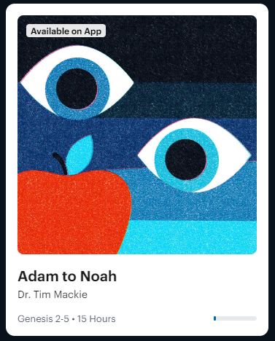
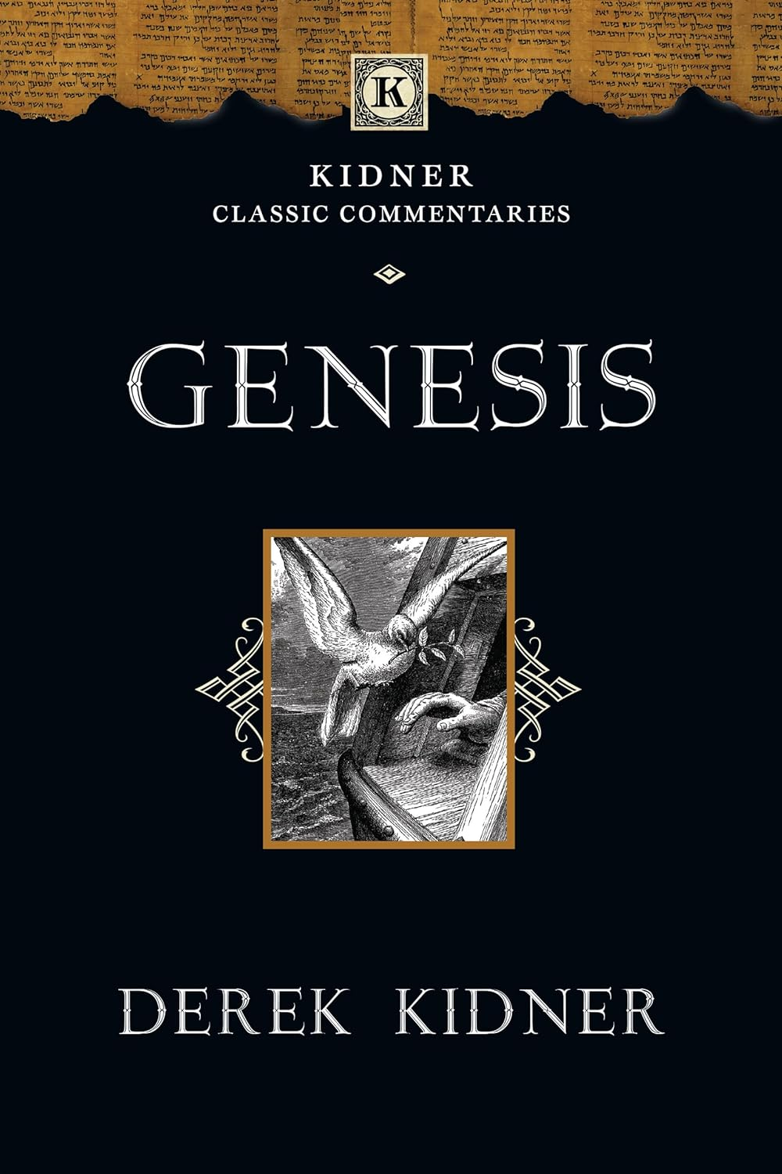
Recommended study material

