Slide 1
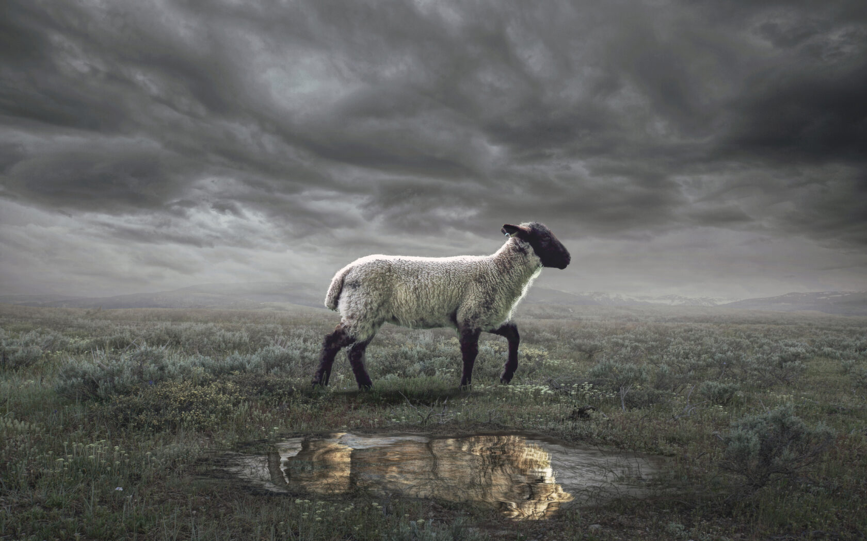
The Revelation
Wednesday Nights
Winter 2023-24

Slide 2
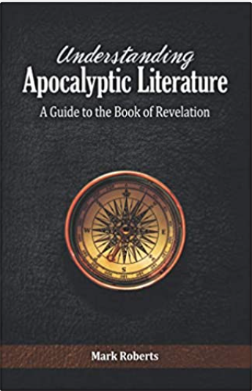
Understanding Apocalyptic Literature: A Guide to the Book of Revelation
Mark Roberts

Slide 3
What are we reading?
¹ The Revelation of Jesus Christ, which God gave Him to show to His bond-servants, the things which must soon take place; and He sent and communicated it by His angel to His bond-servant John, ² who testified to the word of God and to the testimony of Jesus Christ, even to all that he saw. ³ Blessed is he who reads and those who hear the words of the prophecy, and heed the things which are written in it; for the time is near.
⁴ John to the seven churches that are in Asia:

Slide 4
What is an Apocalypse?
This word (in the Bible) does NOT mean ”the end of the world.”
An apocalypse is an “unveiling”—pulling back the curtain to ”reveal” the reality of things.
Biblical examples:
Isaiah’s Call (Isaiah 6)
Saul’s Vision (Acts 9, 22, 26)
The Book of Daniel (ch.7-12)
Jacob’s Dream (Genesis 28; see 35:7)
Other examples?

Slide 5
Apocalyptic Literature
A genre that John’s readers would have been familiar with (Daniel, + contemporary writings)
Characteristics:
Time of distress for God’s people
God reveals something to a human
Mediated by a heavenly being (angel)
Narrative Framework (tells a story)
Shows a transcendent reality (time & space)
Heavy use of symbolism (pictorial, poetic)
To affect behavior (comfort & challenge)

Slide 6
What are we reading?
Apocalyptic Literature is “a story, written in a time of crisis and distress, that is given by otherworldly beings explaining how God will reverse everything so the righteous will triumph.”
- Mark Roberts

Slide 7
What is Prophecy?
In the Bible, prophecy does NOT mean fortune-telling or predicting the future.
It means a word from God, delivered by a man or woman of God (prophet).
The Hebrew prophets did the following:
Interpret History
Enforce Covenants
Describe Future Events

Slide 8
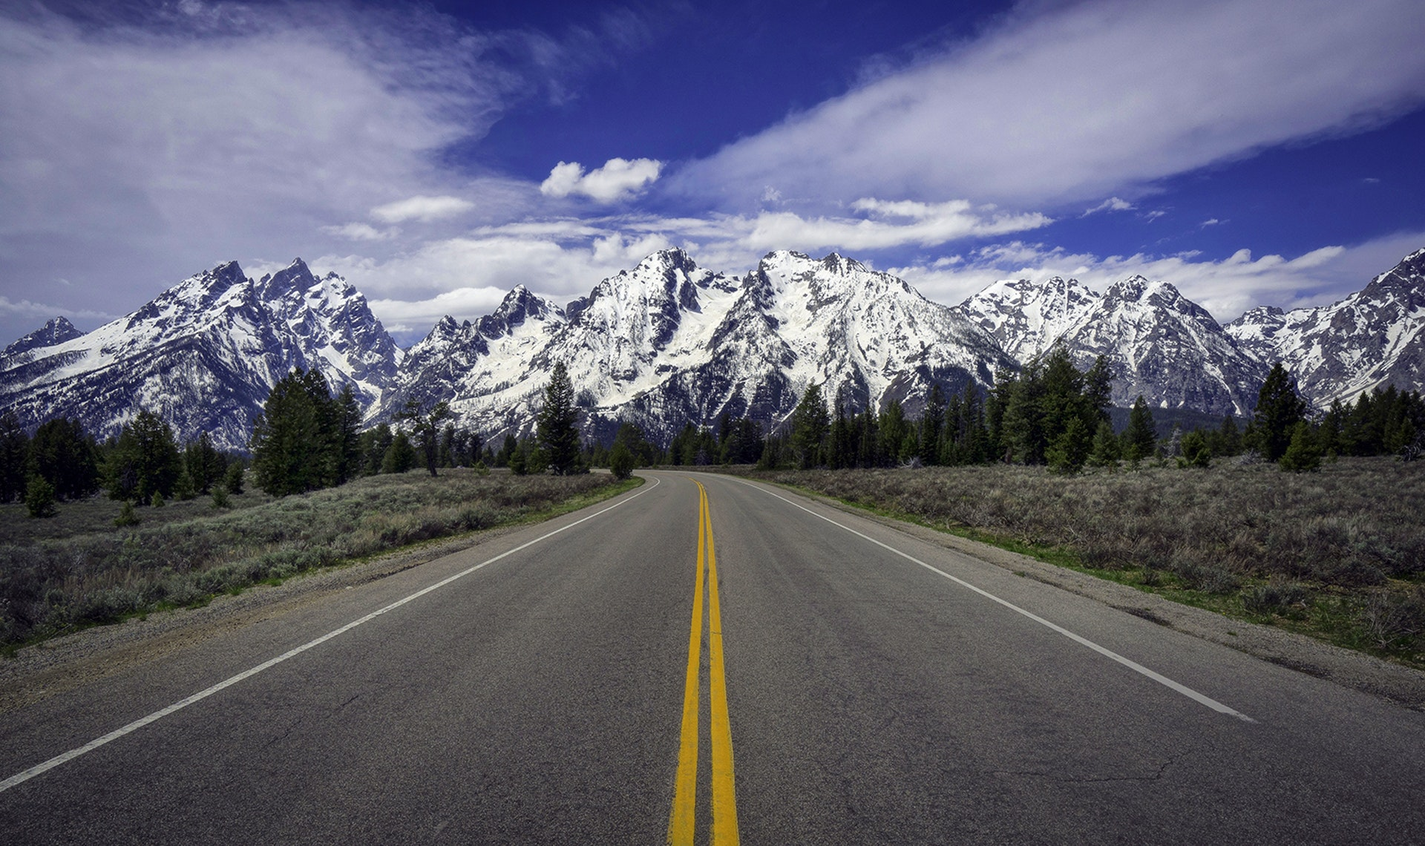
Prophetic View of Time

Slide 9
To when is Ezekiel referring?
^{36:33} Thus says the Lord God, “On the day that I cleanse you from all your iniquities, I will cause the cities to be inhabited, and the waste places will be rebuilt. ³⁴ The desolate land will be cultivated instead of being a desolation in the sight of everyone who passes by. ³⁵ They will say, ‘This desolate land has become like the garden of Eden; and the waste, desolate and ruined cities are fortified and inhabited.’ ³⁶ Then the nations that are left round about you will know that I, the Lord, have rebuilt the ruined places and planted that which was desolate; I, the Lord, have spoken and will do it.”

Slide 10
Apocalyptic View of Time
A common feature in apocalyptic literature is the division of time into periods, with the current moment placed toward the end.
Not as a precise chronology or timeline
Shows God has ordered history/is in control
Encourages reader to hang on a bit longer
Example: 70 Weeks prophecy (Daniel 9)
Response to “Act and don’t delay!” (9:19)
Numbers are symbolic, not literal
The critical moment is the last “week”

Slide 11
“For the time is near”
Revelation says the events of the book will happen “soon.” (1:1; 22:6)
“Soon” in the Bible isn’t always soon
Deut 32:35 - “near” = 800 years
Rom 16:20 - God will “soon” crush Satan
Think of time in Revelation:
Prophetically (layers of fulfillment)
Apocalyptically (hold on a little longer)
Don’t forget the original readers!

Slide 12
The Revelation
Next Week (12/13)
2. Roman Asia in 1st Century

