Slide 1
The Gospel according to Mark
Bellaire Auditorium Class
Wednesday Nights
September to November 2023

Slide 2
“The beginning of the gospel of Jesus the Christ, the Son of God.” (1:1)
The Arrangement of Mark
1-8: Who is Jesus?
healing
casting out demons
teaching
authority
8 → : Why did He come?
foretells suffering
teaching on sacrifice
And a voice came from heaven, “You are my beloved Son; with you I am well pleased.” (1:11)
…a voice came out of the cloud, “This is my beloved Son; listen to him.” (9:7)
“‘Who do you say that I am?’ Peter said, ‘You are the Christ.’” (8:27-30)

Slide 3
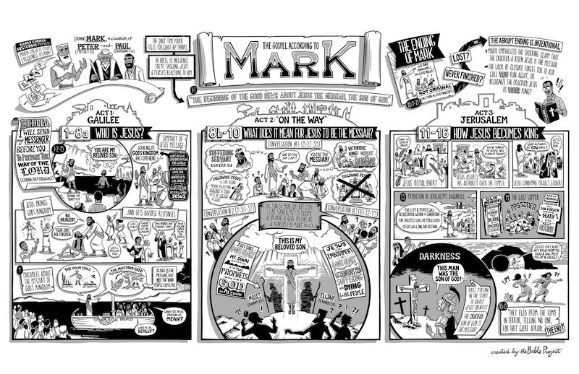

Slide 4
Mark 8-10
Mark 8:31-33 – Jesus foretells suffering / death
Take up your cross, Jesus’ hidden glory revealed, Elijah suffered, disciples need humility
Mark 9:30-32 – Jesus foretells suffering / death
Be servant of all, Receive children, Give a cup of water, Accept God’s command, Give up wealth
Mark 10:32-34 – Jesus foretells suffering / death
Request for status, Great must become servant, Son of Man came to serve, Blind beggar healed

Slide 5
Mark 11-12: Into Jerusalem
Episodes:
Triumphant Entry (11:1-11)
Fig Tree cursed (11:12-14)
Driving out from temple (11:15-19)
Fig Tree withered (11:20-26)
By what authority? (11:27-33)
Parable of Vine-Growers (12:1-12)
Taxes to Caesar? (12:13-17)
Resurrection? (12:18-27)
Greatest commandment? (12:28-34)
How is the Christ David’s son? (12:35-37)
Beware of the scribes (12:38-40)
Widow’s Offering (12:41-44)
What are the stiches?
How does the setting clarify the message of these chapters?
Talk in small groups
Share out to the class

Slide 6
Fig Tree (11:12-14, 20-21)
Why did Jesus curse the fig tree?
He was “hangry”?
It was an ‘object lesson’ (sign act)?
What does the fruitless fig tree represent?
How is the Jerusalem establishment rebuked for having leaves but no fruit?
Trusting temple, dishonoring God (15-17)
Demanding authority, not submitting (27-33)
Given a vineyard, rejected owner (12:1-12)
‘Figured it out’, don’t know Scriptures (24)
Best seat in church, devour widows (38-40)
Large contributions, no sacrifice (41-44)

Slide 7
Into Jerusalem (Mark 11-12)
What do we learn about Jesus?
… about following Jesus?
Jesus is King. He demands total allegiance, full surrender, whole-hearted love, and the bearing of genuine fruit.
We surrender to Him. We do not simply talk like or look like we are God’s people, we offer everything in obedience.

Slide 8
The Gospel according to Mark
Next Wednesday (November 1)
Mark 13

