Slide 1
The Gospel according to Mark
Bellaire Auditorium Class
Wednesday Nights
September to November 2023
Mark 6

Slide 2
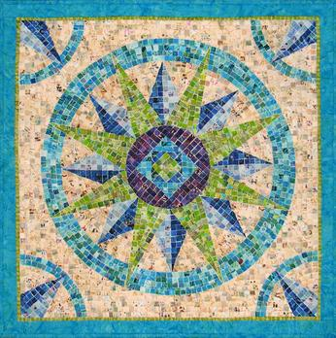

Slide 3
Recap of Mark, Chapters 1 – 5
Ch 1: Jesus announces His kingdom of healing and _______
Ch 2-3: People object to Jesus’ mission to make _______ whole
Ch 4: Jesus’ kingdom is for those with hearing ears and ______ hearts
Ch 5: Jesus overpowers nature, demons, sickness and ______
Sinners
Death
Humble
Freedom

Slide 4
Recap of Mark, Chapters 1 – 5
Ch 1: Jesus announces His kingdom of healing and freedom
Ch 2-3: People object to Jesus’ mission to make sinners whole
Ch 4: Jesus’ kingdom is for those with hearing ears and humble hearts
Ch 5: Jesus overpowers nature, demons, sickness and death
Sinners
Death
Humble
Freedom

Slide 5
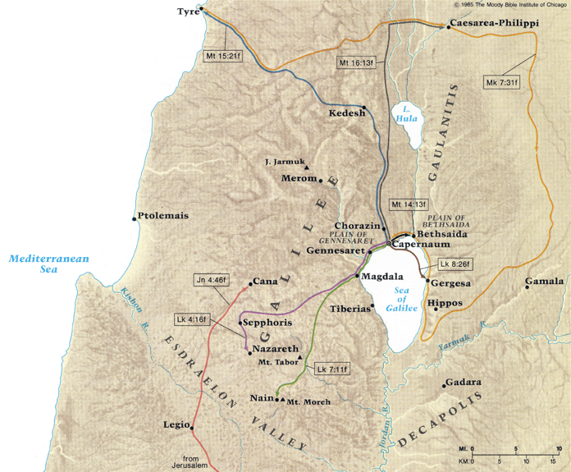
Mark 1-5
12.5 miles
X
8 miles

Slide 6
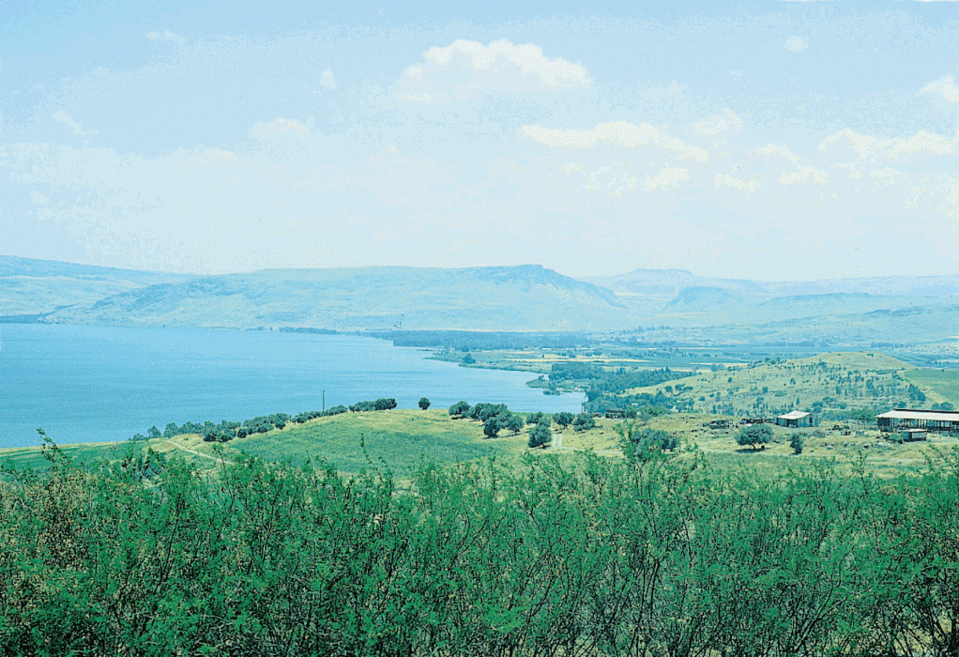
Sea of Galilee

Slide 7
Sea of Galilee

Slide 8
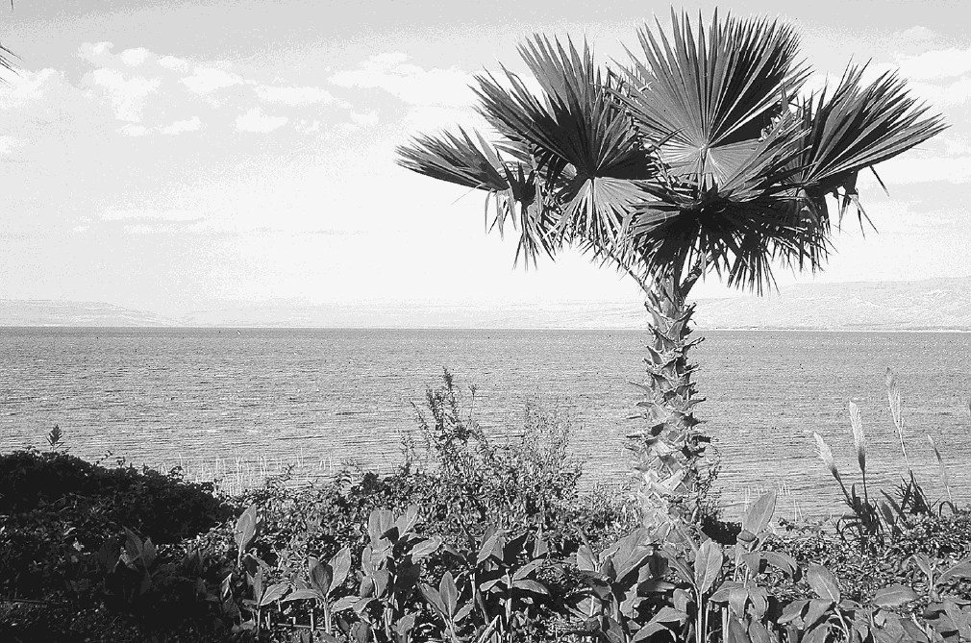
Sea of Galilee

Slide 9
Jesus’ Traits
Accepted by the Father
Knowledge of and adherence to scripture
Compassion
Patience
Service
Active prayer life
Dedicated teacher (by parables, with authority)
Righteous anger

Slide 10
Audience Reactions
Scribes & Pharisees
“He speaks blasphemies”
“He eats and drinks with sinners”
“Why don’t your disciples fast?”
“Why do You break the Sabbath?”
“He casts out demons by Beelzebub”
Plotted to destroy Him
The Crowds
Astonished
Amazed
Fear
Glorified God
Brought their sick
Believed He could heal
Spread the word
Ridiculed, then great amazement
The Demons
“You are the Son of God”
Obedient
The Apostles
Obedient to Jesus’ call
Sought to understand
“Have no faith”
His Own People
“He is out of His mind”
Family sought Him

Slide 11
Mark 5 Recap
While crossing the sea, Jesus calms the wind and the waves
Lands at the country of the Gadarenes
Jesus heals the demon (Legion) possessed man of the Gadarenes
Crosses the sea again
Jesus heals the woman’s issue of blood
Jesus raises Jairus’ daughter from the dead
“And they were overcome with great amazement”

Slide 12
Mark 6
2
3
1

Slide 13
Episodes in Mark 6
Jesus is rejected in Nazareth (6:1-6)
Jesus sends the 12 to preach and to heal (6:7-13)
John the baptist is beheaded by Herod (6:14-29)
Jesus feeds the multitudes (6:30-44)
Jesus walks on the sea to the disciples (6:45-52)
Jesus heals many in Gennesaret (6:53-56)

Slide 14
Key Points (1)
Jesus is rejected in Nazareth (6:1-6)
People were astonished at His knowledge, wisdom, and healing
But they’re offended
Jesus: “A prophet is not without honor….”
He could do mighty work, only heals a few sick people
He marvels because of their unbelief
Jesus sends the 12 to preach and to heal (6:7-13)
Sent out 2 by 2, with power over demons and to heal
Take nothing for the journey. Stay in the place you enter.
Shake the dust off your feet if you’re not received
Apostles preached repentance, healed, and cast out demons

Slide 15
Key Points (2)
John the baptist is beheaded by Herod (6:14-29)
Herod is convinced Jesus is John brought back to life
Herod had no right to marry Herodias. Imprisons John at Herodias’ request, but won’t harm him.
Herodias finagles a way to have John executed.
Similar characters to Herod and Herodias?
Jesus feeds the multitudes (6:30-44)
Apostles are back and de-brief with Jesus.
Try to get to a quiet place to rest, but the crowds follow.
Jesus has compassion and teaches them. “Sheep with no shepherd”.
Time to eat, but only a little food.
Jesus multiplies the food. Everyone eats and is filled. Plenty left over. About 5,000 men.

Slide 16
Sea of Galilee

Slide 17
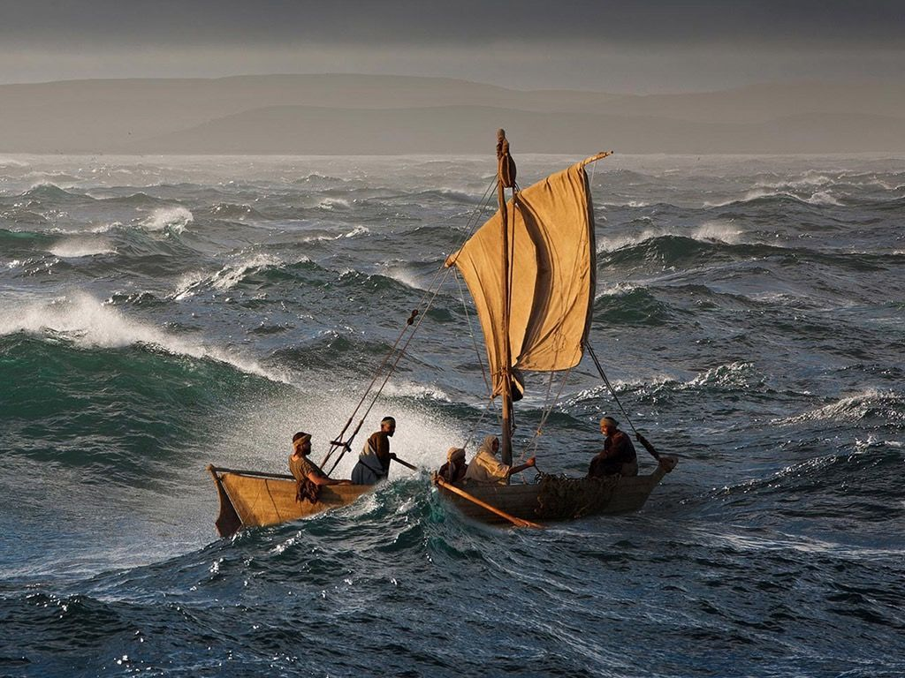
Sea of Galilee

Slide 18
Key Points (3)
Jesus walks on the sea to the disciples (6:45-52)
Jesus sends the disciples to Bethsaida by boat
He then goes to the mountain and prays.
Jesus walks to the apostles in the middle of the sea in the fourth watch of the night (before dawn)
Jesus calms the apostles, and calms the sea.
Apostles greatly amazed, hearts had been hardened.
Jesus heals many in Gennesaret (6:53-56)
The people recognize Jesus when they arrive.
Gather many sick from throughout the region to bring to Jesus.
As many as touched Him were healed.

Slide 19
“Stitches” Between the Episodes
Jesus’ compassion as the loving shepherd
Healings, feeding, teaching, leading
Miracles
Feeding the multitude, healings, calming the sea
Crowds following Jesus
Knowing when to move on
Nazareth’s unbelief, “shake the dust off”
Repeated lack of faith by the apostles
Feeding the multitude, Jesus on the water
Quiet time and prayer

Slide 20
What We Learn from Mark 6
About Jesus
Compassion in many ways (teaching, sickness, hunger)
Leading by example
Value of prayer and quiet time
Patience
About following Jesus
Compassion for our fellow man
Diligence in teaching
Leading
Knowing when to move on
Find time to be alone to pray

Slide 21
Mark 6 Summary
Daniel’s summary next week, but for now….
Mark 6: Jesus continually shows His compassion and willingness to teach

Slide 22
Wrap Up
John 20:31
“these are written that you may believe that Jesus is the Christ, the Son of God, and that believing you may have life in His name”

Slide 23
The Gospel according to Mark
Next Wednesday (October 11)
Mark 7:1 – 9:1

