Slide 1
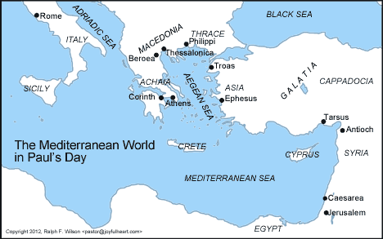
“Cretans are always liars, evil beasts, lazy gluttons.” (Titus 1:12)

Slide 2
Living in Crete? Titus 1:12
Regular deception
Base immorality
Indulgent laziness
How do we live as God’s people in the midst of this?

Slide 3
Message of Titus
For the grace of God has appeared, bringing salvation to all men, instructing us that, denying ungodliness and worldly desires, we should live sensibly, righteously, and godly in the present age.
Titus 2:11-12
the grace of God
instructing us

Slide 4
Instructed by Grace
A Study of the Book of Titus

Slide 5
Titus 1:1-3
Paul, a slave of God and an apostle of Jesus Christ, for the faith of God’s elect and the full knowledge of the truth which is according to godliness, in the hope of eternal life, which the God who cannot lie promised from all eternity, but at the proper time manifested His word in preaching, with which I was entrusted according to the commandment of God our Savior.
Grace
Instruction

Slide 6
Paul’s Message Titus 1:1-3
In a world of…
Regular deception
Base immorality
Indulgent laziness
We have…
Knowledge of the truth
… which accords with godliness
and an eternal perspective.

Slide 7
Instructed by Grace
“Grace and peace from God the Father and Christ Jesus our Savior”

