Slide 1
What You Believe Always Shows Up in What You Do!
Mark 5:21-43

Slide 2
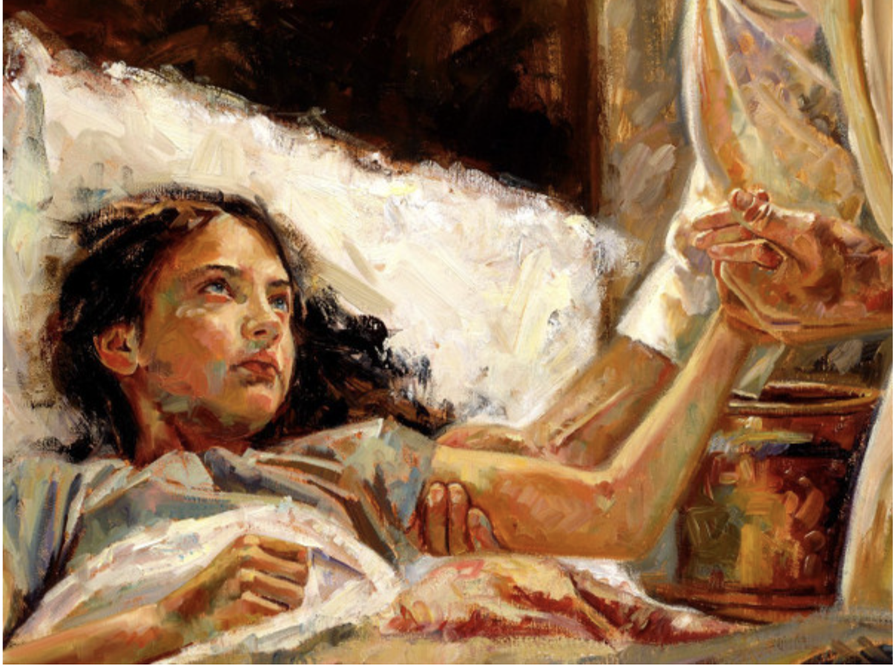

Slide 3
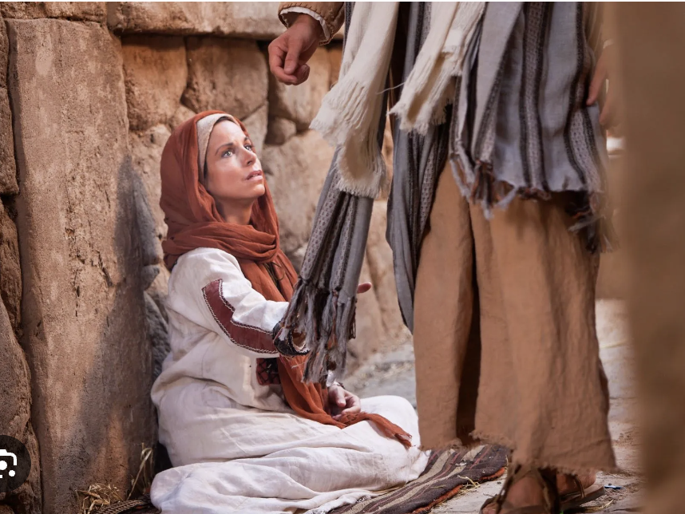

Slide 4
1. Our Faith, Trust & Hope is in Christ, Not Our Plans, Agendas or Capabilities
2. Trusting & Obeying Jesus Defines Truth, Not Our World
3. Now Is the Time to Be Healed

Slide 5
What you believe always shows up in what you are driven to do and go!

