Slide 1
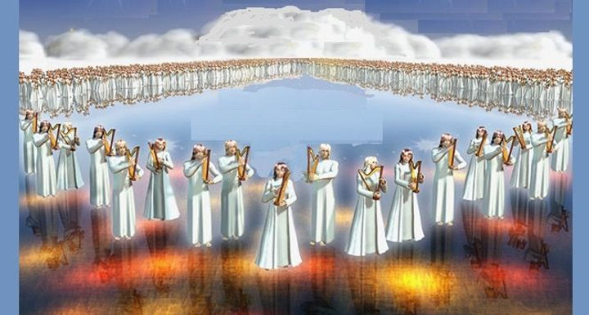
The Revelation
For Sunday (5/7)
18. Seven angels & seven plagues

Slide 2
Overview: Revelation 1-14
Introduction (1-3) – Glorified Christ revealed to John in exile; seven churches in crisis addressed
Heavenly Council (4-5) – God on throne, the scroll (plan to judge & to save), and the worthy Lamb
Seven seals (6-8) – God’s judgments on earth (6), God’s people sealed (7), 7th seal → trumpets (8)
Seven Trumpets (8-11) – God’s wrath on earth (8-9), God’s people bear witness (10-11), 7th trumpet brings the eternal kingdom of Christ (11)
Seven signs (12-15) – War in heaven (12) spills onto earth (13), Lamb conquers, wicked judged (14)

Slide 3
Revelation 15
Read (listen to) the chapter.
Get a big picture sense of what is going on

Slide 4
Making sense of Revelation 11
Do your best to offer a simple “explanation” of what is going on in Revelation 15
Use the tools we’ve discussed:
Put it in context of the Revelation story
Identify key points from this text
See Biblical patterns from OT and NT
Consider the audience (1st century Asia)

Slide 5
Making sense of Revelation 15
Identify key points – anchors in this text
Which figures are present in this chapter?
Seven Angels with seven last plagues
Those who have been victorious over the beast
4 living beasts
Glory of God
What are the key points in this passage?
Seven Last Plagues
The victorious are before the throne of God singing praises to him
Temple opens and the bowls are filled
The temple is filled with the Glory of God

Slide 6
Making sense of Revelation 15
See biblical patterns – from OT and NT
What images/elements from this story remind you of a previous Bible story?
Singing the Song of Moses and the Lamb
Plagues against those that oppose God
Smoke fills the temple

Slide 7
Making sense of Revelation 15
Put it in context – of the Revelation
What themes from Revelation 1-14 are being sounded again in chapter 15?
Brief interlude and song of praise before a judgment is carried out
Those who are victorious over the beast are in the presence of God
John sees the temple/tabernacle of the covenant law
The return of the 7’s
Consider audience – 1st century Asia
What would this mean for the persecuted church? Compromising church? Apathetic?

Slide 8
Reflections on Revelation 15
How does Revelation 15 impact us in our lives today?

