Slide 1
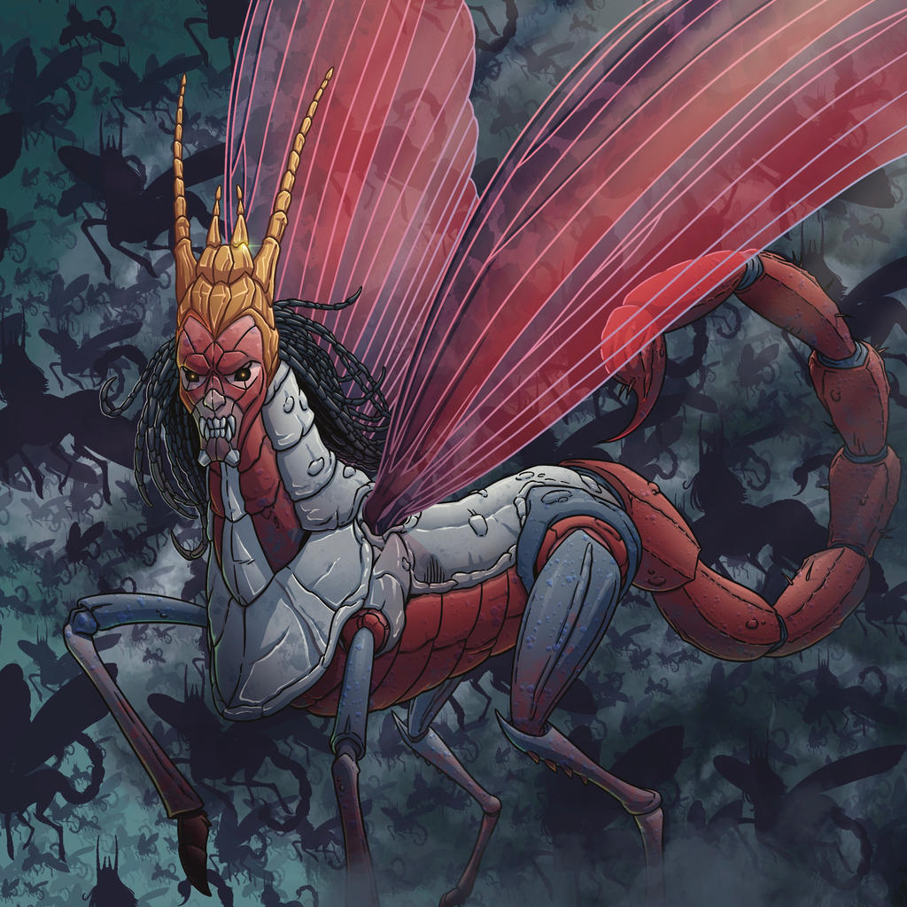
The Revelation
12. Woe to those on the earth
chapter 8-9

Slide 2
Review Quiz
Place these sections in order:
Seven seal judgments
Seven trumpet judgments
Vision of God & the Lamb
Letters to the churches
Christ appears to John
Christ appears (1)
Letters (2-3)
Throne & Lamb (4-5)
7 Seals (6-7)
7 Trumpets (8-9)

Slide 3
Revelation 8-9
Read (listen) to these chapters.
See the action in your mind’s eye. Get the overall sense, and feel what is happening.

Slide 4
Notes on the trumpets
“silence in heaven” – gravity, anticipation
not a linear, chronological description
another angle on the judgments of 6-7
images & numbers are symbolic
the point: the horrors of God’s judgment
an intended target for readers (Rome?)
same God Who works in the same way

Slide 5
Trumpet Judgments (Rev. 8-9)
First Four (8:7-12) – foundations of life (vegetation, seas, water, heavenly lights)
‘Three Woes’ (8:13) – ominous escalation
Fifth Trumpet (9:1-12) – demon locusts!?
“a star fallen” – see Luke 10:18 (?)
“bottomless pit” – or abyss, see Rev. 11:7
locusts – see Joel 1:4-12; 2:1-11; 3:23-25
”Destroyer” – Satan? or death personified?
→ God is unleashing hell on earth

Slide 6
Trumpet Judgments (Rev. 8-9)
Sixth Trumpet (9:13-19) – angelic army
invasion a fear of any nation
2 Kings 6:17 – horses & chariots of fire
The result? (9:20-21) – Men didn’t repent
dual-purpose of judgment and repentance
sins: idolatry, violence, sexual sin, greed
→ God gives them over to self-destruction

Slide 7
Reflections on Trumpets
Who is causing all these catastrophes on the earth?
What/who is God using to carry out these catastrophes?
What is His purpose?
How does all of this inform the way we see catastrophes in our day?

Slide 8
Luke 13:1-5
There were some present at that very time who told him about the Galileans whose blood Pilate had mingled with their sacrifices. And he answered them, “Do you think that these Galileans were worse sinners than all the other Galileans, because they suffered in this way? No, I tell you; but unless you repent, you will all likewise perish. Or those eighteen on whom the tower in Siloam fell and killed them: do you think that they were worse offenders than all the others who lived in Jerusalem? No, I tell you; but unless you repent, you will all likewise perish.”

Slide 9
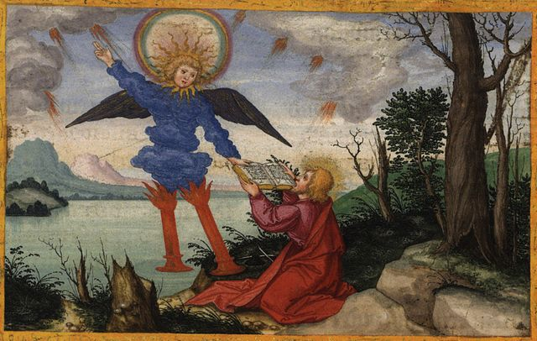
The Revelation
For Wednesday (4/19)
13. Take the scroll and eat it

