Slide 1
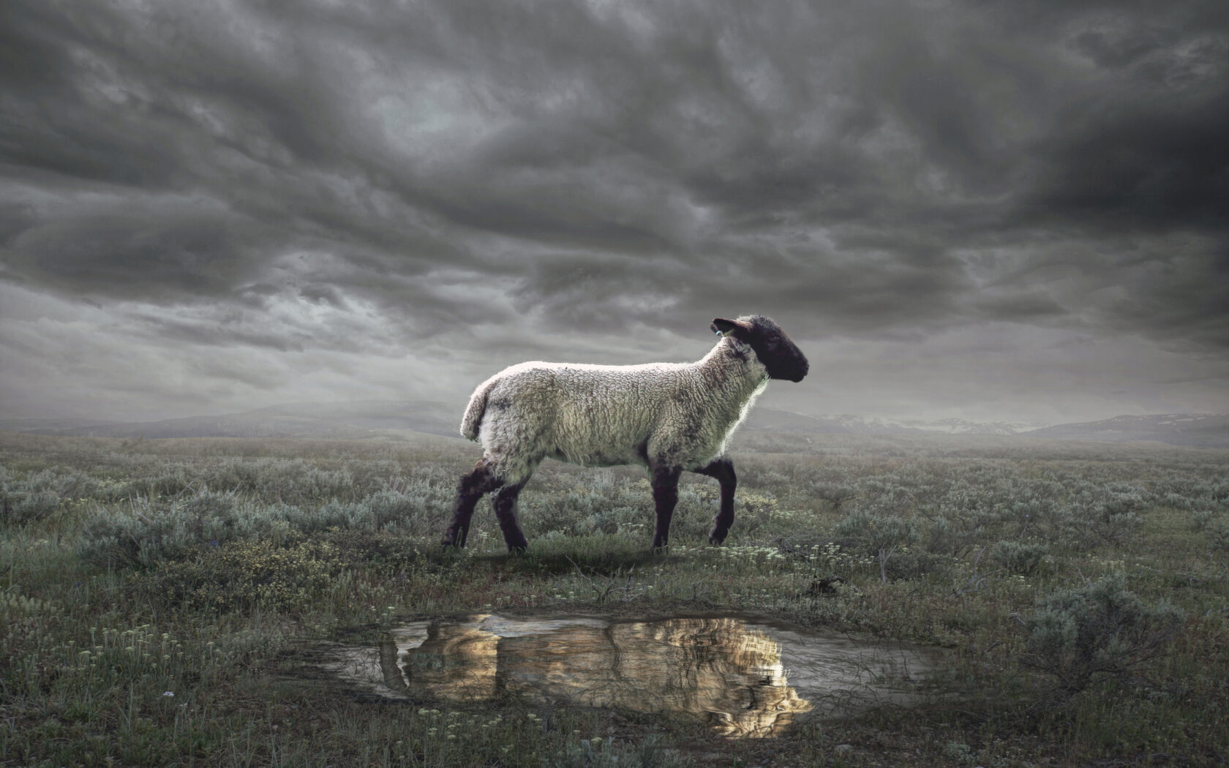
The Revelation
5. He who holds the seven stars
chapters 1-3

Slide 2
Review Quiz
What is the genre of the Book of Revelation?
_________
_________
_________

Slide 3
Review Quiz
What are some characteristics of apocalyptic literature?

Slide 4
Review Quiz
What was the challenge facing the Christians in 1st century Asia?
___________
___________
___________

Slide 5
Revelation 1
Hear, see, & feel what John is relaying

Slide 6
Revelation 1:1-8
“Grace to you and peace from…”
Who is, who was, and who is to come
Seven Spirits before the throne
Faithful witness, firstborn from the dead, ruler of the kings of the earth
“Made us a kingdom, priests to God”
“Behold, He is coming with the clouds”
Foundational text: Daniel 7

Slide 7
Revelation 1:9-20
Vision combines the Ancient of Days and the Son of Man from Daniel 7
Emphasis on Jesus’ sovereignty (rule) as the Lord of History (first and last)
Presence among the lampstands shows Jesus as priest (Exodus 27:20-21)
Fear is the proper reaction, but comfort is the clear message

Slide 8
Structure of the Letters
Jesus is… (description, see chapter 1)
Jesus knows… (church’s situation)
Jesus says… (comfort or challenge)
Jesus will… (promise, see ch. 21-22)
“He who has an ear, let him hear what the Spirit says to the churches.”

Slide 9
Jesus in Revelation 2-3
Ask: Why does the Spirit choose the particular description of Jesus at the beginning of each letter?
Example: To Smyrna, “the first and the last, who died and came to life” (2:8)
Their persecution is past, present, & future.
They may die, but are promised life!
Other examples you’ve noticed?

Slide 10
The Revelation
For Sunday (3/26)
6. Who walks among the lampstands

