Slide 1
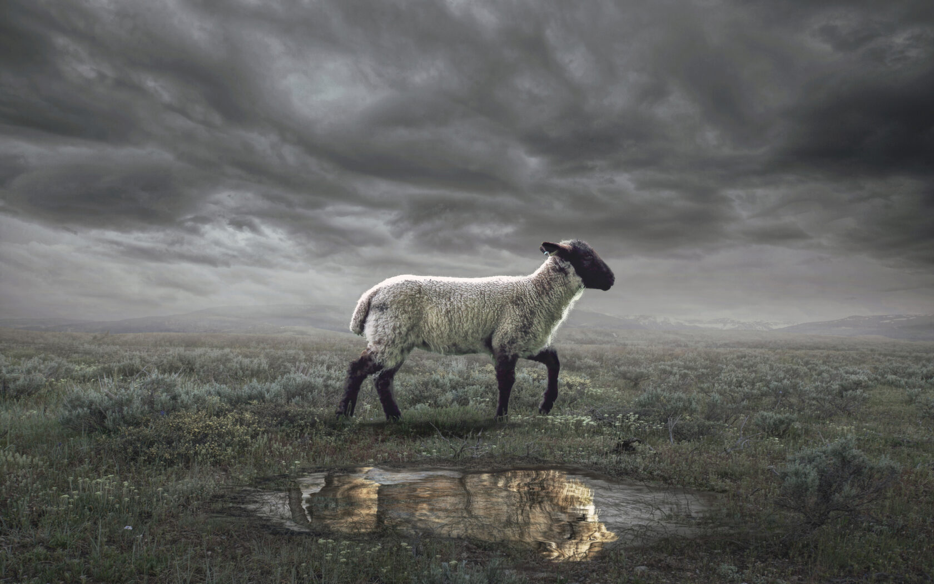
The Revelation
3. To the churches in Asia

Slide 2
Review Quiz
What is the genre of the Book of Revelation?
Letter
Prophecy
Apocalyptic Literature
All of the Above

Slide 3
Review Quiz
What are some characteristics of apocalyptic literature?
Intentionally confusing
Takes you above space/time
Divides history into periods
Encourages you to “hold on”
Written to predict timelines

Slide 4
Review Quiz
What do Biblical prophets do?
Describe future events
Enforce covenants
Interpret history
All of the Above

Slide 5
Review Quiz
Prophecies in the Bible only ever have one single fulfillment.
True
False

Slide 6
What are we reading?
¹ The Revelation of Jesus Christ, which God gave Him to show to His bond-servants, the things which must soon take place; and He sent and communicated it by His angel to His bond-servant John, ² who testified to the word of God and to the testimony of Jesus Christ, even to all that he saw. ³ Blessed is he who reads and those who hear the words of the prophecy, and heed the things which are written in it; for the time is near.
⁴ John to the seven churches that are in Asia:

Slide 7
How should we interpret Revelation?
Our attempt at a “sweet spot”
Preterist
Past Focus
As a Code
Present Focus
As a Lens
Futurist
Future Focus

Slide 8
What are we reading?
¹ The Revelation of Jesus Christ, which God gave Him to show to His bond-servants, the things which must soon take place; and He sent and communicated it by His angel to His bond-servant John, ² who testified to the word of God and to the testimony of Jesus Christ, even to all that he saw. ³ Blessed is he who reads and those who hear the words of the prophecy, and heed the things which are written in it; for the time is near.
⁴ John to the seven churches that are in Asia:

Slide 9
What are we reading?
⁹ I, John, your brother and partner in the tribulation and the kingdom and the patient endurance that are in Jesus, was on the island called Patmos on account of the word of God and the testimony of Jesus. ¹⁰ I was in the Spirit on the Lord's day, and I heard behind me a loud voice like a trumpet ¹¹ saying, “Write what you see in a book and send it to the seven churches, to Ephesus and to Smyrna and to Pergamum and to Thyatira and to Sardis and to Philadelphia and to Laodicea.”

Slide 10
Reading Other People’s Mail
The letters of the New Testament are for us, but they were not written to us.
First: What did it mean to them?
Then: What does it mean for us?
Understanding the situation of the original readers is critical.
External evidence can help us here
But there is internal evidence as well

Slide 11
Christians in Roman Asia
What do chapters 1, 2, & 3 reveal about the situation of the Christians to whom Revelation was written?
Three main dangers:
Persecution (1:9; 2:9; 2:13; 3:9)
Compromise (2:6,14-15; 2:20)
Apathy (2:4; 3:1; 3:16)

Slide 12
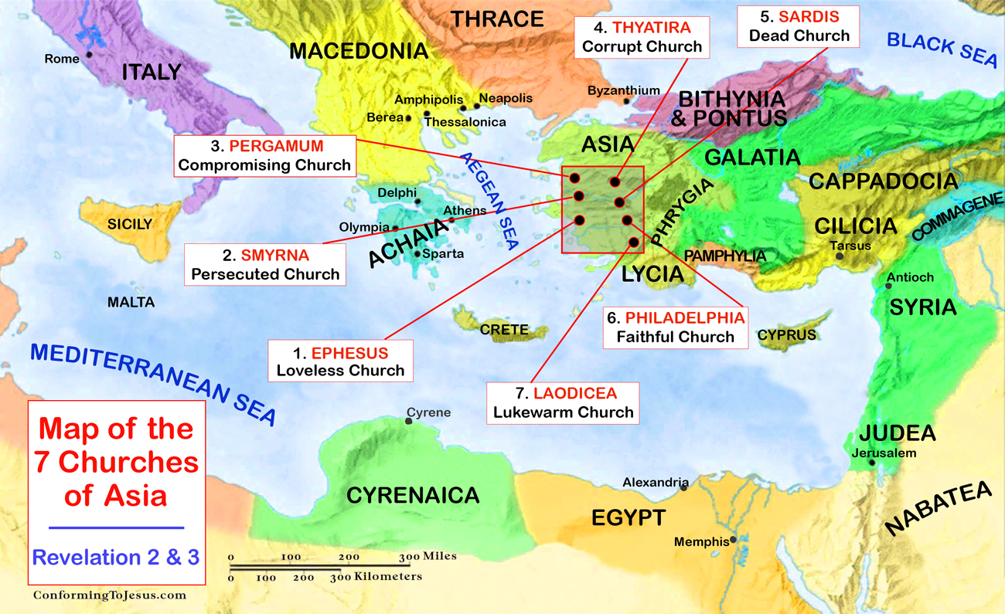

Slide 13
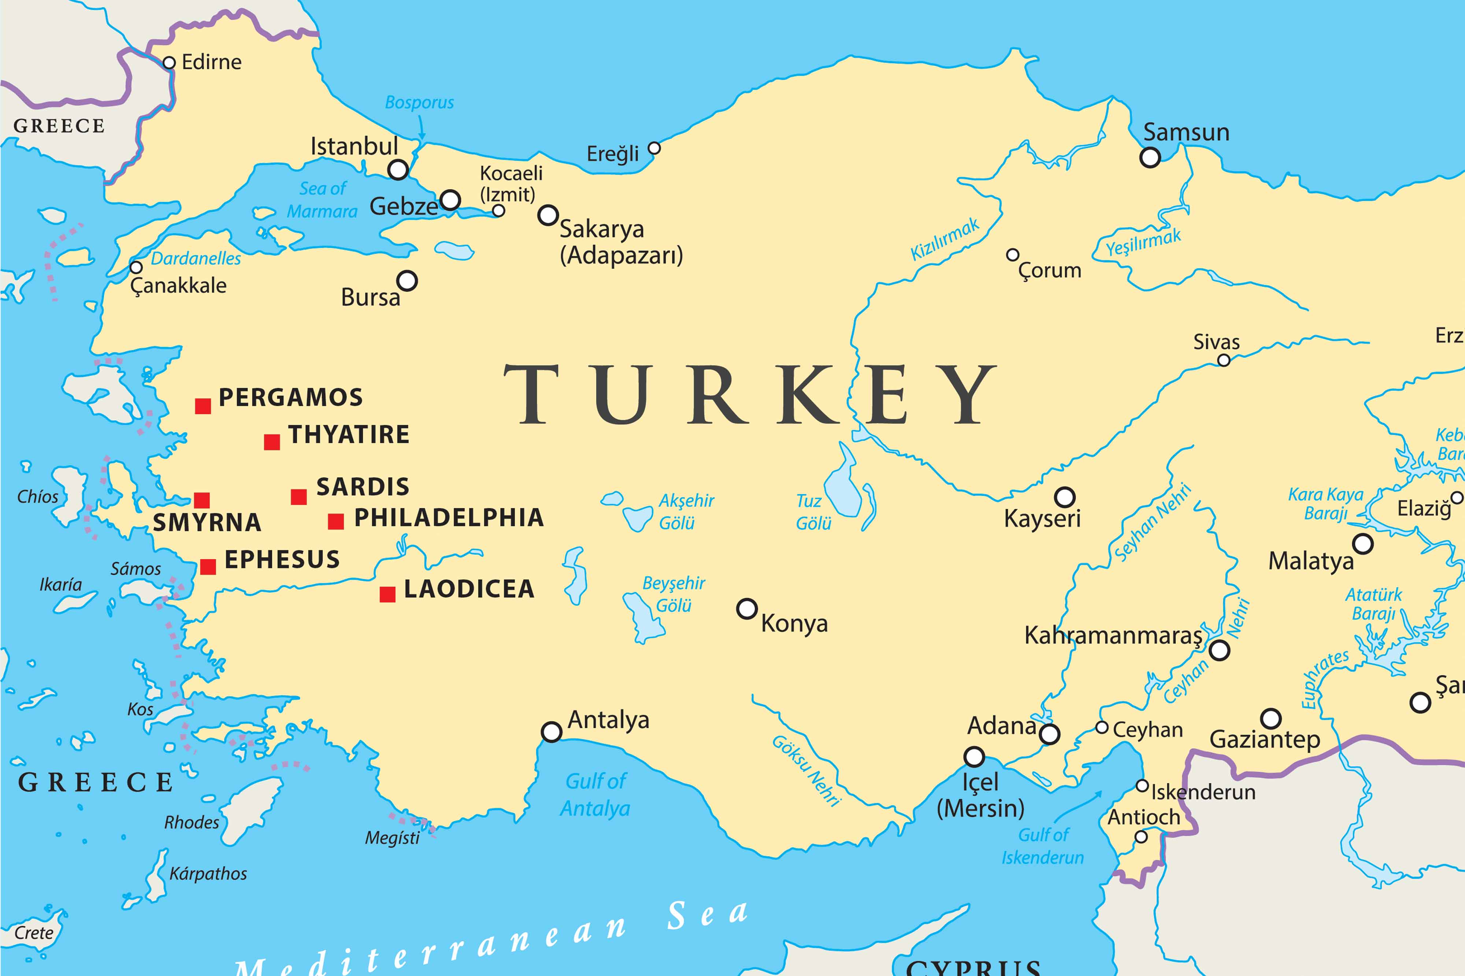

Slide 14
1st Century Roman Asia
One of the wealthiest provinces in the Roman Empire at this time.
Epicenter of the imperial cult (worship of the emperor as a god)
Refusal to participate in emperor worship had its consequences:
Economic (exclusion from work)
Social (ostracized in community)
Legal (imprisonment or death)

Slide 15
Situation of the Readers
Them
Us
Decades removed from Christ
Enjoyed material prosperity
Pressure to worship to the emperor
Choosing between faithfulness & comfort
Faced false teaching of compromise
Centuries removed from Christ
Enjoy (even more) material prosperity
Pressure to bow to the state / zeitgeist
Choosing between faithfulness & comfort
Face false teaching of compromise

Slide 16
The Revelation
For Sunday (3/19)
4. Write what you see in a book

