Slide 1
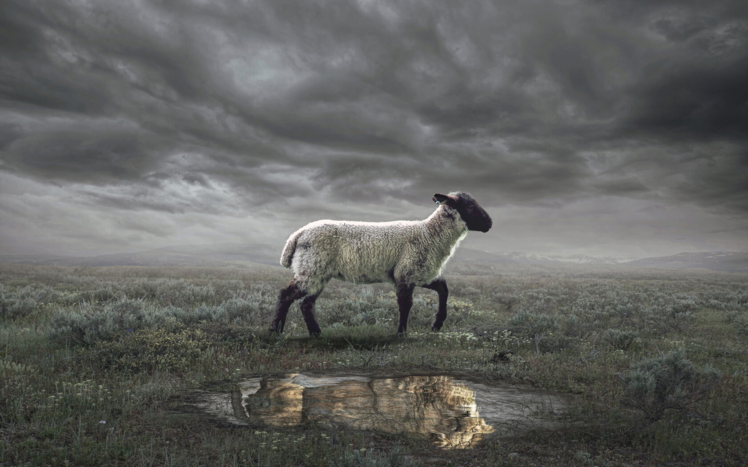
The Revelation
Bellaire Auditorium Class
Spring 2023

Slide 2
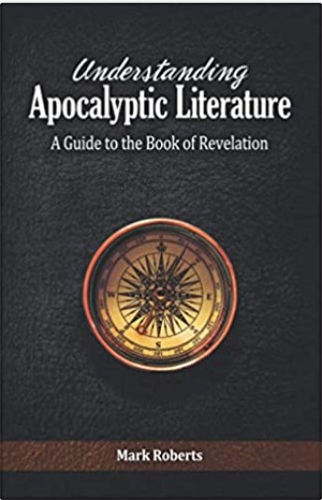
Understanding Apocalyptic Literature: A Guide to the Book of Revelation
Mark Roberts

Slide 3
What are we reading?
¹ The Revelation of Jesus Christ, which God gave Him to show to His bond-servants, the things which must soon take place; and He sent and communicated it by His angel to His bond-servant John, ² who testified to the word of God and to the testimony of Jesus Christ, even to all that he saw. ³ Blessed is he who reads and those who hear the words of the prophecy, and heed the things which are written in it; for the time is near.
⁴ John to the seven churches that are in Asia:

Slide 4
What is an Apocalypse?
This word (in the Bible) does NOT mean ”the end of the world.”
An apocalypse is an “unveiling”—pulling back the curtain to ”reveal” the reality of things.
Biblical examples:
Isaiah’s Call (Isaiah 6)
Saul’s Vision (Acts 9, 22, 26)
The Book of Daniel (ch.7-12)
Jacob’s Dream (Genesis 28; see 35:7)
Other examples?

Slide 5
Apocalyptic Literature
A genre that John’s readers would have been familiar with (Daniel, + contemporary writings)
Characteristics:
Time of distress for God’s people
God reveals something to a human
Mediated by a heavenly being (angel)
Narrative Framework (tells a story)
Shows a transcendent reality (time & space)
Heavy use of symbolism (pictorial, poetic)
To affect behavior (comfort & challenge)

Slide 6
How should we interpret Revelation?
Our attempt at a “sweet spot”
Preterist
Past Focus
As a Code
Present Focus
As a Lens
Futurist
Future Focus

Slide 7
What are we reading?
Apocalyptic Literature is “a story, written in a time of crisis and distress, that is given by otherworldly beings explaining how God will reverse everything so the righteous will triumph.”
- Mark Roberts

Slide 8
The Revelation
For Sunday:
2. The words of this prophecy

