Slide 1
Ten Words
A Study of the Ten Commandments
No Other God’s Before Me

Slide 2
Lead up to Mt. Sinai
In the beginning … it was very good - Genesis 1:26 – 2:3
It was perfect and holy
Everything was created according to His plan and purpose
Everything He created was in its proper order and functioned as it should
Fit for its intended use – (includes man)
Man rejected God’s will - Genesis 3:2-6
“…for in the day you eat from it your eyes will be opened, and you will be like God, knowing good and evil… when the woman saw that the tree was good for food, and that it was a delight to the eyes, and that the tree was desirable to make one wise, she took the fruit and ate…”
Perfection, Purpose, Relationship

Slide 3
All Leads to Mount Sinai
Expelled from garden, Cain & Abel, Corruption of mankind, The flood, Tower of Babel
Abraham – Isaac – Jacob – Levi – Kohath – Amram – Moses
Mankind continues it’s fall – doing what is right in their own eyes
Exodus 1-18
Birth of Moses – burning bush – Egyptian plagues – Passover Lamb – Exodus from slavery – Lord provides manna from heaven – 1st Sabbath observed – Mt. Sinai

Slide 4
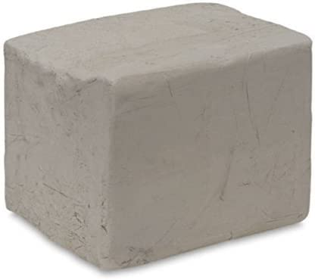
Ten Words
No other gods before me
No graven images
Do not take Lord’s name in vain
Remember the Sabbath
Honor your Father and Mother
Do not murder
Do not commit adultery
Do not steal
Do not bear false witness
Do not covet

Slide 5
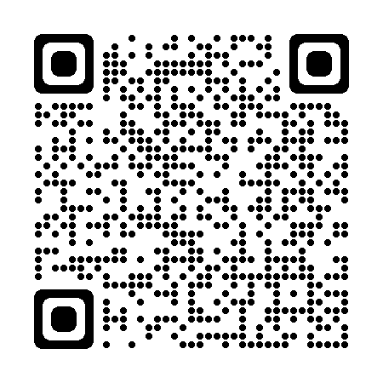
Psalm 1
“How blessed is the man who does not walk in the counsel of the wicked,
Nor stand in the path of sinners,
Nor sit in the seat of scoffers!
But his delight is in the law of the LORD,
And in His law he meditates day and night.
He will be like a tree firmly planted by streams of water,
Which yields its fruit in its season
And its leaf does not wither;
And in whatever he does, he prospers.”

Slide 6
God’s Covenant Agreement
Ex. 19:3-6 “…if you will indeed obey My voice and keep My covenant, then you shall be My own possession among all the peoples, for all the earth is Mine; and you shall be to Me a kingdom of priests and a holy nation.”
“…Obey My voice and keep My covenant…”
Relationship + Purpose + Perfect
Covenant: A binding agreement, a contract, or agreement
Ten Commandments themselves are a treaty document
Formal written agreement btw God and His people.
Written to secure the oath of loyalty between God and His people
To establish a separate and unique identity for God’s people

Slide 7
Historical Context: Ancient Treaties
Suzerain: A nation that controls another nation (vassal/lord)
Preamble: Identifies the giver and recipients of the covenant
Ex. 20:2 “I am the Lord your God…”
Prologue: Reminder of relationship of the suzerain to the people
Ex. 20:2 “…who brought you out of the land of Egypt…”
Stipulations: various laws/obligations on the part of the people
Ex. 20:3-23 – Ten Commandments
List of witnesses to the covenant
Document Clause: providing for writing down of the covenant

Slide 8
Ten Words / Decalogue
Never referred to as Ten Commandments
Hebrew expression appears 3 times in Old Testament
Ex. 34:28, Deut. 4:13, Deut. 10:4
Literally means Ten Words
Greek: Decalogue
Deka – “Ten”
Logos – “Words”
Ten words, statements, warnings, sayings, commands

Slide 9
Exodus 20:1-3
(1) Then God spoke all these words, saying,
(2) I am the Lord your God, who brought you out of the land of Egypt, out of the house of slavery.
(3) You shall have no other gods before Me.
What is the significance of this commandment to the Israelites?
At this moment in history, why was it so important for them?

Slide 10
What is the significance of this commandment to the Israelites?
Forming contract and identity – as God’s people
Ancient world of Egypt and Canaan
Revolutionary concept of monotheism.
Sets stage for remaining commandments
How you serve God matters
You must know who God is to serve Him

Slide 11
Who is this God…?
Ex. 20:2 “I am the Lord your God, who brought you out of the land of Egypt, out of the house of slavery.”
This introductory declaration tells us a lot about our God.
Establishes His identity
God is Omnipotent – ALL POWERFUL, Creator/Liberator (Gen. 1:1, John 1:3)
God is Omnipresent – ALL PRESENT (Prov. 15:3, II Chron. 16:9)
God is Omniscient – ALL KNOWING (Psalm 139:4, Matt 10:30)
Establishes His authority
He is loving – I’ve known you’re pain – you are not forgotten, you are loved, you are rescued, I’m offering you peace and stability.

Slide 12
New Testament Parallels
Exodus 20:2-3
Ex. 20:2 - “I am the Lord your God…”
Ex. 20:2 - “…who brought you out of the land of Egypt, out of the house of slavery.” Deut. 5:15 - Remember you were a slave!
“You shall have no other gods before me.” Deut. 6:5-6 – “..love the Lord your God with all your heart ...soul… might. These words, which I am commanding you today, shall be on your heart.”
New Testament Fulfillment
The Word was God – John 1 Transfiguration - Mark 9:7 “This is My beloved Son, listen to Him!”
Rom. 6:6 – In Christ we are no longer slaves to sin Gal. 5:1 – Christ set us free from sin John 8:32 – You will know the Truth and the Truth will set you free.
Matt. 22:37, 39 “…’You shall love the Lord your God with all your heart, and with all your soul, and with all your mind’ … the second is like it, ‘You shall love your neighbor as yourself”

Slide 13
Fulfilled in Christ
How does Jesus fulfill the law?
Matt. 5:17 “Do not think that I came to abolish the Law or the Prophets; I did not come to abolish but to fulfill.”
Matt. 22:37, 39 “…’You shall love the Lord your God with all your heart, and with all your soul, and with all your mind’ … the second is like it, ‘You shall love your neighbor as yourself”
Christ demonstrated the Greatest Command in every facet of His life!
Revealed the deeper meaning behind the decalogue
Matt 5 – murder/hate, adultery/lust, etc.
Conditions of the heart born from a person's true allegiance (self or God)

Slide 14
Covenant Renewals
Warnings/Admonition
Deut. 4:9-14
Deut. 5:15 - Remember you were a slave!
Deut. 6:5-6 – “You shall love the Lord your God with all your heart and with all your soul and with all your might. These words, which I am commanding you today, shall be on your heart.”
At Shechem under Joshua (Josh. 24)
At the coronation of David (II Sam. 5)
At the dedication of Solomon’s temple (I Kings 8)
At the Passover celebrated under Josiah (II Kings 23)

Slide 15
This Sunday
Exodus 20:4 – No Graven Images

