Slide 1
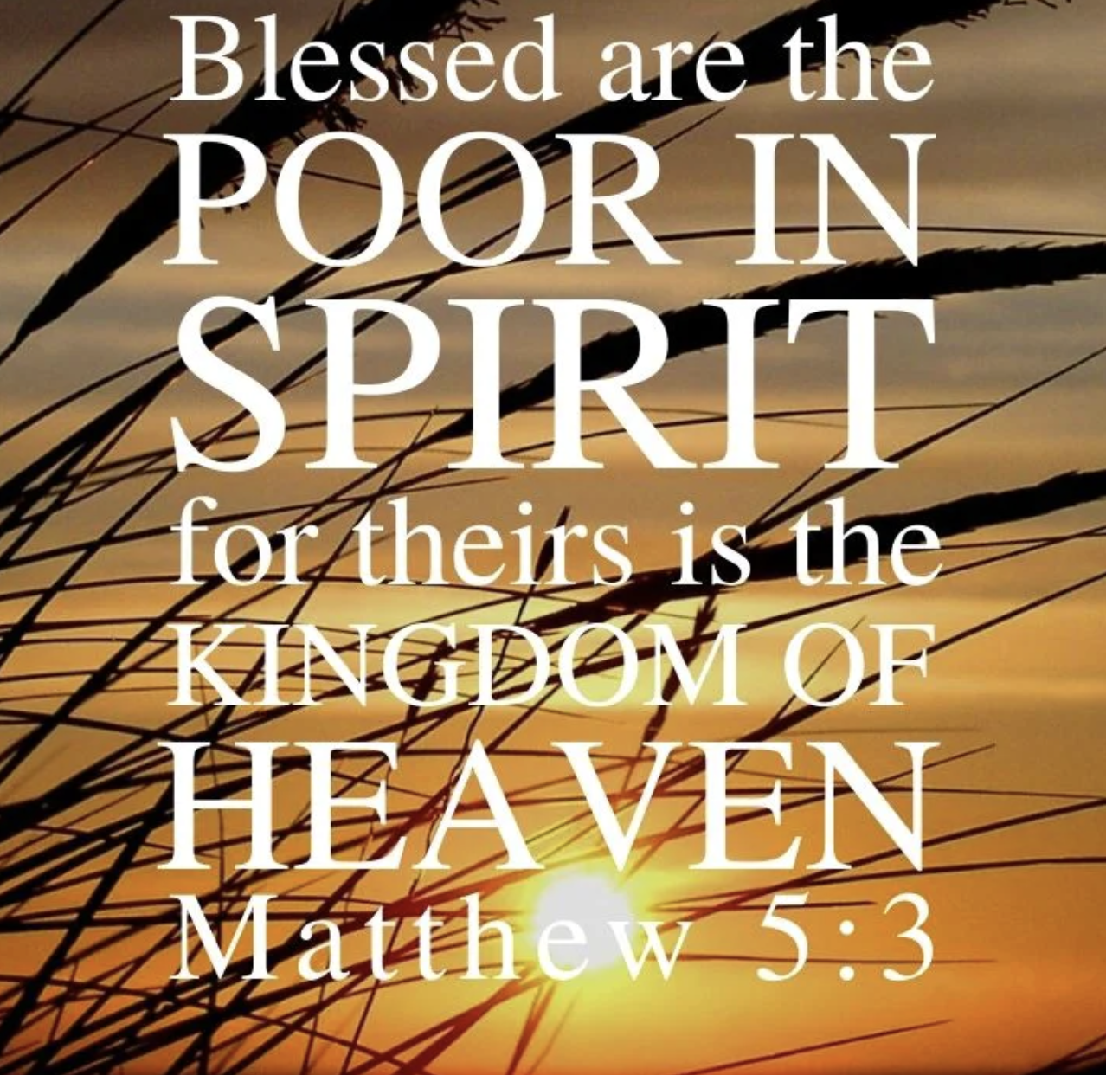

Slide 2
What Does It Mean? Poor in Spirit & The Kingdom of Heaven

Slide 3
For the word of the cross is folly to those who are perishing, but to us who are being saved it is the power of God. 1 Cor. 1:18
For consider your calling, brothers: not many of you were wise according to worldly standards, not many were powerful, not many were of noble birth. But God chose what is foolish in the world to shame the wise; God chose what is weak in the world to shame the strong; God chose what is low and despised in the world, even things that are not, to bring to nothing things that are, so that no human being might boast in the presence of God. And because of him you are in Christ Jesus, who became to us wisdom from God, righteousness and sanctification and redemption, so that, as it is written, “Let the one who boasts, boast in the Lord.” 1 Cor. 1:26-31

Slide 4
“Blessed are the poor in spirit, For theirs is the kingdom of heaven.” Matt. 5:3
Are you poor?
Who are the poor among us?
How is poor defined in the Bible?
1. Widow: Mark 12:43 the widow’s 2 mites were all that she had – “her whole livelihood”.
2. Lazarus: Luke 16:20-21
3. Parable of Great Supper: Luke 14:21

Slide 5
1. In the language of Judaism the terms were synonymous.
2. Accurate interpretation of Scripture requires that, when two or more passages are similar but not exactly alike, the clearer one explains the others
3. If Jesus was promoting material poverty, he would have contradicted other scriptures that teach us to give financial help to the poor.
4. The poor do have certain spiritual advantages over the rich (not having certain distractions and temptations),
5. Jesus often had “nowhere to lay His head” (Matt 8:20), but He and His disciples were not beggars.

Slide 6
What does it mean to be “poor in spirit”?
“To be poor in spirit is to have a humble opinion of ourselves; to be sensible that we are sinners, and have no righteousness of our own; to be willing to be saved only by the rich grace and mercy of God“ (Barnes)
1. An opinion/conviction of one’s own spiritual poverty:
2. Being “poor is spirit” involves 3 attitudes toward God and myself.

Slide 7
Humility – God is everything, not me.
Devotion – Because He is everything, He is to be praised and appeased; not me.
Dependence – Because God is everything, I must depend upon Him for everything; not me.
What poor in spirit does not mean:
Weakness:
And God is able to make all grace abound to you, so that having all sufficiency in all things at all times, you may abound in every good work. 1Cor. 9:8

Slide 8
Cowardice:
For you know the grace of our Lord Jesus Christ, that though he was rich, yet for your sake he became poor, so that you by his poverty might become rich. 2 Cor 8:9
The Priority of being “poor in spirit” –
God accepts “the spiritually poor”…
1. Isaiah 57:15 – For thus says the One who is high and lifted up, who inhabits eternity, whose name is Holy: “I dwell in the high and holy place, and also with him who is of a contrite and lowly spirit, to revive the spirit of the lowly,
and to revive the heart of the contrite. For I will not contend forever,

Slide 9
2. Isaiah 66:1-2 –
Thus says the LORD: “Heaven is my throne, and the earth is my footstool; what is the house that you would build for me, and what is the place of my rest? All these things my hand has made, and so all these things came to be, declares the LORD. But this is the one to whom I will look: he who is humble and contrite in spirit and trembles at my word.
3. Psalms 51:17 – The sacrifices of God are a broken spirit; a broken and contrite heart, O God, you will not despise.

Slide 10
God uses the “spiritually poor”:
Moses
John the Baptizer
Peter
“Depart from me, for I am a sinful man, O Lord!” (Luke 5:8).
Paul
“nothing good dwells in me, that is, in my flesh” (Rom 7:18),

Slide 11
He learned:
That he was the chief of sinners
(1 Tim 1:15)
That the best things he could do in himself were rubbish (Phil 3:8).
He learned that knowing God’s grace was sufficient for him.

Slide 12
“For theirs is the kingdom of heaven”
“The kingdom of God is at hand” meant more than just the coming of the church in Acts 2.
The Pharisees had a legalistic view of the kingdom; those who were truly under God’s reign were those who kept the law best.
Poverty of spirit is the key to greatness in the Kingdom. Matthew 18:1-4
In God’s kingdom, the way up is down.

Slide 13
James 4:10 – 10 Humble yourselves in the sight of the Lord, and He will lift you up.
Proverbs 16:18 – 18 Pride goes before destruction, And a haughty spirit before a fall.
Some practical manifestations of poverty of spirit:
A. In Our Prayers:
B. In Our Unity: (treatment of others)
For by the grace given to me I say to everyone among you not to think of himself more highly than he ought to think, but to think with sober judgment, each according to the measure of faith that God has assigned. Rom. 12:3

Slide 14
Philippians 2:3-4 Do nothing from selfish ambition or conceit, but in humility count others more significant than yourselves. Let each of you look not only to his own interests, but also to the interests of others.
C. In Our Obedience:

