Slide 1
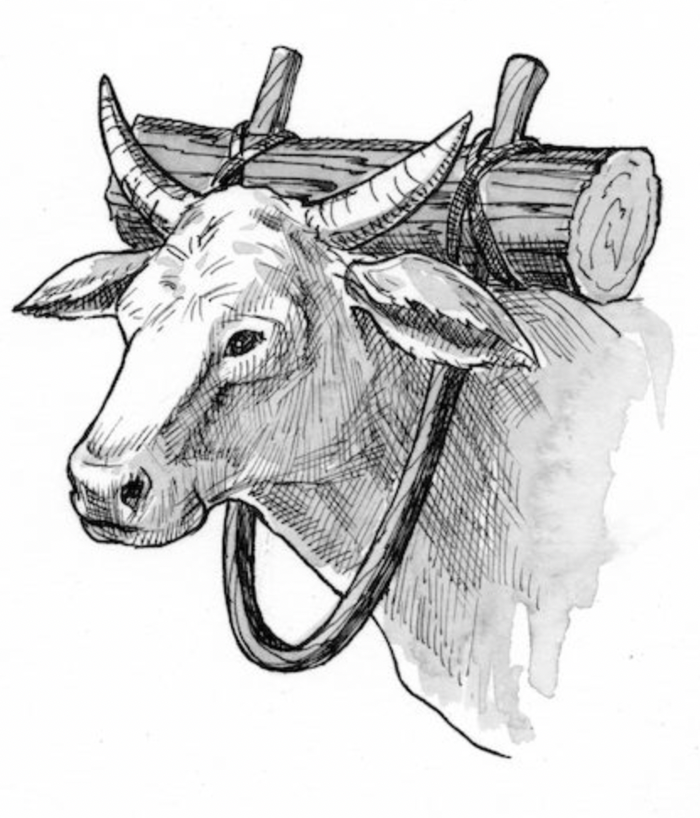
Jesus’ Invitation
Matt. 11:28-30
Isa. 61:1-11

Slide 2
1. These words depict what is often referred to as the “invitation of Jesus” – “Come unto Me”.
2. To whom did Jesus make this promise? Why does he promise them rest? What is the basis of Jesus’ invitation to come?
3. To view the context of Jesus words, go back with me to Matt.11

Slide 3
The Old Testament Key is found in Isaiah 61:1-11

Slide 4
In the year of the Lord’s favor:
1. That day will be a day of judgment against those who rebel.
2. But it will also be a day when those who mourn in Zion will be comforted.
3. The cities that had been destroyed by God’s judgment will be rebuilt.
4. Isaiah continues to describe the Messianic age as a time when God’s people will rest from their labors –
5. vs. 7-10 - The land will provide a double portion; more than enough.
6. Righteousness will sprout up before the nations.

Slide 5
Repentance Equals Rest:
The events between the beginning of Matthew 11 and the promise of v. 28-30 help us see the continuing picture of rest.
1. v. 8-15; John was “more than a prophet”:
2. v. 16-19; “To what can I compare this generation?”
3. v. 20-24; “Woe to you, Korazin…”
4. v. 25-27; Arrogance vs. Humility:

Slide 6
“Come to Me…” (Matt 11:28-30)
But who are the “weary and heavy laden”?
“the poor, lost, ruined sinner:
the man “burdened” with a consciousness of his transgressions, trembling at his danger, and seeking deliverance.”
How were they Burdened?
Burden of the Pharisaical Traditions:
Burden of Personal Sin:
Burden of Moral Guilt:
Burden of the Practice of Sin:

Slide 7
For to set the mind on the flesh is death, but to set the mind on the Spirit is life and peace. Rom. 8:6
“I Will Give you Rest”
But now in Christ Jesus you who once were far off have been brought near by the blood of Christ. For he himself is our peace, who has made us both one and has broken down in his flesh the dividing wall of hostility by abolishing the law of commandments expressed in ordinances, that he might create in himself one new man in place of the two, so making peace, and might reconcile us both to God in one body through the cross, thereby killing the hostility. And he came and preached peace to you who were far off and peace to those who were near.
(Eph. 2:13-17)

Slide 8
“Take My Yoke Upon You and Learn from Me”
- Submit to what? How do I take on the yoke?
- Faith comes by hearing the word of God, and no one can come to Christ without being taught correctly. But Jesus is more specific here.
- What must I learn from Jesus?
- There is no promise of rest for those who fail to learn from Jesus how to be humble before God.

Slide 9
And being found in human form, he humbled himself by becoming obedient to the point of death, even death on a cross. Therefore, God has highly exalted him and bestowed on him the name that is above every name. Phil. 2:8-9
“My yoke is easy; my burden is light”

Slide 10
Everyone who believes that Jesus is the Christ has been born of God, and everyone who loves the Father loves whoever has been born of him. By this we know that we love the children of God, when we love God and obey his commandments. For this is the love of God, that we keep his commandments. And his commandments are not burdensome. 1 John 5:1-3

Slide 11
For I consider that the sufferings of this present time are not worth comparing with the glory that is to be revealed to us. Rom. 8:18

Slide 12
Jesus’ Invitation
Matt. 11:28-30
Isa. 61:1-11

