Slide 1
Pentecost Fully Come
Gratitude, Law, & Life

Slide 2
Feast of Weeks (Pentecost)
Spring Harvest Festival (Leviticus 23)

Slide 3
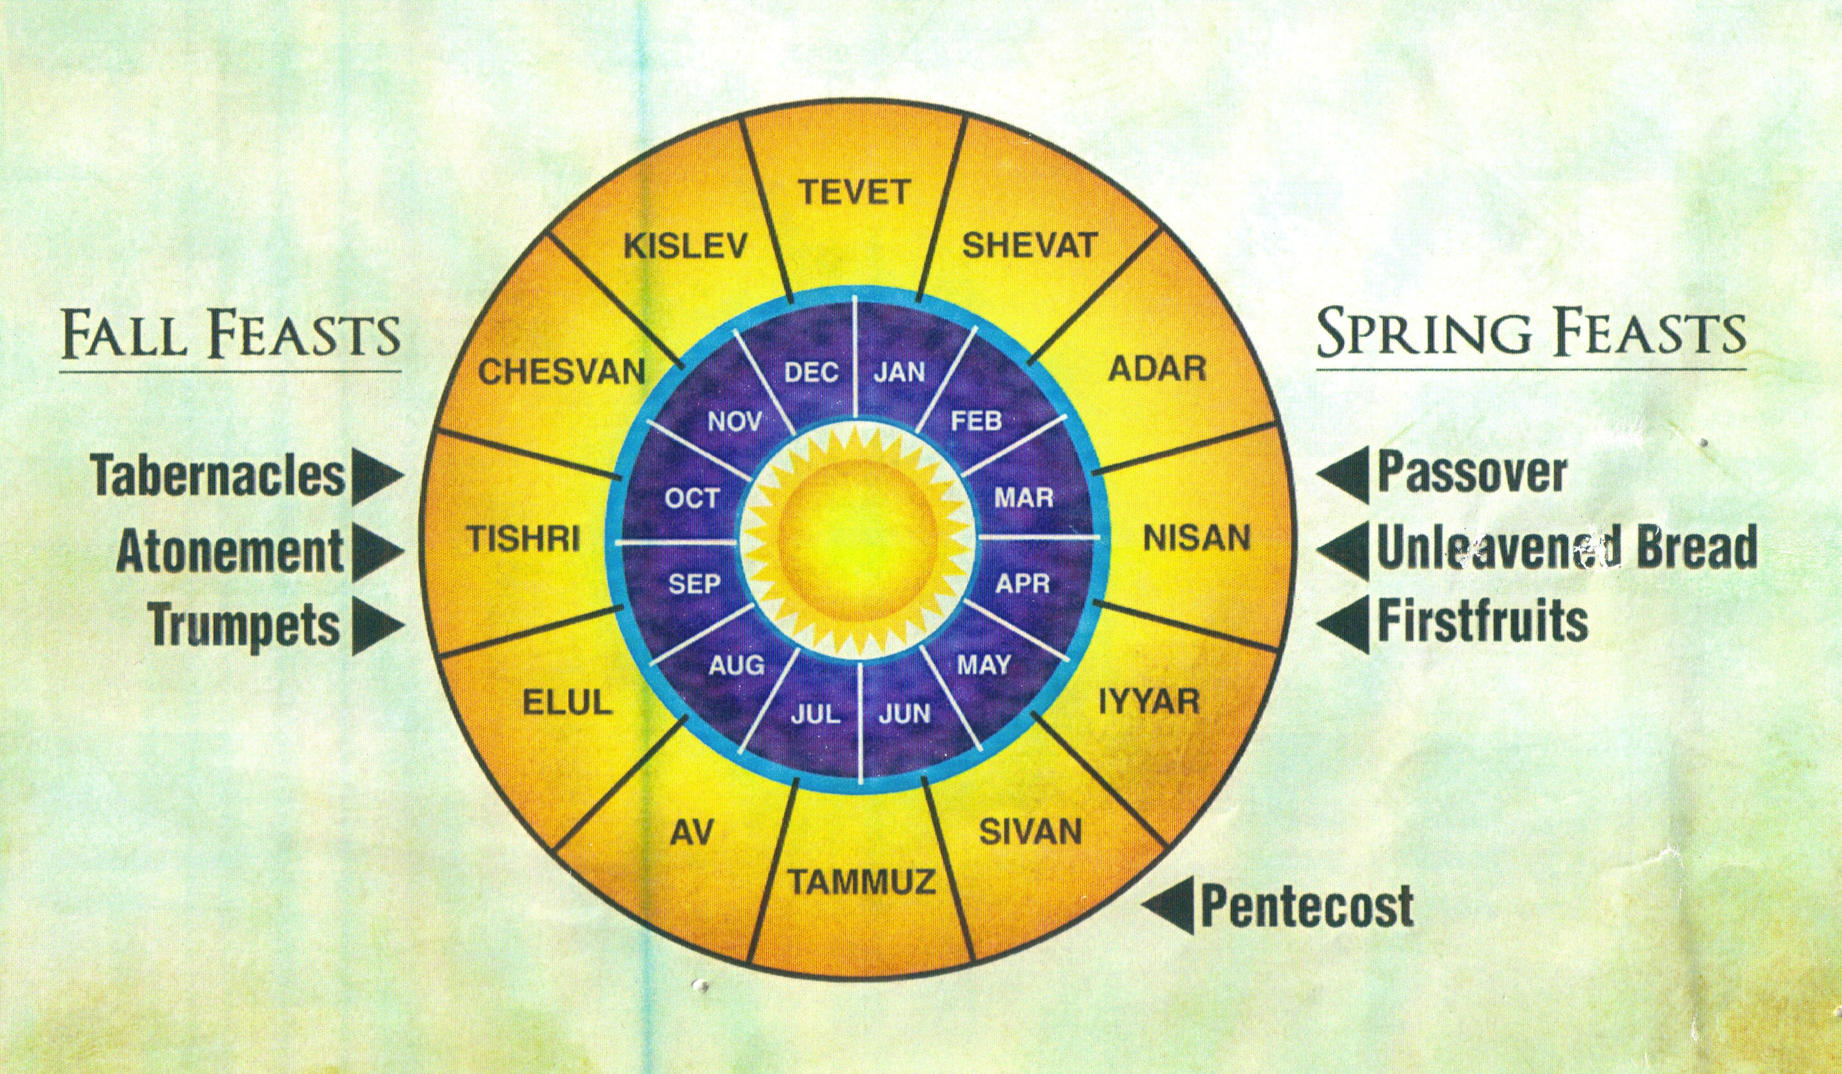
Barley
Olives/ Grapes
Wheat

Slide 4
Feast of Weeks (Pentecost)
Spring Harvest Festival (Leviticus 23)
For us: Gratitude → Generosity

Slide 5
Exodus 19:1 – “In the third month after the sons of Israel had gone out of the land of Egypt...”
1
Exodus from Egypt
2
3
God speaks at Sinai

Slide 6
Feast of Weeks (Pentecost)
Spring Harvest Festival (Leviticus 23)
Anniversary of Sinai (Exodus 19)
For us: Celebrate God’s Instruction

Slide 8
Pentecost Fully Come (Acts 2)
God’s presence comes in power
A New Covenant proclaimed
First fruits of God’s harvest
Sharing of God’s good blessings

Slide 9
Feast of Weeks (Pentecost)
Spring Harvest Festival (Leviticus 23)
Anniversary of Sinai (Exodus 19)
First Fruits of Believers (Acts 2)
For us: We are first-fruits, offered to God.

Slide 10
Pentecost Fully Come
Lift up your eyes and look on the fields, that they are white for harvest!

