Slide 1
Perspective

Slide 2
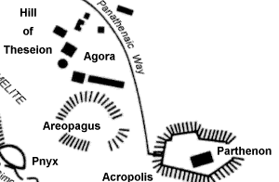
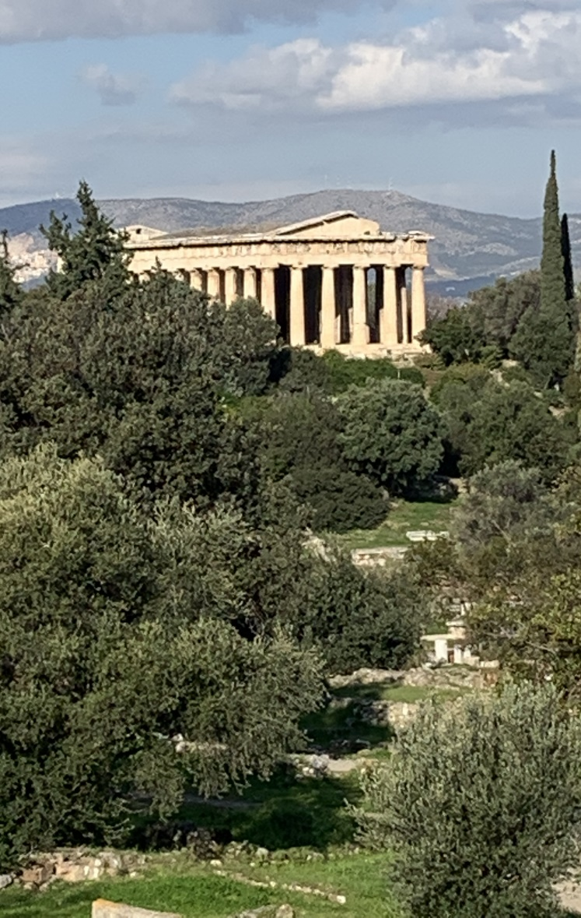
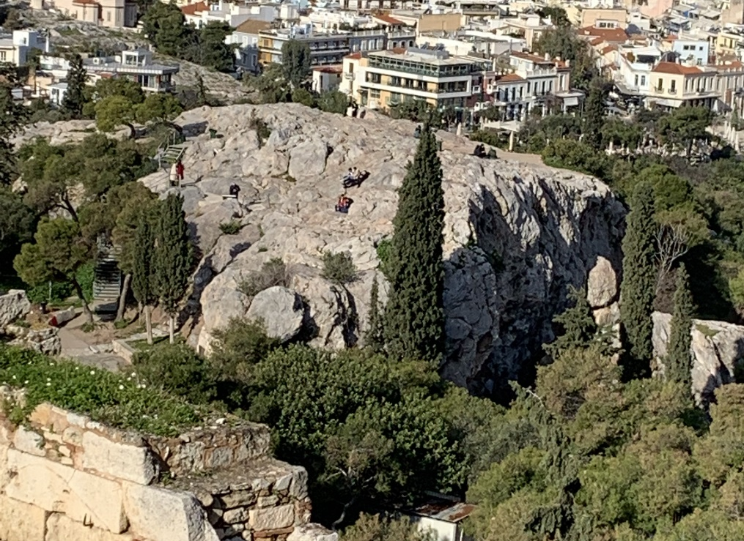
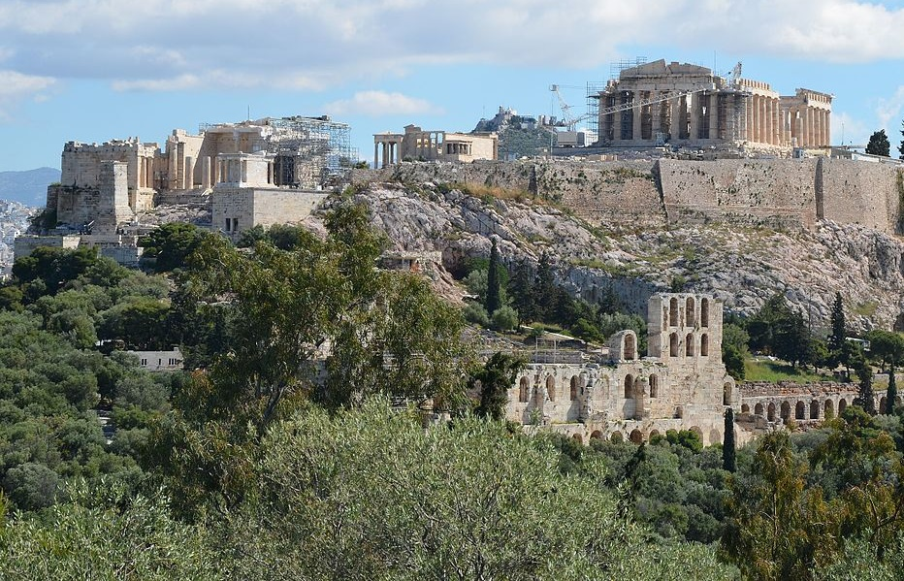
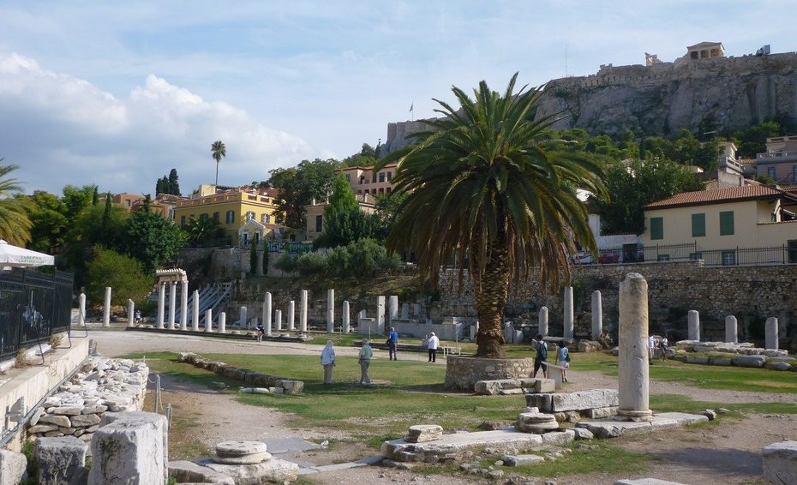
Temple of Hephaestus
Temple of Hephaestus
Site Map
Areopagus
(Acropolis view)
Acropolis
Ancient Agora
(possible location of Synagogue)

Slide 3
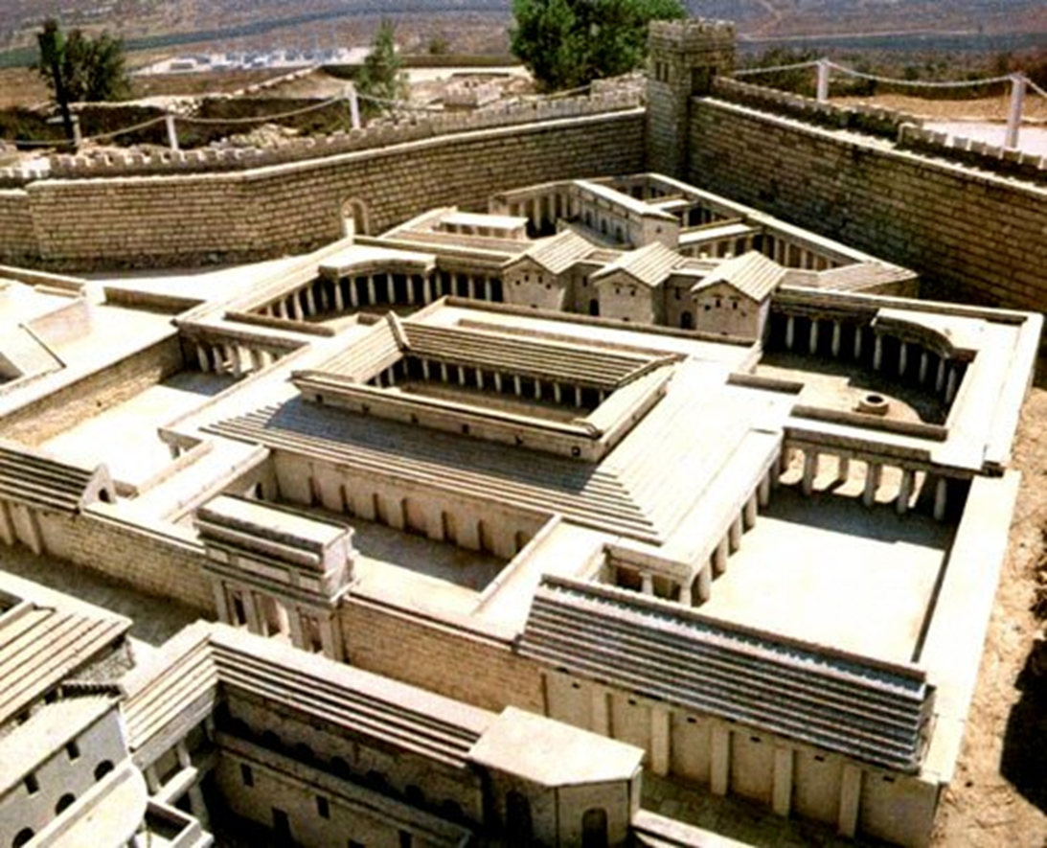
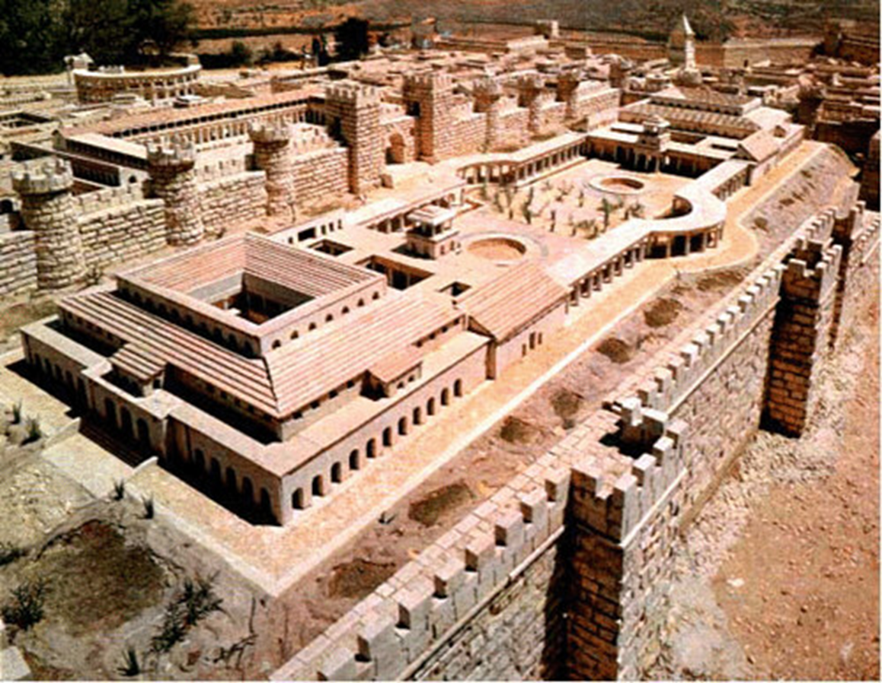
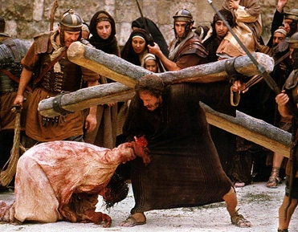
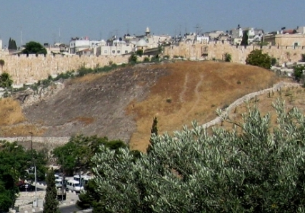
Christ’s Suffering – A New Perspective
Trials of Jesus - House of Caiaphas
Jesus is Beaten - Praetorium
Luke 22:54-71
Mark 15:15-20
Luke
23: 20-23, 27-38,
44-46
Jerusalem – Jesus carries the Cross
Golgotha – Jesus on the Cross

