Slide 1
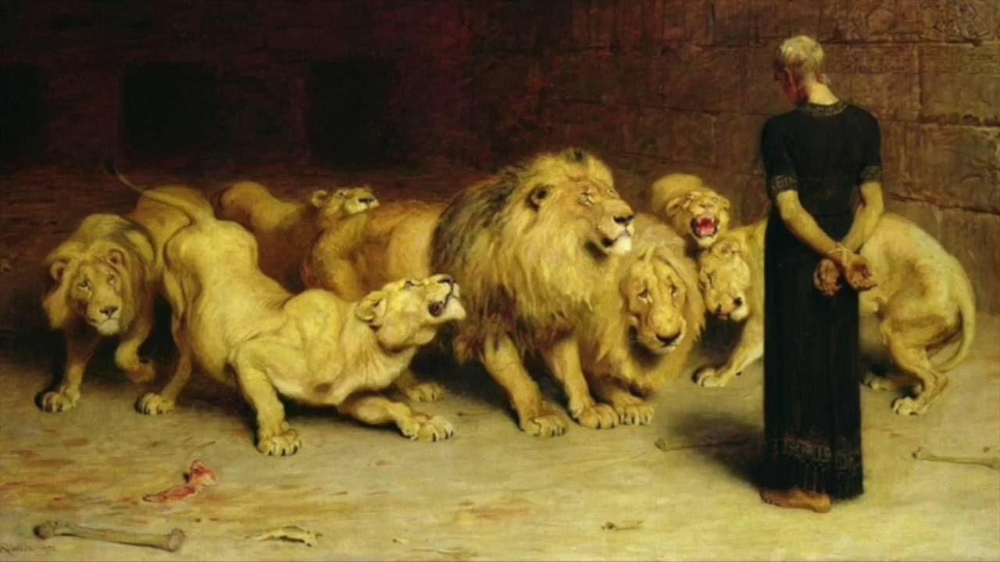
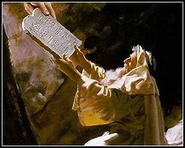
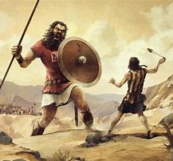
Old Testament Survey
Lesson 9: The Divided Kingdom – Judah
“….our tutor to bring us to Christ” (Gal 3:24)

Slide 2
Date | Lesson Topic | Class Leader
Dec 1 (W) | Why study the OT? Theme of the OT. OT Summary. | Rick
Dec 5 (S) | Genesis (part 1) | Jordan
Dec 8 (W) | Genesis (part 2) | Jordan
Dec 12 (S) | The Exodus (Egypt to Canaan) | Rick
Dec 15 (W) | The Law | Rick
Dec 19 (S) | Joshua and Judges | Jordan
Dec 22 (W) | The United Kingdom: Saul, David, and Solomon | Rick
Dec 26 (S) | The Divided Kingdom: Israel | Jordan
Jan 2 (S) | The Divided Kingdom: Judah | Rick
Jan 5 (W) | Books of Poetry and Wisdom | Jordan
Jan 9 (S) | Major Prophets: Isaiah, Jeremiah, Ezekiel, Daniel | Rick
Jan 12 (W) | Old Testament Review | Jordan
Jan 16 (S) | Between the Testaments | Jordan

Slide 3
Summary of OT Bible Chronology (In Round Numbers)
Event | Approximate Date
Creation | ~4,200 BC
Noah / The Flood | ~2,600 BC
Joseph / Israel to Egypt | ~2,000 BC
Moses / Exodus from Egypt | ~1,500 BC
Reign of Solomon | ~970 BC
The Divided Kingdom (Rehoboam / Jeroboam) | ~930 BC
The Assyrian captivity of Israel | ~740 BC
The Babylonian captivity of Judah | ~606 BC / ~587 BC
Return to Judah | ~536 BC
Birth of Christ | ~3 BC

Slide 4
Why Study & Focus on OT
Leads us to Christ
Prophecies to confirm the Gospel
Gives Examples to us
Shows us the Nature and Expectations of God

Slide 5
Genesis Connection Points
Fall of Man in Genesis 3
Knowing good & evil (v3)
Eternal life (v22)
First Adam, Last Adam (I Cor 15:45)
The Covenant
God chooses one family and makes them great in order to bless all mankind

Slide 6
Exodus / Law Connection Points
Moses led out of Egypt… Jesus leads out of sin
Brass Serpent (John 3:14-15)
The Passover is established
Jesus as the Passover (I Cor 5:7)
A New Prophet (Deu 18:15-20)

Slide 7
Joshua / Judges Connection Points
The name “Jesus”
A descendent of Rehab (Matt 1:5)
Like Joshua, Jesus leads to victory
The Perfect Judge

Slide 8
Period of the Kings Connection Points
The lineage of David
I Chronicles 17:14
Sending of Elijah the Prophet
John the Baptist
Transfiguration

Slide 9
Poetry / Wisdom Connection Points
The Hope of Redemption
The Hope of Deliverance
Awaiting the Messianic King

Slide 10
The Prophets Connection Points
Isaiah 53
The New Covenant (Jer 31:31-34)
The One Shepard (Ezek 37:24-26)
The New Kingdom w/ an everlasting dominion (Dan 2 & 7)

