Slide 2
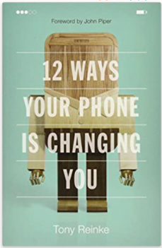
12 Ways Your Phone is Changing You
By: Tony Reinke

Slide 3
Two Visions of Technology
Garden of Eden
(Genesis 1-2)
City of Babel
(Genesis 11)
Man made to rule (cultivate, protect), filling the earth with God’s glory.
We are made in God’s image, with intellect & ingenuity.
Intended to build, create, invent to fulfill God-given purpose.
Man is intelligent & capable, human potential is unlimited.
We are better off seeking their own purposes (w/o God)
We can create, build, invent to overcome our limitations and make our world what we want it to be.

Slide 4
My Vision of Tech/Devices
Can I redeem my view in Christ?
Have I bought into Babylon’s view?
Can I use my device in submission to God?
Can I use tech & media to produce good fruit in myself?
How can I protect myself and my family?
How can I use social media to bless others?
Does my use of tech give glory to God?
Is it, “If I can … , I will”?
Am I pursuing happiness in tech & media?
Am I using devices & social media to avoid (hard) reality?
Does my use of technology isolate me?
Do I use tech to do what I want to do?

