Slide 1
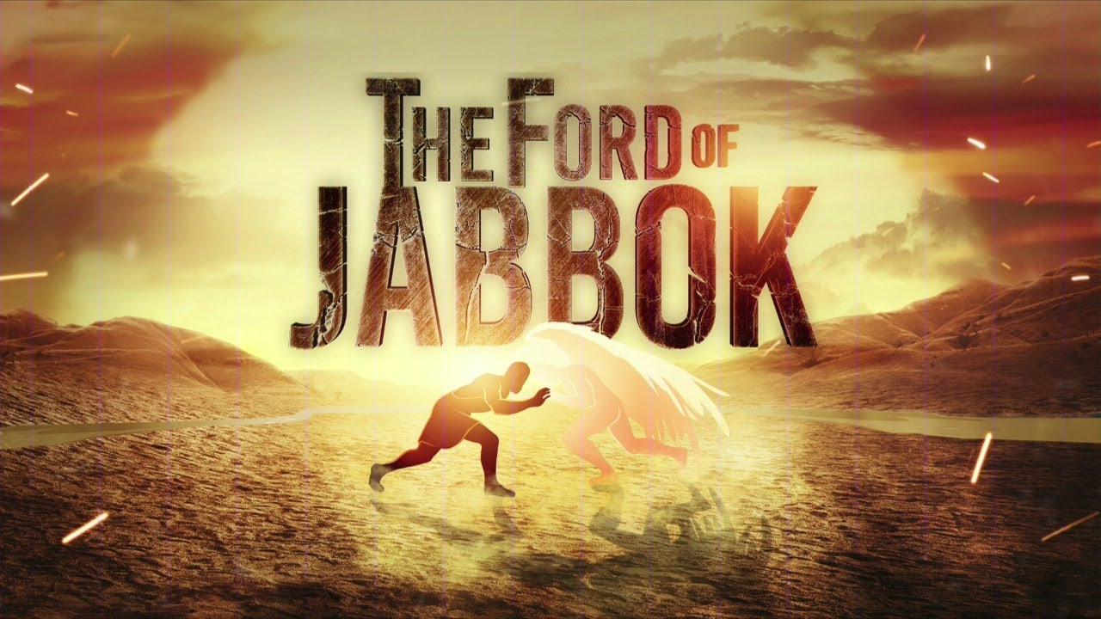
PENIEL

Slide 2
PENIEL

Slide 3
It is a story of contrasts:
A contrast between the human and the divine,
A contrast between nature and grace,
A contrast between man and God,
A contrast between self-effort and Divine Power.

Slide 4
²⁴ Then Jacob was left alone, and a man wrestled with him until daybreak.

Slide 5
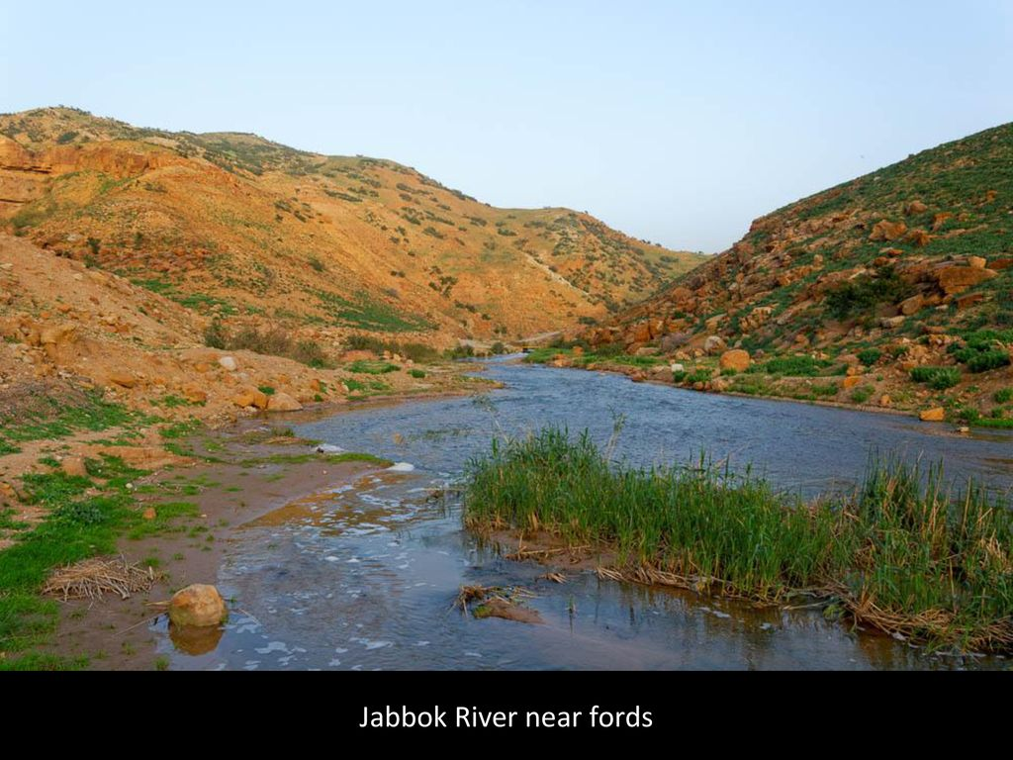

Slide 6
²⁴ Then Jacob was left alone, and a man wrestled with him until daybreak.
NOT BY CRAFT or ABILITY
NOT BY FLATTERY
BUT BY DIVINE GRACE AND POWER!
WE ARE SO MUCH LIKE JACOB!

Slide 7
GOD DID NOT GIVE UP ON JACOB!
GOD DOES NOT GIVE UP ON US!
²⁵ When he saw that he had not prevailed against him, he touched the socket of his thigh; so the socket of Jacob’s thigh was dislocated while he wrestled with him.
Hebrews 12:11
¹¹ All discipline for the moment seems not to be joyful, but sorrowful; yet to those who have been trained by it, afterwards it yields the peaceful fruit of righteousness.

Slide 8
²⁶ Then he said, “Let me go, for the dawn is breaking.” But he said, “I will not let you go unless you bless me.”
²⁷ So he said to him, “What is your name?” And he said, “Jacob.” ²⁸ He said, “Your name shall no longer be Jacob, but Israel; for you have striven with God and with men and have prevailed.” ²⁹ Then Jacob asked him and said, “Please tell me your name.” But he said, “Why is it that you ask my name?” And he blessed him there.

Slide 9
What was included in that divine blessing.
A new character.
Not Jacob the crafty one – but Israel – the one who leads and overcomes.
2. A new power is to be his.
When God is first in your life – power with men naturally follows.
Having the first guarantees the second!
³⁰ So Jacob named the place Peniel, for he said, “I have seen God face to face, yet my life has been preserved.”

Slide 10
Now he can meet Esau without fear.
Now he can face any emergency.
Now he can overcome any obstacle.
³¹ Now the sun rose upon him just as he crossed over Penuel, and he was limping on his thigh. ³² Therefore, to this day the sons of Israel do not eat the sinew of the hip which is on the socket of the thigh, because he touched the socket of Jacob’s thigh in the sinew of the hip.
“Peniel” was a monument fashioned by Jacob.
But now Jacob is a monument fashioned by God!

Slide 11
Peniel or the face of God has a three-fold significance for us today.
1. Peniel is the place of power for daily life.
2. Peniel is the place of spiritual blessing
The supreme need of man is the Grace of God!
3. Peniel is the place of transformation of character.

Slide 12
Hebrews 12:9-10
⁹ Furthermore, we had earthly fathers to discipline us, and we respected them; shall we not much rather be subject to the Father of spirits, and live? ¹⁰ For they disciplined us for a short time as seemed best to them, but He disciplines us for our good, so that we may share His holiness.

Slide 13
Psalms 27:7-8
⁷ Hear, O LORD, when I cry with my voice, And be gracious to me and answer me. ⁸ When You said, “Seek My face,” my heart said to You, “Your face, O LORD, I shall seek.”

Slide 14
PENIEL

