Slide 2
Neither Hot Nor Cold
The Church in Laodicea Revelation 3:14-22

Slide 3
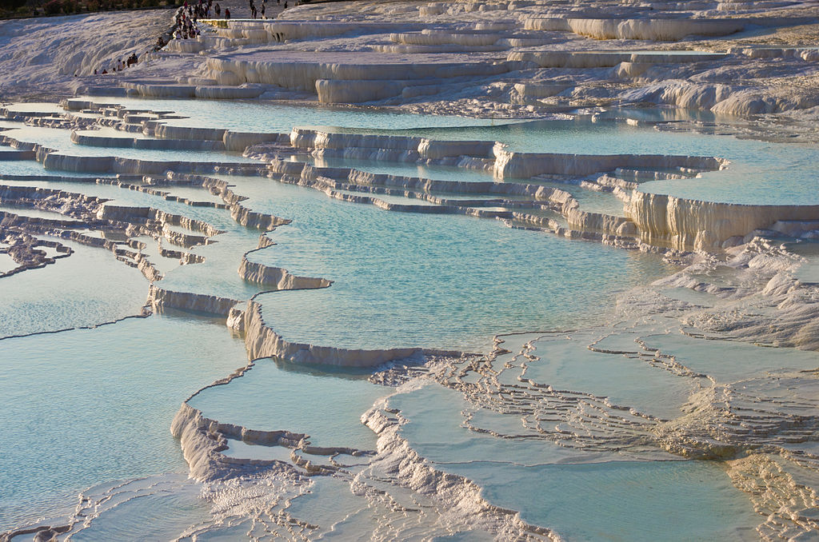
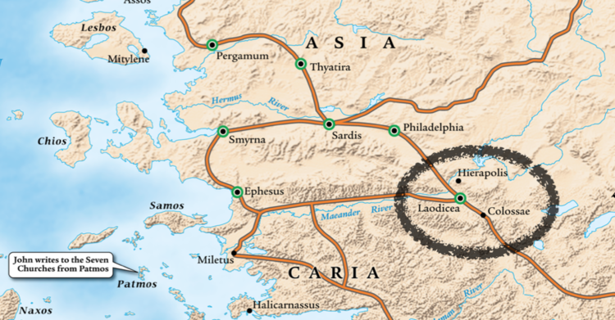
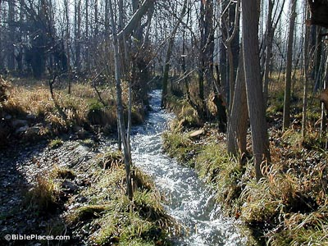

Slide 4
What the Spirit Says to the Church at Laodicea (Revelation 3:14-22)
A stagnant church, worthless, repulsive to the Lord. (15-16)
External comfort blinded them to their spiritual wretchedness. (17)
If this is us, what do we do?

Slide 5
What The Lord Sees & Advises (Revelation 3:14-22)
Poverty (Riches without wealth)
Shame (Appearance without honor)
Blindness (Sight without vision)
Buy Jesus’ refined gold (13:17; 21:18)
Wear His white garments (7:14; 19:8)
Use His healing salve (1:1,15; John 9)

Slide 6
A Harsh Message? (Revelation 3:14-22)
Jesus the Amen, the Faithful & True Witness, the Origin of Creation. (14)
He rebukes and disciplines because He loves. (19)
He continues to stand at the door, knock, and call. (20)
He offers intimate fellowship and a seat on His throne. (21)

Slide 7
Hear What The Spirit Says
“Be zealous and repent … hear My voice, open the door, and I will come in.” Revelation 3:19-20

