Slide 1
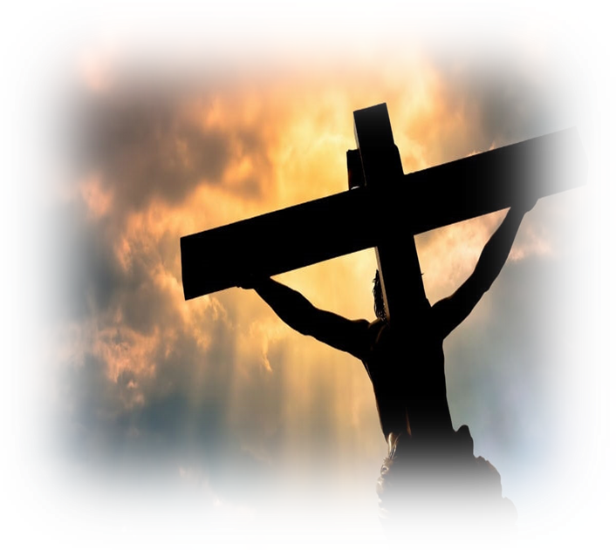
Lord’s Supper
The Purpose and Meaning of Life
Jesus Christ is The Foundation
Notes:
To prepare or minds for the Lord’s Supper, my comments will concern the purpose and meaning of life of which Jesus Christ is the foundation and Chief Corner Stone. Without Jesus, our lives have no meaning or purpose. Without Him, we would only have death and the grave. With Him, we have everything

Slide 2
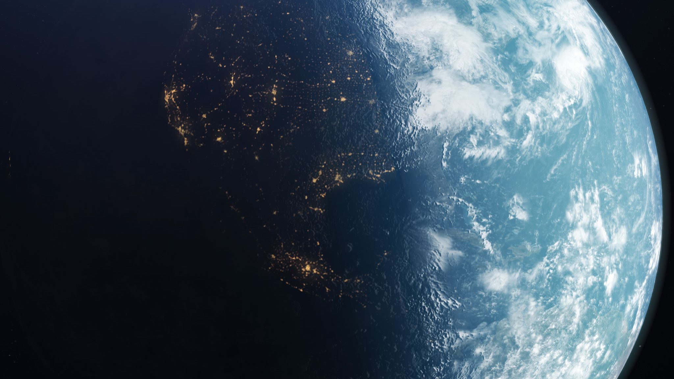
Life is a Journey
How? How did we get on this journey?
Why? Why are we on this journey?
When? When does our journey end?
Where? Where are we going?
What? What is our Destination?

Slide 3
Not Idle Questions Critically Important Answers we provide to Ourselves
Determines understanding of this life’s meaning and purpose
Determines the roles – behaviors – priorities we choose for ourselves while in this life

Slide 4
Two Viewpoints Shape our Answers
World’s Perspective
God’s Perspective

Slide 5
World’s Perspective – Creation & Life
Since the World Rejects God – Searches for Natural Law Explanations
Not know how we entered this life’s journey
Not know why we are on this life’s journey
Offers no rational explanation why we live and exist

Slide 6
World’s Perspective – Creation & Life
No discernable reason or purpose for Existence or Life - It only offers
Unproven Theories – How infinite Void of Nothingness Created Everything
Conflicting Philosophies concerning Meaning of Life
Pondering why Good – Evil – Suffering Co-Exist – No Answers Found
Conclusion: Life serves no higher purpose than to exist

Slide 7
World’s Perspective – Journey’s End & Destination
Journey End:
Death
Grave
Destination: Non-Existence - Oblivion

Slide 8
World’s Perspective Descends into a Paradoxical Contradiction
Despite Death’s Certainty – You Shall not Die
How?
Don’t think about death
Ignore looming certainty
Hidden & Unseen
Not Relevant to Present Everyday Life
Relegated to Distant Future
Unimportant to the Present

Slide 9
World’s Perspective – Destination Paradox
Having no sense of Life’s Purpose – Ignoring Death’s Imminence
Live Life as if the world is all there is
Lose Sight of the Eternal Spiritual Things that Matter
Engage in the Temporal Things that Don’t Matter
Treat the Temporary & Passing Things as Eternal
Overlook the Ecclesiastical Message:
Physical Life is Hevel: vapor-smoke-vanity Eccl 1:14; 2:11
Soon vanish – Utterly & Absolutely Forgotten. Ps 103:15-16

Slide 10
World’s Perspective – Destination Paradox
Those without faith don’t stand a Chance – Blind - Perish
2 Corinthians 4:4
But God’s Children can fall victim to the deception – the lie.
Focus on things of world because we Live in the World
Responsibilities-Pressures-Desires Clamor for our attention.
Squeeze out Spiritual Lives – Choke our Souls
Lose sight of what matters eternally – focus on the temporal – not matter
Not Uncommon. Its normal. Spiritual Battle. Ephesians 6:10-18

Slide 11
The Apostle Paul’s Admonishment
1 John 2:15-17 Do not love the world nor the things in the world. …¹⁷ The world is passing away, and also its lusts; but the one who does the will of God lives forever.

Slide 12
Scriptural Perspective on Life’s Journey: How?
According to Scripture - How did we get on Life’s Journey?
Unlike the World not knowing how Existence and Life began
Scripture declares God created - Everything:
All of Existence. Genesis chapters 1-2; Colossians 1:16; Revelation 4:7
All life. Genesis 1-2; Psalms 139:13; 119:73; Isaiah 43:7; 44:2, 24; Jeremiah 1:5; Ephesians 2:10
Why is it easier to believe the Void of Nothingness is our Creator?

Slide 13
Scriptural Perspective on Life’s Journey: Why?
According to Scripture - Why did God put us on Life’s Journey?
Unlike the World not knowing Meaning of Life
Scripture declares Two Reasons for Creation and Life
Bring Other Sons into Glory. Ephesians1:3-4; Hebrews 2:10
Perfection of God’s Children. Matthew 5:48; 2 Timothy 3:16; Hebrews 12:23; James 1:2-4

Slide 14
Scriptural Perspective on Life’s Journey
Life’s journey fulfills God’s dual purposes: Choosing and Perfecting His sons.
Therefore, this life is comprised of two parts:
A journey to Christ by which God chooses His sons.
A journey with Christ by which God perfects His sons.
This is the true essence and meaning of this life.

Slide 15
Journey to Christ – Fulfills Two Purposes
The Invitation – God calls all Men to Salvation & Adoption as Sons through the Gospel. Acts 2:39; 2 Thessalonians 2:14; 1 Timothy 2:3-4

Slide 16
Journey to Christ – Fulfills Two Purposes
The Choosing – God chooses His sons at baptism
Union: United To Christ – Death – Burial - Resurrection. Romans 6:3-9; Galatians 3:26-27
Salvation – Saved from Death by Christ’s Death. Mark 16:16; Romans 8:8; 1 Corinthians 15:1-4; 2 Thessalonians 2:13; 1 Peter 3:21
Eternal Life – Given by Christ’s Cleansing Blood Isaiah 59:2; Ezekiel 18:20; Romans 6:23; Acts 22:16; 1 John 1:7; Revelation 1:5
Sons of God – Chooses those in Christ to be His sons. Galatians 3:26-27; Ephesians 1:3-4; 2 Thessalonians 2:13

Slide 17
Life’s Journey to Christ Ends
Having become united to Christ in baptism, given eternal life, and chosen to be God’s Sons:
Journey to Christ Ends:
Not the End of Life’s Journey
Not our Destination
Journey Continues with Christ

Slide 18
Journey with Christ: Perfection of Sons
Instruction-Discipline-Reproof-Correction-Training in Righteousness 2 Timothy 3:15
Growth
In Christ Ephesians 4:15
In Salvation 1 Peter 2:2
In Knowledge 2 Peter 3:18; 1 Corinthians 1:24; 2:10-16; 2 Timothy3:15; Hebrews 5:14; Deuteronomy 4:6; Psalms 111:10; Proverbs 2:1-10; Colossians 1:9;
In Wisdom Proverbs 2:6; 11:2; James 1:5; Job 12:12; Deut 4:6; Psalms 111:10; Eccl 2:26
In Discernment – Knowing Good and Evil Hebrews 5:14
In Strength, Endurance, Perseverance Isaiah 40:29, 41:10; Phil 4:13; 1 Peter 5:10; Hebrews 11:34; 2 Thess 2:17; 3:13; Romans 2:7; 5:3; 5:15; James 1:3

Slide 19
Journey with Christ: Perfection of Sons
By growth in our knowledge, wisdom, and strength
Able to Overcome and Defeat Evil Romans 12:21; 1 Corinthians 10:13
Practice Purity, Holiness, Love, and Righteousness Col 5:6; 1 John 3:7-10
Gain the Divine Qualities of God: Moral Excellence, Knowledge, Self-Control, Godliness, Love 1 Peter 1:39
Gain the Qualities Love: Humble, Kind, Gentle, Forgiving, Patient, Bear all things, Believe all things, hope all things, endure all things 1 Corinthians chapter 13

Slide 20
Journey with Christ: Perfection of Sons
Transformed into the Image of God and the glory of Christ: Romans 12:1-2; 1 2 Corinthians 3:18; 1 John 3:2
Perfected: Made perfect, complete, lacking in nothing– even as Jesus Christ was perfected in this life. Matthew 5:48, Hebrews 2:10; 12:23; James 1:4; 1 Peter 5:10
Preparation:
God is preparing His children for eternity.
God is preparing His children for glory to be revealed.
God is preparing His children for:
Who we will be, and
What we will do in eternity.

Slide 21
Scriptural Perspective - Destination
According to Scripture:
When Does our Life’s Journey End?
What is Our Destination?
Unlike the World View:
Our Journey does not End at Death
The Grave & Oblivion is not our Destination

Slide 22
Scriptural Perspective - Destination
Yes, we will physically die of course – on this the scriptures are clear.:
Unlike the world which repeats Satan’s first lie that we shall not die
Scripture repeatedly warns mankind we shall die and that this life is very short, tenuous, and uncertain. Hebrews 9:27; Psalms 90:10; 103:15-17; Luke 12:20

Slide 23
Scriptural Perspective - Destination
And yet, scripture is also very clear:
The child of God lives eternally.
Having died with Christ, we have been raised with Christ
Given a New Eternal Life
Never to die again.

Slide 24
Scriptural Perspective - Destination
The Body physically dies:
Scripture tells us this and our experiences confirm.
Our spirit departs and our bodies die and return to the dust of earth.
The Spirit Lives: We do not cease to exist.
While our discarded bodies return to the dust of the earth
Our eternal spirits go to be with Christ in paradise. Luke 23:43
But this is not the end.
This is not our final destination.
It is only the beginning of eternal life.

Slide 25
Scriptural Perspective - Destination
In Paradise, we wait with Christ for the last day when Christ returns.
God gives back to us the physical life that we gave up in death. 1 Thessalonians 6:14-17
We are resurrected from our physical deaths
However, we do not return to our old physical flesh
We obtain glorified bodies.

Slide 26
In the Resurrection – Twinkling of an Eye
Perishable puts on the imperishable. 1 Corinthians 15:53
Natural puts on the spiritual 1 Corinthians 15:44
Dishonorable puts on glory and power. 1 Corinthians 15:43
Earthy puts on the heavenly 1 Corinthians 15:47
Mortal puts on immortality 1 Corinthians 15:53
Transformed into the glory of Christ and the image of God. Romans 8:29; 2 Corinthians 3:18; 1 John 3:2
But this is not the end of our journey
This is not our final destination

Slide 27
Life’s Journey – The Final Destination
We enter into the kingdom of heaven 1 Corinthians 15:24-28
We enter into the glories God has been preparing us for
To take possession of God’s kingdom. Luke 12:32
To serve as royal priests. 1st Peter 2:9
To sit on Christ’s throne and reign with Him through eternity. Romans 5:17; Revelation 3:21; 22:5
Share in all that Jesus Christ inherited. Romans 8:16-17
To receive all the spiritual blessings in the heavenly places. Ephesians 1:3

Slide 28
Life’s Journey – The Final Destination
This is our destination:
But our journey through life does not end here
Eternal Life Never Ends
We have eternal life
Our Life’s Journey with Christ is Eternal –
Our journey with Christ never ends.
This great adventure continues forever.

Slide 29
Life’s Journey – The Final Destination
The sweetest most precious moment we will ever experience in this physical life is the moment we physically die and depart to be with Jesus. Philippians 1:21-23
It will only get better after that.
Owe it all to Jesus Christ and His suffering on the cross of calvary
Why do we cling so desperately to this life?
Why do we get distracted from the eternal glory that awaits to pursue the passing things of this world.

Slide 30
How Will We Partake of the Lord’s Supper
In what manner will each of us partake?
Will we partake in a nonchalant distracted manner.
Or will we spiritually prostrate ourselves before God
Will we sincerely express our love and gratitude.
Will we look upon our Lord’s intense suffering and crucified body.
Will we tell Christ how much we love Him.
I pray it is the latter
We owe everything to Christ
He is the meaning of life – our lives.
Without Him – we have nothing but death & grave

Slide 31
A Prayer in Closing
Thanks be to thee, O Lord Jesus Christ for the blessings which thou that hast given us; for all the pains and insults which thou hast borne for us.
O most merciful Redeemer, Friend, and Brother, may I know thee more clearly, love thee more dearly, and follow thee more nearly, for thine own sake.
Richard of Chichester
1197 – 1253

