Slide 1
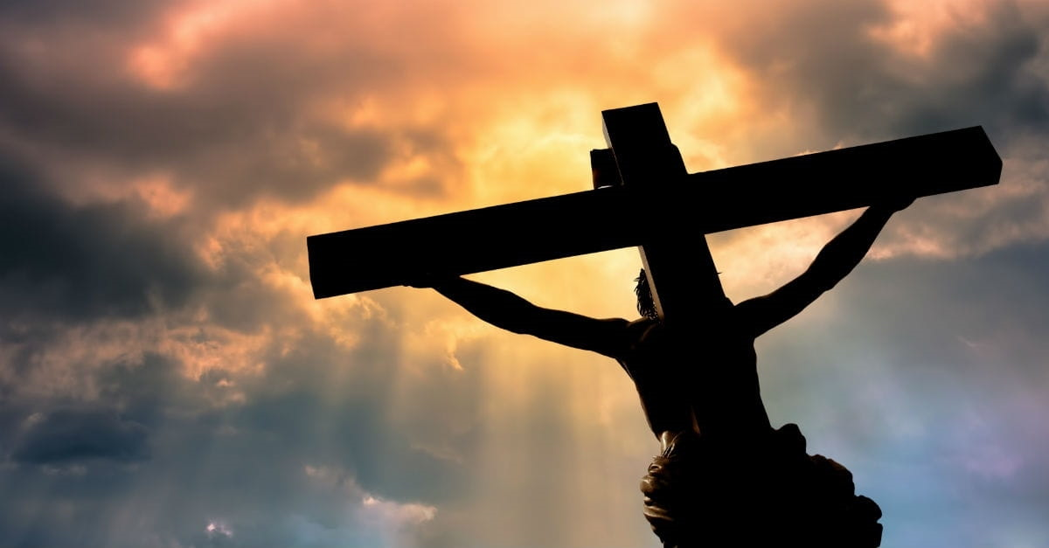
Partaking of the Lord’s Supper
Importance of Fellowship

Slide 2
Fellowship in the Lord’s Supper
Three Questions
What is Spiritual Fellowship
Where does Spiritual Fellowship Come From
Role of Spiritual Fellowship in the Partaking of the Lord’s Supper

Slide 3
Fellowship Defined
Koinonia - a participation in or a sharing in something.
Root Greek words (noun) meaning partaker, partner or sharer
Further derived from the root words denoting of having something in common.
Greek Word: koinônia (noun) Definition: fellowship, participation, sharing
Root Greek Word: koinônos (coin-oh-nahs) meaning partaker, partner, sharers
Root Greek Word: koinos meaning common
Root Greek Word: sun meaning with, together
Its verb form is koinoneo meaning to share or to participate
Greek Word: koinôneô Definition: to share, participate, contribute

Slide 4
What is Source of Spiritual Fellowship
In a Word: Union
More Accurately: A Relationship derived from a union
Spiritual Fellowship is derived from our Union with God

Slide 5
Sin
Separation-Hostility-Wrath-Death
Sacrificial Death and Shed Blood
Debt of Sin’s Death is Paid - Blood Cleanses Sin Away
Sanctification - Union with God – Eternal Life
Sanctification - removal of sin - Eliminates Separation-Hostility-Death
Peace and Fellowship (Sharing) with Each Other
Derived from Sanctification and Union

Slide 6
Spiritual Principle of Unity
We become united to Christ in Baptism – Galatians 3:27
Having become united to Christ, we become
One with God - John 17:21
One with Jesus - John 17:21
One with the Holy Spirit – I Corinthians 6:19
One with Each Other - John 17:21

Slide 7
Spiritual Principle of Fellowship
Having become one with God, we now have
Fellowship with God – 1 John 1:3
Fellowship with Jesus – 1 John 1:3
Fellowship with the Holy Spirit – 2 Corinthians 3:14
Fellowship with Each Other – 1 John 1:3, 7

Slide 8
Fellowship in Lord’s Supper
Power of the Meal
Social Activity
Sharing of Each Other-Bonding-Company-Conversation
Share Meals in Happy Times – Laughter and Joy
Share Meals in Sad Times – Support and Tears
Share Meals in Weddings and Funerals
Share a first meal with the one who becomes our life-long sweetheart
Shared Food – Shared Flesh, Bone, and Blood

Slide 9
Law of Moses Sacrificial System
God understands power of Shared Meal
Incorporated the meal in Sacrificial System
Old Law Sacrifice Pattern:
Sin Offering: Death and Shed Blood
Peace Offering: Meal-Fellowship-Thanksgiving Offering celebrating Peace with God resulting from the sin offering’s atonement

Slide 10
Passover Sacrifice – Before the Law
Passover Sacrifice was neither a sin nor a peace offering
But it was a prophetic figure of both in the Old and New Covenants
Sacrificial Death and Shed Blood spared Israelites from death and freed them from Egyptian Captivity – foretelling sin offering’s sacrificial death in stead of the sinner and the blood that freed mankind from bondage of sin
Ate the Passover Lamb – Foretelling of the Peace Offering

Slide 11
New Covenant Sacrifices
Jesus is our sacrificial sin offering. Romans 8:3; Ephesians 5:2, 1 Peter 1:19; Hebrews 9:26, 13:10-12
Jesus is our sacrificial peace offering. Romans 5:1; Ephesians 2:14

Slide 12
Question
Is there anything like a peace offering in the New Testament?
Is there a place where the worshippers gather around in fellowship and thanksgiving to celebrate our shared peace with God because our sins have been forgiven and washed away by the blood of Christ.

Slide 13
Answer
The answer is of course yes!
When we partake of the Lord’s Supper, we are partaking of the New Covenant’s fulfillment of the Peace Offering as foretold by the Passover Supper and the Old Law Peace Offerings.

Slide 14
Role of Fellowship in Lord’s Supper
Partaking of the Lord’s Supper is clearly about:
“Jesus and me” and “Jesus and you” individually.
Afterall, Jesus died for each of us personally and individually. But that is not the limit of our fellowship.
The partaking of the Lord’s Supper is also about “Jesus and us.”

Slide 15
Role of Fellowship in Lord’s Supper
1 Corinthians 10:16-17 Is not the cup of blessing which we (body of Christ – the church) bless a sharing (koinonia) in the blood of Christ? Is not the bread which we (body of Christ – the church) break a sharing (koinonia) in the body of Christ? ¹⁷ Since there is one bread, we who are many are one body (united in Christ); for we all partake of the one bread.

Slide 16
Role of Fellowship in Lord’s Supper
1 Corinthians 11:27-29 Therefore whoever eats the bread or drinks the cup of the Lord in an unworthy manner, shall be guilty of the body and the blood of the Lord. ²⁸ But a man must examine himself, and in so doing he is to eat of the bread and drink of the cup. ²⁹ For he who eats and drinks, eats and drinks judgment to himself if he does not judge the body rightly.
1 Corinthians 11:29 (NIV) …without recognizing the body of the Lord eats and drinks judgment on himself.
1 Corinthians 11:29 (NKJV & KJV) … not discerning the Lord's body.
Discern, judge, and recognize means to see, understand, and know.

Slide 17
The Lord’s Body
Normally the discernment of the Lord’s body as looking back upon the wounded body of Christ as He hung dying upon the cross.
And I think this in part is true.
It is part of the commanded remembrance of Christ’s sacrifice.
But I think the context is referring to the discernment of the body of Christ – that being the church – that being each other.

Slide 18
The Lord’s Body
In the preceding verses, the Apostle Paul severely rebukes the Corinthian church for the divisions and factions that exist within the church
The opposite of fellowship.
So severe that when they partake of the Lord’s Supper, some are bringing entire banquets while others go hungry.
They dishonored their fellow saints – approving of some and shaming others for their poverty.
There was neither fellowship with Christ nor unity among the members of the body of Christ.
Showed Despise for the Church

Slide 19
Application
And I think this is the point.
As we partake, we should of course focus upon the Lord and the death He suffered on our behalf
But that is not the limit of what we are doing.
Communion and fellowship go hand in hand with the partaking of the Lord’s Supper – as well as all other aspects of the church.
Again, communion is not just a “Jesus and me” moment.
It is a “Jesus and us” moment also.
Our fellowship with each other in the partaking of the Lord’s Supper matters too. It matters a lot.

Slide 20
Application
Paul’s rebuke of the Corinthians was harsh and well deserved.
His warning was even more severe.
Failure to partake in fellowship turns a beautiful moment for celebrating salvation to moment that causes condemnation.

Slide 21
Application
As we partake of the Lord’s Supper this morning, please know that we are communing – that is fellowshipping or sharing - of the bread and wine with both Christ and with Christ’s body, that is, each other.
Therefore, take a moment and look around this auditorium to consider – discern – know – understand our fellow brothers and sisters in Christ. Ask yourself these questions
Is church something that we simply attend and then go home – or in the age of this Pandemic – simply turn off the live streaming video on the TV or our smart phone.
Or……

Slide 22
Application
Do we love to assemble in fellowship with the saints to worship God?
Do we love those sitting around us?
Do we pray for each other?
Do we care for each other?
Do we honor one another?
Are we kind, gentle, patient, and forgiving of each other – like a young mother is towards her child.
Do we rejoice together in fellowship when we partake of the Lord’s Supper – the New Covenant Peace Offering – knowing that we are all united in Christ and will all be joined together in eternity

Slide 23
Partaking Worthily
Not forgetting the other important elements of the Lord’s Supper
This is what it means to partake of the Lord’s Supper worthily

