Slide 1
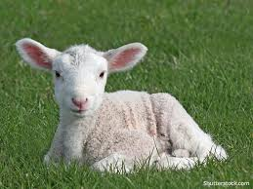
Christ – The Lamb of God
Passover Lamb - Exodus
Behold the Lamb of God
John 1:29
Sacrificial Lamb
John 19, 20
Reigning in Heaven
Acts 1; Revelation 4, 5

