Slide 2
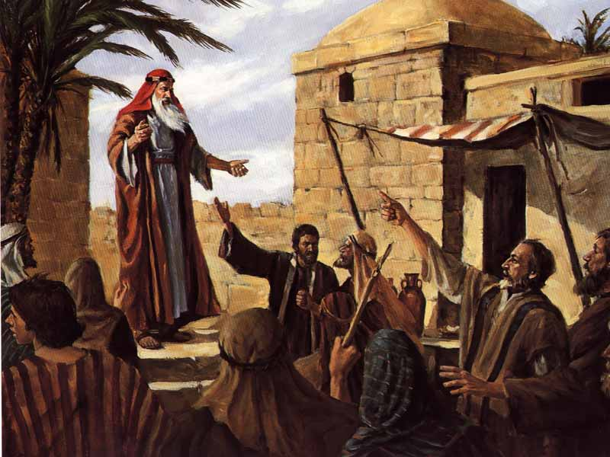
33 A.D.
Jerusalem
Pentecost

Slide 3
33 A.D.
Jerusalem
Pentecost

Slide 4
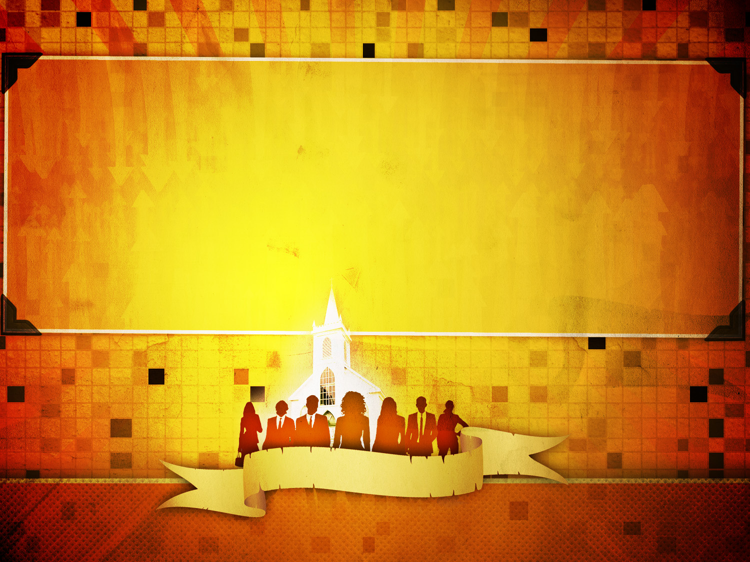
1. A Teaching Church (Acts 2:42)
WHAT WAS THE…
JERUSALEM CHURCH LIKE?

Slide 5
“For this reason also, since the day we heard of it, we have not ceased to pray for you and to ask that you may be filled with the knowledge of His will in all spiritual wisdom and understanding,
So that you will walk in a manner worthy of the Lord, to please Him in all respects, bearing fruit in every good work and increasing in the knowledge of God.”
- Colossians 1:9-10
WHAT WAS THE…
JERUSALEM CHURCH LIKE?

Slide 6
1. A Teaching Church (Acts 2:42)
2. A Worshipping Church (Acts 2:42)
WHAT WAS THE…
JERUSALEM CHURCH LIKE?

Slide 7
They continually devoted themselves to…
1. The Apostles’ Teaching (Studying God’s Will)
2. Fellowship (Sharing)
3. Breaking of Bread (Lord’s Supper)
4. Prayer (Communication with God)
Acts 2:42
WHAT WAS THE…
JERUSALEM CHURCH LIKE?

Slide 8
“So then brethren, stand firm and hold to the traditions which you were taught whether by word of mouth or by letter from us.”
- 2 Thessalonians 2:15
“God is spirit, and those who worship Him must worship in spirit and in truth.”
- John 4:24
WHAT WAS THE…
JERUSALEM CHURCH LIKE?

Slide 9
1. A Teaching Church (Acts 2:42)
2. A Worshipping Church (Acts 2:42)
3. A Connected Church (Acts 2:43-46)
WHAT WAS THE…
JERUSALEM CHURCH LIKE?

Slide 10
How were they connected?
They took care of each other (Acts 2:44-45).
2. They spent time together with…
“Gladness and sincerity of heart” (Acts 2:46).
WHAT WAS THE…
JERUSALEM CHURCH LIKE?

Slide 11
Why do some disciples struggle to connect with their brethren?
1. Simply not interested
2. Care to spend more time with worldly friends
3. Bitter about something
4. Just plain selfish!
WHAT WAS THE…
JERUSALEM CHURCH LIKE?

Slide 12
1. A Teaching Church (Acts 2:42)
2. A Worshipping Church (Acts 2:42)
3. A Connected Church (Acts 2:43-46)
4. A Working Church (Acts 2:47)
WHAT WAS THE…
JERUSALEM CHURCH LIKE?

