Slide 1
For we did not follow cunningly devised fables when we made known to you the power and coming of our Lord Jesus Christ, but were eyewitnesses of His majesty.
For He received from God the Father honor and glory when such a voice came to Him from the Excellent Glory: "This is My beloved Son, in whom I am well pleased."
And we heard this voice which came from heaven when we were with Him on the holy mountain. And so we have the prophetic word confirmed, which you do well to heed as a light that shines in a dark place, until the day dawns and the morning star rises in your hearts.
2 Peter 1:16-19

Slide 2
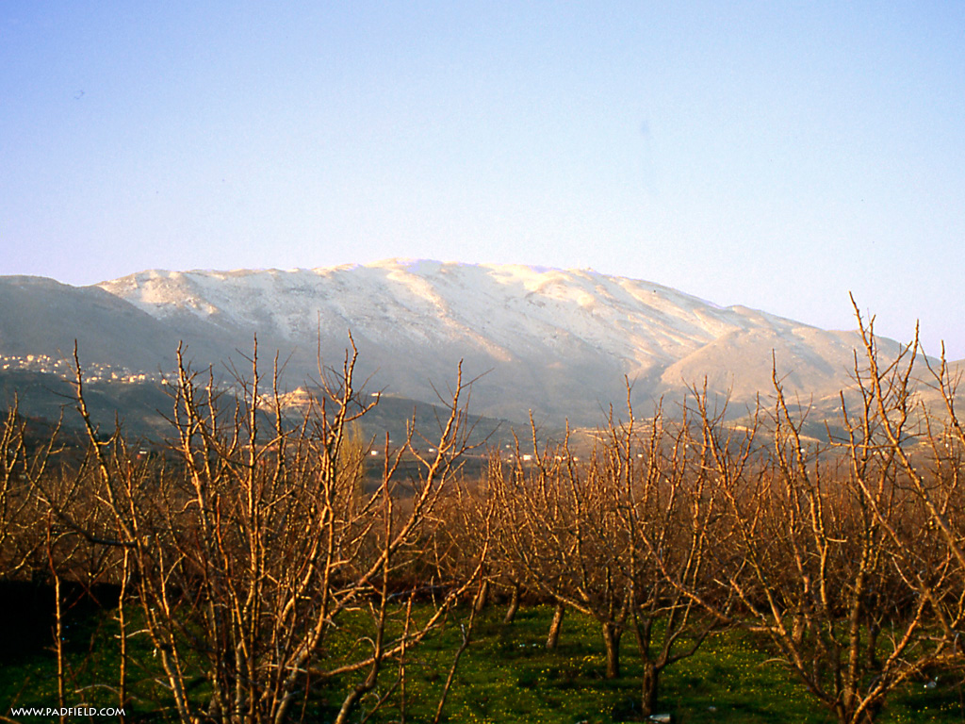
JESUS
"This is My beloved Son, in whom I am well pleased. Hear Him!"
JESUS
elijah
moses
james
john
peter

Slide 3
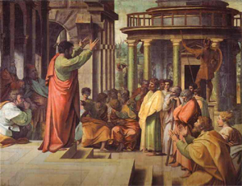
They Preached…
A Sure Gospel
It Everywhere
To Everyone
In The Face Of Harsh Opposition
What God Told Them To Preach
Out Of Faith In Jesus The Messiah
Their Mission Is Now Our Mission
Hearts of Conviction
The Preaching of The Apostles

Slide 4
For we did not follow cunningly devised fables when we made known to you the power and coming of our Lord Jesus Christ, but were eyewitnesses of His majesty.
For He received from God the Father honor and glory when such a voice came to Him from the Excellent Glory: "This is My beloved Son, in whom I am well pleased."
And we heard this voice which came from heaven when we were with Him on the holy mountain. And so we have the prophetic word confirmed, which you do well to heed as a light that shines in a dark place, until the day dawns and the morning star rises in your hearts.
2 Peter 1:16-19

